Slide 1
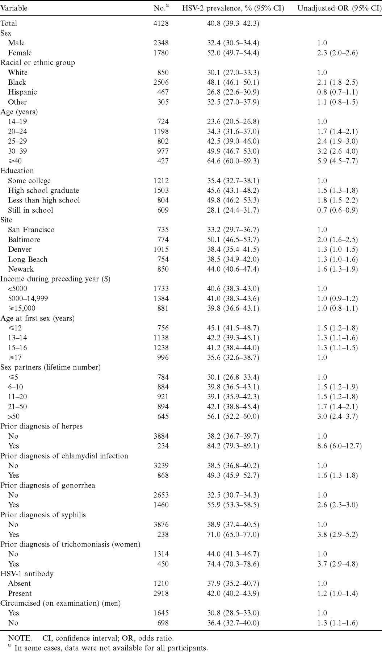
Table 1 Herpes simplex virus type 2 (HSV-2) seroprevalence, by selected participant characteristics
Notes:
Table 1 Herpes simplex virus type 2 (HSV-2) seroprevalence, by selected participant characteristics
Unless provided in the caption above, the following copyright applies to the content of this slide: © 2002 by the Infectious Diseases Society of America

Slide 2
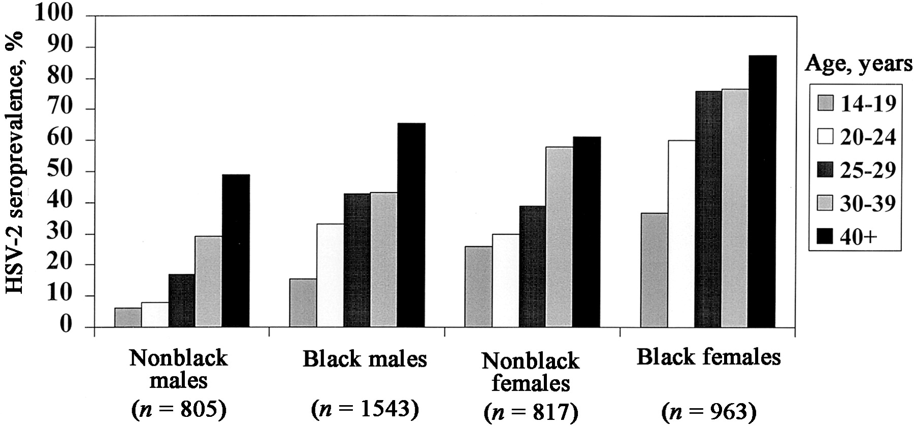
Figure 1 Herpes simplex virus type 2 (HSV-2) seroprevalence according to age, race, and sex. HSV-2 seroprevalence ...
Notes:
Figure 1 Herpes simplex virus type 2 (HSV-2) seroprevalence according to age, race, and sex. HSV-2 seroprevalence increased with age (χ2 for trend, P<.0001 for all race and sex groups). For each age group, women had higher seroprevalences than did men, and blacks had higher rates than nonblacks (P<.05 for all comparisons)
Unless provided in the caption above, the following copyright applies to the content of this slide: © 2002 by the Infectious Diseases Society of America

Slide 3
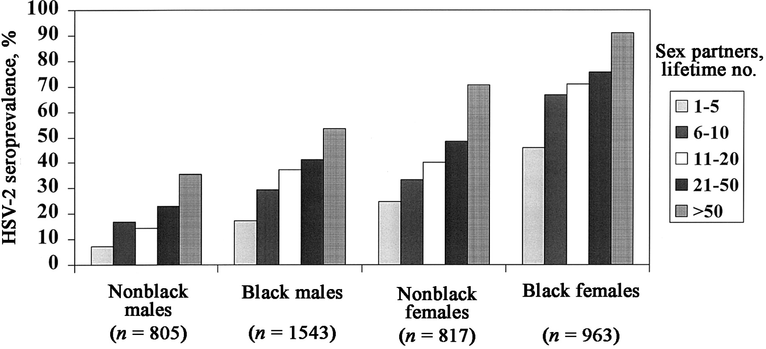
Figure 2 Herpes simplex virus type 2 (HSV-2) seroprevalence by lifetime sex partners, race, and sex. HSV-2 ...
Notes:
Figure 2 Herpes simplex virus type 2 (HSV-2) seroprevalence by lifetime sex partners, race, and sex. HSV-2 seroprevalence increased with increasing numbers of lifetime partners (χ2 for trend, P<.0001 for all race and sex groups). For each category of lifetime partners, women had higher seroprevalences than did men, and blacks had higher rates than nonblacks (P<.05 for each comparison)
Unless provided in the caption above, the following copyright applies to the content of this slide: © 2002 by the Infectious Diseases Society of America

Slide 4
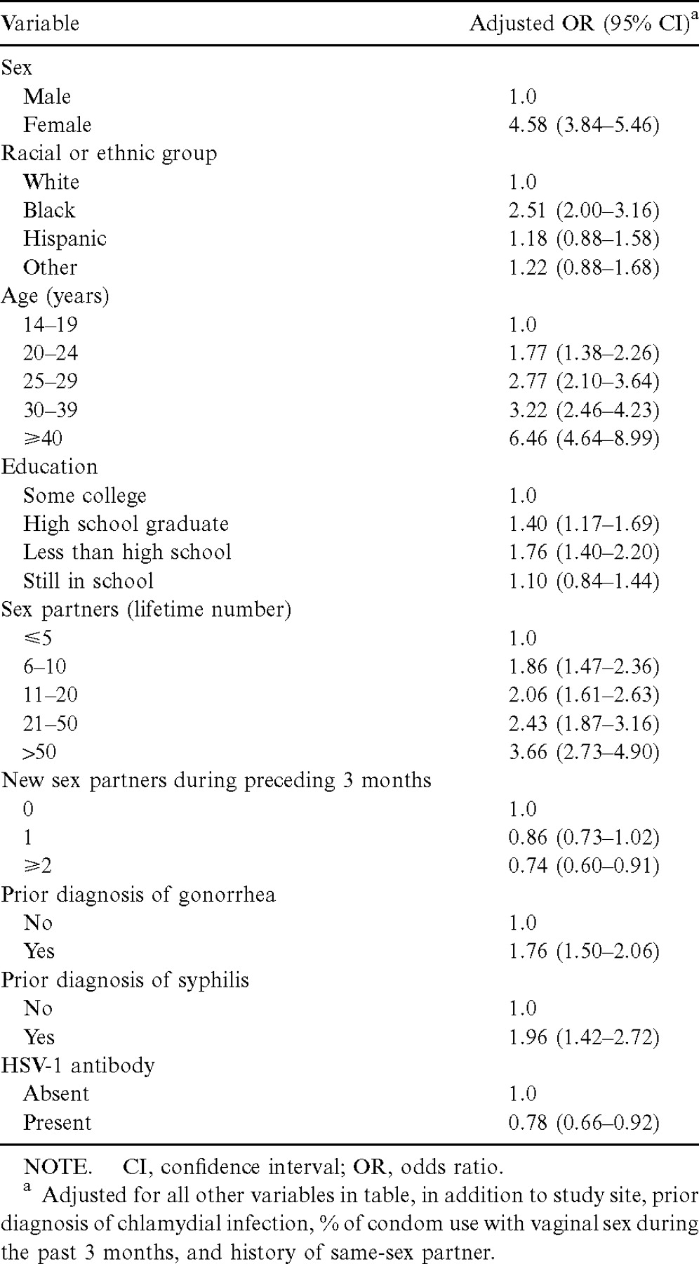
Table 2 Independent predictors of herpes simplex virus type 2 (HSV-2) seropositivity, by multivariate analysis
Notes:
Table 2 Independent predictors of herpes simplex virus type 2 (HSV-2) seropositivity, by multivariate analysis
Unless provided in the caption above, the following copyright applies to the content of this slide: © 2002 by the Infectious Diseases Society of America

Slide 5
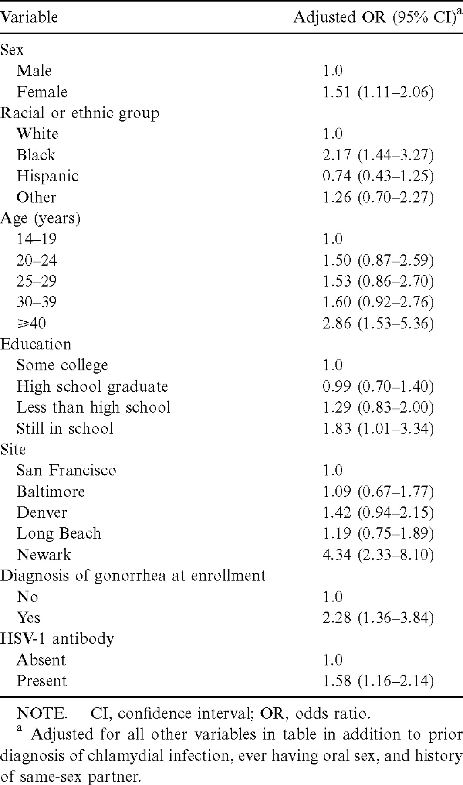
Table 3 Independent predictors of remaining undiagnosed with genital herpes among herpes simplex virus type 2 ...
Notes:
Table 3 Independent predictors of remaining undiagnosed with genital herpes among herpes simplex virus type 2 (HSV-2)–seropositive persons (n=1686), by multivariate analysis
Unless provided in the caption above, the following copyright applies to the content of this slide: © 2002 by the Infectious Diseases Society of America

Slide 6
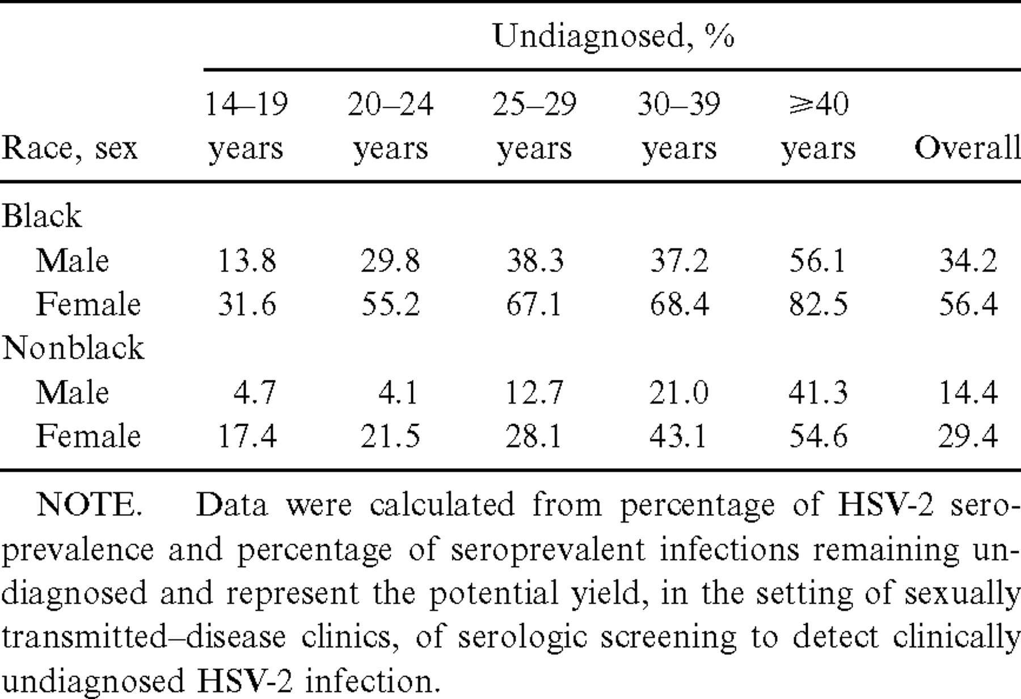
Table 4 Percentage of total study population with undiagnosed herpes simplex virus type 2 (HSV-2) infection, found ...
Notes:
Table 4 Percentage of total study population with undiagnosed herpes simplex virus type 2 (HSV-2) infection, found only by serologic tests, according to age, race, and sex
Unless provided in the caption above, the following copyright applies to the content of this slide: © 2002 by the Infectious Diseases Society of America

