Slide 1
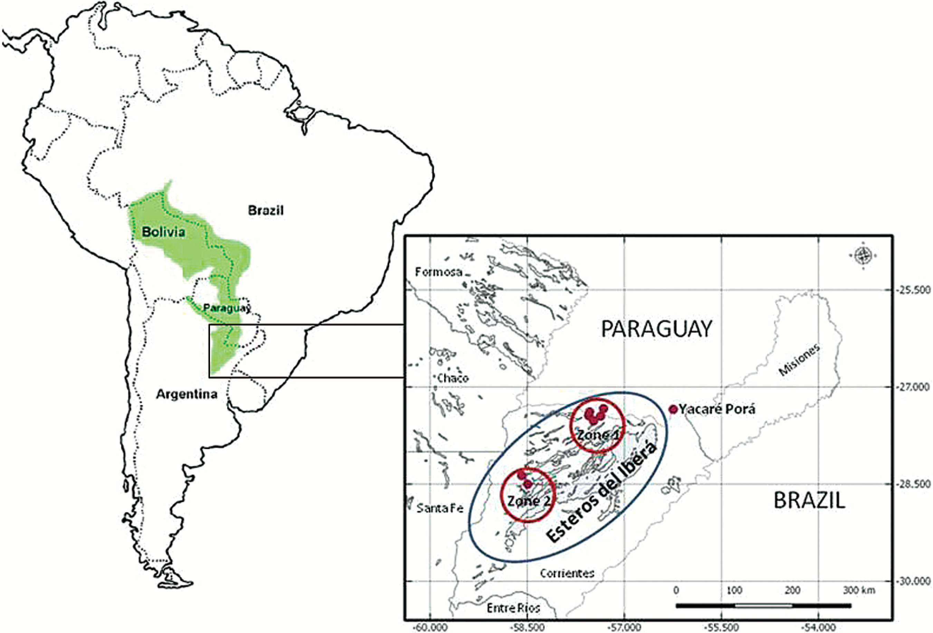
Figure 1. Geographical distribution for Caiman yacare (Godshalk 2006). Nests’ collection per ranching (Zone 1 and Zone ...
Notes:
Figure 1. Geographical distribution for Caiman yacare (Godshalk 2006). Nests’ collection per ranching (Zone 1 and Zone 2). “Esteros del Ibera” (the wetland). “Yacaré Porá” (breeding farm).
Unless provided in the caption above, the following copyright applies to the content of this slide: © The American Genetic Association 2016. All rights reserved. For permissions, please e-mail: journals.permissions@oup.com

