Slide 1
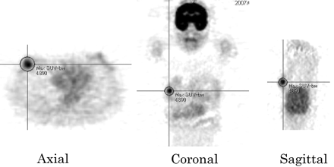
Figure 1. For semiquantitative of ¹⁸F-FDG uptake, the region of interest (ROI) was placed in the primary ...
Notes:
Figure 1. For semiquantitative of 18F-FDG uptake, the region of interest (ROI) was placed in the primary lesion, including the highest uptake area (circular ROI, 2 cm in diameter), and maximum standardized update values (SUV) in the ROI was calculated. SUV is decay-corrected tissue activity divided by the injected dose per patient body. Representative axial, coronal and sagittal ROIs were shown in this figure. The spatial resolution of the reconstructed images was 6.0–7.0 mm in cranio-caudal, 6.3–7.1 mm in right-left and 6.3–7.1 mm in anterior-posterior directions.
Unless provided in the caption above, the following copyright applies to the content of this slide: © The Author (2008). Published by Oxford University Press. All rights reserved

Slide 2
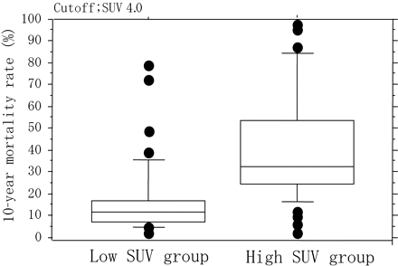
Figure 2. Prognostic significance of SUV simulated by the data published on computed program Adjuvant! ...
Notes:
Figure 2. Prognostic significance of SUV simulated by the data published on computed program Adjuvant! (http://www.adjuvantonline.com). Mann–Whitney U-test reveals significant higher incidence of mortality after 10 years in high SUV (higher than 4.0) group compared to in low SUV (4.0 or less) group. Mean mortality rate (13.4% in low SUV group and 33.3% in high SUV group) are indicated with horizontal bars. The vertical bars indicate the range and the horizontal boundaries of the boxes represent 10 and 90% confidential indexes. Round plots represent outliers.
Unless provided in the caption above, the following copyright applies to the content of this slide: © The Author (2008). Published by Oxford University Press. All rights reserved

