Slide 1
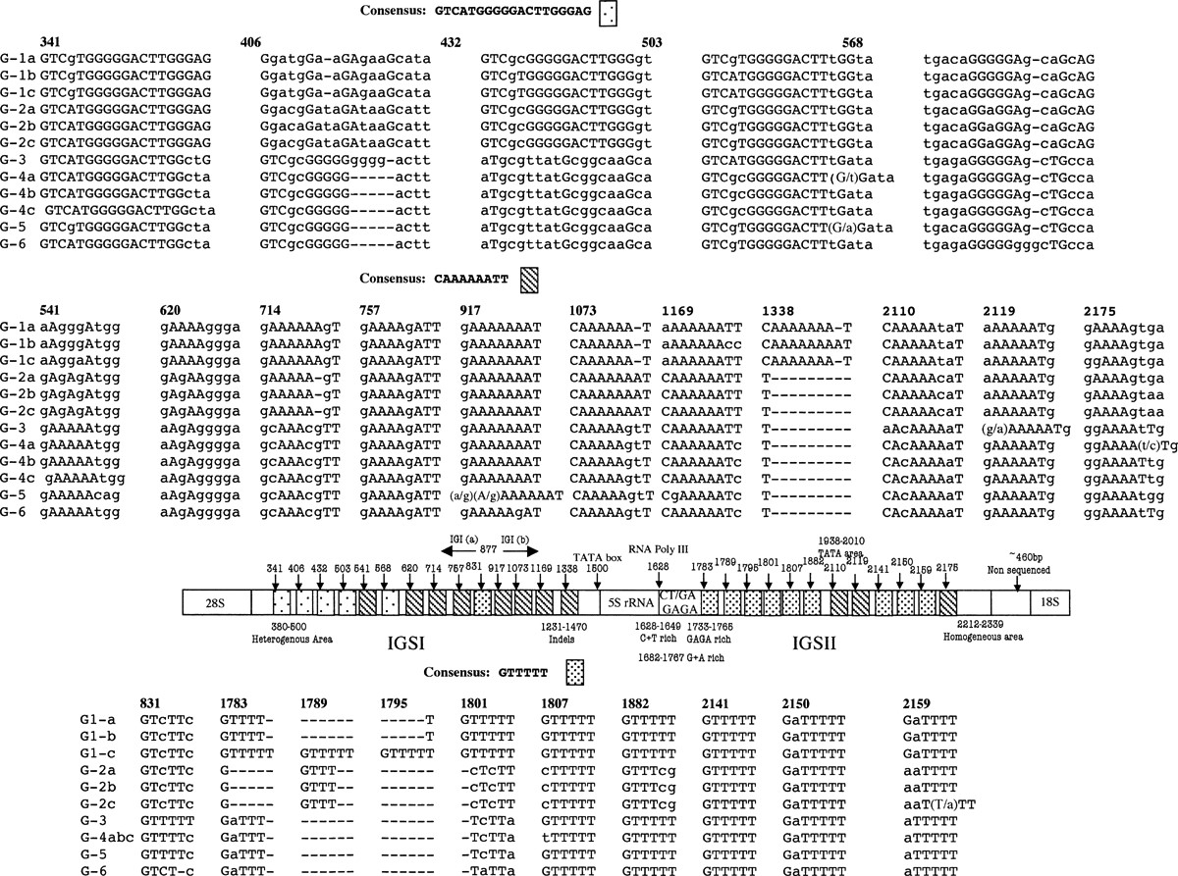
1 Diagrammatic presentation of the repeat motifs, locations and their variations in the IGSI and IGSII regions ...
Notes:
1 Diagrammatic presentation of the repeat motifs, locations and their variations in the IGSI and IGSII regions of C. neoformans species complex. Numbers indicate location.
Unless provided in the caption above, the following copyright applies to the content of this slide: © 2005 Federation of European Microbiological Societies. Published by Elsevier B.V. All rights reserved.

Slide 2
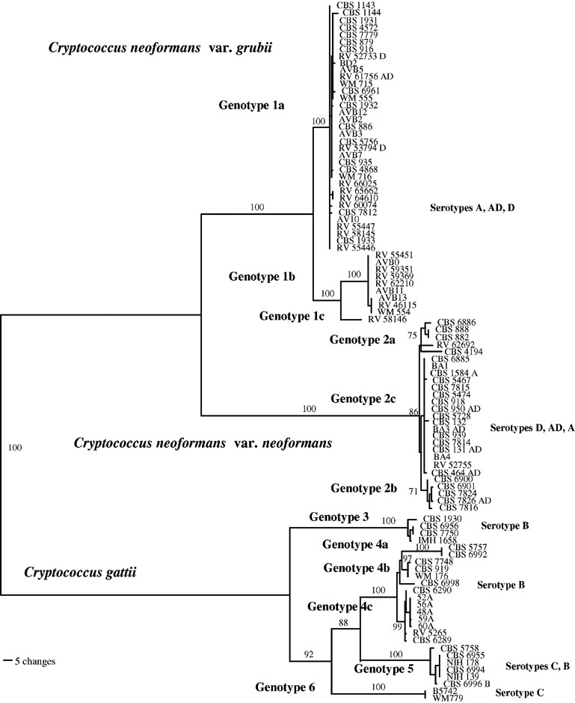
2 Phylogenetic tree of C. neoformans species complex derived from IGSI + 5S rRNAt + IGSII sequence data. ...
Notes:
2 Phylogenetic tree of C. neoformans species complex derived from IGSI + 5S rRNAt + IGSII sequence data. Presented is one of 100 most-parsimonious tree (length 948 bp; CI: 0.91; RI: 0.995) computed with PAUP*4 (heuristic search, stepwise addition, random addition sequence, nearest neighbor interchange, 100 maximum trees). Data consisted of 2350 characters (constant characters: 1582; uninformative variable characters: 46; informative characters: 722). Gaps were treated as missing data. Numbers indicate bootstrap values of 100 replicates.
Unless provided in the caption above, the following copyright applies to the content of this slide: © 2005 Federation of European Microbiological Societies. Published by Elsevier B.V. All rights reserved.

