Slide 1
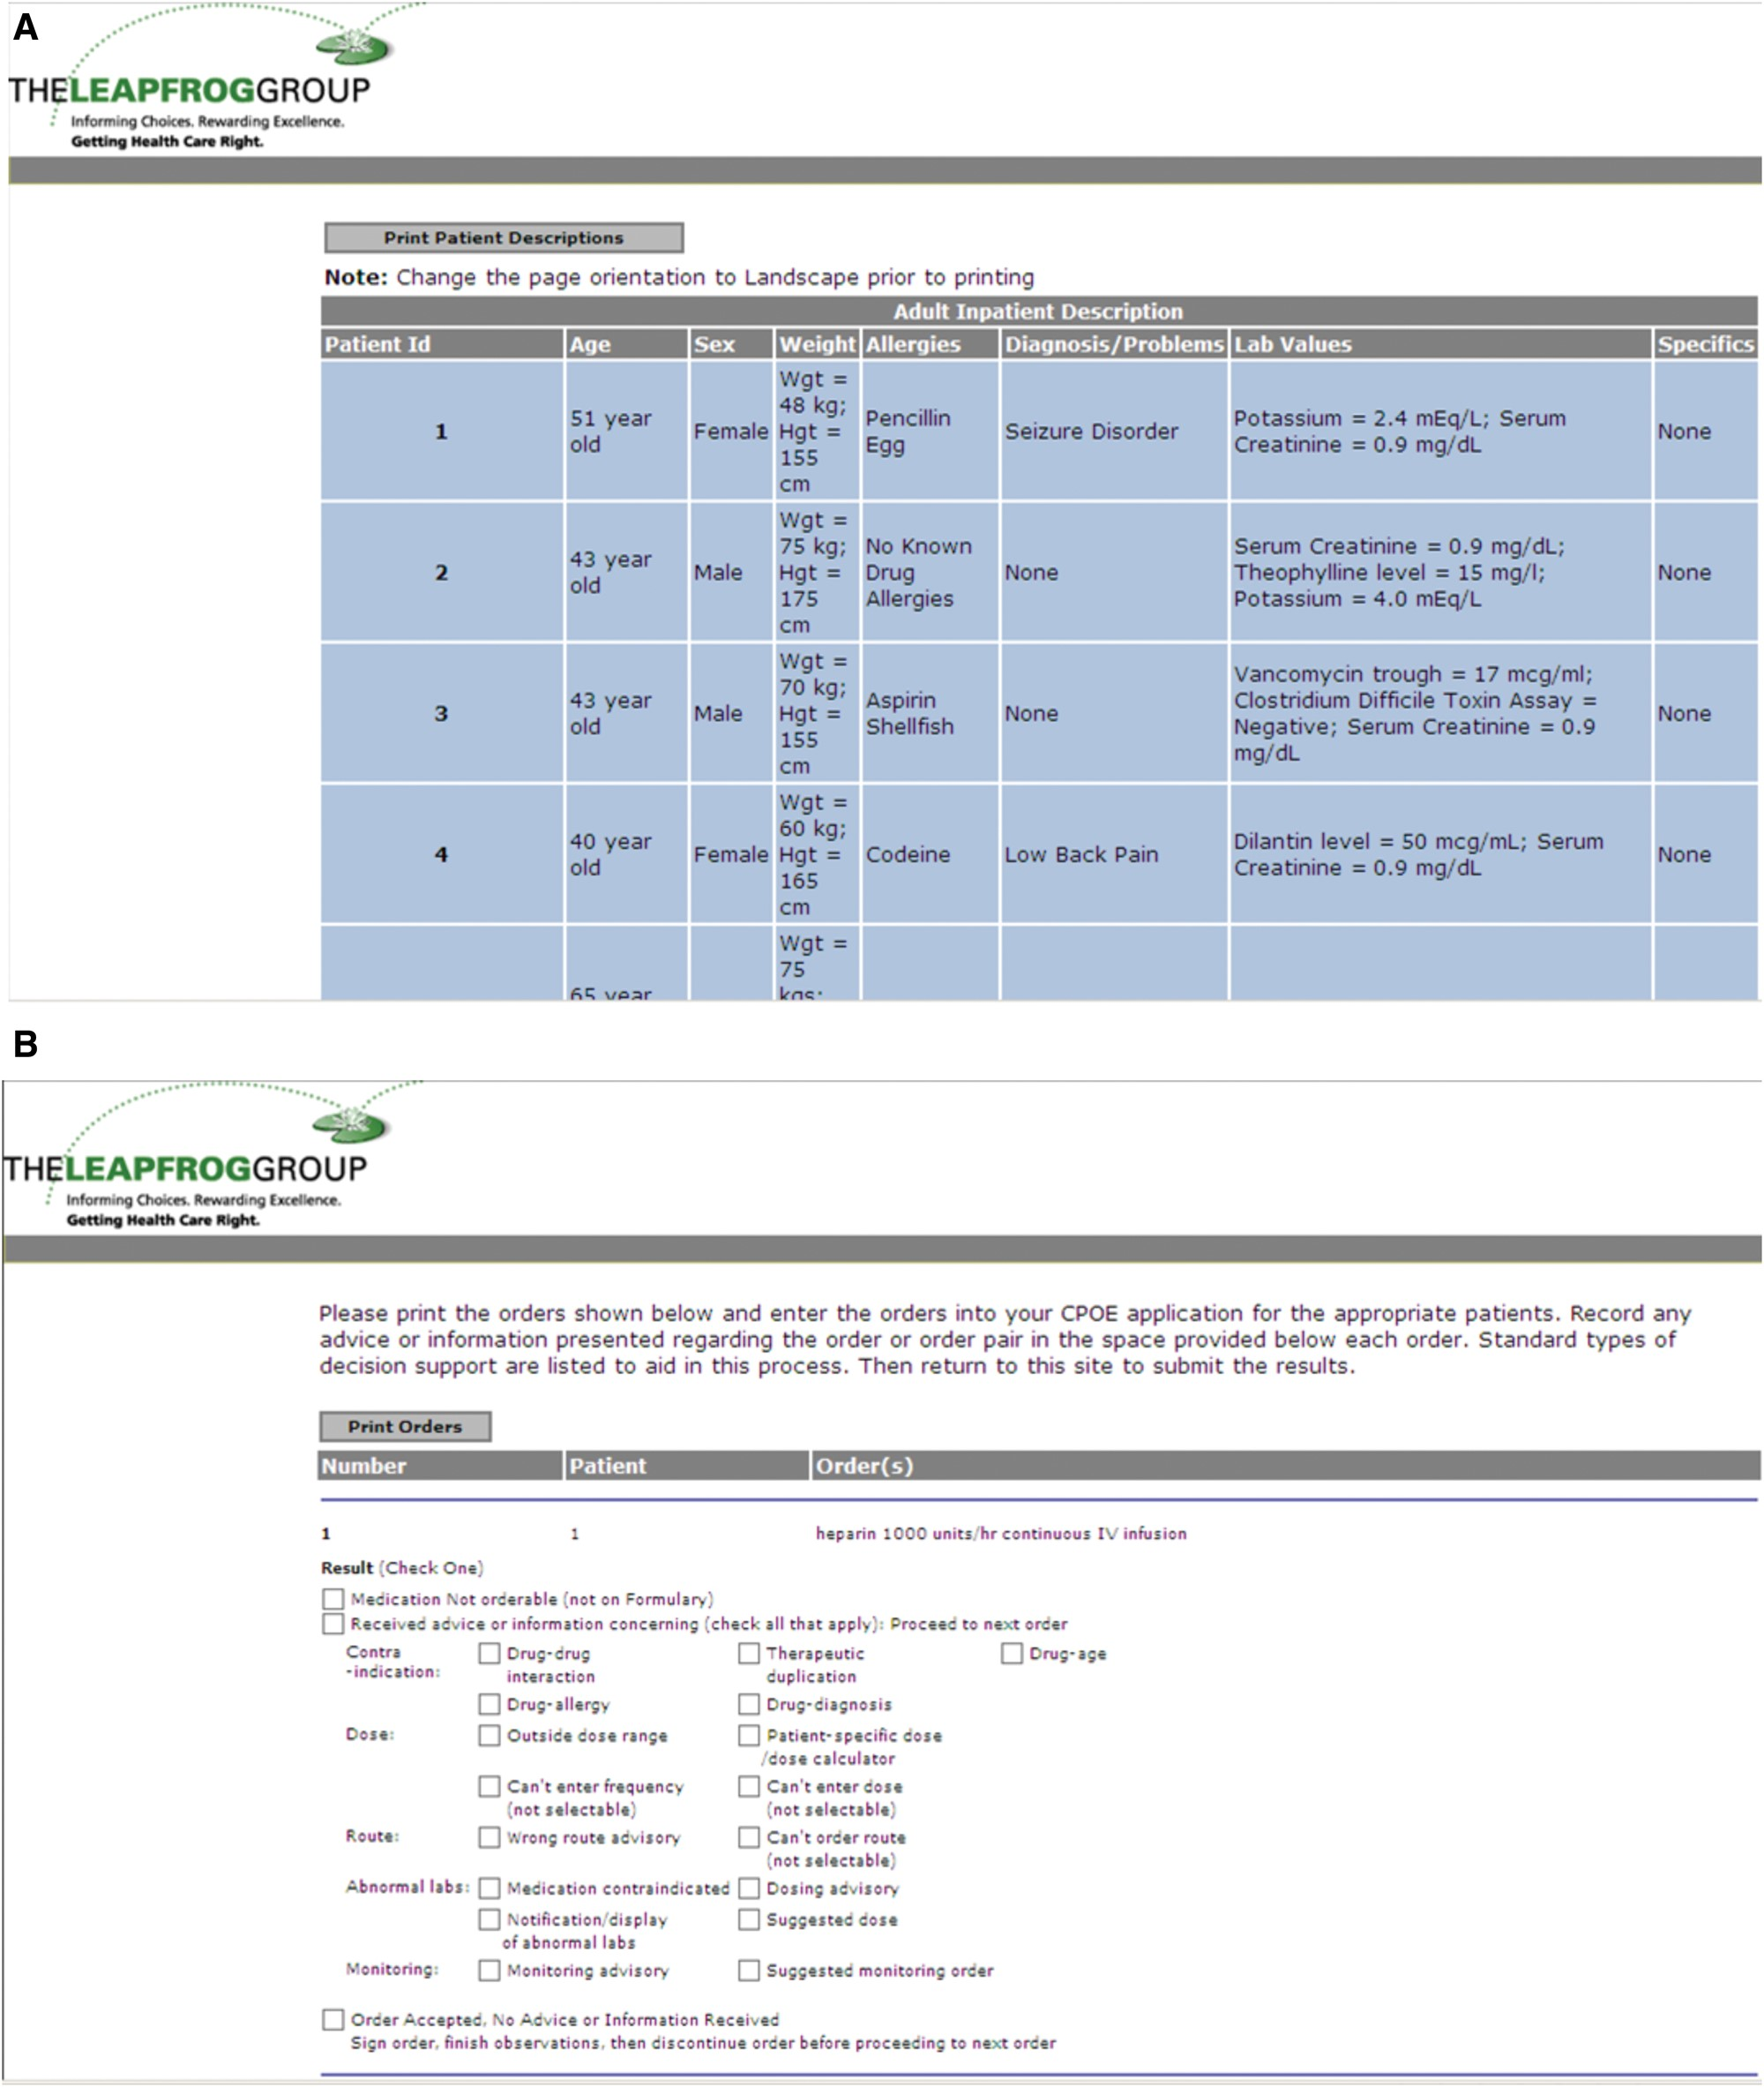
Figure 1. (A) Sample patient profiles used in the adult Leapfrog Group computerized physician order entry (CPOE) ...
Notes:
Figure 1. (A) Sample patient profiles used in the adult Leapfrog Group computerized physician order entry (CPOE) evaluation tool. Sample pediatric profiles were not available for public release but are similar. (B) Sample test orders used in the Leapfrog Group CPOE evaluation tool.
Unless provided in the caption above, the following copyright applies to the content of this slide: © The Author 2016. Published by Oxford University Press on behalf of the American Medical Informatics Association. All rights reserved. For Permissions, please email: journals.permissions@oup.com

Slide 2
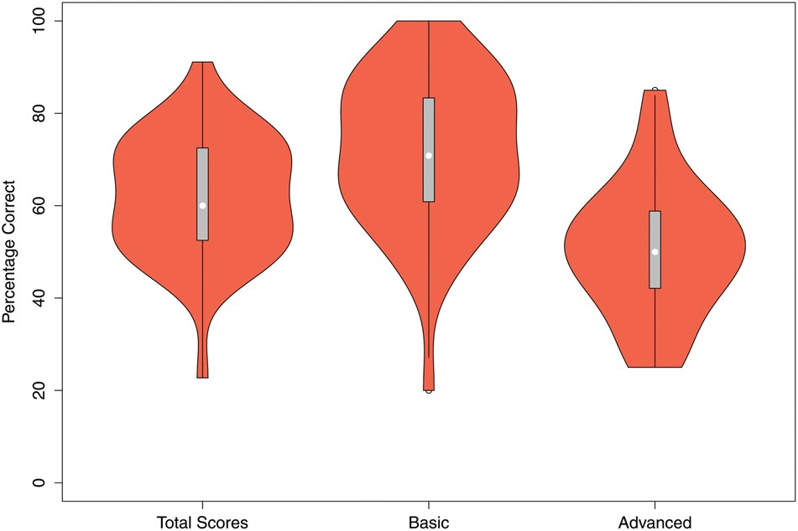
Figure 2. Violin plots, a plot type that combines box plots and kernel density plots, comparing total, basic, and ...
Notes:
Figure 2. Violin plots, a plot type that combines box plots and kernel density plots, comparing total, basic, and advanced scores for last tests. Scores in the basic decision support group were significantly higher than in the advanced decision support group (P < .0001).
Unless provided in the caption above, the following copyright applies to the content of this slide: © The Author 2016. Published by Oxford University Press on behalf of the American Medical Informatics Association. All rights reserved. For Permissions, please email: journals.permissions@oup.com

Slide 3
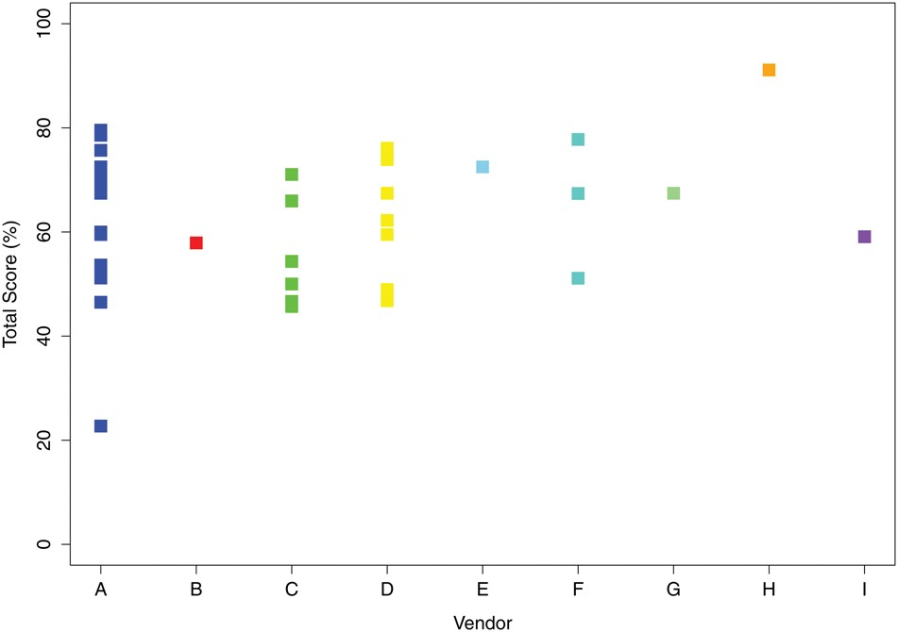
Figure 3. Scores by vendor: (A) n = 16, (B) n = 1, (C) n = 7, (D) n = 10, (E) n = 1, (F) n = 3, (G) n = 1, (H) n = 1, ...
Notes:
Figure 3. Scores by vendor: (A) n = 16, (B) n = 1, (C) n = 7, (D) n = 10, (E) n = 1, (F) n = 3, (G) n = 1, (H) n = 1, (I) n = 1.
Unless provided in the caption above, the following copyright applies to the content of this slide: © The Author 2016. Published by Oxford University Press on behalf of the American Medical Informatics Association. All rights reserved. For Permissions, please email: journals.permissions@oup.com

Slide 4
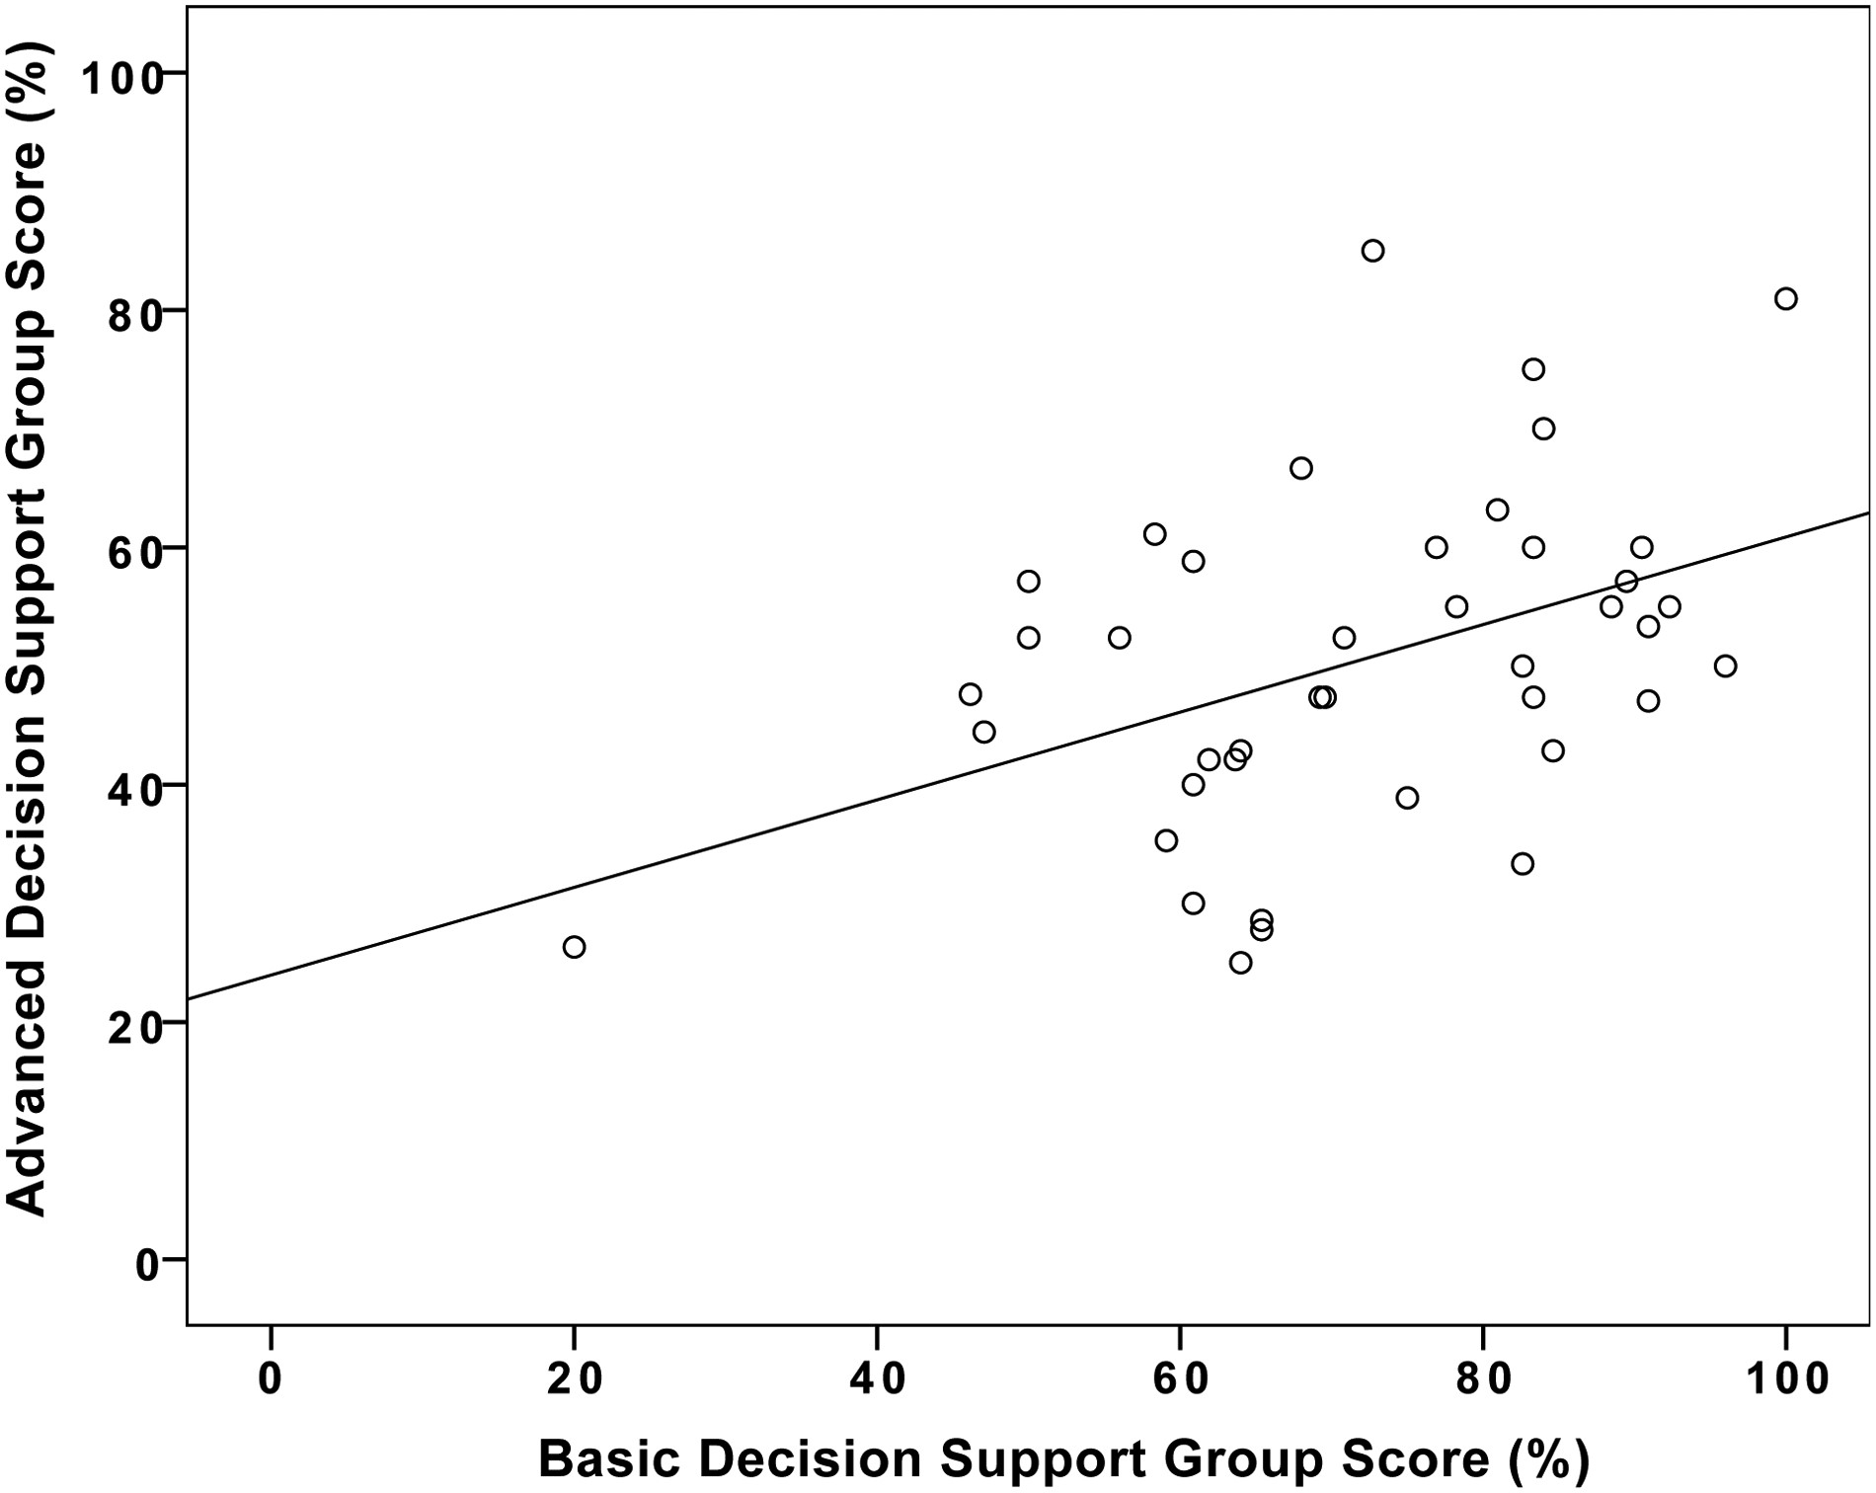
Figure 4. Correlation between scores in basic and advanced decision support categories with fit line. R = 0.432 and ...
Notes:
Figure 4. Correlation between scores in basic and advanced decision support categories with fit line. R = 0.432 and P = .005.
Unless provided in the caption above, the following copyright applies to the content of this slide: © The Author 2016. Published by Oxford University Press on behalf of the American Medical Informatics Association. All rights reserved. For Permissions, please email: journals.permissions@oup.com

Slide 5
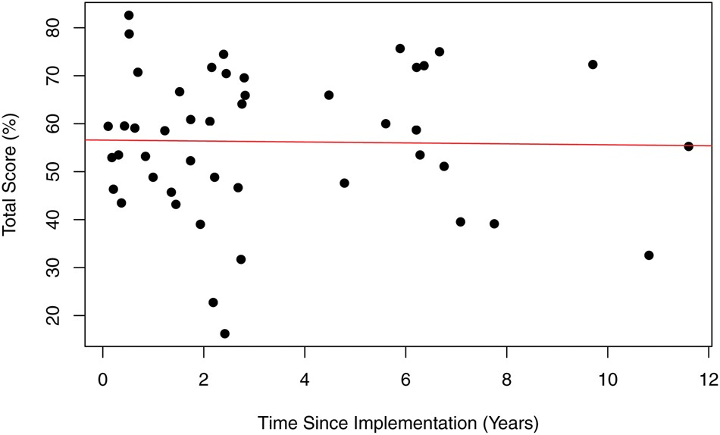
Figure 5. Total score on initial testing as a function of time since implementation of computerized physician order ...
Notes:
Figure 5. Total score on initial testing as a function of time since implementation of computerized physician order entry system.
Unless provided in the caption above, the following copyright applies to the content of this slide: © The Author 2016. Published by Oxford University Press on behalf of the American Medical Informatics Association. All rights reserved. For Permissions, please email: journals.permissions@oup.com

Slide 6
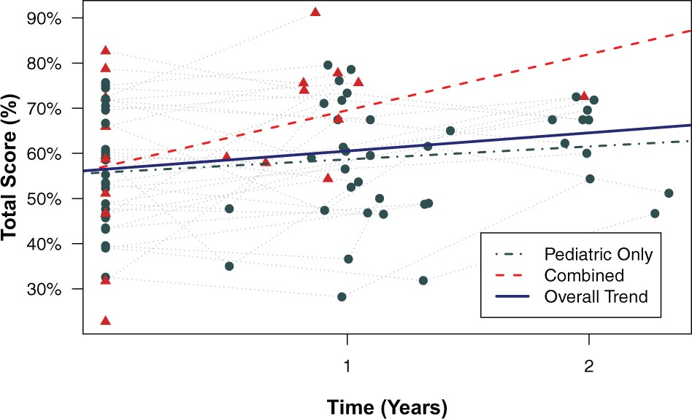
Figure 6. Longitudinal trends of overall test scores relative to initial test date (time zero). “Pediatric” (circles) ...
Notes:
Figure 6. Longitudinal trends of overall test scores relative to initial test date (time zero). “Pediatric” (circles) refers to pediatric-only institutions, and “combined” (triangles) refers to pediatric hospitals within adult institutions.
Unless provided in the caption above, the following copyright applies to the content of this slide: © The Author 2016. Published by Oxford University Press on behalf of the American Medical Informatics Association. All rights reserved. For Permissions, please email: journals.permissions@oup.com

