Slide 1
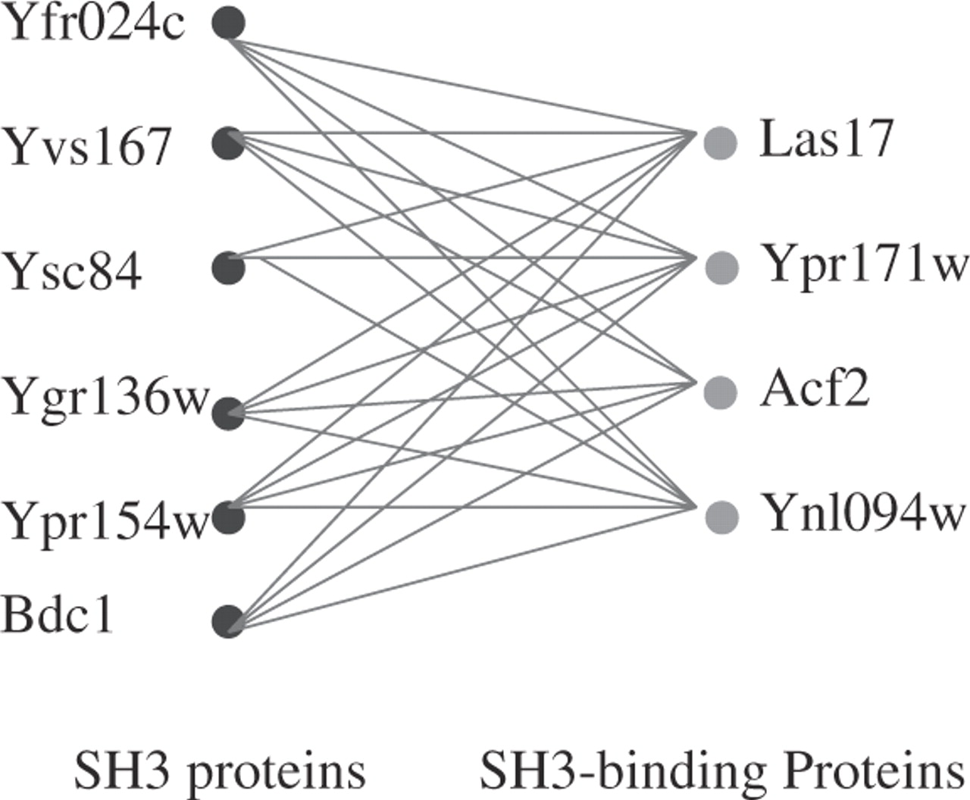
Fig. 1 An all-versus-all predicted interaction subnetwork (most are confirmed by experiments) consisting of two ...
Notes:
Fig. 1 An all-versus-all predicted interaction subnetwork (most are confirmed by experiments) consisting of two groups of proteins, where one group contains six proteins with SH3 domains and the other contains four proteins with SH3-binding motifs. (Tong et al., 2002). A colour version of this figure is available online as Supplementary data.
Unless provided in the caption above, the following copyright applies to the content of this slide: © The Author 2006. Published by Oxford University Press. All rights reserved. For Permissions, please email: journals.permissions@oxfordjournals.org

Slide 2
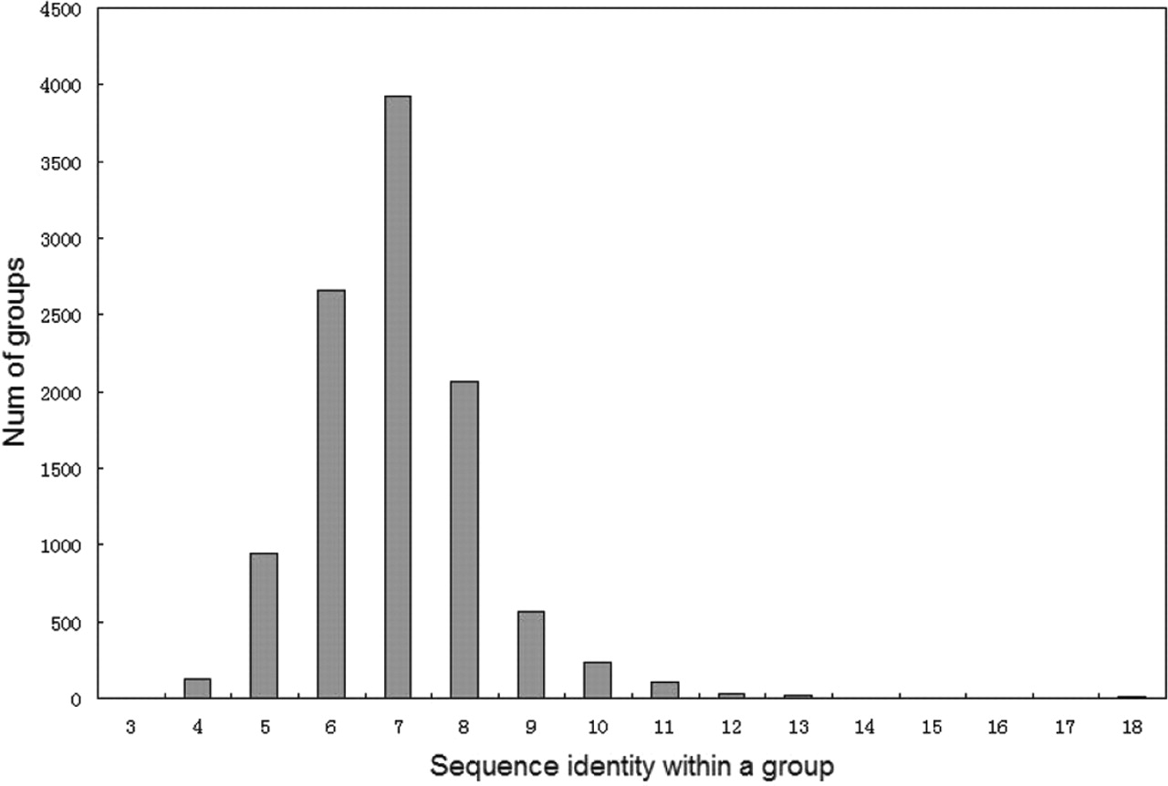
Fig. 2 The distribution of the sequence identities within our 10 698 groups.
Notes:
Fig. 2 The distribution of the sequence identities within our 10 698 groups.
Unless provided in the caption above, the following copyright applies to the content of this slide: © The Author 2006. Published by Oxford University Press. All rights reserved. For Permissions, please email: journals.permissions@oxfordjournals.org

Slide 3
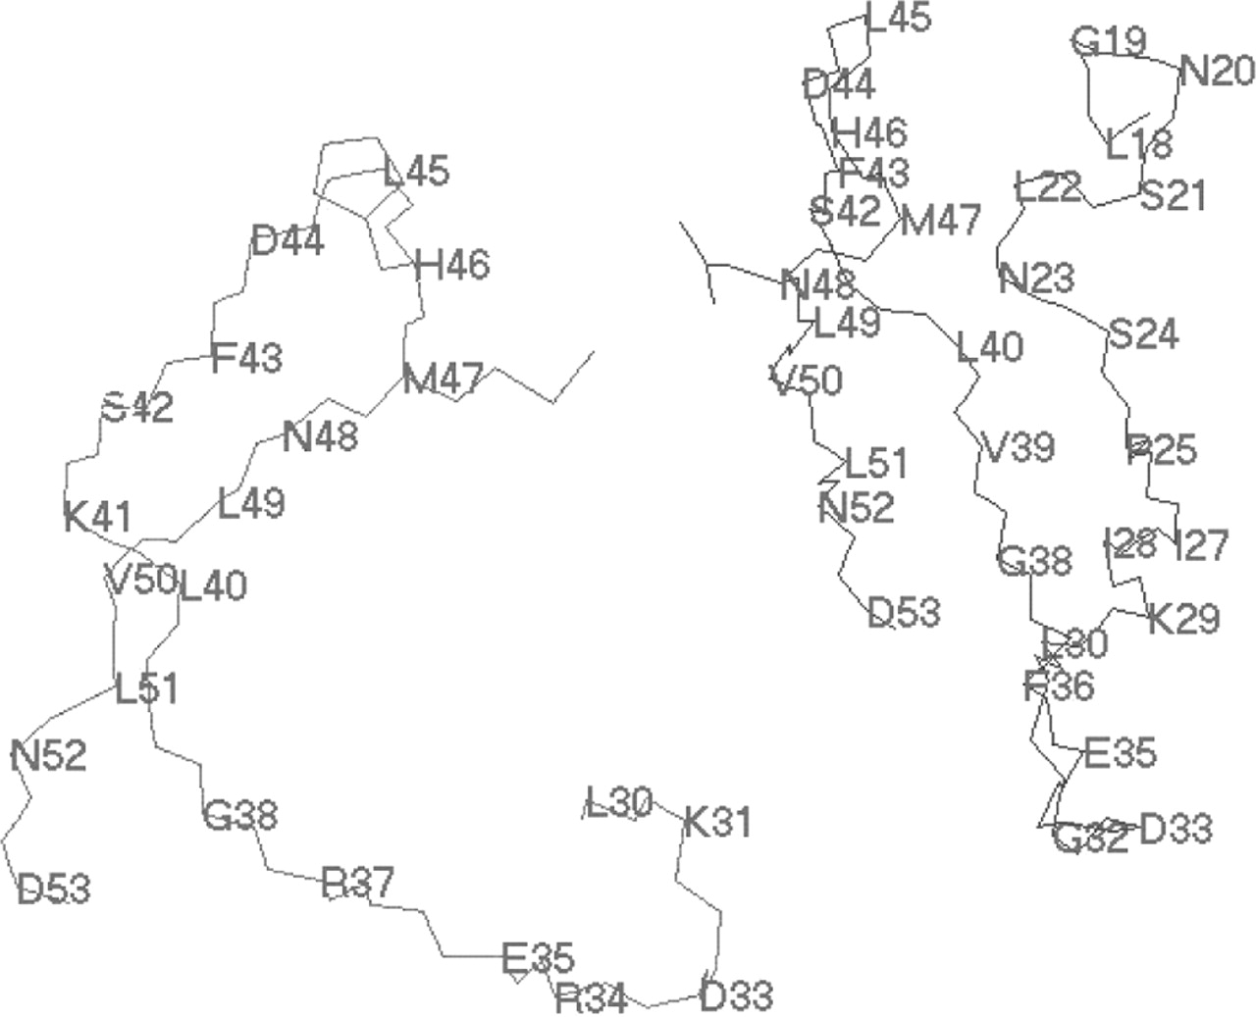
Fig. 3 Interactions between segment [30L, 53D] of the chain LSM A and segment [18L,53D] of the chain LSM B in the ...
Notes:
Fig. 3 Interactions between segment [30L, 53D] of the chain LSM A and segment [18L,53D] of the chain LSM B in the complex pdb1mgq (showing only the backbone). A colour version of this figure is available as Supplementary data.
Unless provided in the caption above, the following copyright applies to the content of this slide: © The Author 2006. Published by Oxford University Press. All rights reserved. For Permissions, please email: journals.permissions@oxfordjournals.org

