Slide 1
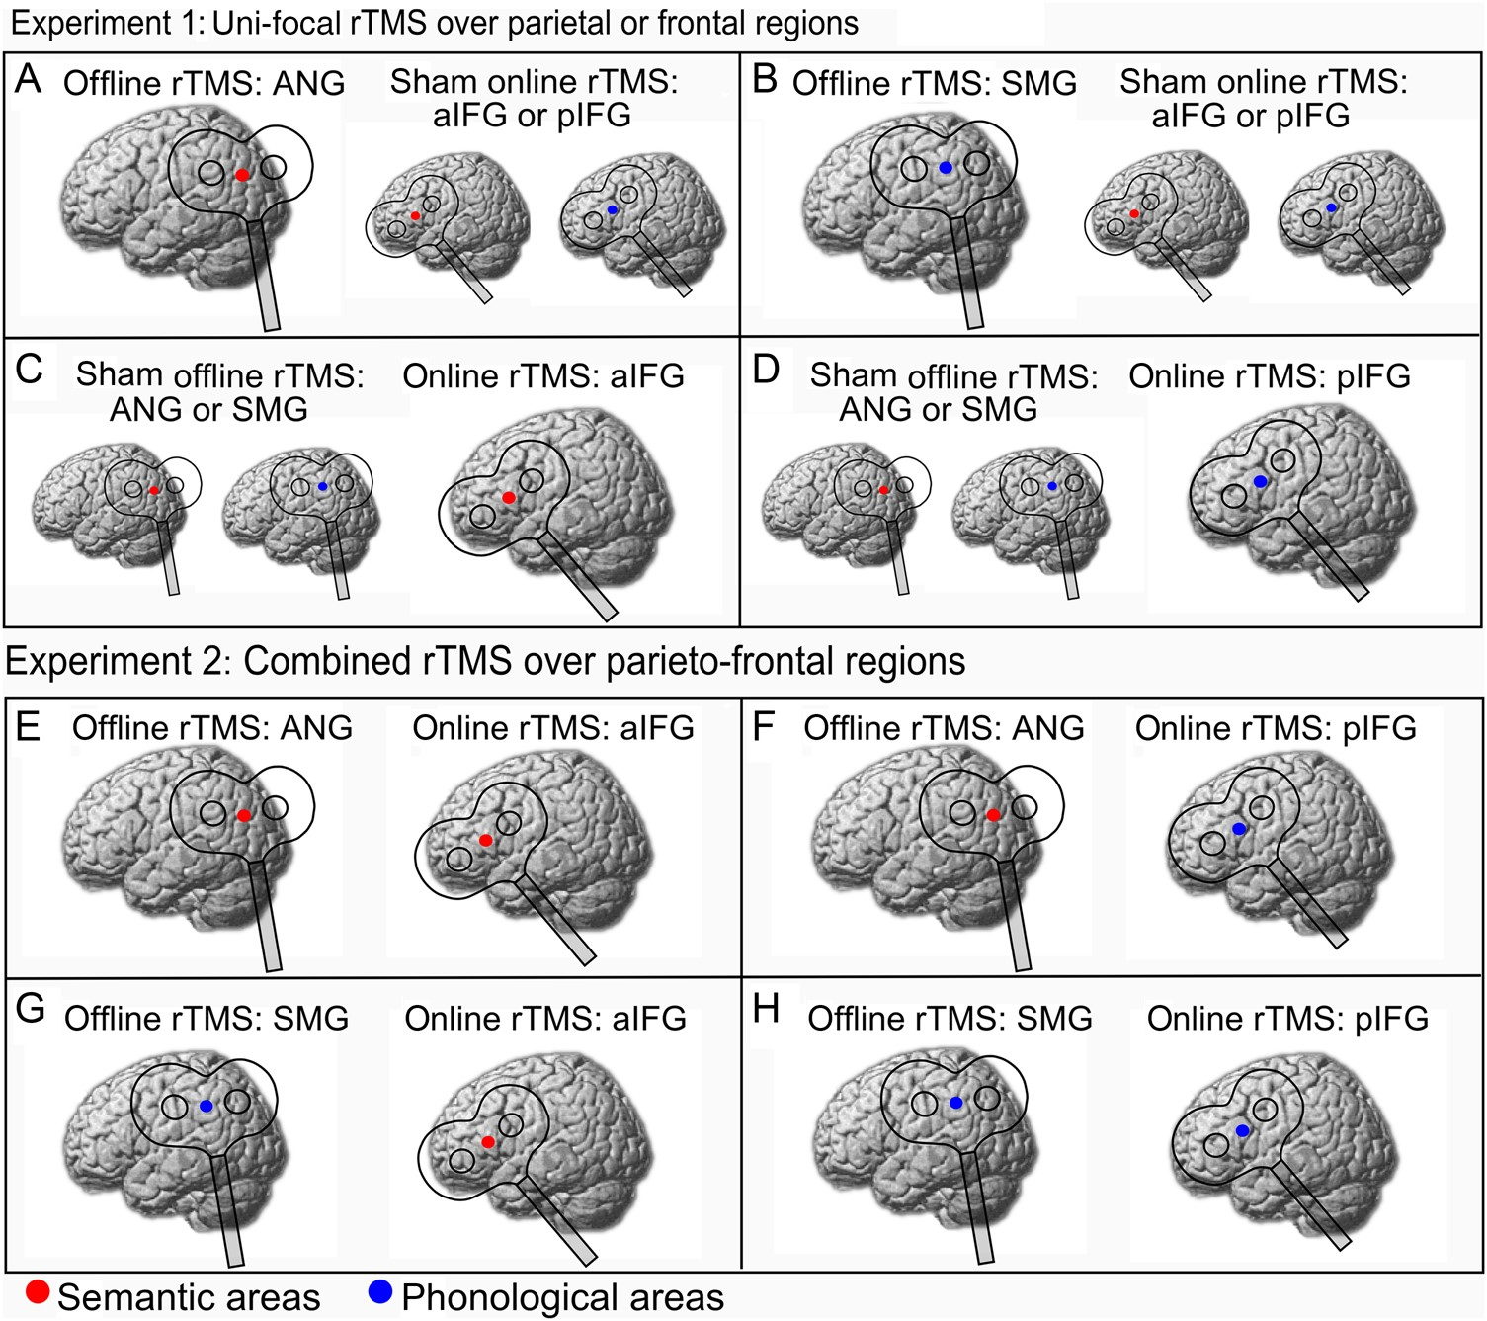
Figure 1. rTMS sites for the parieto-frontal networks targeted with unifocal rTMS (A–D) and combined rTMS over parietal ...
Notes:
Figure 1. rTMS sites for the parieto-frontal networks targeted with unifocal rTMS (A–D) and combined rTMS over parietal and frontal areas (E–H). Experiment 1: (A) In 1 session, offline rTMS of left ANG during quiet wakefulness was combined with subsequent sham online rTMS of either left anterior or posterior inferior frontal gyrus (aIFG or pIFG; counterbalanced across subjects). (B) In another session, offline rTMS of left SMG preceded sham online rTMS of either aIFG or pIFG. (C) Sham offline rTMS of ANG or SMG (counterbalanced across subjects) was followed by online rTMS of left aIFG. (D) Sham offline rTMS of ANG or SMG was combined with online rTMS of pIFG. Experiment 2: (E) Semantic network: In 1 session, offline rTMS was applied to ANG and subsequent online rTMS targeted aIFG. (F) Offline rTMS of ANG was combined with online rTMS over pIFG. (G) Offline rTMS over SMG preceded online rTMS over aIFG. (H) Phonological network: Offline rTMS over SMG was combined with online rTMS to pIFG.
Unless provided in the caption above, the following copyright applies to the content of this slide: © The Author 2015. Published by Oxford University Press. All rights reserved. For Permissions, please e-mail: journals.permissions@oup.com

Slide 2
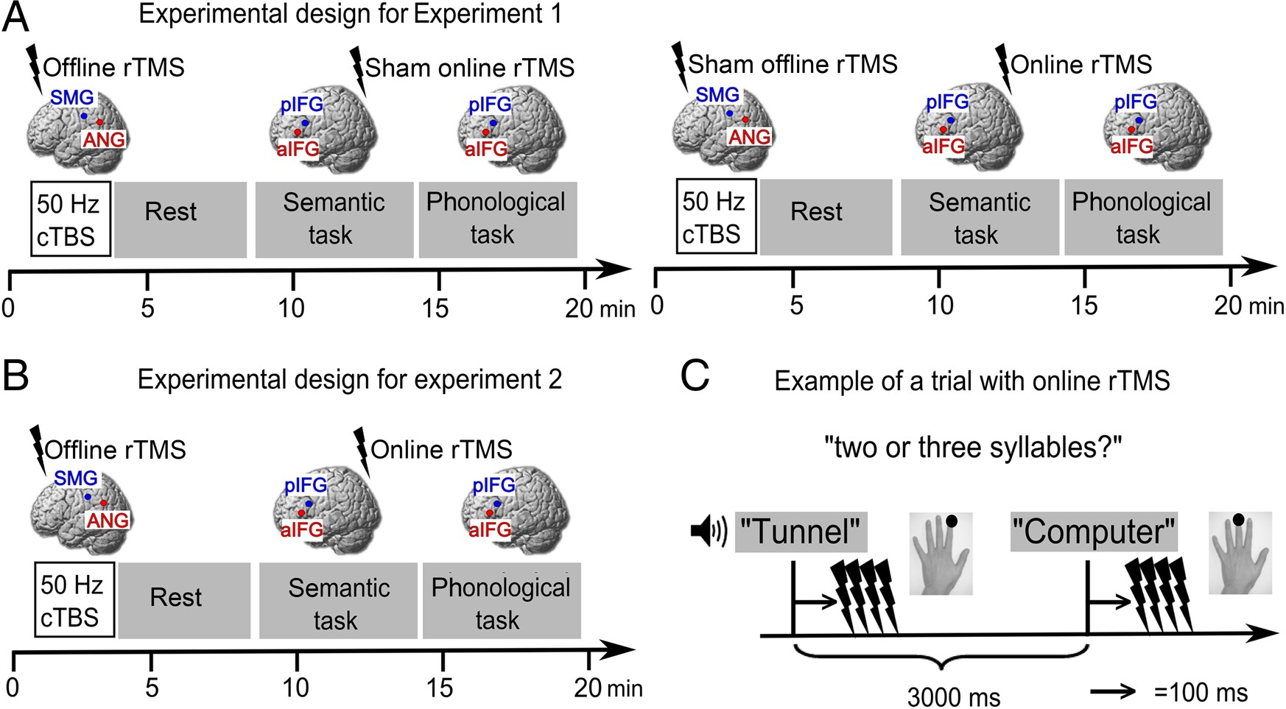
Figure 2. Experimental design. (A) Experiment 1. Left panel: After a training session, subjects received 50 Hz of ...
Notes:
Figure 2. Experimental design. (A) Experiment 1. Left panel: After a training session, subjects received 50 Hz of offline continuous theta burst stimulation (cTBS) either over SMG or ANG in different sessions. A rest period of 5 min was included to allow for the unfolding of the cTBS effect. Afterward, subjects performed the semantic and phonological tasks while receiving high-frequency sham online rTMS over either the aIFG or pIFG in different sessions. The order of semantic and phonological blocks was counterbalanced across subjects. Right panel: In 2 additional sessions, subjects received sham offline cTBS over ANG or SMG and online rTMS over aIFG or pIFG. (B) Experiment 2. Subjects received a combination of effective offline and online rTMS in 4 different sessions without any sham rTMS. In all other aspects, this experiment was identical to Experiment 1. (C) Each trial had a duration of 3000 ms. During each trial, an auditory word was presented and subjects responded via button press with their left hand. 10 Hz online rTMS (or sham rTMS in 2 sessions of Experiment 1) was applied 100 ms after word onset during each trial. Subjects responded with their left index or middle finger.
Unless provided in the caption above, the following copyright applies to the content of this slide: © The Author 2015. Published by Oxford University Press. All rights reserved. For Permissions, please e-mail: journals.permissions@oup.com

Slide 3
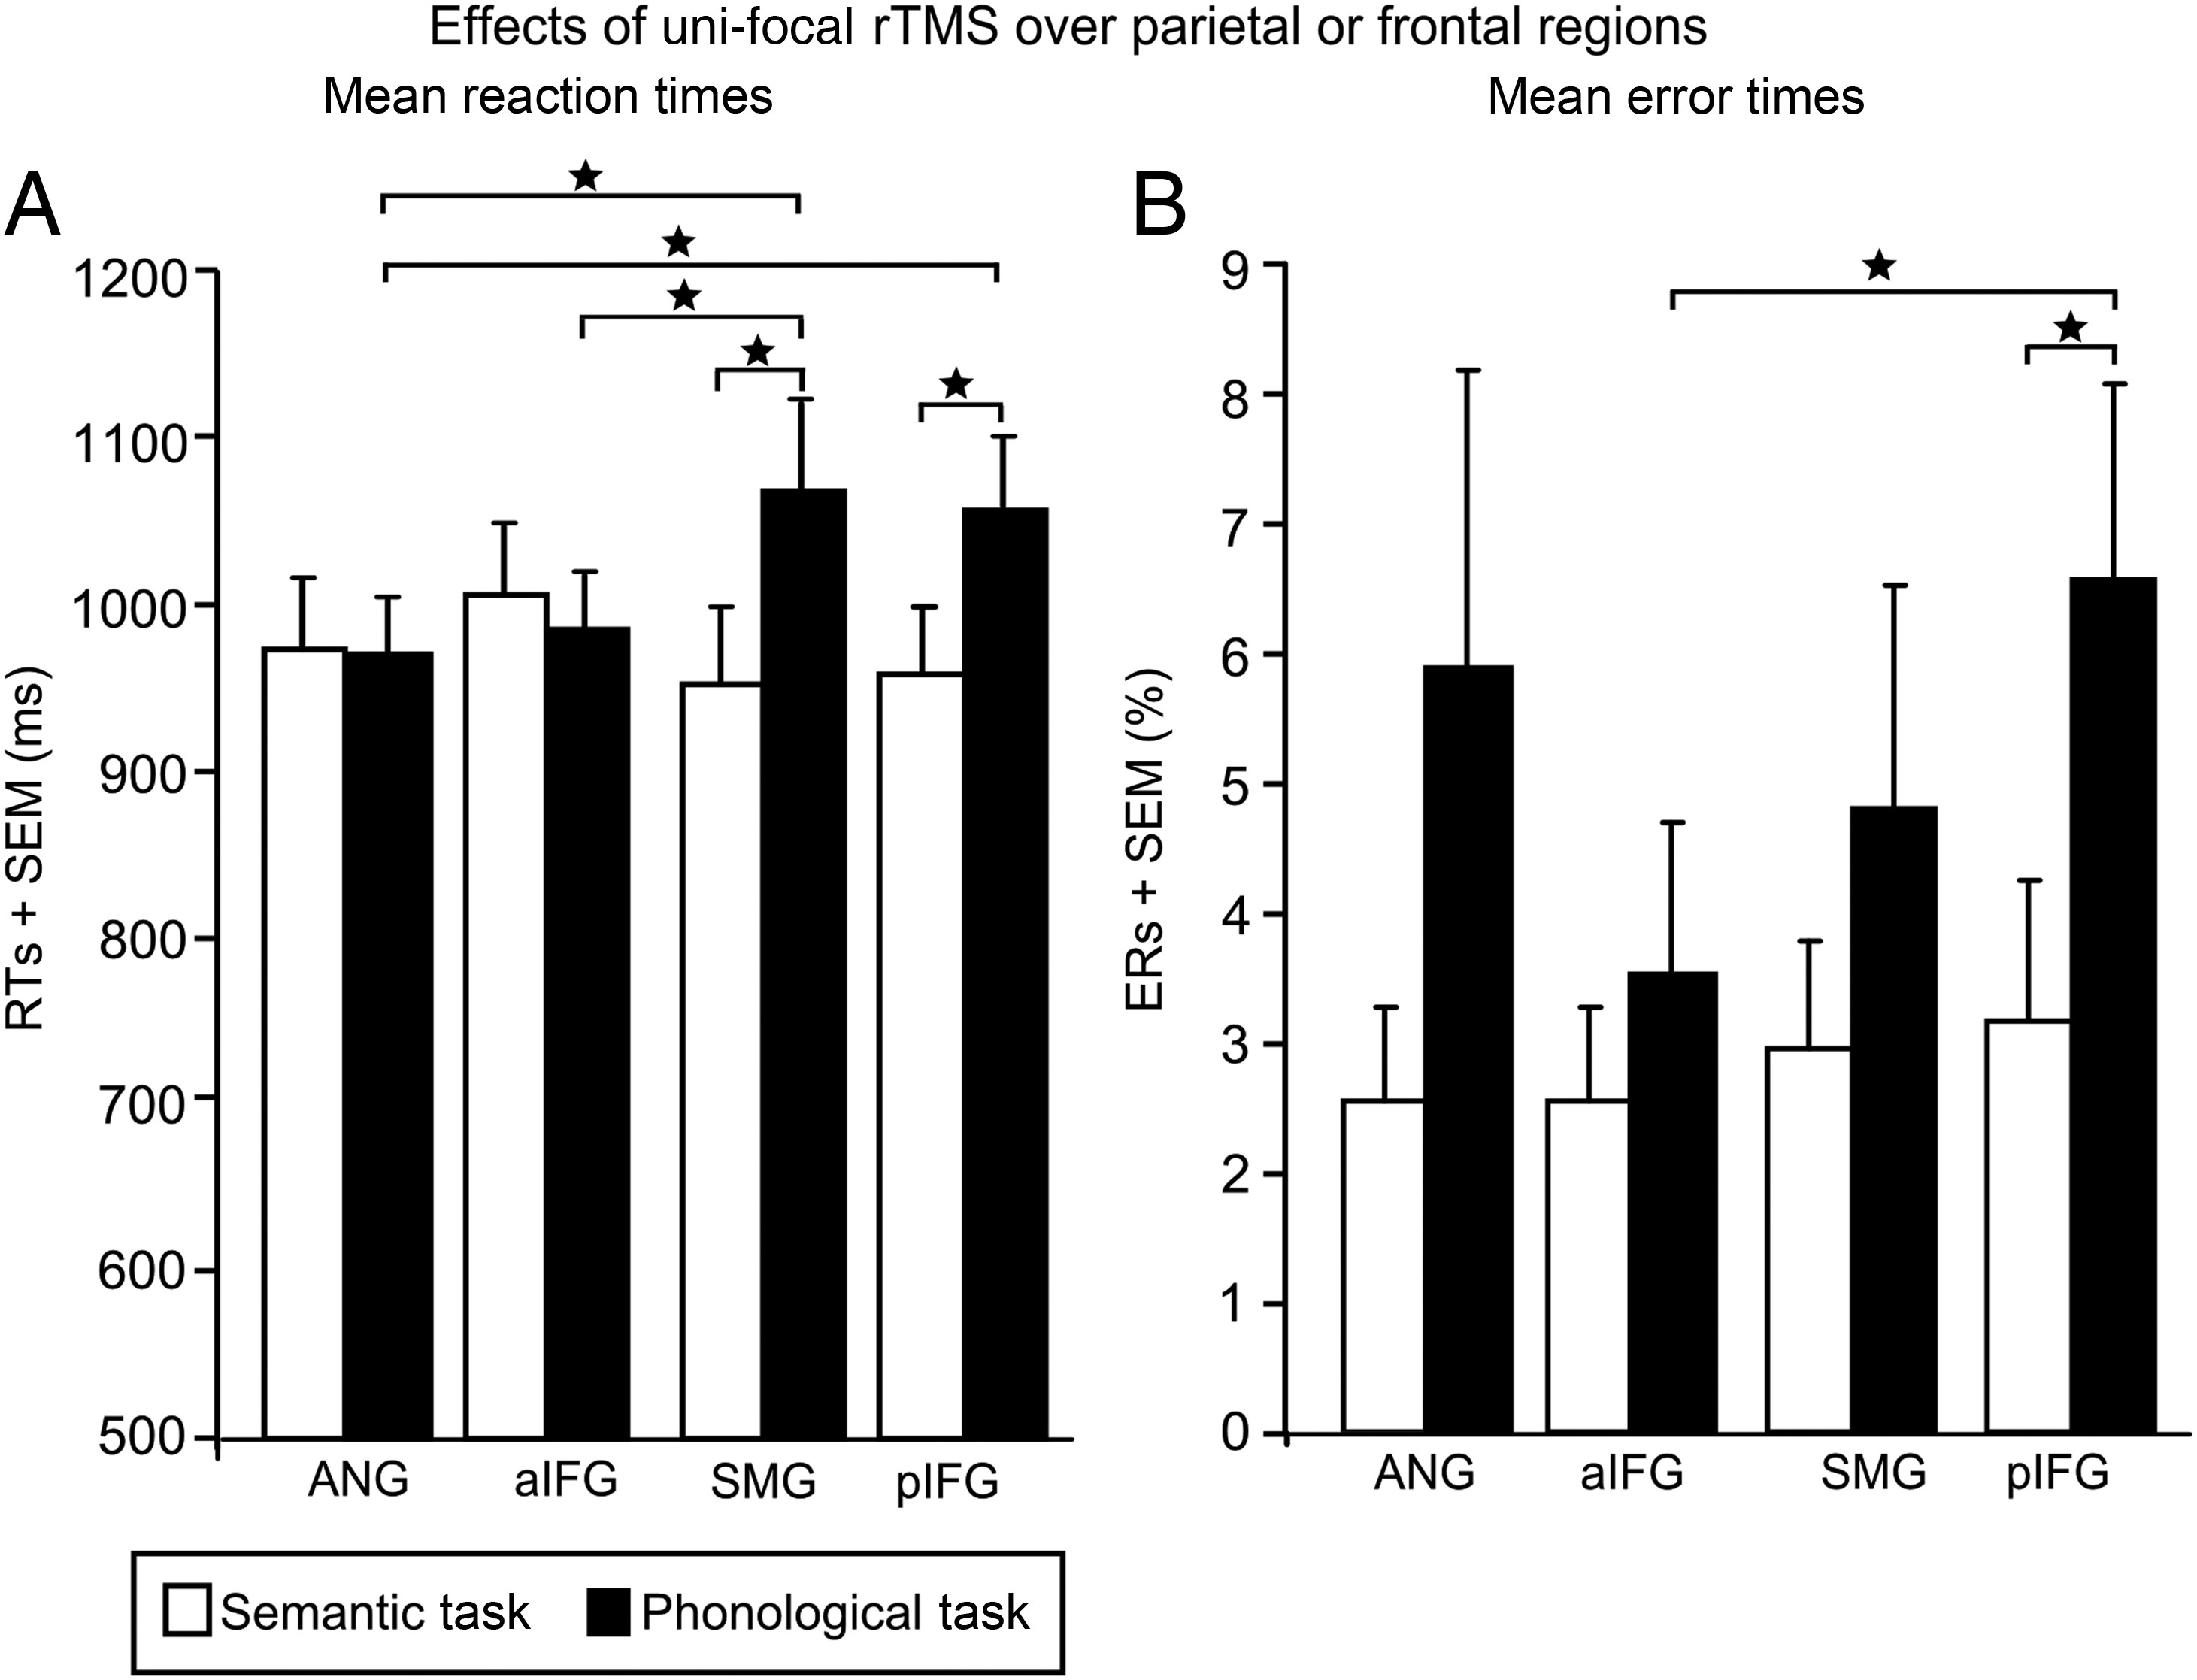
Figure 3. Effects of unifocal rTMS over angular gyurs (ANG), anterior/posterior inferior frontal gyrus (a/pIFG) and SMG ...
Notes:
Figure 3. Effects of unifocal rTMS over angular gyurs (ANG), anterior/posterior inferior frontal gyrus (a/pIFG) and SMG (each combined with sham rTMS). (A) The significant effects of rTMS on mean reaction times (RTs). (B) Effects of unifocal rTMS on mean error rates (ERs). *P < 0.05, corrected for multiple comparisons with the Bonferroni–Holm correction; a/pIFG, anterior/posterior inferior frontal gyrus; ANG, angular gyrus; SMG, supramarginal gyrus; SEM, standard error of the mean.
Unless provided in the caption above, the following copyright applies to the content of this slide: © The Author 2015. Published by Oxford University Press. All rights reserved. For Permissions, please e-mail: journals.permissions@oup.com

Slide 4
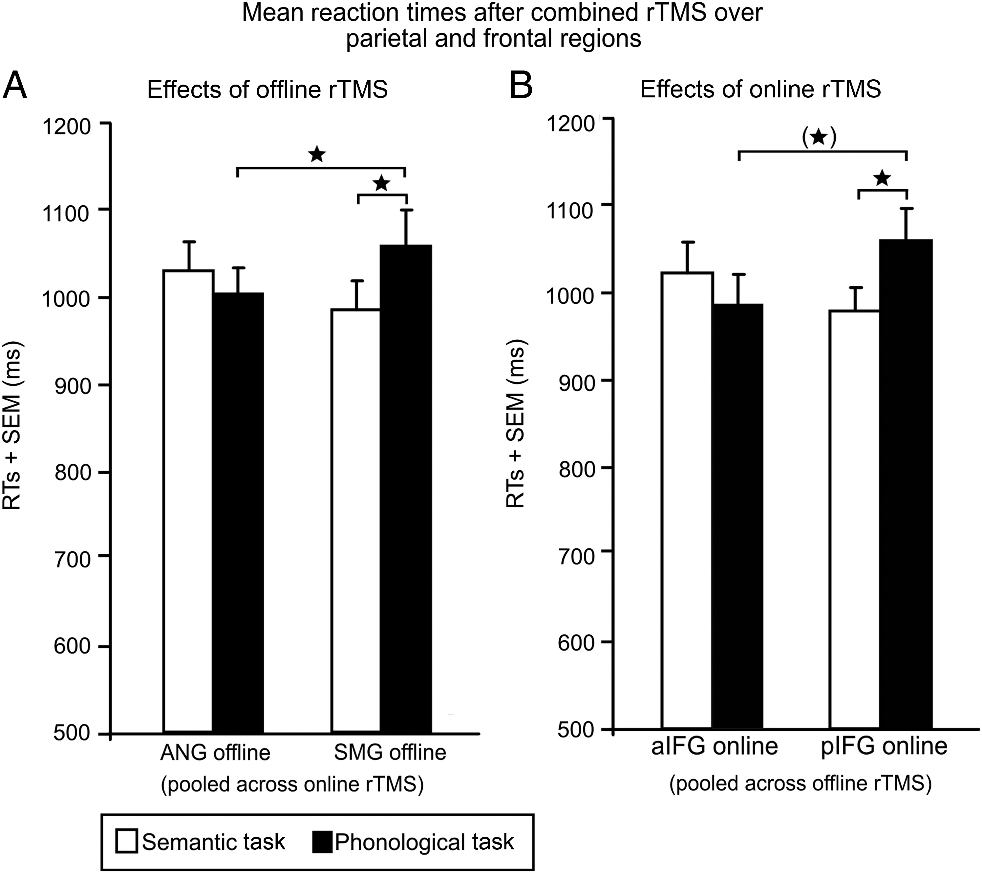
Figure 4. Effects of combined offline and online rTMS on mean reaction times (RTs). (A) The significant two-way ...
Notes:
Figure 4. Effects of combined offline and online rTMS on mean reaction times (RTs). (A) The significant two-way interaction between task and offline rTMS (pooled across online rTMS). (B) The significant two-way interaction between task and online rTMS (pooled across offline rTMS). *P < 0.05; two-tailed; corrected for multiple comparisons with the Bonferroni–Holm correction; (*)P < 0.05, does not survive the Bonferroni–Holm correction; a/pIFG, anterior/posterior inferior frontal gyrus; ANG, angular gyrus; SMG, supramarginal gyrus; SEM, standard error of the mean.
Unless provided in the caption above, the following copyright applies to the content of this slide: © The Author 2015. Published by Oxford University Press. All rights reserved. For Permissions, please e-mail: journals.permissions@oup.com

Slide 5
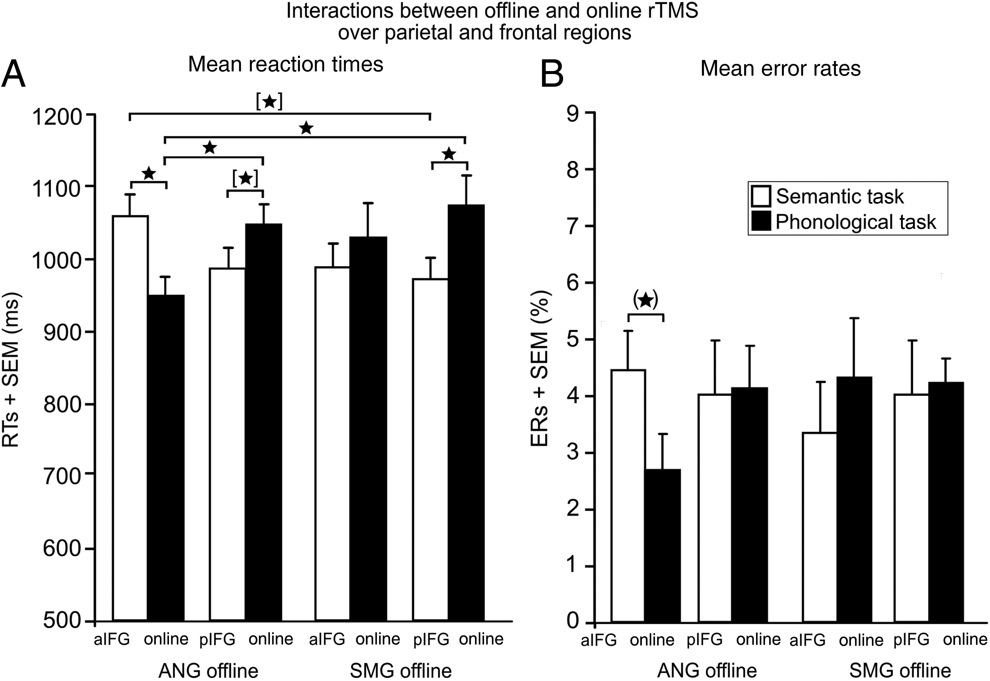
Figure 5. Interactions between offline and online rTMS. (A) The significant three-way interaction between task, offline ...
Notes:
Figure 5. Interactions between offline and online rTMS. (A) The significant three-way interaction between task, offline rTMS and online rTMS on mean reaction times (RTs). *P < 0.05; two-tailed; corrected for multiple comparisons with the Bonferroni–Holm correction; [*]P < 0.05, at threshold with the Bonferroni–Holm correction. (B) The significant three-way interaction between task, offline and online rTMS on mean error rates (ERs). (*)P < 0.05, two-tailed, does not survive the Bonferroni–Holm correction. a/pIFG, anterior/posterior inferior frontal gyrus; ANG, angular gyrus; SMG, supramarginal gyrus; SEM, standard error of the mean.
Unless provided in the caption above, the following copyright applies to the content of this slide: © The Author 2015. Published by Oxford University Press. All rights reserved. For Permissions, please e-mail: journals.permissions@oup.com

Slide 6
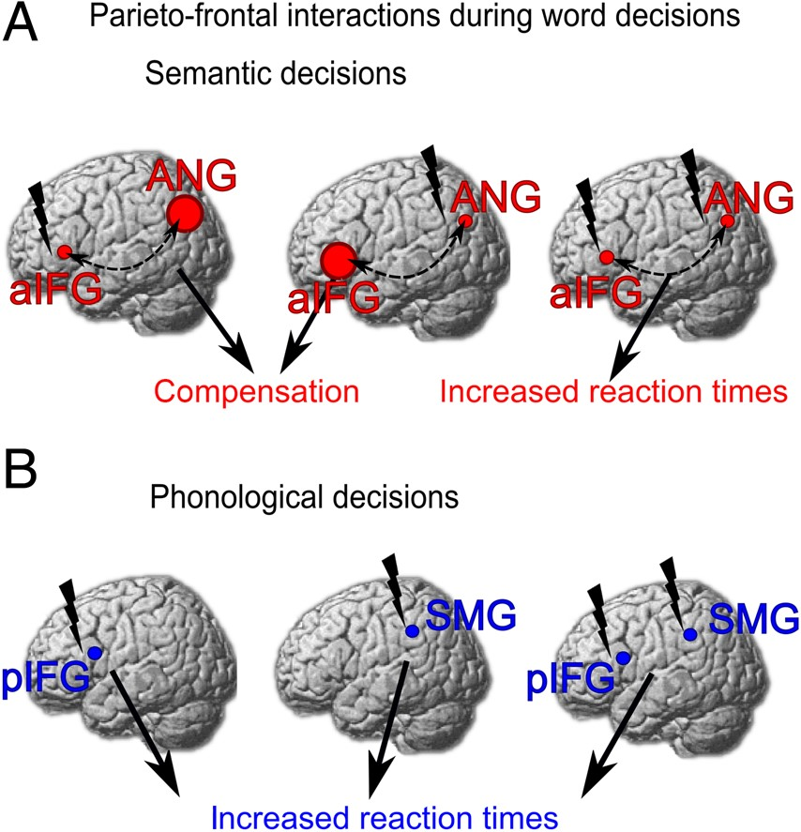
Figure 6. Schematic illustration of parieto-frontal contributions to phonological and semantic word decisions. (A) rTMS ...
Notes:
Figure 6. Schematic illustration of parieto-frontal contributions to phonological and semantic word decisions. (A) rTMS over either left aIFG or ANG alone does not significantly affect semantic decisions (left and middle panel) because the respective other non-lesioned region can compensate for the rTMS-induced lesion effect as indicated by the large circles. Only combined rTMS over both areas affects reaction times (and to a lesser degree also error rates) (right panel). (B) rTMS over either left pIFG or SMG disrupts phonological decisions (left and middle panel) without any additive effect for combined TMS over both regions (right panel).
Unless provided in the caption above, the following copyright applies to the content of this slide: © The Author 2015. Published by Oxford University Press. All rights reserved. For Permissions, please e-mail: journals.permissions@oup.com

