Slide 1
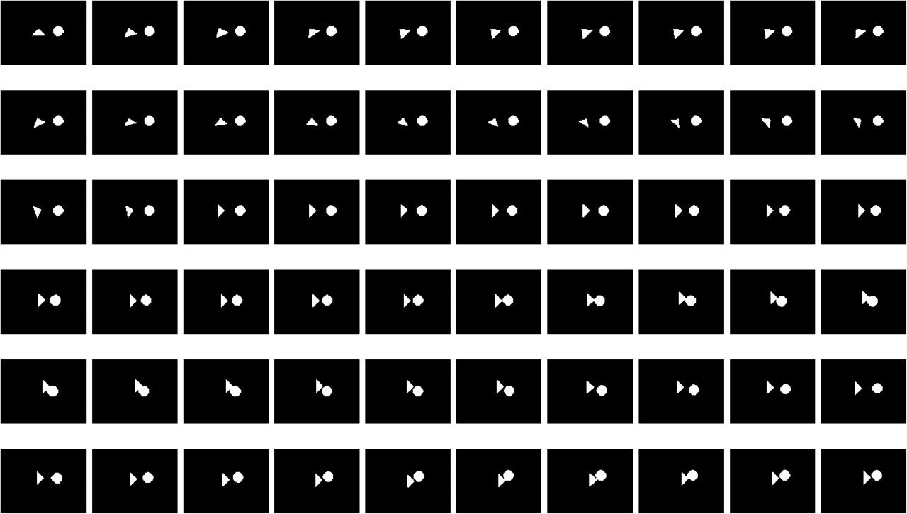
Figure 1. An example of consecutive static frames representing one of the HS-like animations. Each HS-like display ...
Notes:
Figure 1. An example of consecutive static frames representing one of the HS-like animations. Each HS-like display consisted of 2 shapes (bright triangle and circle of the same size and luminance) that irregularly moved against a black background (see Supplementary materials online for dynamic examples of stimuli).
Unless provided in the caption above, the following copyright applies to the content of this slide: © The Author 2010. Published by Oxford University Press. All rights reserved. For permissions, please e-mail: journals.permissions@oxfordjournals.org

Slide 2
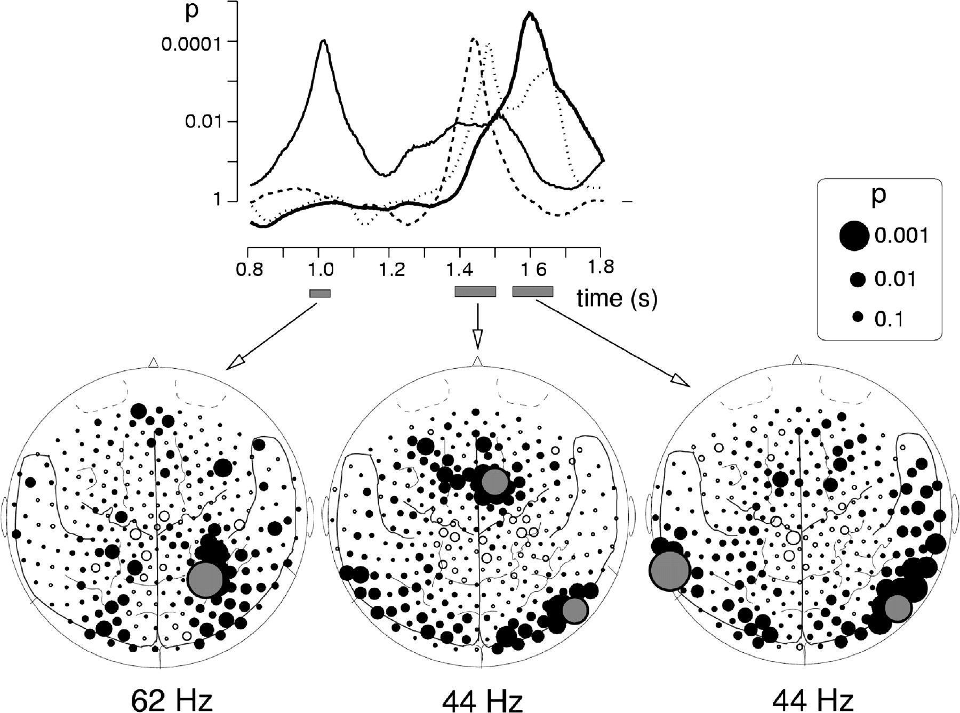
Figure 2. Induced gamma MEG response to HS-like animations. The graph on the top represents the results of t-test ...
Notes:
Figure 2. Induced gamma MEG response to HS-like animations. The graph on the top represents the results of t-test comparisons between the HS-like animations and control displays or, in other words, the time course of the P values of the spectral amplitude differences in the filtered frequency bands. The thin solid curve shows the time course of spectral amplitude of differences between HS-like animations and control displays at one of the sensors in the right PTJ (filled gray circle in left map). The bold dotted curve represents differences between HS-like animations and control displays at the right medial frontal cortex (upper gray circle in middle map). The thin dotted curve stands for differences at one of the right posterior temporal sensors (lower gray circle in the right hemisphere in middle and in right maps), and the solid curve stands for differences at one of the left temporal sensors (largest gray circle in right map). The left map depicts the topography of spectral amplitude differences in the 62 Hz range and the middle and right maps in the 44 Hz range. Each circle represents 1 of the 275 MEG sensors projected onto a 2D cortical surface map with major anatomical landmarks (dorsal view and nose up). Filled and open circles represent sensors with relative spectral amplitude enhancements to HS-like and control stimuli, respectively. The size of the circle reflects the statistical strength of the differences in gamma activity. The largest circles represent the most strong and robust differences in the gamma band activity (GBA).
Unless provided in the caption above, the following copyright applies to the content of this slide: © The Author 2010. Published by Oxford University Press. All rights reserved. For permissions, please e-mail: journals.permissions@oxfordjournals.org

Slide 3
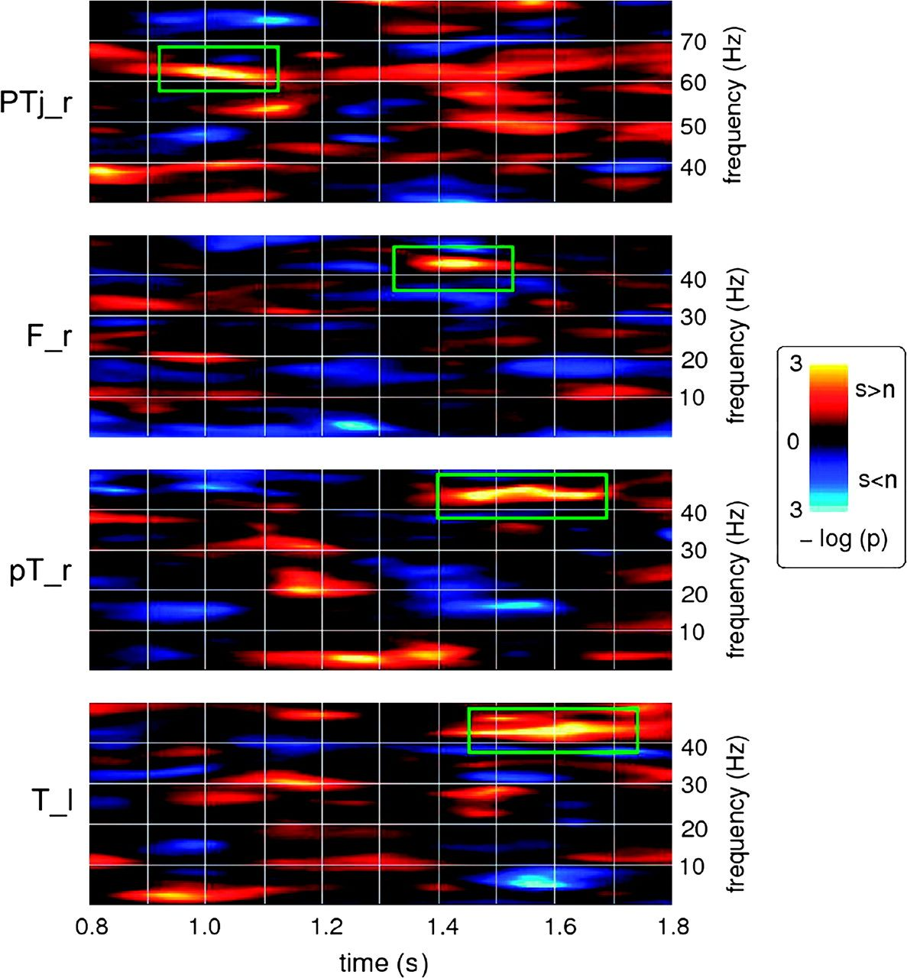
Figure 3. Time–frequency representations depicting statistical strength of differences in the spectral amplitude of ...
Notes:
Figure 3. Time–frequency representations depicting statistical strength of differences in the spectral amplitude of induced oscillatory response between the HS-like and control displays. Data are shown in the interval from 0.8 to 1.8 s from the stimulus onset. Color coding indicates the statistical significance level of differences in the spectral amplitude (the inverse of log p): Warm colors point to greater amplitudes for HS-like (social) than for control (nonsocial) displays (s > n), and cold colors point to greater amplitudes for control (nonsocial) than to HS-like (social) displays (s < n). Effects that met the statistical significance criteria are marked with green rectangles. The first peak in time–frequency amplitude of the oscillatory response of 62 Hz is observed at a latency of 1 s from the stimulus onset over the right PTJ (upper plot, PTj_r). The next plot (F_r) represents the enhancement of 44 Hz at one of the right medial frontal sensor at 1.4 s from the stimulus onset. The third plot from the top (pT_r) represents the enhancements of 44 Hz at one of the right posterior temporal sensors. The lower plot (T_l) shows the peak of 44 Hz over the left temporal cortex at 1.6 s from the stimulus onset.
Unless provided in the caption above, the following copyright applies to the content of this slide: © The Author 2010. Published by Oxford University Press. All rights reserved. For permissions, please e-mail: journals.permissions@oxfordjournals.org

