Slide 1
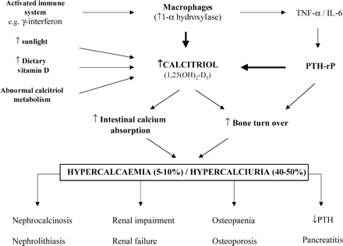
Figure 1. Causes and consequences of abnormal calcium homeostasis in sarcoidosis. PTH-rP, parathyroid hormone (PTH) ...
Notes:
Figure 1. Causes and consequences of abnormal calcium homeostasis in sarcoidosis. PTH-rP, parathyroid hormone (PTH) related protein; TNF-α, tissue necrosis factor- α; IL-6, interleukin-6.
Unless provided in the caption above, the following copyright applies to the content of this slide: © Association of Physicians 2003; all rights reserved

