Slide 1
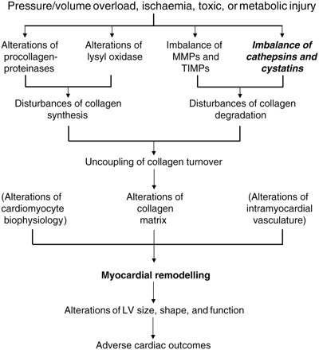
Figure 1 General mechanisms and consequences of myocardial remodelling that occurs in hearts exposed to different ...
Notes:
Figure 1 General mechanisms and consequences of myocardial remodelling that occurs in hearts exposed to different types of injury. MMPs, matrix metalloproteinases; TIMPs, tissue inhibitors of MMPs; LV, left ventricular.
Unless provided in the caption above, the following copyright applies to the content of this slide: Published on behalf of the European Society of Cardiology. All rights reserved. © The Author 2010. For permissions please email: journals.permissions@oxfordjournals.org.

