Slide 1
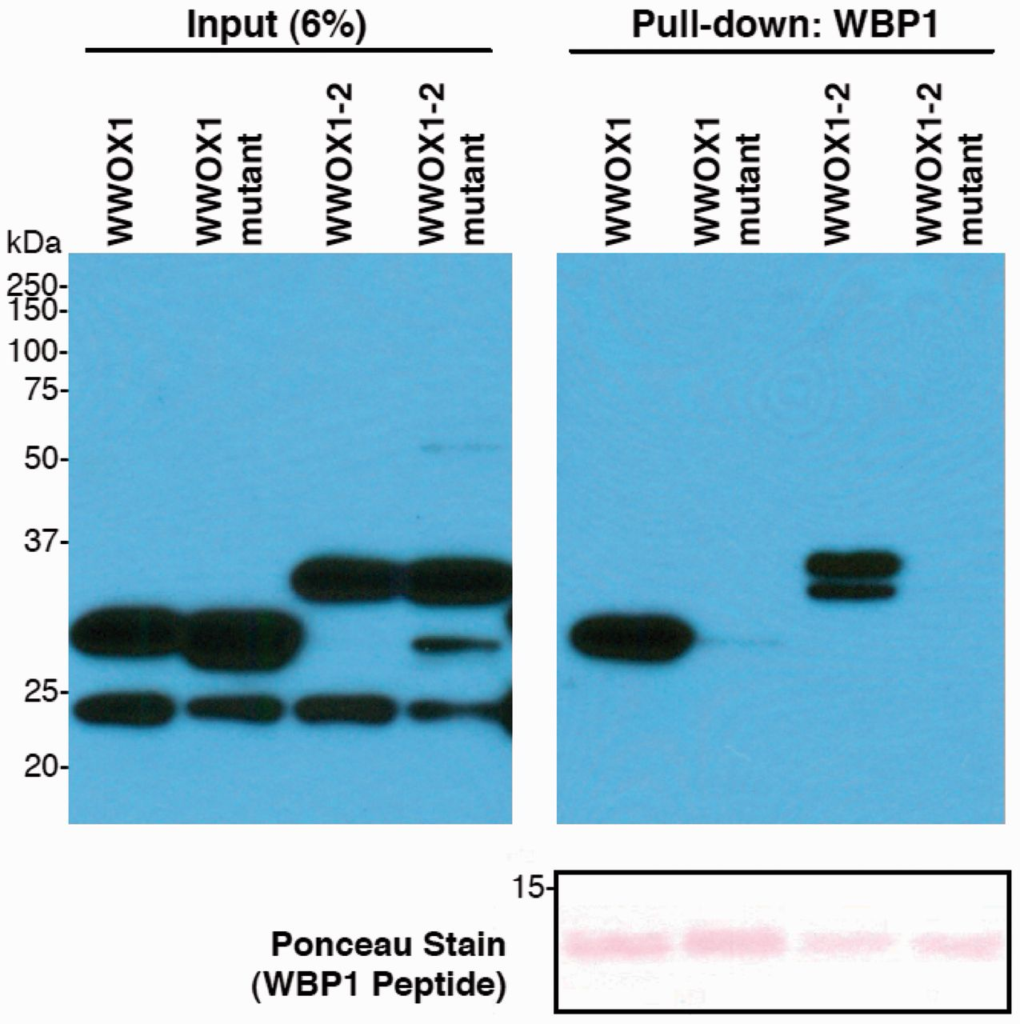
Figure 3 Wild-type and mutant WWOX WW domain pull-down assays. Purified GST-WWOX WW domain fusion proteins were ...
Notes:
Figure 3 Wild-type and mutant WWOX WW domain pull-down assays. Purified GST-WWOX WW domain fusion proteins were incubated with biotinylated WBP1 peptide (SGSGGTPPPPYTVG) in pull-down assays. WWOX1, first WWOX WW domain only; WWOX1–2, WWOX WW1 and WW2 domains. Mutant indicates the fusion peptides with the p.Pro47Thr change. Western blot of 6% input of GST fusion proteins to demonstrate equal amounts of input material in the pull-down experiments (left). Right: only the wild-type and not the mutant fusion peptides were efficiently pulled down with the PPPY containing oligopeptide, demonstrating that the change of proline 47 to threonine is sufficient to abrogate the affinity of WWOX for PPXY motif containing interacting partners, presumably by destabilizing the WW1 fold. Bottom: red ponceau stain of the pull-down blot (oligopeptide range), to demonstrate incubation with equal amounts of biotinylated WBP1 peptide.
Unless provided in the caption above, the following copyright applies to the content of this slide: © The Author (2013). Published by Oxford University Press on behalf of the Guarantors of Brain. All rights reserved. For Permissions, please email: journals.permissions@oup.com

Slide 2
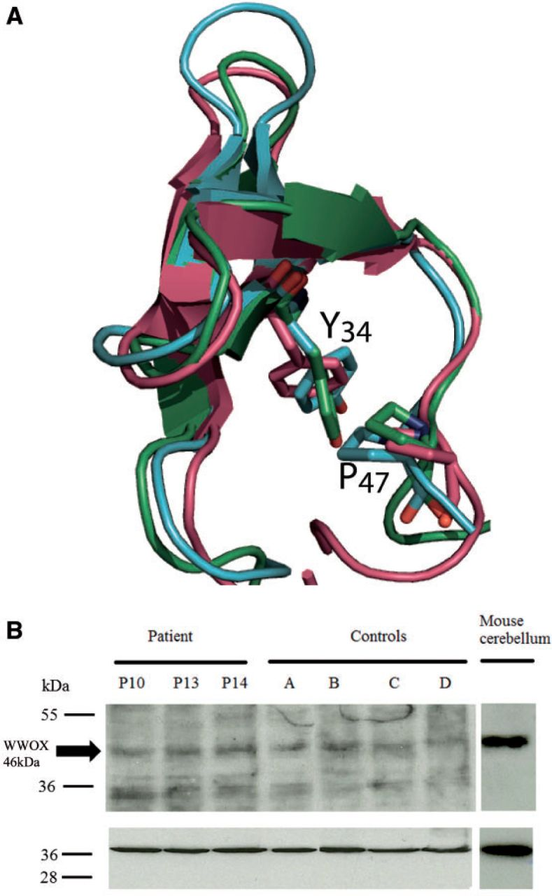
Figure 2 Analysis of normal and p.Pro47Thr mutant WWOX protein. (A) Superimposition of the well structurally ...
Notes:
Figure 2 Analysis of normal and p.Pro47Thr mutant WWOX protein. (A) Superimposition of the well structurally characterized WW domain of TCERG1 (purple, pdb code 1E0L; Macias et al., 2000) and the 3D homology models of WWOX (green) and PQBP1 (blue) WW domains. Two amino acids belonging to the hydrophobic core of WW domains are highlighted and annotated according to the WWOX sequence: tyrosine 34 (Y34) and proline 47 (P47). In TCERG1, mutation of the proline into alanine results in a WW domain that is largely unfolded (Petrovich et al., 2006). In PQBP1, the mutation of the tyrosine into a cysteine is causing Golabi-Ito-Hall mental retardation syndrome: the mutation affects the WW domain folding, reduces its binding activity, and alters the function of PQBP1 (Tapia et al., 2010). These two residues are in direct hydrophobic contact within WW domains. (B) Western blot analysis of WWOX expression in cultured human skin fibroblasts and in mouse cerebellar tissue. Upper panel: WWOX expression in cultured skin fibroblasts from Patient II-3 of Family 1 at three passages 10, 13 and 14 (P10, P13, P14) and from fibroblasts from four different controls (A to D). Based on visual inspection, similar amounts of the mutant and wild-type WWOX protein (arrow) are observed. Right lane: cerebellar mouse extracts were analysed in a similar western blot with the same primary antibody, in order to show the position of the WWOX band and high expression of WWOX in this tissue. The nature of the 35 kDa band seen on the human fibroblast lanes is not known and is presumably non-specific cross-reaction since it is not seen in the mouse tissues (tissues other than cerebellum were also tested, not shown). Lower panel: the same western blot was analysed with anti-actin antibodies, to check for equal loading of protein extracts.
Unless provided in the caption above, the following copyright applies to the content of this slide: © The Author (2013). Published by Oxford University Press on behalf of the Guarantors of Brain. All rights reserved. For Permissions, please email: journals.permissions@oup.com

Slide 3
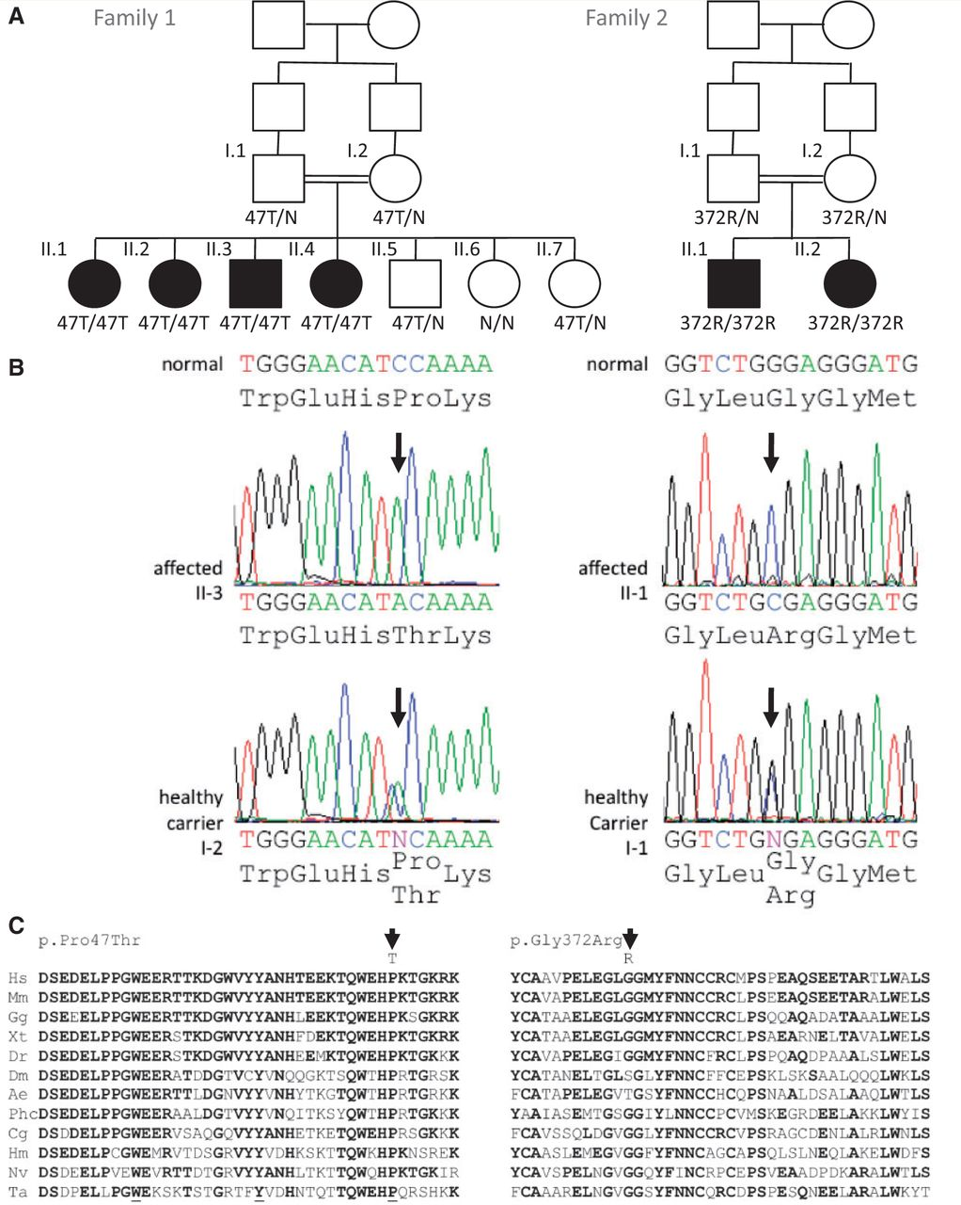
Figure 1 Identification of WWOX mutations in the Saudi and Israeli Palestinian families. (A) Family trees showing ...
Notes:
Figure 1 Identification of WWOX mutations in the Saudi and Israeli Palestinian families. (A) Family trees showing consanguinity and segregation of the disease with mutations c.139C>A, causing the p.Pro47Thr missense change (47T) and c.1114G>C causing the p.Gly372Arg missense change (372R). (B) Sanger sequencing of the mutations c.139C>A and c.1114G>C: index patients are homozygous for the substitution and carrier relatives (mother I-2 in Family 1 and father I-1 in Family 2) are heterozygous for the same substitution. (C) Sequence comparison of the WW1 domain (left) and of the C-terminal part of the dehydrogenase/reductase domain (right) of WWOX from different species. Amino acids that are identical to the human sequence are shown in bold. The highly conserved aromatic residues that are part of the hydrophobic core of the WW1 domain are underlined. The mutant amino acids (threonine, T, and arginine, R), on top of the mutated amino acids (proline, P, and glycine, G, respectively), are indicated by an arrow. The mutated amino acids are conserved in all metazoan species analysed, except glycine 372 in some insects (endopterygota branch). Hs = human; Mm = opossum; Gg = chicken; Xt = frog; Dr = bony fish; Dm = fly; Ae = ant; Phc = louse; Cg = oyster; Hm = hydra; Nv = sea anemone; Ta = trichoplax (multi-cellular amoeba).
Unless provided in the caption above, the following copyright applies to the content of this slide: © The Author (2013). Published by Oxford University Press on behalf of the Guarantors of Brain. All rights reserved. For Permissions, please email: journals.permissions@oup.com

Slide 4
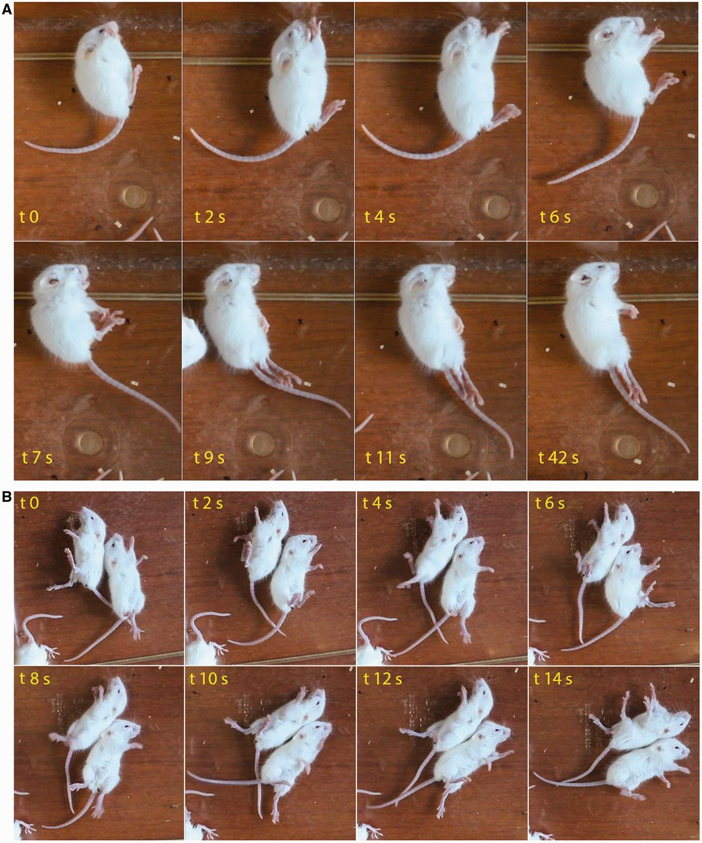
Figure 4 Still frames of audiogenic tonic-clonic seizures of Wwox knock-out mouse. Twenty-day-old Wwox knock-out mice ...
Notes:
Figure 4 Still frames of audiogenic tonic-clonic seizures of Wwox knock-out mouse. Twenty-day-old Wwox knock-out mice were exposed for 10 min to a digital 14 kHz tone. After 30 s sound exposure, the first mouse presented a wild-running phase (see Supplementary Video 1), followed by tonic contractions that lasted over 42 s (A). After 4 min sound exposure, two other mice also experienced clonic movements (B and Supplementary Video 1).
Unless provided in the caption above, the following copyright applies to the content of this slide: © The Author (2013). Published by Oxford University Press on behalf of the Guarantors of Brain. All rights reserved. For Permissions, please email: journals.permissions@oup.com

