Slide 1
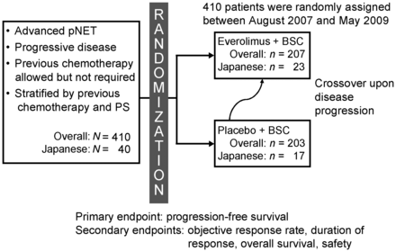
Figure 1. Study design. BSC, best supportive care; pNET, pancreatic neuroendocrine tumours; PS, performance status.
Notes:
Figure 1. Study design. BSC, best supportive care; pNET, pancreatic neuroendocrine tumours; PS, performance status.
Unless provided in the caption above, the following copyright applies to the content of this slide: © The Author 2012. Published by Oxford University Press. All rights reserved. For Permissions, please email: journals.permissions@oup.comThis is an Open Access article distributed under the terms of the Creative Commons Attribution Non-Commercial License (http://creativecommons.org/licenses/by-nc/3.0/), which permits unrestricted non-commercial use, distribution, and reproduction in any medium, provided the original work is properly cited.

Slide 2
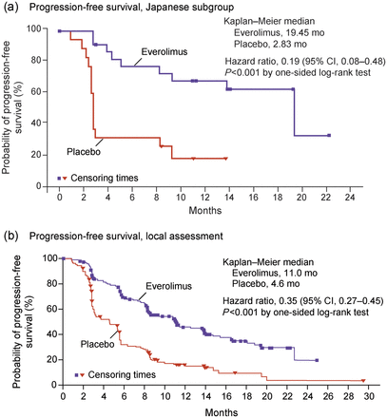
Figure 2. Kaplan–Meier plot of progression-free survival (PFS) for (a) Japanese subgroup and (b) local assessment of ...
Notes:
Figure 2. Kaplan–Meier plot of progression-free survival (PFS) for (a) Japanese subgroup and (b) local assessment of the overall population (24). Hazard ratios were obtained from a Cox model. CI, confidence interval; HR, hazard ratio. Reprinted from Yao JC, Shah MH, Ito T, et al. Everolimus for advanced pancreatic neuroendocrine tumors. N Engl J Med 2011;364:514–23 (24). Copyright© 2011 Massachusetts Medical Society.
Unless provided in the caption above, the following copyright applies to the content of this slide: © The Author 2012. Published by Oxford University Press. All rights reserved. For Permissions, please email: journals.permissions@oup.comThis is an Open Access article distributed under the terms of the Creative Commons Attribution Non-Commercial License (http://creativecommons.org/licenses/by-nc/3.0/), which permits unrestricted non-commercial use, distribution, and reproduction in any medium, provided the original work is properly cited.

Slide 3
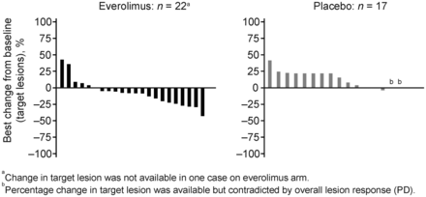
Figure 3. Best percentage change from baseline in Japanese subgroup. PD, progressive disease.
Notes:
Figure 3. Best percentage change from baseline in Japanese subgroup. PD, progressive disease.
Unless provided in the caption above, the following copyright applies to the content of this slide: © The Author 2012. Published by Oxford University Press. All rights reserved. For Permissions, please email: journals.permissions@oup.comThis is an Open Access article distributed under the terms of the Creative Commons Attribution Non-Commercial License (http://creativecommons.org/licenses/by-nc/3.0/), which permits unrestricted non-commercial use, distribution, and reproduction in any medium, provided the original work is properly cited.

