Slide 1
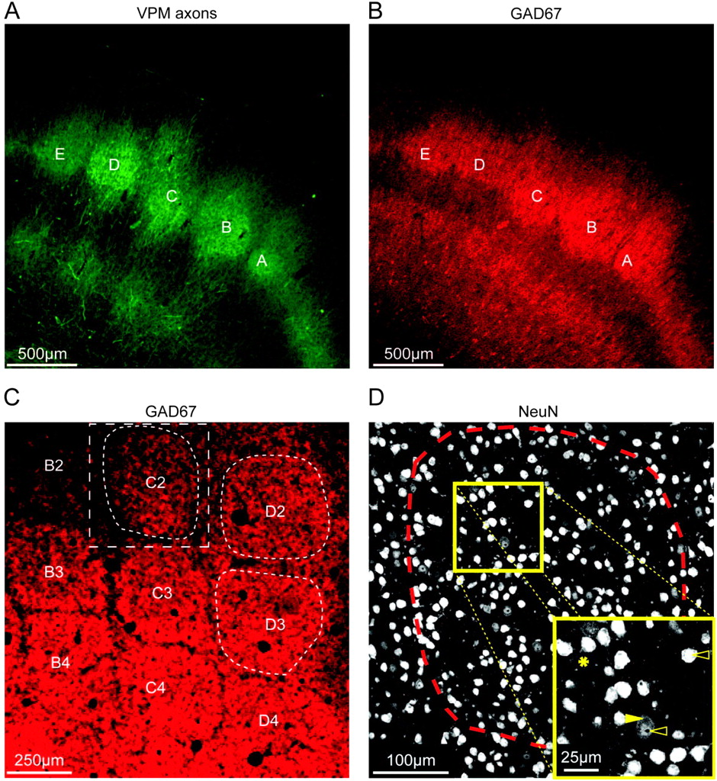
Figure 1. Outlines of TC projection columns. (A) Fluorescence image of a semi-coronal slice of barrel cortex showing ...
Notes:
Figure 1. Outlines of TC projection columns. (A) Fluorescence image of a semi-coronal slice of barrel cortex showing thalamic VPM axons visualized by viral-mediated fluorescence (mOrange). Barrels A–E in layer 4 can be delineated as spots of high VPM axon density. (B) GAD67 immunofluorescence image of the slice shown in (A). The GAD67 immunofluorescence showed hot spots in layer 4 whose outlines match the patches of TC projection. (C) GAD67 fluorescence image of a tangential slice of L4 of barrel cortex. Arcs 2–4 of rows B–D are shown. Barrels can be delineated as hot spots of GAD67 immunofluorescence. The white box (dashed rectangle) illustrates the region of interest that was selected for imaging the C2 barrel column (dashed barrel outline) through the entire depth of the cortex using confocal scanning microscopy. The D2 and D3 barrel columns were also imaged. (D) NeuN immunofluorescence image (single optical slice) from a confocal scan of a tangential slice (thickness: 50 μm) of the region of interest outlined in (C). Dashed line: barrel outline of the C2 barrel. The inset illustrates that NeuN immunolabeling predominantly stains the nucleus. However, it also outlines the cytosol (arrows); sometimes, even parts of dendrites can be followed (asterisk), as reported before (Mullen et al. 1992).
Unless provided in the caption above, the following copyright applies to the content of this slide: © The Authors 2010. Published by Oxford University Press.This is an Open Access article distributed under the terms of the Creative Commons Attribution Non-Commercial License (http://creativecommons.org/licenses/by-nc/2.5), which permits unrestricted non-commercial use, distribution, and reproduction in any medium, provided the original work is properly cited.

Slide 2
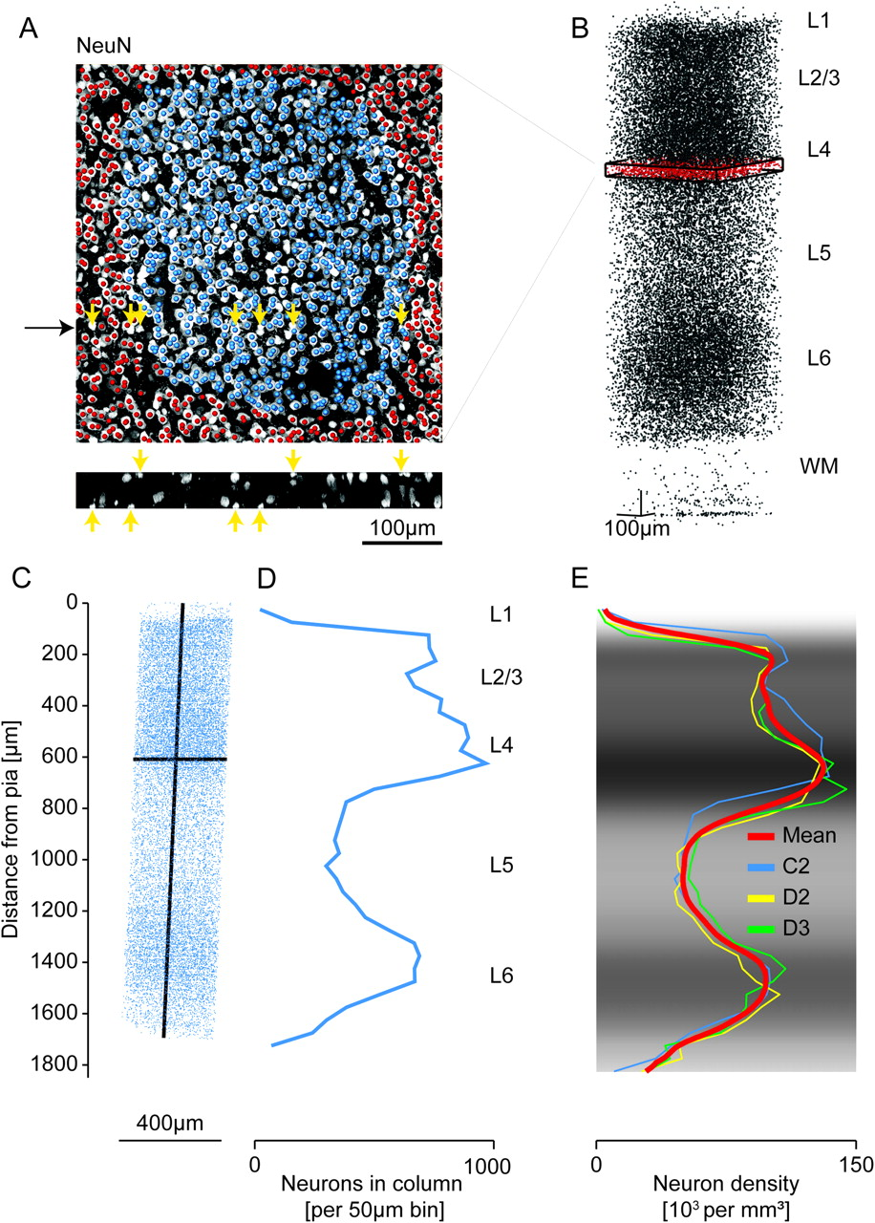
Figure 2. Number and distribution of NeuN-positive cell bodies. (A) Overlay of a maximum intensity NeuN ...
Notes:
Figure 2. Number and distribution of NeuN-positive cell bodies. (A) Overlay of a maximum intensity NeuN immunofluorescence image with markers that were manually placed at the presumptive midpoints of NeuN-positive cell bodies (blue markers were located within the C2 barrel outline). Yellow arrows indicate examples of somata that were located at the edge of a slice and were contained to less than half in that slice (see reslice in the bottom panel; black arrow indicates reslice location); these neurons were counted in the adjacent slice; for estimates of the measurement error introduced by this counting procedure, see Materials and Methods and Discussion. (B) 29 159 markers identified as NeuN-positive somata in the region of interest comprising the C2 barrel column. Red: slice shown in (A). (C) 18 597 manually placed markers indicating NeuN-positive cell bodies within the C2 barrel column, which was defined by extrapolation of the barrel outline in L4 (see Fig. 1) along the vertical column axis (which was assumed to be perpendicular to the pial surface). (D) 1D profile of marker density projected onto the vertical column axis. (E) 1D profiles of NeuN density along the respective vertical column axis for the C2, D2, and D3 columns and the mean profile. Gray scale indicates mean NeuN density. Profiles were scaled to the length of a “standard” TC projection column (1840 μm, see Wimmer et al. 2010 and Results). The indicated layers represent approximate layer boundaries; for a quantitative definition of layer borders, see Figure 3, Table 2, and Results.
Unless provided in the caption above, the following copyright applies to the content of this slide: © The Authors 2010. Published by Oxford University Press.This is an Open Access article distributed under the terms of the Creative Commons Attribution Non-Commercial License (http://creativecommons.org/licenses/by-nc/2.5), which permits unrestricted non-commercial use, distribution, and reproduction in any medium, provided the original work is properly cited.

Slide 3
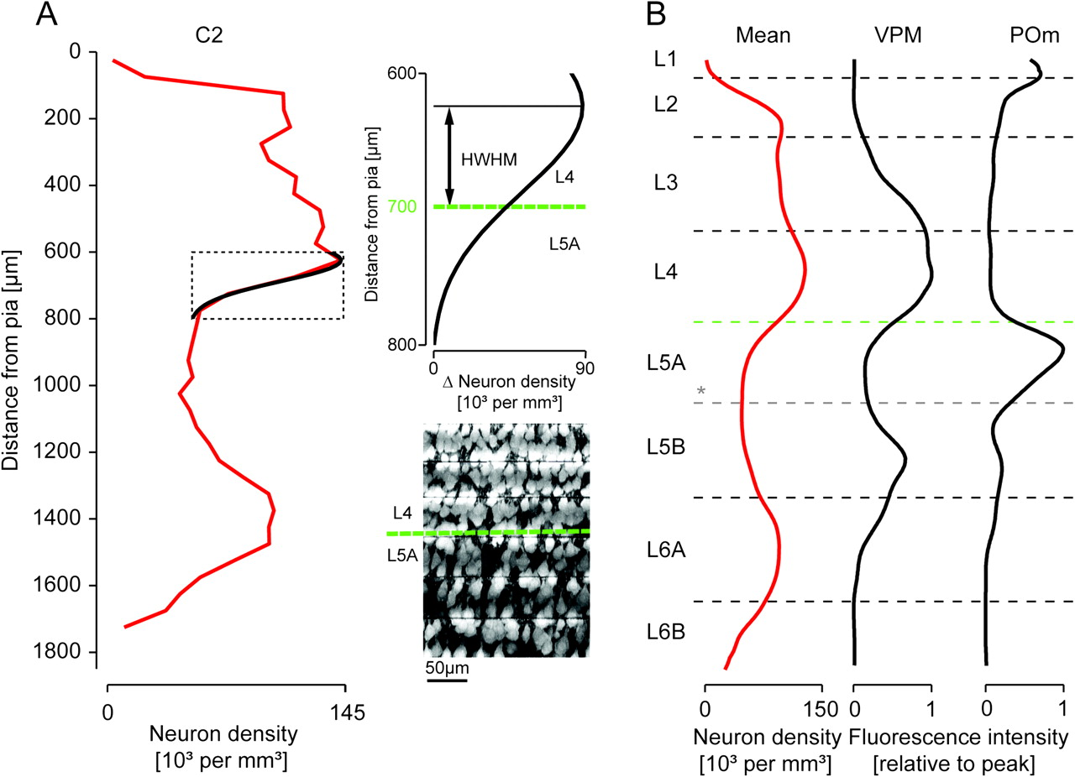
Figure 3. Definition of layer borders based on the density of NeuN-positive cell bodies along the vertical column axis. ...
Notes:
Figure 3. Definition of layer borders based on the density of NeuN-positive cell bodies along the vertical column axis. (A) Cytoarchitectonic layer borders (dashed black horizontal lines) determined based on the vertical neuron density gradients (red line, left panel) by fitting Gaussian functions to the neuron density z-profile of the C2 column at the presumed layer borders. Inset: Example of fit used to define the L4-to-L5A border. HWHM, half width half maximum. Maximum intensity projection images of 6 consecutive slices of the C2 column illustrating that the fitted L4-to-L5A layer border (green dashed line) matched the apparent density drop in the anti-NeuN immunofluorescence. For a summary of the resulting layer heights, see Table 2. (B) Comparison of the such defined layer borders with profiles of thalamic projection density (profiles from Meyer et al. 2010). *The border between L5A and L5B could not be defined based on changes in neuron density. We therefore used GAD67 immunofluorescence to delineate the border between L5A and L5B, which provided clear subdivision of layer 5 (cf. Fig. 1B) and matched the putative L5A outline defined by the POm projection density.
Unless provided in the caption above, the following copyright applies to the content of this slide: © The Authors 2010. Published by Oxford University Press.This is an Open Access article distributed under the terms of the Creative Commons Attribution Non-Commercial License (http://creativecommons.org/licenses/by-nc/2.5), which permits unrestricted non-commercial use, distribution, and reproduction in any medium, provided the original work is properly cited.

Slide 4
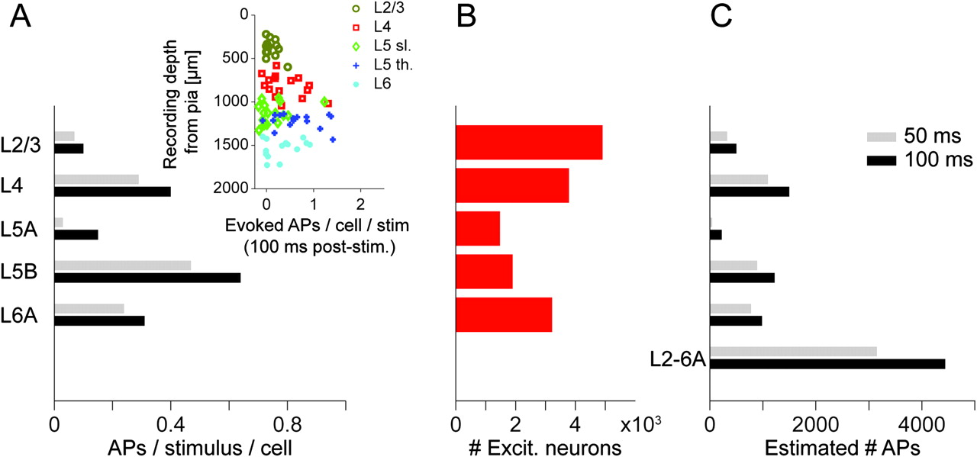
Figure 4. Estimation of the number of action potentials emitted from a cortical column in response to a sensory ...
Notes:
Figure 4. Estimation of the number of action potentials emitted from a cortical column in response to a sensory stimulus. (A) Average number of APs per neuron type elicited by stimulation of the principal whisker within a 50 ms and 100 ms post-stimulus time window, respectively. Inset: Number of evoked APs per neuron in dependence of soma depth from the pia for the 100 ms time window (different colors illustrate different neuron types as determined by their dendritic morphology). Data from de Kock et al. (2007). (B) Number of excitatory neurons in a cortical column per type (Fig. 3A and Table 1). (C) Estimated number of APs evoked in a cortical column in response to stimulation of the principal whisker. Note that the majority of APs are emitted by spiny L4 neurons (35% within 50 ms, 34% within 100 ms time window) and thick-tufted L5 pyramidal neurons (28% in both time windows). For the number of spontaneous and the total number of APs within these time windows, see Table 3.
Unless provided in the caption above, the following copyright applies to the content of this slide: © The Authors 2010. Published by Oxford University Press.This is an Open Access article distributed under the terms of the Creative Commons Attribution Non-Commercial License (http://creativecommons.org/licenses/by-nc/2.5), which permits unrestricted non-commercial use, distribution, and reproduction in any medium, provided the original work is properly cited.

