Slide 1
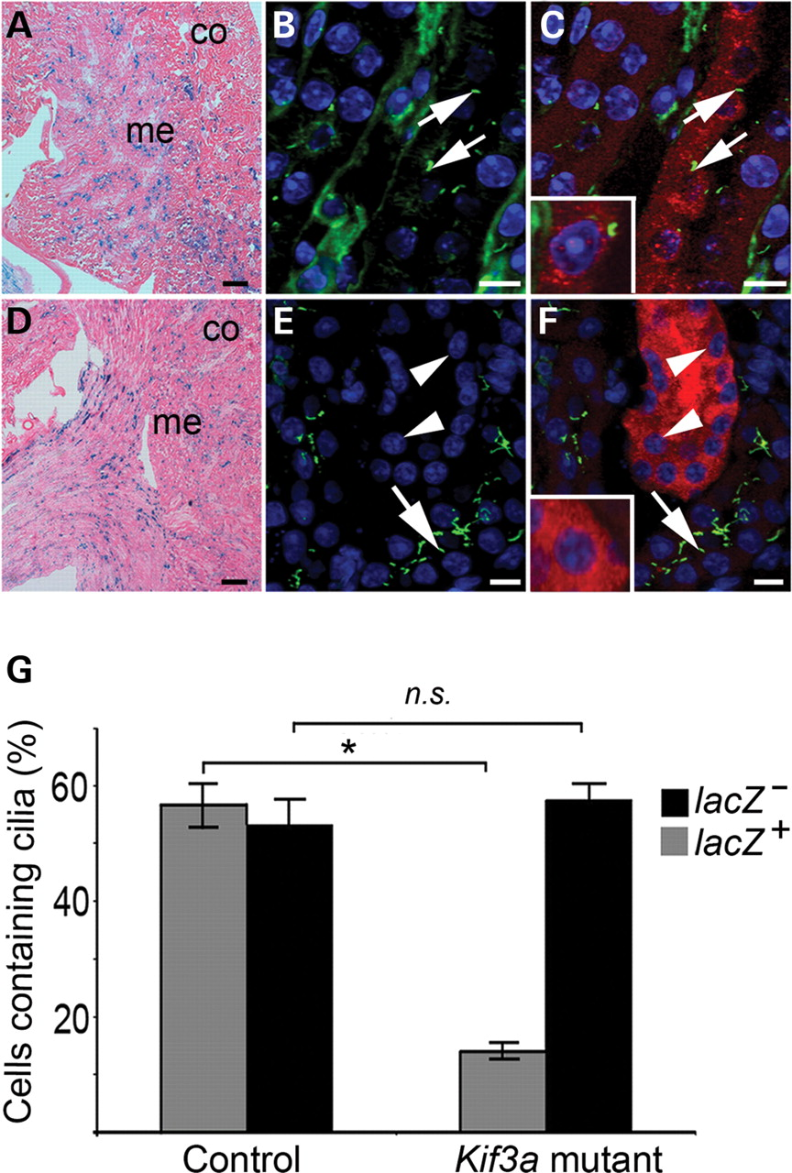
Figure 4. Kidney-specific inactivation of Kif3a in adult mice does not produce kidney cysts despite the loss of primary ...
Notes:
Figure 4. Kidney-specific inactivation of Kif3a in adult mice does not produce kidney cysts despite the loss of primary cilia. Conditional Kif3a mutant mice and control littermates were administered tamoxifen at P35, and the kidneys were analyzed 4 weeks later. (A and D) The histology of the renal cortex (co) and medulla (me) was normal in both control mice (A) and conditional Kif3a mutant mice (D). X-gal staining revealed similar mosaic expression of lacZ in renal tubules in mutants (D) and controls (A). (B, C, E, F) To identify primary cilia, kidney sections were stained with an Ab against acetylated tubulin (green). lacZ-positive cells were identified by staining with an Ab against β-galactosidase (red). (B and C) In control kidneys, primary cilia (arrows) were present on the luminal surface of lacZ-positive tubular epithelial cells. (E and F) In the Kif3a mutant kidneys, cilia were absent from the apical surface (arrowheads) of the lacZ-positive, non-cystic tubules but were present in adjacent lacZ-negative tubules (arrows). Nuclei were counterstained with DAPI. Scale bars: 200 µm (A and D) and 10 µm (B, C, E, F). (G) Histogram shows the percentage of lacZ-positive cells (shaded bars) and lacZ-negative cells (solid bars) that contained primary cilia in the control mice (left) and conditional Kif3a mutant mice (right). *P < 0.0001; NS, not significant (P = 0.22, Student's t-test, n = 3).
Unless provided in the caption above, the following copyright applies to the content of this slide: © The Author 2008. Published by Oxford University Press. All rights reserved. For Permissions, please email: journals.permissions@oxfordjournals.org

Slide 2
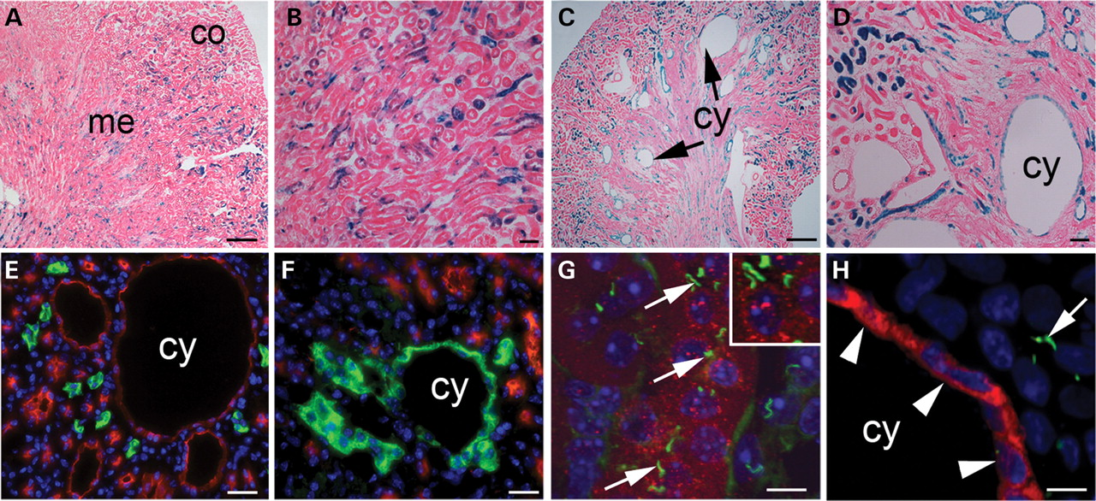
Figure 2. Kidney-specific inactivation of Kif3a at P2 results in the loss of primary cilia and produces kidney cysts. ...
Notes:
Figure 2. Kidney-specific inactivation of Kif3a at P2 results in the loss of primary cilia and produces kidney cysts. Conditional Kif3a mutant mice (Ksp/CreERT2;Kif3aflox/−;R26R) and littermate controls (Ksp/CreERT2;Kif3aflox/+;R26R and Ksp/CreERT2;Kif3a+/−;R26R) were treated with tamoxifen from P2 to P4 and analyzed 4 weeks later. Kidney sections were stained with X-gal to identify lacZ-positive cells in which Cre/loxP recombination had been induced with tamoxifen. (A) Kidneys from tamoxifen-treated control mice showed normal histology of the renal cortex (co) and medulla (me). (B) A higher magnification image shows mosaic expression of lacZ in the renal tubules. (C) Conditional Kif3a mutant mice treated with tamoxifen developed kidney cysts (cy) near the cortico-medullary junction. (D) The kidney cysts were lined with lacZ-positive epithelial cells. (E and F) To identify the origins of the cysts, kidney sections were stained with markers of specific nephron segments. Staining with DBA (green) and anti-NKCC2 Ab (red) revealed that the cysts originated from the loops of Henle (E) and the collecting ducts (F). (G and H) Primary cilia were identified by staining with an Ab against acetylated tubulin (green), and lacZ-positive cells were identified by costaining with an Ab against β-galactosidase (red). (G) In control kidneys, primary cilia (arrows) were present on the luminal surface of lacZ-positive tubular epithelial cells. Inset shows higher magnification image of the primary cilia. (H) In the Kif3a mutant kidneys, cilia were absent from the apical surface (arrowheads) of lacZ-positive cyst epithelial cells. Arrows indicate cilia that were present in adjacent lacZ-negative, non-cystic tubules. Nuclei were counterstained with DAPI. Scale bars: 200 µm (A and C), 50 µm (B and D), 20 µm (E and F), 10 µm (H and I).
Unless provided in the caption above, the following copyright applies to the content of this slide: © The Author 2008. Published by Oxford University Press. All rights reserved. For Permissions, please email: journals.permissions@oxfordjournals.org

Slide 3
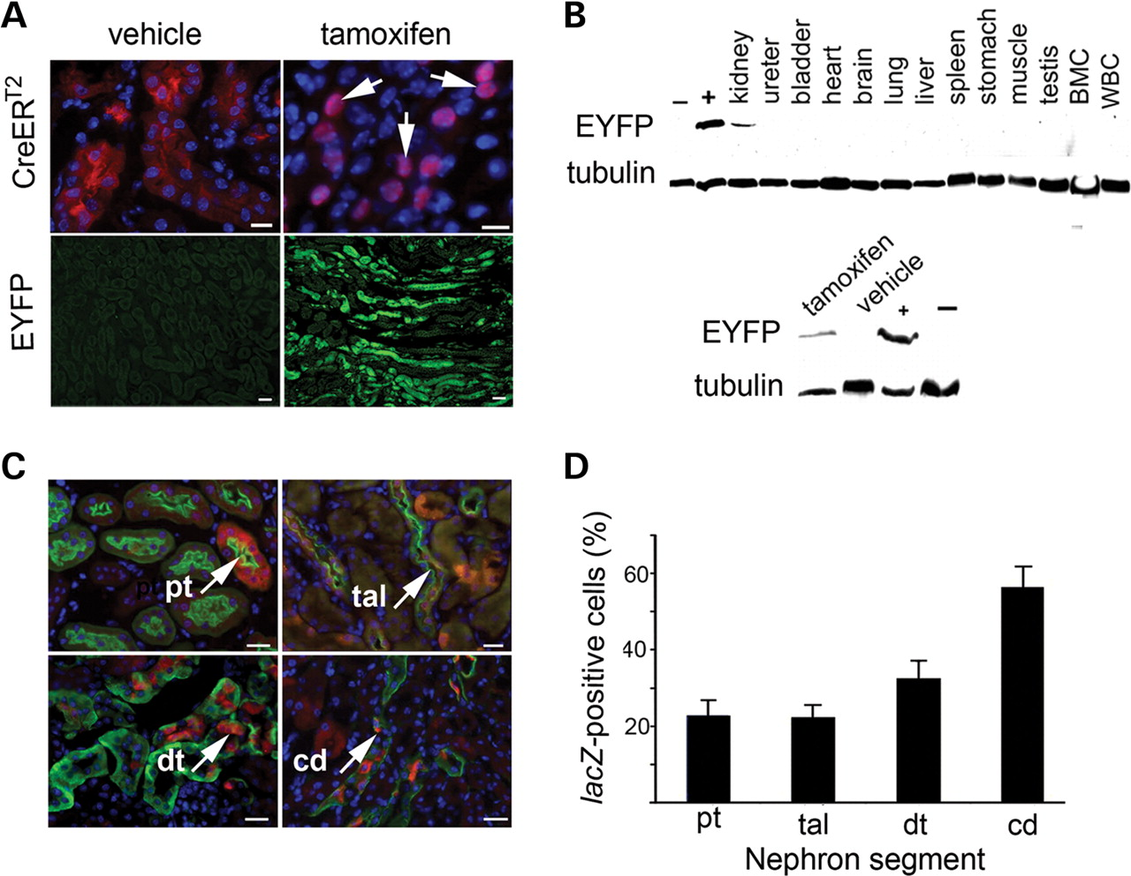
Figure 1. Characterization of Ksp/CreER^{T2} transgenic mice. Transgenic mice expressing tamoxifen-inducible ...
Notes:
Figure 1. Characterization of Ksp/CreERT2 transgenic mice. Transgenic mice expressing tamoxifen-inducible Cre recombinase (CreERT2) under the control of the Ksp-cadherin promoter (Ksp) were generated. (A) Ksp/CreERT2 mice were crossed with R26R-EYFP reporter mice, and the bitransgenic progeny were administered tamoxifen (right) or vehicle (left). Staining of kidney sections with an Ab against the human estrogen receptor (red) showed nuclear translocation of the CreERT2 fusion protein (arrows) following administration of tamoxifen. Nuclei were counterstained with DAPI. Staining with an Ab against GFP that cross-reacted with EYFP (green) showed that the reporter gene was activated by Cre/loxP recombination only in tamoxifen-treated animals. Scale bars: 20 µm. (B) Immunoblot analysis of tissues from tamoxifen-treated Ksp/CreERT2;R26R-EYFP mice revealed expression of EYFP only in the kidney, indicating that Cre/loxP recombination was tissue-specific (upper panel). Immunoblot analysis of kidneys from Ksp/CreERT2;R26R-EYFP mice that were treated with tamoxifen or vehicle revealed that Cre/loxP recombination was tamoxifen-dependent (lower panel). Ksp/Cre;R26R-EYFP mouse kidneys were used as positive controls (+), and Ksp/Cre mouse kidneys were used as negative controls (−). Immunoblotting with anti-tubulin Ab was used as a loading control. (C) To identify the nephron segments in which Cre/loxP recombination was induced, Ksp/CreERT2;R26R mice were injected with tamoxifen and the kidneys were co-stained with an Ab against β-galactosidase (red) and markers of specific nephron segments (green). Staining with LTA, anti-NKCC2, anti-NCX1 and anti-AQP3 revealed that lacZ was expressed in proximal tubules (pt), thick ascending limbs of loops of Henle (tal), distal convoluted tubule (dt), and collecting duct (cd), respectively. Arrows indicate co-localization. Scale bars: 20 µm. (D) Efficiency of tamoxifen-inducible Cre/loxP recombination in different nephron segments. Adult Ksp/CreERT2;R26R mice (n = 3) were treated with tamoxifen for 5 days, and 2 weeks later the kidneys were removed and co-stained with an Ab to β-galactosidase and markers of specific nephron segments. Histogram shows the percentage of lacZ-positive cells in the proximal tubules (pt), thick ascending limbs of loops of Henle (tal), distal convoluted tubule (dt) and collecting ducts (cd). Error bars indicate SD.
Unless provided in the caption above, the following copyright applies to the content of this slide: © The Author 2008. Published by Oxford University Press. All rights reserved. For Permissions, please email: journals.permissions@oxfordjournals.org

Slide 4
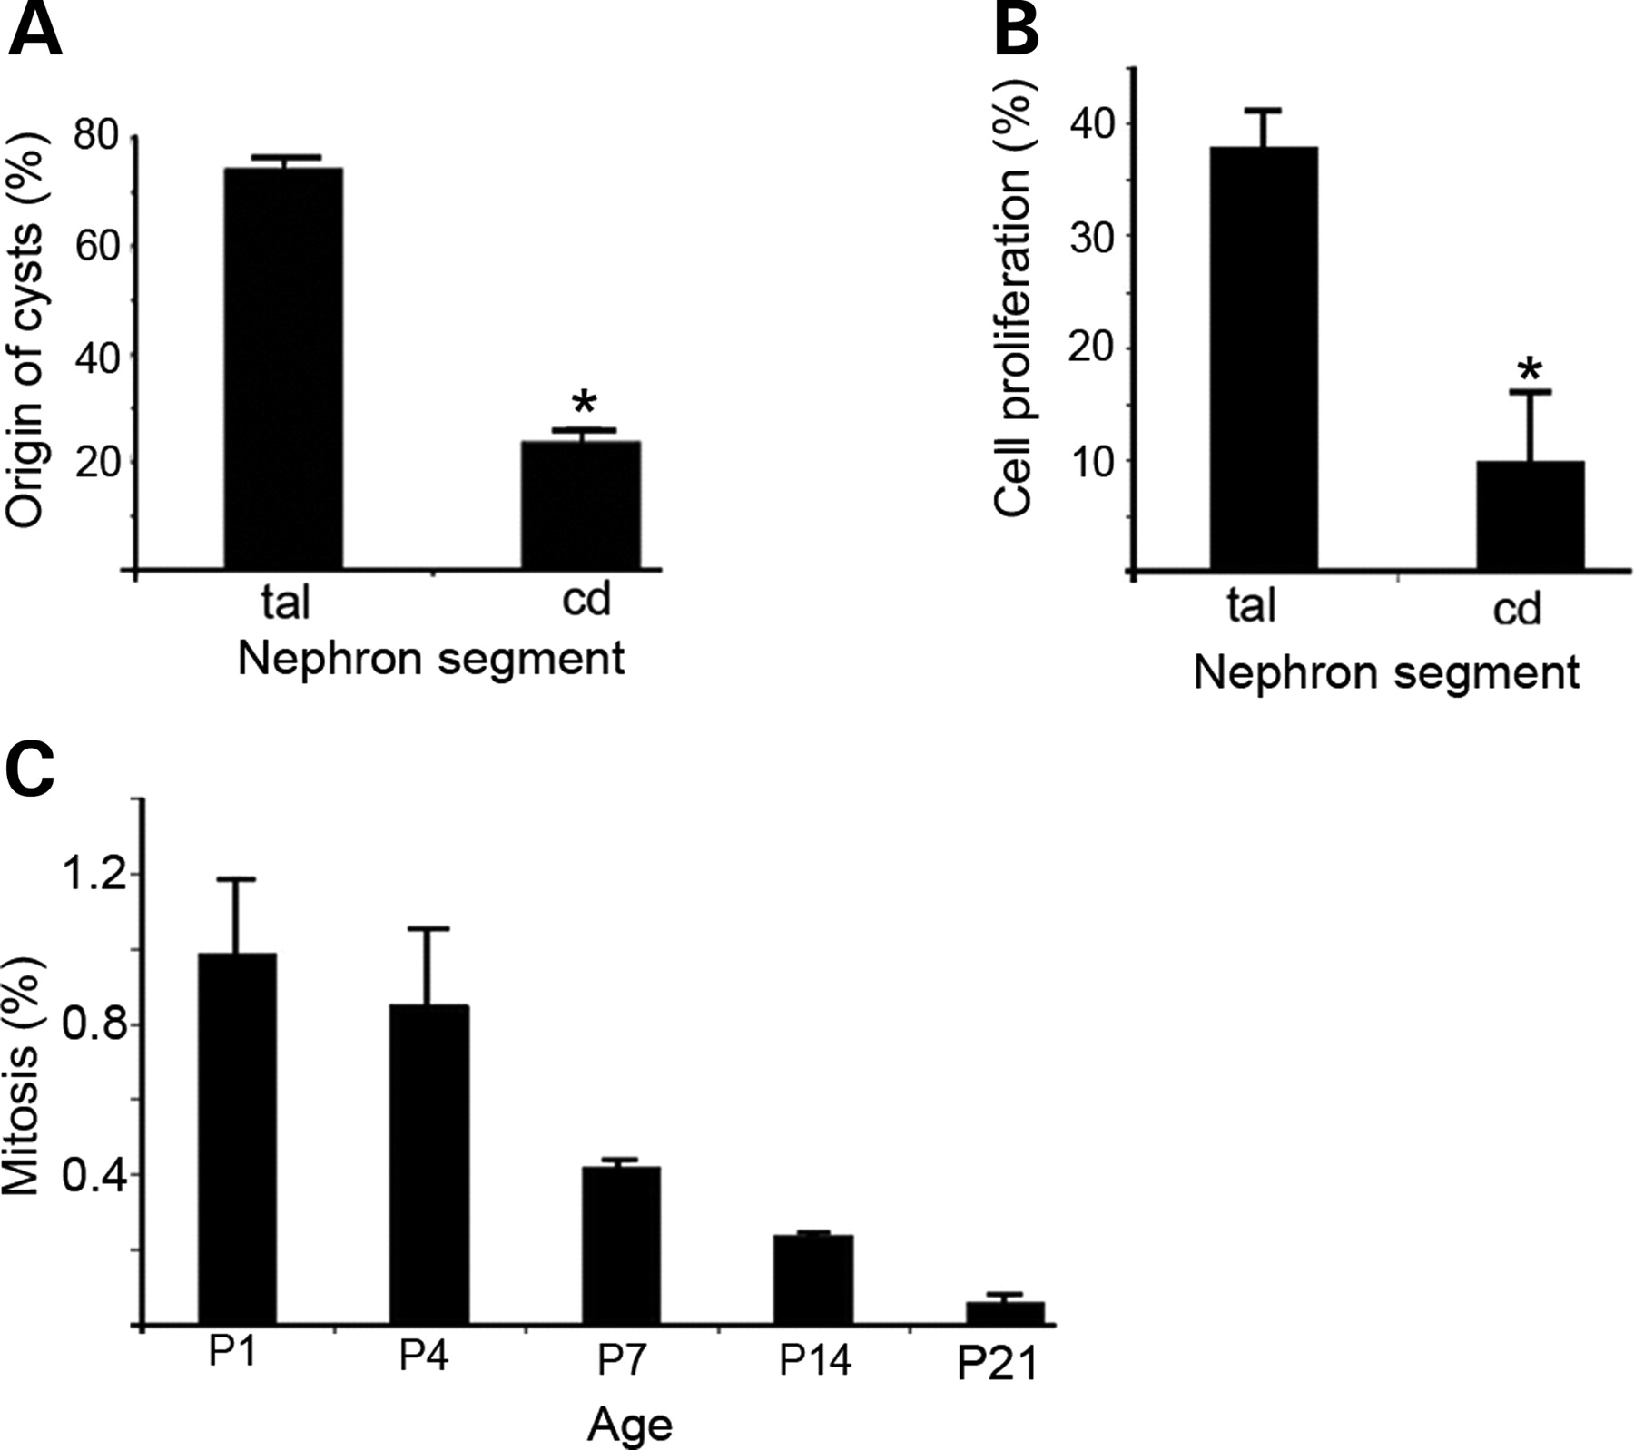
Figure 3. Postnatal cyst formation in Kif3a mutant mice correlates with cell proliferation. (A) Origins of kidney cysts ...
Notes:
Figure 3. Postnatal cyst formation in Kif3a mutant mice correlates with cell proliferation. (A) Origins of kidney cysts in conditional Kif3a mutant mice. Newborn mice were treated with tamoxifen from P2 to P4, and 4 weeks later the kidneys were sectioned and stained with DBA and anti-NKCC2 Ab. Histogram shows the percentage of cysts originating from the collecting ducts (cd) and loops of Henle (tal). Error bars indicate SD. *Significantly different from tal (P < 0.0001, Student's t-test, n = 3). (B) Cell proliferation in the newborn mouse kidney. Wild-type pups (n = 3) were sacrificed at P4, and kidney sections were stained with anti-Ki-67 Ab to label proliferating cells. Histogram shows the percentage of Ki-67-positive cells in the thick ascending limbs of loops of Henle (tal) and collecting ducts (cd). Error bars indicate SD. *Significantly different from tal (P = 0.0002, Student's t-test). (C) Decline in cell proliferation during postnatal kidney development. Wild-type mice (n = 2–5 at each time point) were sacrificed at various ages, and kidney sections were stained with an anti- phosphohistone H3 Ab (H3pS10) to identify cells in mitosis. Histogram shows the percentage of H3pS10-positive cells from P1 to P21. Error bars indicate SD.
Unless provided in the caption above, the following copyright applies to the content of this slide: © The Author 2008. Published by Oxford University Press. All rights reserved. For Permissions, please email: journals.permissions@oxfordjournals.org

Slide 5
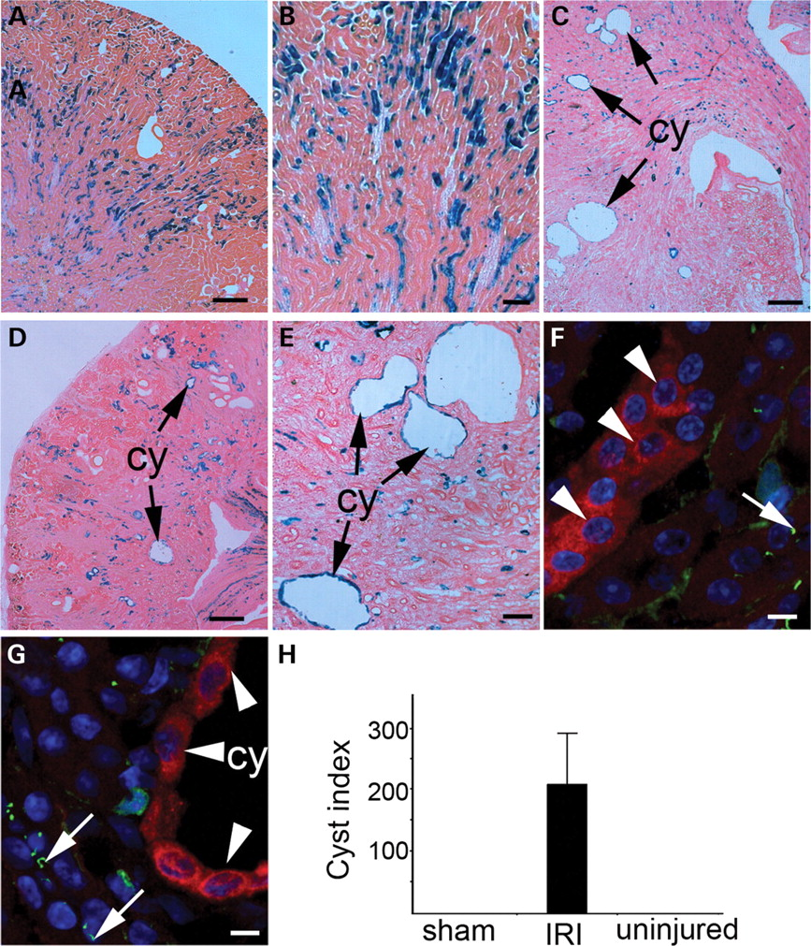
Figure 5. Acute kidney injury stimulates cyst formation in adult Kif3a mutant mice. Conditional Kif3a mutant mice were ...
Notes:
Figure 5. Acute kidney injury stimulates cyst formation in adult Kif3a mutant mice. Conditional Kif3a mutant mice were administered tamoxifen at P35 and subjected to unilateral renal IRI. Kidneys were analyzed 2.5 weeks later. (A and B) X-gal staining of the uninjured kidney revealed normal histology. Higher magnification images showed that lacZ-positive cells were present in non-cystic tubules (B). (C–E) The injured kidney contained multiple cysts (cy) that were lined by lacZ-positive epithelial cells. (F and G) Co-staining with Abs against acetylated tubulin (green) and β-galactosidase (red) revealed that cilia were absent (arrowheads) in lacZ-positive cells composing the non-cystic tubules in the uninjured kidney (F) as well as the cyst epithelium in the injured kidney (G). Cilia were present in lacZ-negative tubules (arrows). Scale bars: 200 µm (A, C, D), 20 µm (B and E), 10 µm (F and G). (H) Histogram showing the cyst index in conditional Kif3a mutant mice treated with tamoxifen at P35 and subjected to unilateral renal IRI or sham surgery.
Unless provided in the caption above, the following copyright applies to the content of this slide: © The Author 2008. Published by Oxford University Press. All rights reserved. For Permissions, please email: journals.permissions@oxfordjournals.org

Slide 6
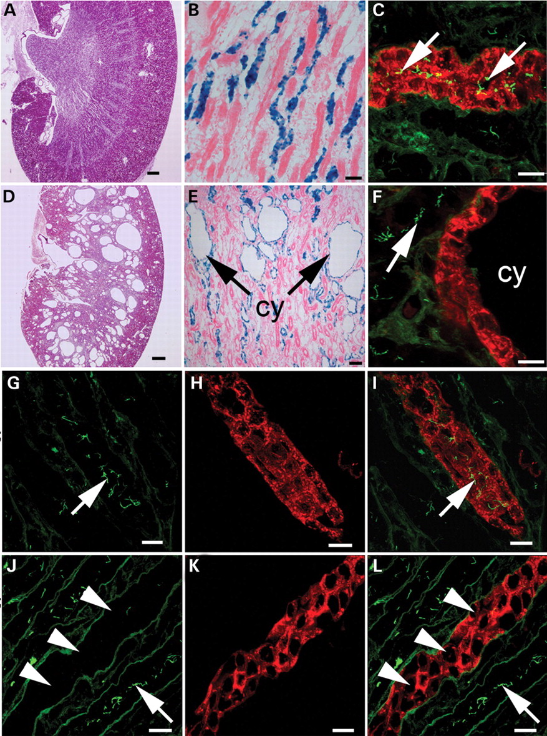
Figure 6. Loss of cilia precedes cyst formation in kidney-specific Kif3a mutant mice. To study the mechanism of cyst ...
Notes:
Figure 6. Loss of cilia precedes cyst formation in kidney-specific Kif3a mutant mice. To study the mechanism of cyst formation following the loss of cilia, Pkhd1/Cre;Kif3aflox/−;R26R mice were generated. (A) H&E staining of the kidneys from 21-day-old control littermates (Pkhd1/Cre;Kif3a+/−;R26R) revealed normal histology, whereas Pkhd1/Cre;Kif3aflox/− mice contained numerous cysts, primarily in the renal medulla (D). (B) X-gal staining revealed that lacZ was expressed in collecting ducts in control kidneys. (E) In the Pkhd1/Cre;Kif3aflox/− kidneys, the cysts (cy) were lined by lacZ-positive cells that had undergone Cre/loxP recombination. (C) Co-staining with DBA (red) and an Ab against acetylated tubulin (green) revealed that cilia (arrows) were present in the collecting ducts of control kidneys. (F) In the Pkhd1/Cre;Kif3aflox/− kidneys, the cysts (cy) stained with DBA, which indicated that they originated from the collecting ducts, but did not contain cilia. To determine whether the loss of cilia preceded cyst formation, kidneys from Pkhd1/Cre;Kif3aflox/− mice were examined at P7-10 prior to the onset of cyst formation. (G–I) Staining of kidneys with DBA (red) and Ab against acetylated tubulin (green) showed that cilia were present in the collecting ducts of control mice but were absent in the pre-cystic collecting ducts of Pkhd1/Cre;Kif3aflox/− mice (J–L). Scale bars: 100 µm (A and D), 50 µm (B and E), 10 µm (C, F, G–L).
Unless provided in the caption above, the following copyright applies to the content of this slide: © The Author 2008. Published by Oxford University Press. All rights reserved. For Permissions, please email: journals.permissions@oxfordjournals.org

Slide 7
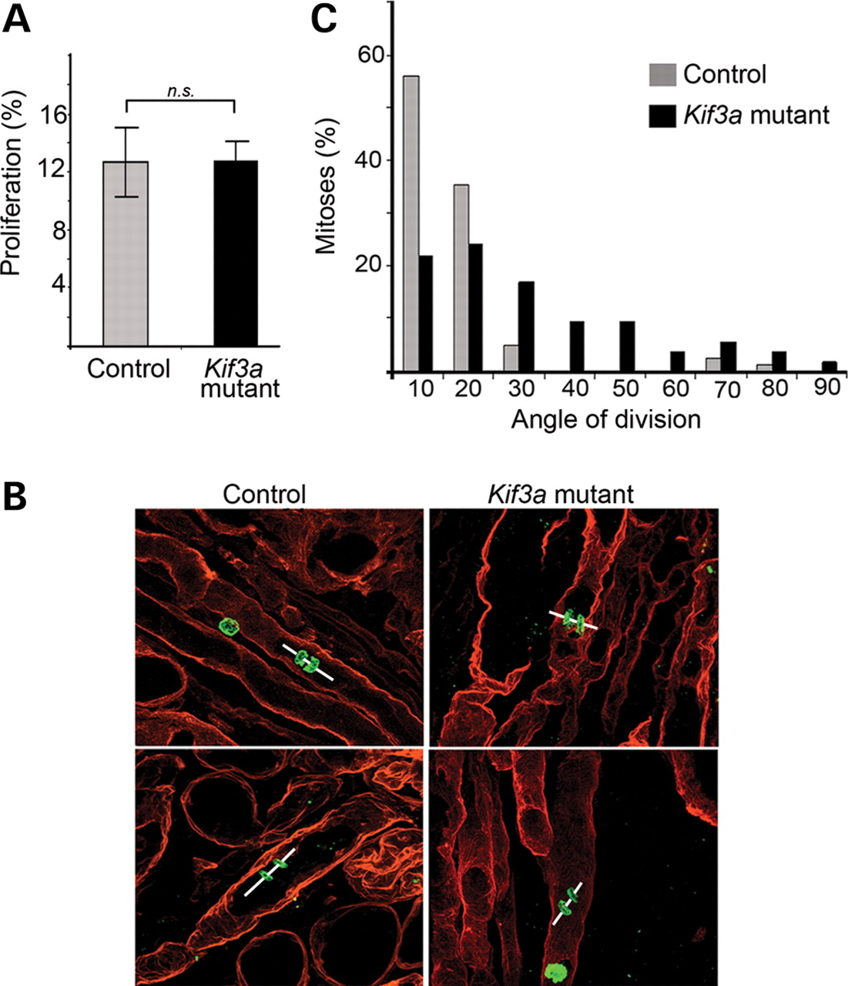
Figure 7. Loss of renal cilia does not stimulate cell proliferation but produces aberrant planar cell polarity. (A) ...
Notes:
Figure 7. Loss of renal cilia does not stimulate cell proliferation but produces aberrant planar cell polarity. (A) Quantification of Ki-67 positive cells in lacZ-positive renal tubules in control mice (shaded bars) and Pkhd1/Cre;Kif3aflox/− mice (solid bars) at P7–P10 revealed no significant differences in the rates of cell proliferation. NS, not significant (P = 0.92, Student's t-test, n = 3). Error bars indicate SD. (B) To determine whether the loss of cilia produced aberrant planar cell polarity, the orientation of cell division was measured in Pkhd1/Cre;Kif3aflox/− mice at P7–P10 prior to cyst formation. Representative images of kidneys stained with Abs against phosphohistone H3 (green) and entactin (red) showed that the orientation of cell division (lines) was parallel to the longitudinal axis of the tubule in collecting ducts from control mice (left) but not in the Pkhd1/Cre;Kif3aflox/− mice (right). (C) Histogram showing the distribution of mitotic spindle orientations in control mice (shaded bars) and Pkhd1/Cre;Kif3aflox/− mice (solid bars). The orientation of cell division was significantly more randomized in the Pkhd1/Cre;Kif3aflox/− mice (P = 0.0004, Mann–Whitney U test, n = 82).
Unless provided in the caption above, the following copyright applies to the content of this slide: © The Author 2008. Published by Oxford University Press. All rights reserved. For Permissions, please email: journals.permissions@oxfordjournals.org

