Slide 1
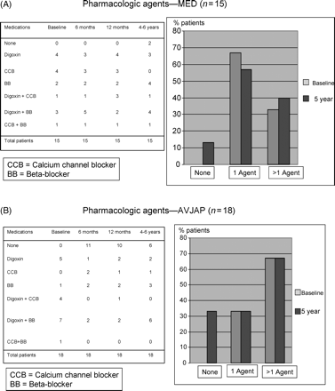
Figure 1 Pharmacologic therapy in MED and AVJAP patients.
Notes:
Figure 1 Pharmacologic therapy in MED and AVJAP patients.
Unless provided in the caption above, the following copyright applies to the content of this slide: © The European Society of Cardiology 2007. All rights reserved. For Permissions, please e-mail: journals.permissions@oxfordjournals.org

Slide 2
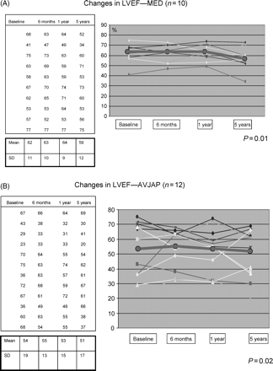
Figure 2 Changes in left ventricular ejection fraction (LVEF) in MED and AVJAP patients.
Notes:
Figure 2 Changes in left ventricular ejection fraction (LVEF) in MED and AVJAP patients.
Unless provided in the caption above, the following copyright applies to the content of this slide: © The European Society of Cardiology 2007. All rights reserved. For Permissions, please e-mail: journals.permissions@oxfordjournals.org

Slide 3
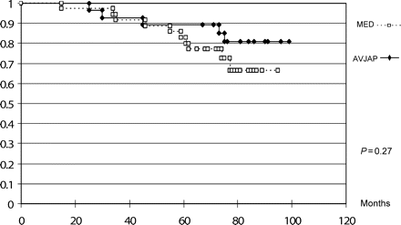
Figure 3 Kaplan-Meier survival analysis.
Notes:
Figure 3 Kaplan-Meier survival analysis.
Unless provided in the caption above, the following copyright applies to the content of this slide: © The European Society of Cardiology 2007. All rights reserved. For Permissions, please e-mail: journals.permissions@oxfordjournals.org

