Slide 1
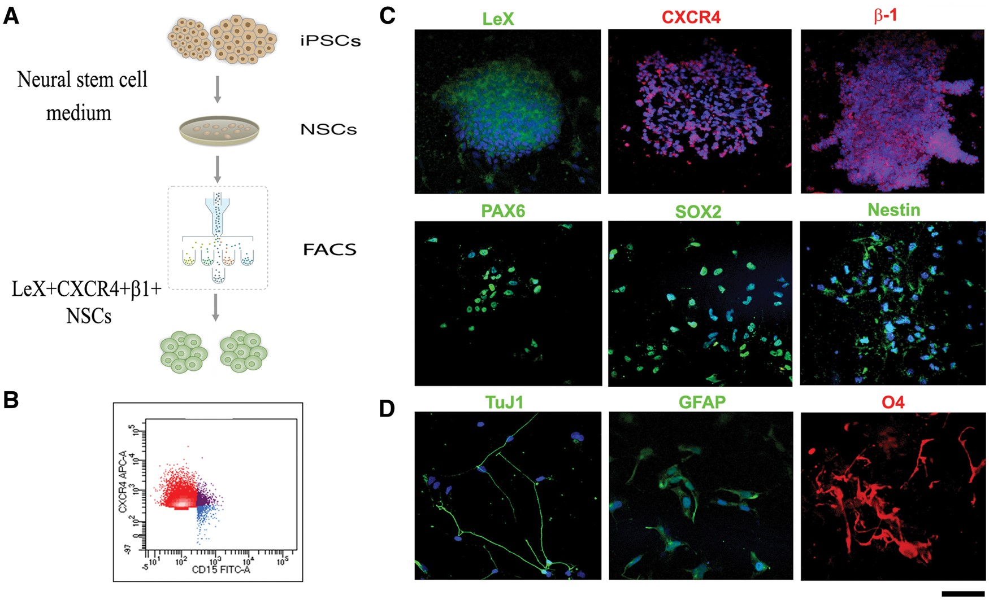
Figure 1. Differentiation of iPSCs into neuroectodermal lineage and isolation of the LeX + CXCR4+β1+ subpopulation. (A) ...
Notes:
Figure 1. Differentiation of iPSCs into neuroectodermal lineage and isolation of the LeX + CXCR4+β1+ subpopulation. (A) Illustration of the differentiation method of iPSCs into neuroepithelium and selection of a specific NSC subset. After plate detachment, the iPSCs generated cell clusters that were maintained for 1 week in neural medium. The cells differentiated into neuroepithelial (NE) rosettes expressing PAX6. NSCs were afterward isolated by FACS for their LeX-CXCR4-β1 positivity and expanded in vitro. (B) Representative flow cytometric data analysis of LeX-CXCR4−β1 expression on NSCs. (C) iPSC–NSC selected cells in culture express LeX (green), CXCR4 (red), β1 (red) and neuroectodermal markers PAX6 (green), SOX2 (green) and nestin (green). Scale bar: LeX: 100 µm; CXCR4: 70 µm; β1: 75 µm; PAX6: 65 µm; SOX2: 50 µm; Nestin: 70 µm (D) After in vitro differentiation, LeX+CXCR4+ β1+ cells differentiated into neurons (TuJ1, green), GFAP-positive astrocytes (green) and O4-positive oligodendrocytes (red). Nuclei are counterstained with DAPI (blue signal, except for O4). Scale bar: 50 µm.
Unless provided in the caption above, the following copyright applies to the content of this slide: © The Author 2016. Published by Oxford University Press. All rights reserved. For permissions, please e-mail: journals.permissions@oup.com

