Slide 1
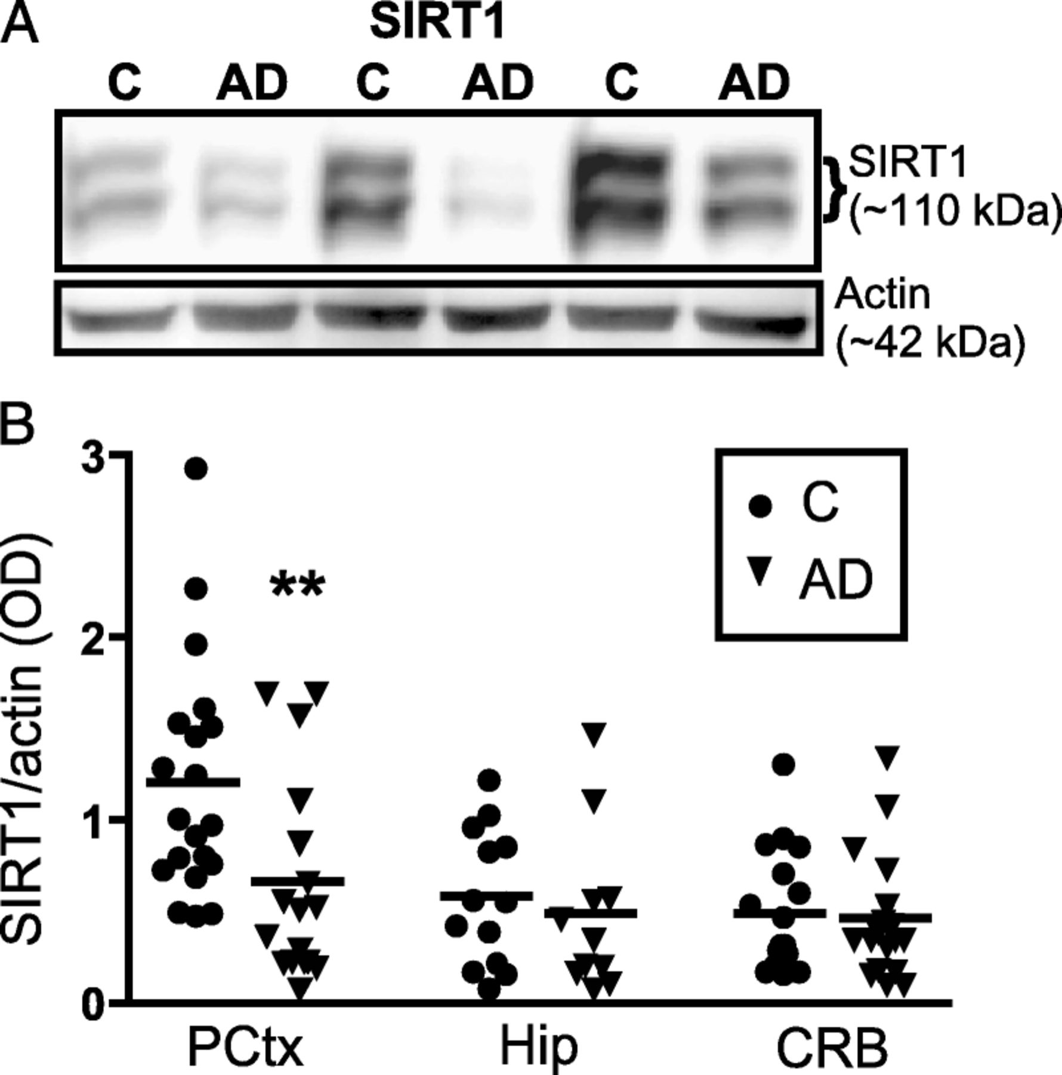
FIGURE 1. Lower sirtuin 1 (SIRT1) protein concentration in the cerebral cortex of patients with advanced Alzheimer ...
Notes:
FIGURE 1. Lower sirtuin 1 (SIRT1) protein concentration in the cerebral cortex of patients with advanced Alzheimer disease (AD). (A) Representative immunoblots from homogenates of the parietal cortex of control subjects and AD patients. (B) Sirtuin 1 concentrations normalized to actin in homogenates from the parietal cortex, the hippocampus and the cerebellum from control subjects (Consortium to Establish a Registry for AD [CERAD] 3-4) and persons diagnosed with AD (CERAD 1-2) based on CERAD neuropathology stages. Values are expressed as SIRT1/actin ratios based on relative optical densities (each point represents an individual and the horizontal bar is the average). **p < 0.01 versus control subjects. C, controls; CRB, cerebellum; Hip, hippocampus; kd, kilodaltons; OD, relative optical density; PCtx, parietal cortex.
Unless provided in the caption above, the following copyright applies to the content of this slide: Copyright © 2009 by the American Association of Neuropathologists, Inc.

Slide 2
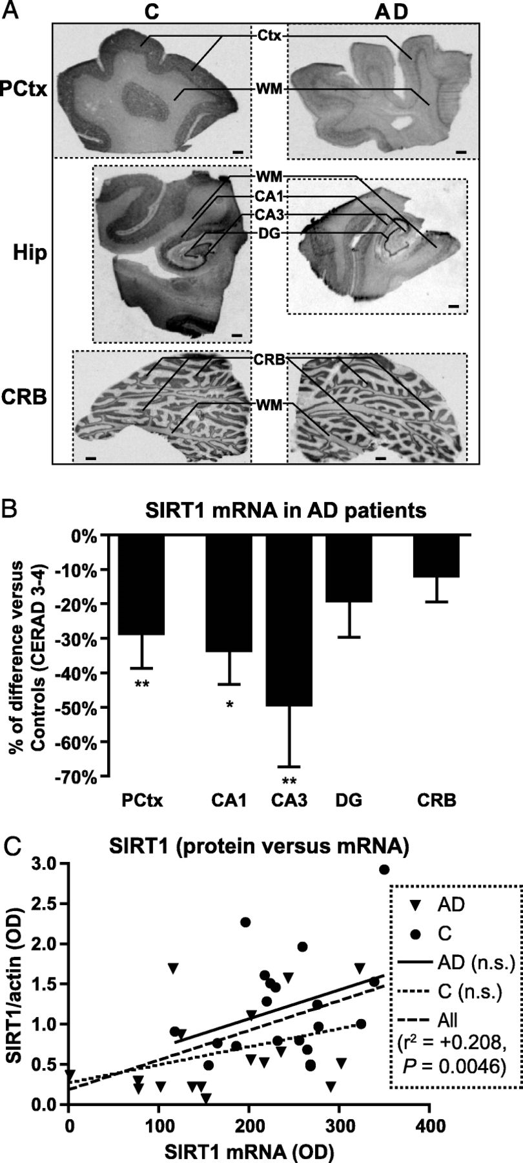
FIGURE 2. Lower sirtuin 1 (SIRT1) messenger RNA (mRNA) levels in the brain cortex and hippocampus of patients with ...
Notes:
FIGURE 2. Lower sirtuin 1 (SIRT1) messenger RNA (mRNA) levels in the brain cortex and hippocampus of patients with advanced Alzheimer disease (AD). (A) Representative autoradiograms of parietal cortex (PCtx), hippocampus (Hip), and cerebellum (CRB) showing hybridization of [33P]-labeled probes to SIRT1 mRNA in a control (C) and an AD patient (Scale bar = 2 mm). (B) Quantification of SIRT1 mRNA expression in the PCtx, CA1, CA3, and dentate gyrus (DG) region of the Hip and in the CRB. (C) Correlation between SIRT1 mRNA content and SIRT1 protein levels. Values are expressed as percentage (mean ± SEM) of relative optical density (OD) compared with Consortium to Establish a Registry for AD (CERAD) 3 to 4 controls. Diagnoses were based on CERAD criteria (controls, CERAD 3-4; AD patients, CERAD 1-2). *p < 0.05, **p < 0.01 versus control levels. CA1 and CA3, CA1 and CA3 areas of the hippocampus; n.s., not significant; WM, white matter.
Unless provided in the caption above, the following copyright applies to the content of this slide: Copyright © 2009 by the American Association of Neuropathologists, Inc.

Slide 3
FIGURE 3. Relationship between postmortem cortical sirtuin 1 (SIRT1) concentration, neuropathologic diagnoses, clinical ...
Notes:
FIGURE 3. Relationship between postmortem cortical sirtuin 1 (SIRT1) concentration, neuropathologic diagnoses, clinical diagnosis, and global cognition score. Severe Alzheimer disease (AD) neuropathology as assessed by (A) Consortium to Establish a Registry for AD (CERAD), (B) Braak, and (C) National Institute on Aging-Reagan criteria was associated with lower SIRT1 protein levels. (D) Cortical SIRT1 content was not significantly different among individuals with no cognitive impairment (NCI), mild cognitive impairment (MCI), or AD, based on the clinical evaluation (Welch analysis of variance). (E) There is a significant relationship between SIRT1 and the antemortem global cognition score. Values are expressed as SIRT1/actin ratios based on relative optical densities (each point represents an individual; horizontal bars indicate averages).
Unless provided in the caption above, the following copyright applies to the content of this slide: Copyright © 2009 by the American Association of Neuropathologists, Inc.

Slide 4
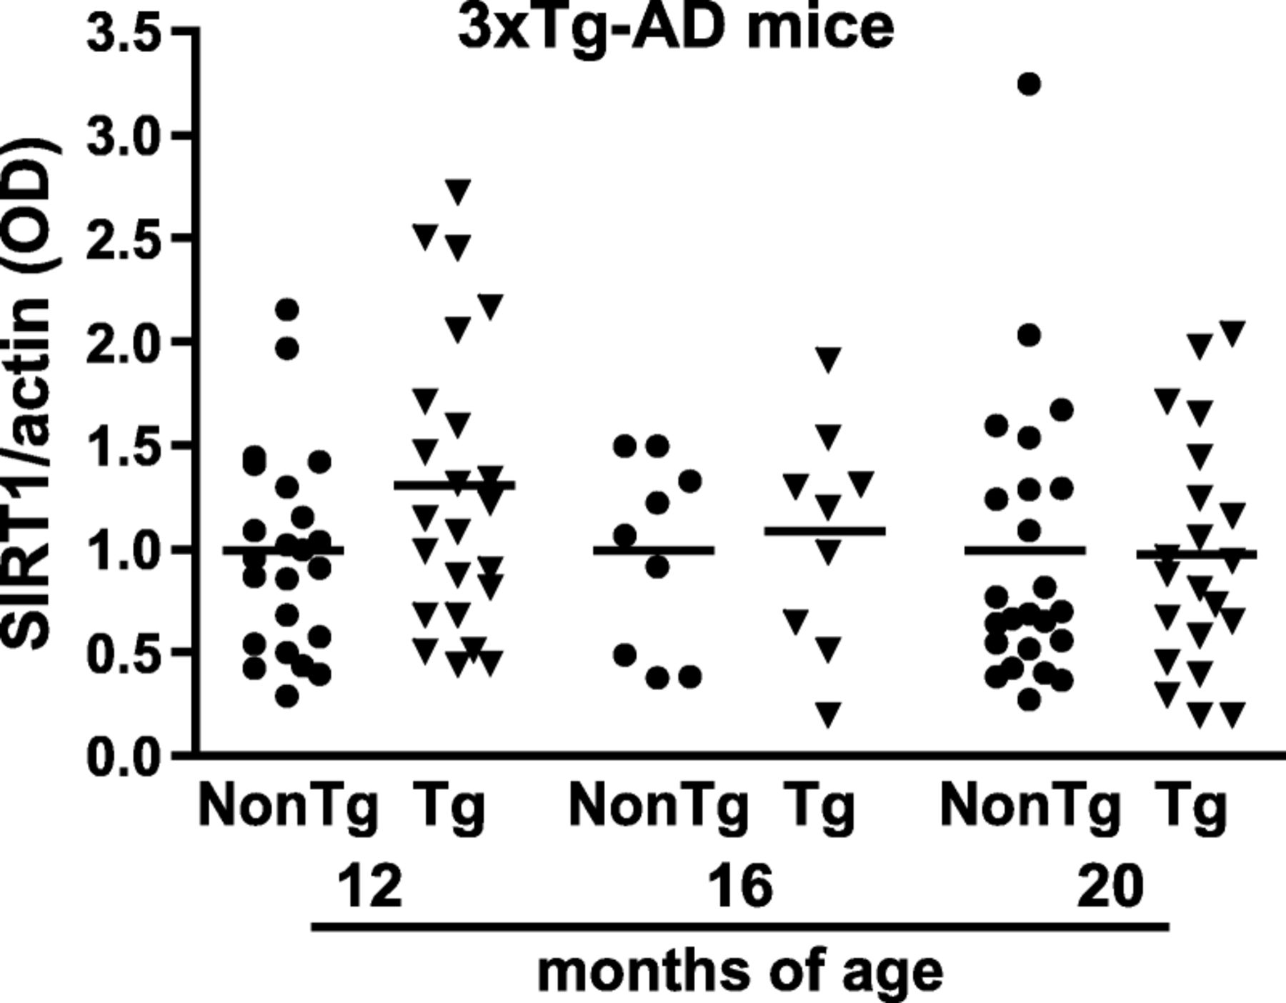
FIGURE 4. Sirtuin 1 (SIRT1) protein levels are constant in 12-, 16-, and 20 month-old triple transgenic model of AD ...
Notes:
FIGURE 4. Sirtuin 1 (SIRT1) protein levels are constant in 12-, 16-, and 20 month-old triple transgenic model of AD (3×Tg-AD or Tg) and control nontransgenic littermate (NonTg) mice. Values are expressed as SIRT1/actin ratios based on relative optical densities ([ODs] each point represents a single mouse; horizontal bars indicate averages).
Unless provided in the caption above, the following copyright applies to the content of this slide: Copyright © 2009 by the American Association of Neuropathologists, Inc.

