Slide 1
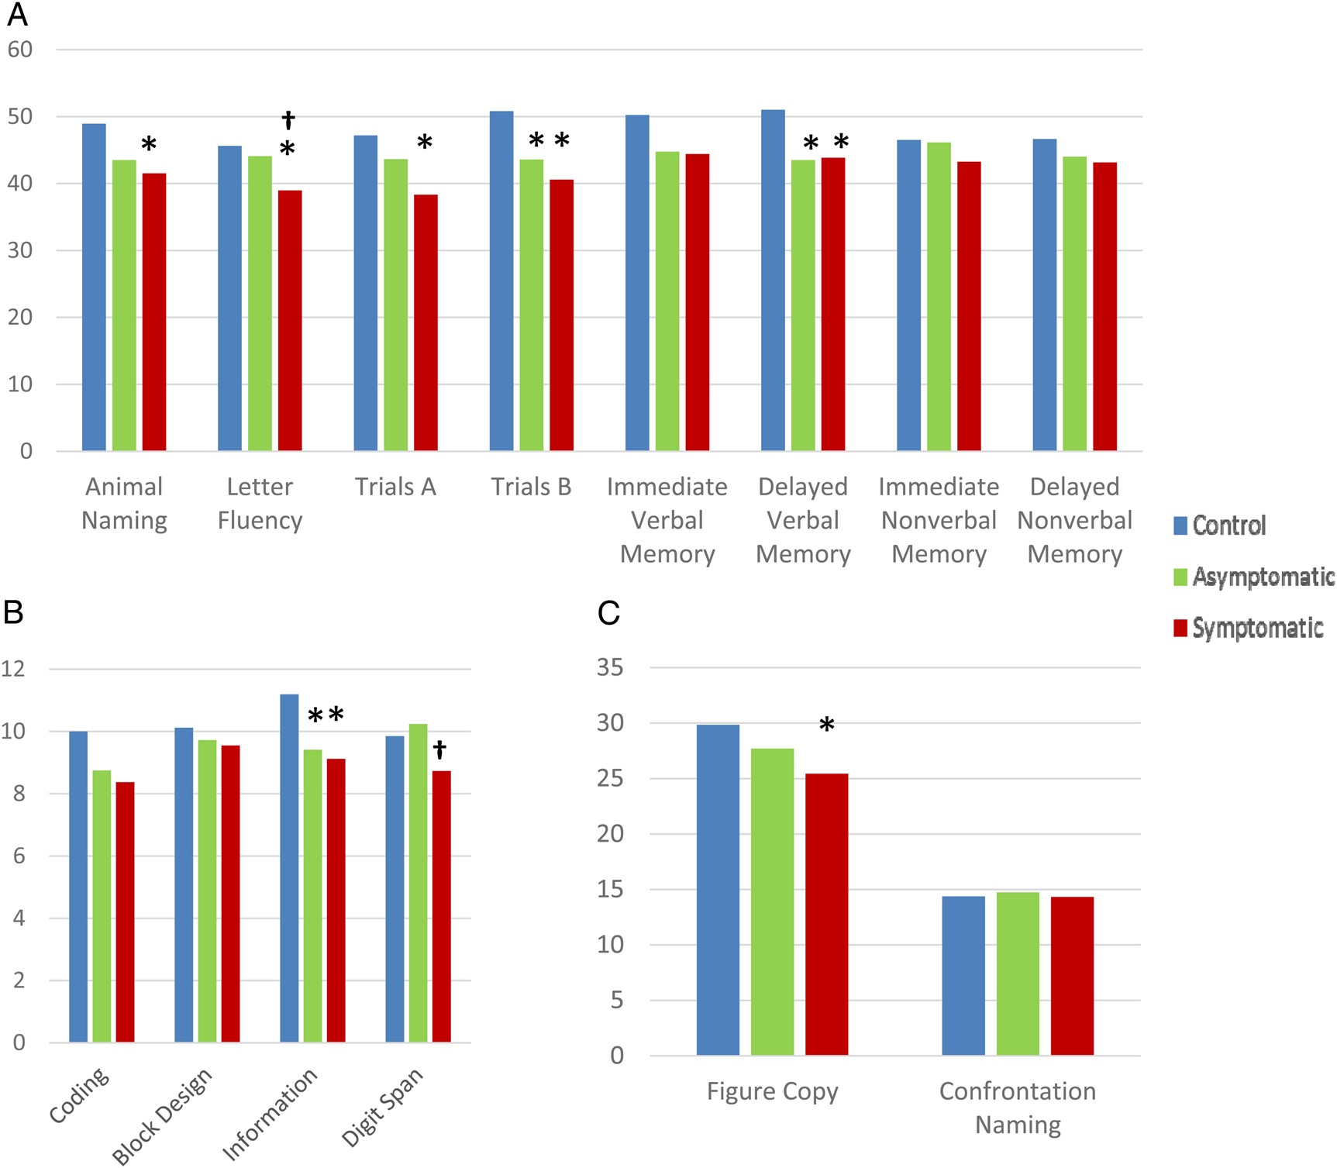
Fig. 1. Patient and control performance by test. Existing norms have been used when possible to produce T-scores (A) ...
Notes:
Fig. 1. Patient and control performance by test. Existing norms have been used when possible to produce T-scores (A) or Scaled Scores (B). (C) Results for non-normed tests. All analyses controlled for age, sex, and level of education. *Differs from controls (p ≤ .05). †Differs from asymptomatic patients (p ≤ .05).
Unless provided in the caption above, the following copyright applies to the content of this slide: © The Author 2015. Published by Oxford University Press. All rights reserved. For permissions, please e-mail: journals.permissions@oup.com.

