Slide 1
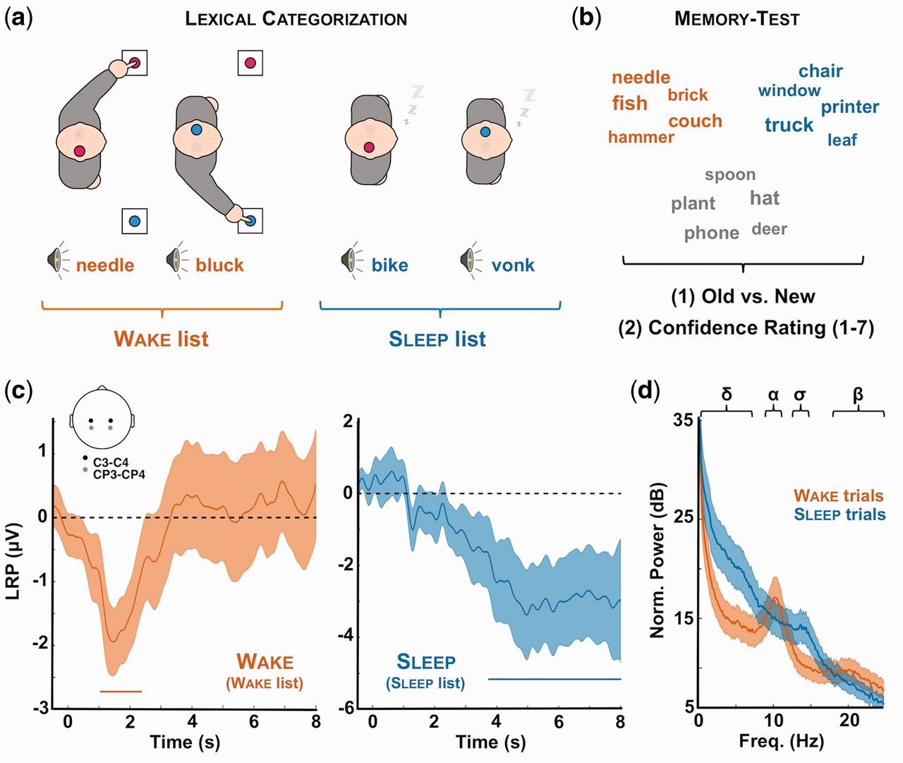
Figure 1. Experimental procedure and evidences for complex information processing during sleep. (a) Lexical ...
Notes:
Figure 1. Experimental procedure and evidences for complex information processing during sleep. (a) Lexical categorization task: participants (N = 22) were asked to classify spoken words and pseudo-words while falling asleep (daytime nap). Each category (word or pseudo-word) was associated with a response side (left or right). Once asleep (see “Methods” section for criterion) and unknown to participants, novel words and pseudo-words were presented to participants (sleep list). Importantly, the initial set of stimuli (wake list) was played again to participants whenever they awoke in order to present the elements of the sleep list during sleep only. (b) Memory test: upon awakening, participants (N = 17) underwent a memory test during which the words presented during the nap session (red: wake list; blue: sleep list) were played along new words (gray: new list). For each word, participants were asked to indicate whether they remembered hearing the word during the nap session (old vs. new recognition test). They were then instructed to estimate their confidence in their old vs. new response using a scale from 1 (not sure at all) to 7 (absolutely sure). (c) LRPs: during the nap session, we computed LRPs during wake (red, left) and sleep (blue, right) to determine whether participants performed the lexical categorization task even when unresponsive. The LRP was computed over right and left central electrodes (see inset and “Methods” section) and averaged across participants. Shaded areas denote the standard error of the mean across participants (N = 18). Horizontal bars show the significant clusters (pcluster < 0.05). The LRP determines whether neural activity is lateralized in respect to the expected side of response. A LRP was preserved in sleep, albeit delayed compared to wakefulness. (d) Average power spectra for wake (red) and sleep (blue) trials. Power spectra were computed on C3/C4 referenced to the mastoids with a FFT and averaged across subjects. Note the replacement of wake-related rhythms (α: 8–11 Hz; β: 20–30 Hz) by sleep-related oscillations (∂: 0.1–4 Hz; σ: 11–16 Hz). Shaded areas denote the standard error of the mean across participants (N = 18).
Unless provided in the caption above, the following copyright applies to the content of this slide: © The Author 2016. Published by Oxford University Press.This is an Open Access article distributed under the terms of the Creative Commons Attribution Non-Commercial License (http://creativecommons.org/licenses/by-nc/4.0/), which permits non-commercial re-use, distribution, and reproduction in any medium, provided the original work is properly cited. For commercial re-use, please contact journals.permissions@oup.com

Slide 2
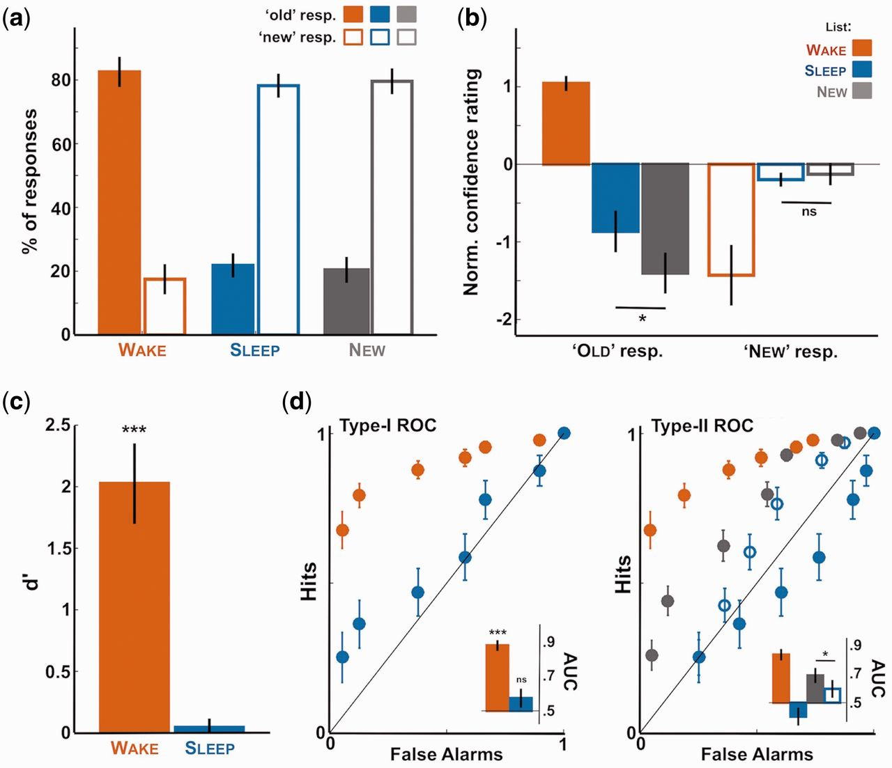
Figure 2. First- and second-order responses in the memory test. Behavioral results for the memory test. (a) Proportion ...
Notes:
Figure 2. First- and second-order responses in the memory test. Behavioral results for the memory test. (a) Proportion of “old” and “new” responses for the wake (red), sleep (blue), and new (gray) lists (first-order responses). Proportions are averaged across participants (N = 17) after excluding items heard around arousals or micro-arousals for the sleep list. Note that participants responded to sleep items as if they were new. (b) Confidence rating associated with the old and new responses for the wake, sleep, and new lists (second-order responses averaged across participants). Ratings were normalized by subtracting for each participant the average confidence rating. Note the increase in confidence for sleep items in comparison to new items when participants categorized them as old. (c) Sensitivity index d’ averaged across participants for the old vs. new discrimination and computed for the wake and sleep lists separately. As in panel a, the null d’ reveals participants’ failure to distinguish sleep and new items in their first-order responses. (d) Type-I and type-II ROC curves computed for the first order (old vs. new, left) or second order (confidence rating, right) responses. Inset shows the AUC computed for the different ROC curves and averaged across participants (0.5: area under the bisector line). In all subpanels, error-bars denote the standard error of the mean across participant. Stars atop bars denote the significance levels when comparing with 0 [t-test (u-tests for AUC values) across participants; ***P < 0.005, **P < 0.01, *P 0.05]. Stars between bars show the paired comparison between bars (paired t-tests or u-tests).
Unless provided in the caption above, the following copyright applies to the content of this slide: © The Author 2016. Published by Oxford University Press.This is an Open Access article distributed under the terms of the Creative Commons Attribution Non-Commercial License (http://creativecommons.org/licenses/by-nc/4.0/), which permits non-commercial re-use, distribution, and reproduction in any medium, provided the original work is properly cited. For commercial re-use, please contact journals.permissions@oup.com

Slide 3
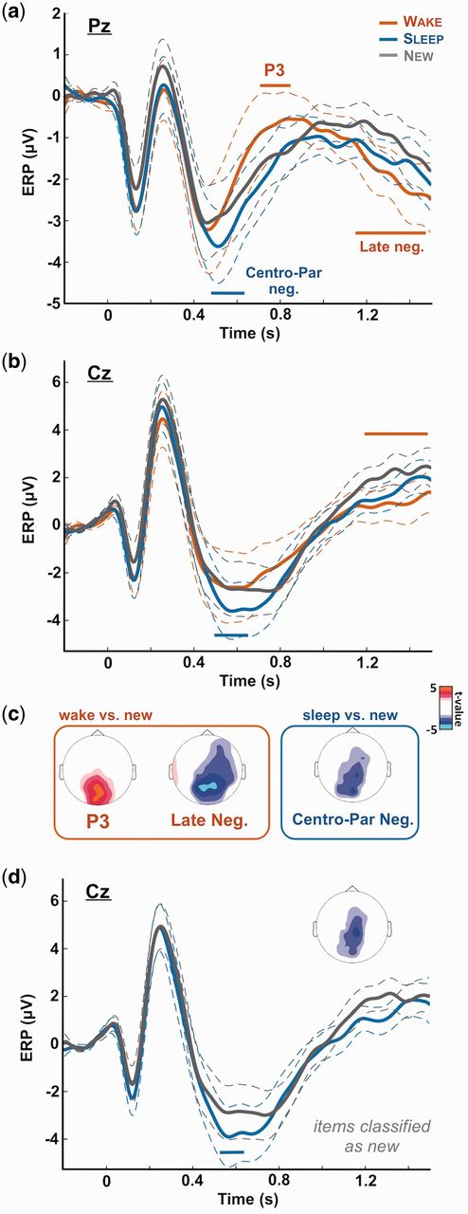
Figure 3. ERP to wake, sleep, and new words. The EEG signal time-locked to sound onset was averaged across participants ...
Notes:
Figure 3. ERP to wake, sleep, and new words. The EEG signal time-locked to sound onset was averaged across participants (N = 17) for the three lists separately (red: wake; blue: sleep; gray: new lists). (a) Shows the ERPs for electrode Pz and (b) for electrode Cz. Horizontal bars show the significant clusters for the comparison between the wake list (red bars) or the sleep list (blue bars) and the new list (pcluster 0.05) were set to 0]. Note the classical posterior positivity when comparing wake (explicitly remembered) and new items (‘P3’). For sleep items, an opposite negativity (centro-parietal negativity) was observed in lieu of a positivity, despite the absence of explicit recognition at the behavioral level (Fig. 2). (d) Shows the same ERPs as in (b) (Cz electrode) for sleep and new items declared as new. The inset shows the topography of the significant cluster observed between the sleep and new lists. In (a), (b), and (d), dotted lines show the standard error of the mean computed across participants (N = 17).
Unless provided in the caption above, the following copyright applies to the content of this slide: © The Author 2016. Published by Oxford University Press.This is an Open Access article distributed under the terms of the Creative Commons Attribution Non-Commercial License (http://creativecommons.org/licenses/by-nc/4.0/), which permits non-commercial re-use, distribution, and reproduction in any medium, provided the original work is properly cited. For commercial re-use, please contact journals.permissions@oup.com

Slide 4
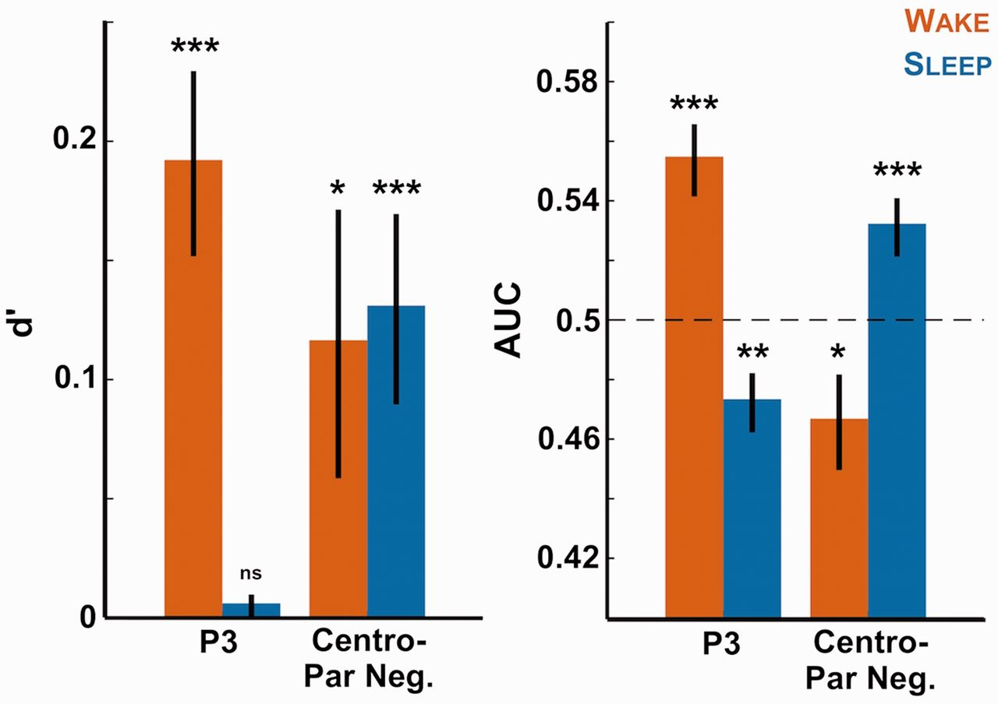
Figure 4. Decoding stimulus category with the EEG signal. The EEG amplitude over the clusters observed in Fig. 3 (‘P3’ ...
Notes:
Figure 4. Decoding stimulus category with the EEG signal. The EEG amplitude over the clusters observed in Fig. 3 (‘P3’ cluster: [0.73, 0.86] s over parieto-occipital electrodes; “Centro-Parietal Negativity” cluster: [0.49, 0.62] s over centro-parietal electrodes) was retrieved on a single trial basis for all participants. A leave-one-out approach was applied at the subject-level to fit a logistic regression (see “Methods” section), which was then used to predict stimulus category (sleep vs. new or wake vs. new). The sensitivity index d’ (left) and AUC (right) of this prediction was computed for each participant and each contrast and averaged across participants. The bars show therefore the extent to which we can predict if an item (red: wake item; blue: sleep item) had been previously heard from the EEG signal. Stars atop bars show the Monte Carlo P-values comparing the real decoding performance with surrogate datasets obtained through the permutation of trial categories (see “Methods” section: ***P < 0.001, **P < 0.005, *P 0.05). Note that the P3 cluster allows classifying only wake items while the negative sleep vs. new cluster could differentiate both wake and sleep items from new ones.
Unless provided in the caption above, the following copyright applies to the content of this slide: © The Author 2016. Published by Oxford University Press.This is an Open Access article distributed under the terms of the Creative Commons Attribution Non-Commercial License (http://creativecommons.org/licenses/by-nc/4.0/), which permits non-commercial re-use, distribution, and reproduction in any medium, provided the original work is properly cited. For commercial re-use, please contact journals.permissions@oup.com

Slide 5
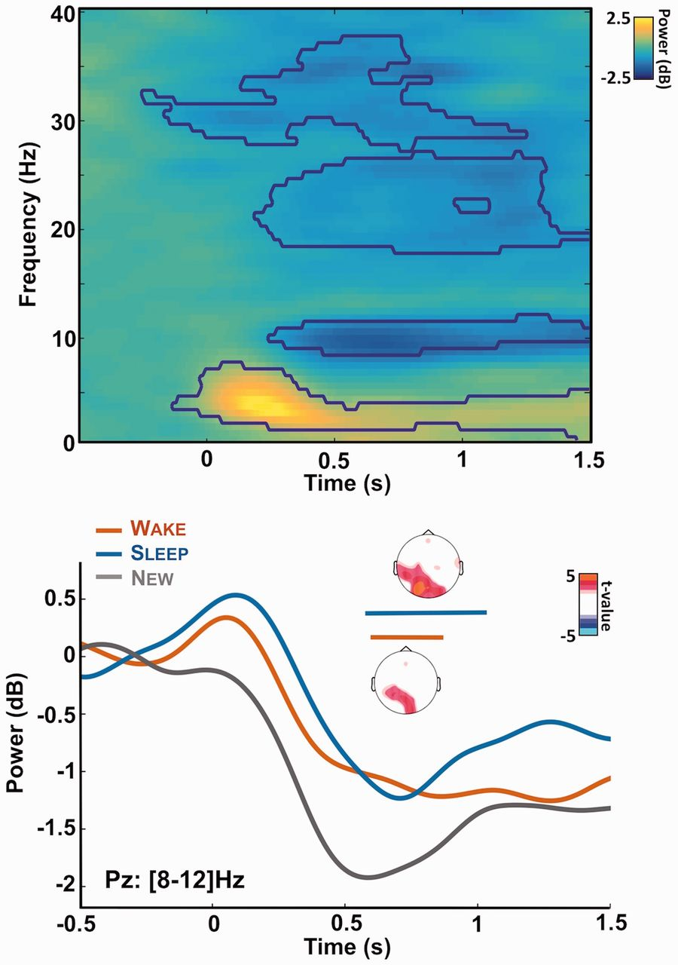
Figure 5. Alpha desynchronization during memory recognition. Top: time-frequency decomposition of the EEG signal ...
Notes:
Figure 5. Alpha desynchronization during memory recognition. Top: time-frequency decomposition of the EEG signal recorded at electrode Pz and for all trials. Power is expressed as a log ratio of the baseline activity and was averaged across participants (N = 17). The contours show the significant clusters (pcluster 20 Hz) bands. Bottom: Power modulation for the alpha band ([8–12] Hz) over electrode Pz for the different lists of stimuli (red: wake, blue: sleep, gray: new list). Horizontal bars show the significant cluster when comparing the wake and new lists (red: pcluster = 0.02) or the sleep and new lists (blue: pcluster = 0.009) across participants. Insets show the corresponding topographies for these clusters: power was averaged on the clusters’ time-window and t-values were computed by comparing the corresponding power for the wake (or sleep) list and the new one. Nonsignificant t-values (P > 0.05, uncorrected) were set to 0.
Unless provided in the caption above, the following copyright applies to the content of this slide: © The Author 2016. Published by Oxford University Press.This is an Open Access article distributed under the terms of the Creative Commons Attribution Non-Commercial License (http://creativecommons.org/licenses/by-nc/4.0/), which permits non-commercial re-use, distribution, and reproduction in any medium, provided the original work is properly cited. For commercial re-use, please contact journals.permissions@oup.com

