Slide 1
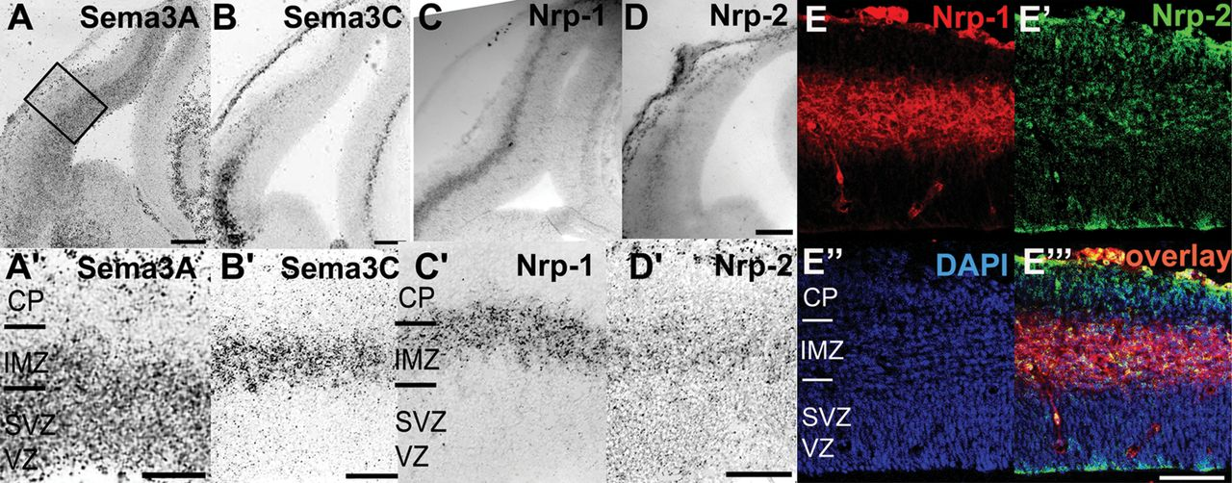
Figure 1. Expression patterns of Sema3A, Sema3C, Nrp-1, and Nrp-2 in the developing cortex. (A–D) In situ hybridization ...
Notes:
Figure 1. Expression patterns of Sema3A, Sema3C, Nrp-1, and Nrp-2 in the developing cortex. (A–D) In situ hybridization in coronal sections of E14 mouse brains with riboprobes directed against Sema3A (A), Sema3C (B), Nrp-1 (C), and Nrp-2 messenger RNA (D). The rectangle indicated in the low power micrograph in A represents the location of the magnified sections in A′–D′ for Sema3A (A′), Sema3C (B′), Nrp-1 (C′), and Nrp-2 (D′). Sema3A is expressed in the VZ and extends into the SVZ/IMZ, whereas Sema3C transcripts are restricted to the SVZ/IMZ. Nrp-1 (C and C′) and Nrp-2 (D and D′) transcripts are both expressed in the IMZ of the developing cortex. Colocalization of Nrp-1 and Nrp-2 was further shown at the protein level using immunohistochemistry at E14 (E–E′′′). Nrp-1 and Nrp-2 labeling is illustrated in E and E′, respectively. (E″) The IMZ was identified with DAPI staining, representing the less cell-dense region between the VZ/SVZ and CP. The overlay of Nrp-1, Nrp-2, and DAPI staining is presented in E′′′. Scale bars: 200 μm in A–D and 100 μm in A′–D′ and E′′′. VZ = ventricular zone, SVZ = subventricular zone, IMZ = intermediate zone, CP = cortical plate, and MZ = marginal zone.
Unless provided in the caption above, the following copyright applies to the content of this slide: © The Author 2012. Published by Oxford University Press. All rights reserved. For permissions, please e-mail: journals.permissions@oup.com

Slide 2
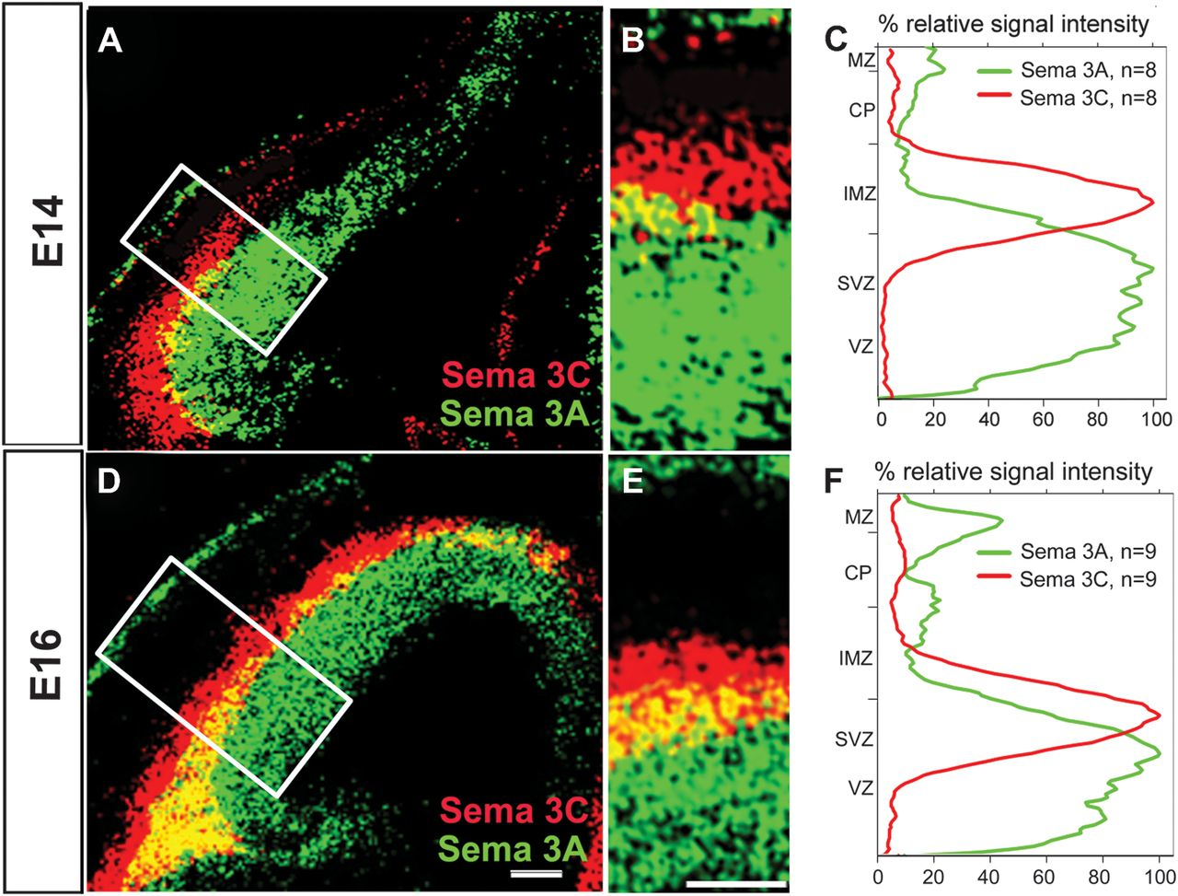
Figure 2. Overlap of Sema3A and Sema3C expression in the developing cortex. (A and D) pseudocolor overlay of in situ ...
Notes:
Figure 2. Overlap of Sema3A and Sema3C expression in the developing cortex. (A and D) pseudocolor overlay of in situ hybridization against Sema3A (green) and Sema3C (red) on consecutive coronal sections at E14 (A) and E16 (D). Overlapping gene expression appears as yellow. (B and E) Magnification of the pseudocolor overlay of Sema3A and Sema3C of the cortical region indicated by the white box in A and D at E14 and E16, respectively. (C and F) Signal intensity plots of Sema3A (green) and Sema3C expression (red) at E14 (C) and E16 (F) measured in the area indicated by the white box in A and D. These profile lines are the average from 10 overlays for each embryonic stage. Note that there is a considerable overlap in the expression of these transcripts in the IMZ/SVZ at E14 and in the SVZ at E16. Scale bars: 200 μm in A and D, 100 μm in B and E. VZ = ventricular zone, SVZ = subventricular zone, IMZ = intermediate zone, CP = cortical plate, and MZ = marginal zone.
Unless provided in the caption above, the following copyright applies to the content of this slide: © The Author 2012. Published by Oxford University Press. All rights reserved. For permissions, please e-mail: journals.permissions@oup.com

Slide 3
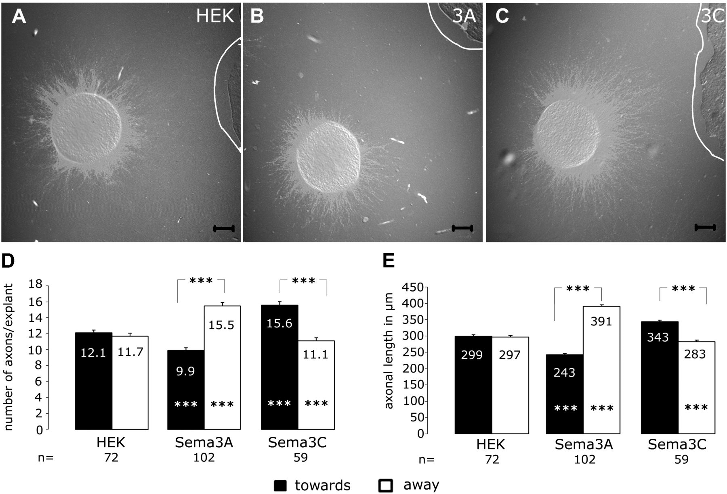
Figure 3. Response of cortical axons to semaphorin gradients in coculture assays. (A–C) Micrographs of representative ...
Notes:
Figure 3. Response of cortical axons to semaphorin gradients in coculture assays. (A–C) Micrographs of representative cortical explants cocultured with aggregates of untransfected (control) HEK cells (A), Sema3A-transfected HEK cells (B), and Sema3C-transfected HEK cells (C). The borders of the cell aggregates (to the right in the pictures) are indicated by white lines. (A) In control conditions, axons grow out radially from cortical explants. In contrast, when cortical explants are cocultured with Sema3A-secreting cells aggregates (B), axonal outgrowth from the explants is reduced toward the cell aggregate, whereas in cocultures with Sema3C-secreting cells, outgrowth toward the explants is increased. (D and E) Quantitative analysis of the number (D) and length (E) of axons growing toward and away of from HEK cell aggregates. For control cells, there is no difference in number and length of cortical axons growing toward or away from the cell aggregate. However, both the number and length of cortical axons growing toward the Sema3A source are reduced compared with axons growing away from Sema3A-expressing cells. The opposite effect was observed for Sema3C. Axons growing toward Sema3C-secreting HEK cells are increased in number and longer than axons growing in the opposite direction. Scale bars: 100 μm; n.s. = not significant; ***P < 0.0001; n = number of explants analyzed.
Unless provided in the caption above, the following copyright applies to the content of this slide: © The Author 2012. Published by Oxford University Press. All rights reserved. For permissions, please e-mail: journals.permissions@oup.com

Slide 4
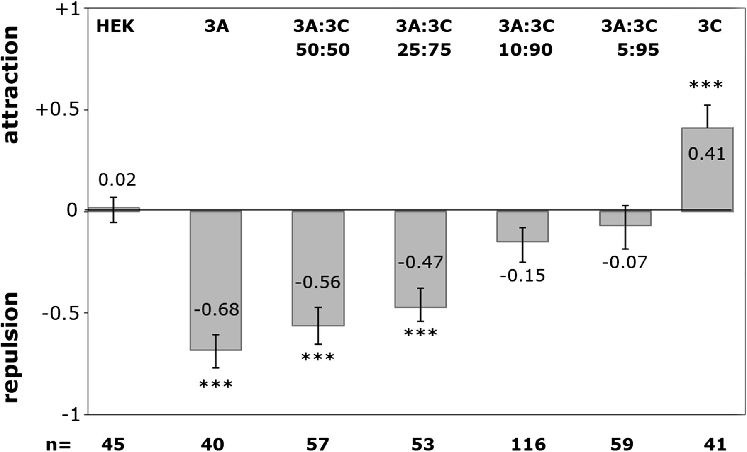
Figure 4. Response of cortical axons to Sema3A and Sema3C cocktails. Coculture experiments with defined mixtures of ...
Notes:
Figure 4. Response of cortical axons to Sema3A and Sema3C cocktails. Coculture experiments with defined mixtures of Sema3A- and Sema3C-expressing HEK cells. At Sema3A:Sema3C ratios of 50%: 50% and 25%: 70%, there was still a repulsive response of cortical axons (negative index) with only a modest reduction of this effect compared with Sem3A alone. When Sema3C concentrations were further increased to 90% and 95%, there was neither a repulsive nor an attractive effect on cortical axons. A clear attractive response (positive index) was only elicited when Sema3C was presented in the absence of Sema3A. ***P < 0.0001; n = number of explants analyzed.
Unless provided in the caption above, the following copyright applies to the content of this slide: © The Author 2012. Published by Oxford University Press. All rights reserved. For permissions, please e-mail: journals.permissions@oup.com

Slide 5
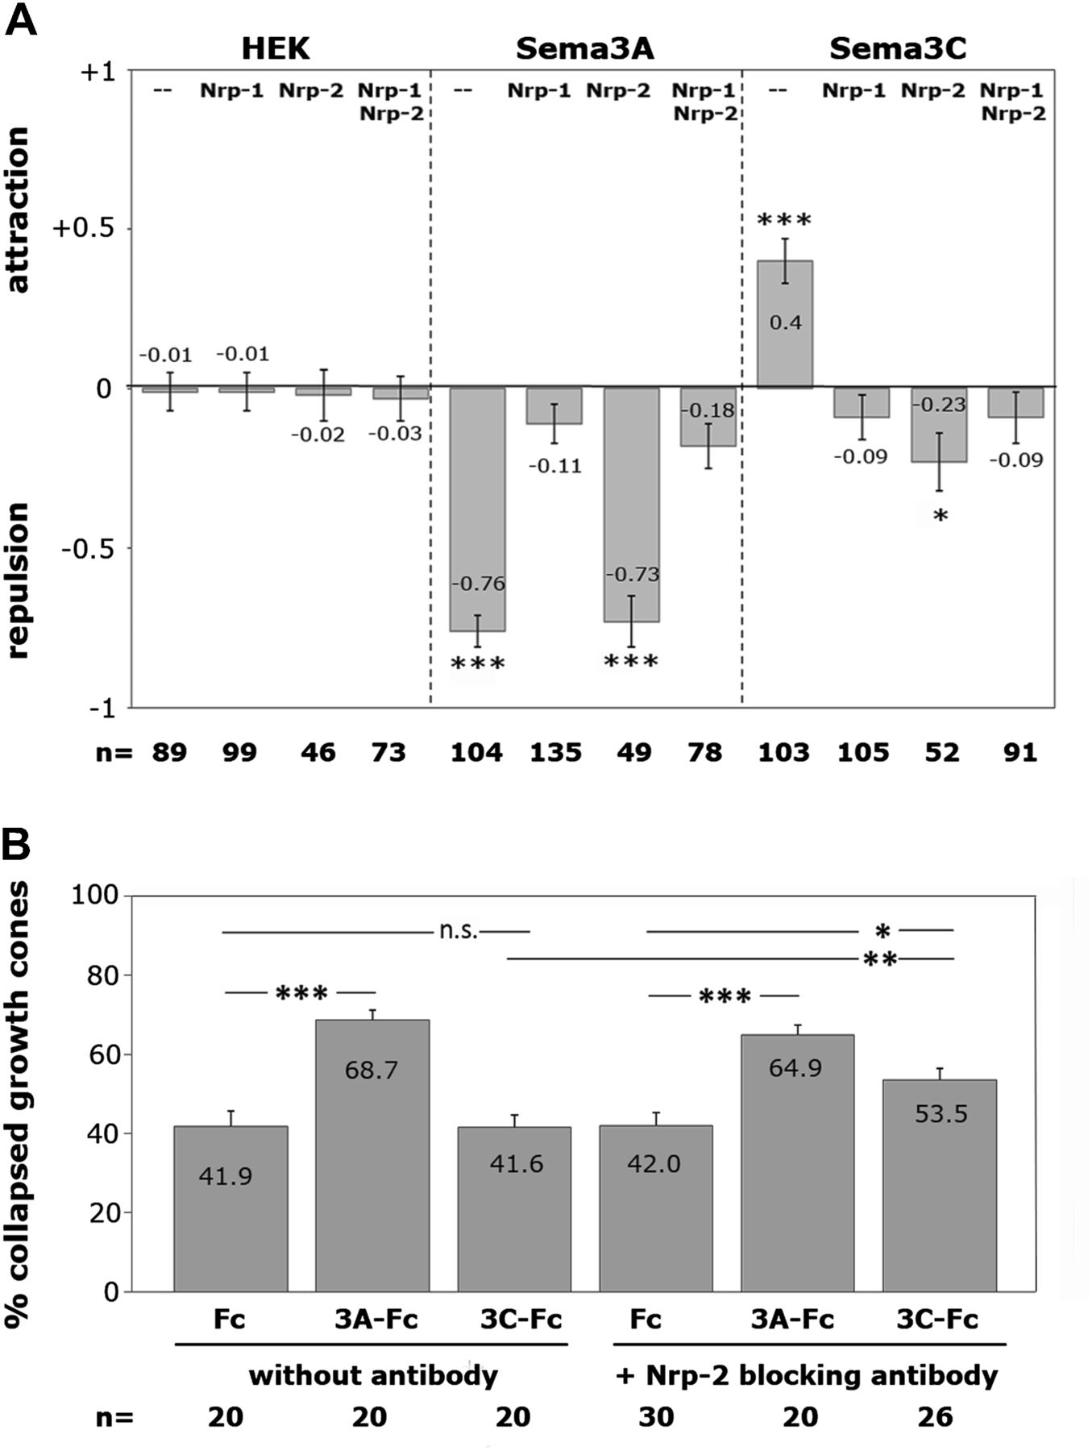
Figure 5. Cortical outgrowth behavior in neuropilin blocking experiments. The response of cortical axons to Sema3A and ...
Notes:
Figure 5. Cortical outgrowth behavior in neuropilin blocking experiments. The response of cortical axons to Sema3A and Sema3C was tested in the presence of function-blocking antibodies directed against Nrp-1 and/or Nrp-2 in cocultures (A) and in growth cone collapse assays (B). (A) Application of anti-Nrp-1 antibodies leads to an abolishment of the Sema3A-induced repulsion of cortical axons in the coculture assay, whereas Nrp-2 antibodies had no effect on the response to Sema3A. The Sema3C-mediated axonal attraction was also abolished by blocking Nrp-1 function. However, after blocking Nrp-2, the Sema3C-induced attractive effect on cortical axons was converted into a repulsive effect. (B) The repulsive Sema3C effect after Nrp-2 inhibition was confirmed using the growth cone collapse assays. Without antibodies, recombinant Sema3A induced a growth cone collapse, whereas Sema3C had no collapsing effect, there was no difference to the control (Fc) condition. The collapse activity of Sema3A was not affected by the application of Nrp-2 antibodies. However, in the presence of Nrp-2 antibodies, recombinant Sema3C was now also able to induce a collapse of cortical growth cones. ***P < 0.0001 and *P < 0.01; n = number of explants analyzed.
Unless provided in the caption above, the following copyright applies to the content of this slide: © The Author 2012. Published by Oxford University Press. All rights reserved. For permissions, please e-mail: journals.permissions@oup.com

Slide 6
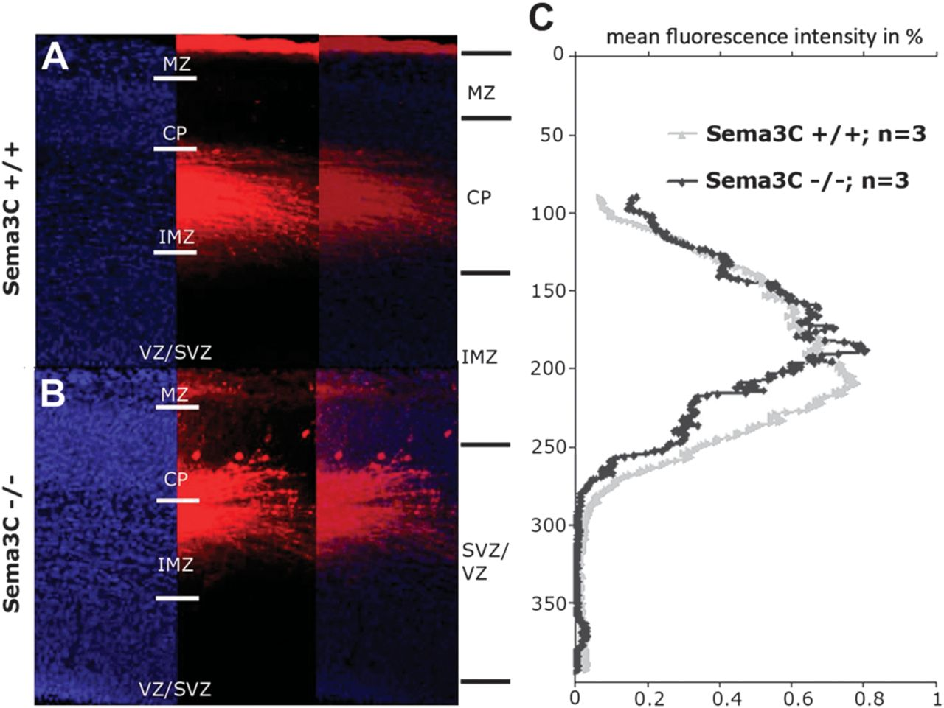
Figure 6. Axon-tracing experiments in Sema3C knockout mice. (A and B) DAPI staining (left) and labeling of corticofugal ...
Notes:
Figure 6. Axon-tracing experiments in Sema3C knockout mice. (A and B) DAPI staining (left) and labeling of corticofugal axons (right) after DiI injections in fixed E16 brains from Sema3C+/+ (A) and Sema3C−/− (B) animals. (C) Quantification averaged from 3 mutant and 3 wild-type brains revealed that cortical fibers are shifted toward the CP. Scale bar = 50 μm. Abbreviations as in Figure 1.
Unless provided in the caption above, the following copyright applies to the content of this slide: © The Author 2012. Published by Oxford University Press. All rights reserved. For permissions, please e-mail: journals.permissions@oup.com

Slide 7
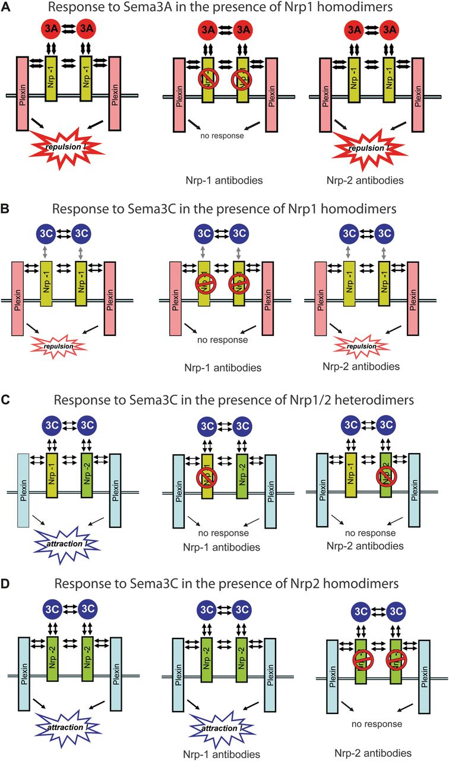
Figure 7. Schemes how cortical axons integrate Sema3A and Sema3C responses. The predictions from these different models ...
Notes:
Figure 7. Schemes how cortical axons integrate Sema3A and Sema3C responses. The predictions from these different models are compared with the functional in vitro assays presented in Figure 5. (A) The repulsive Sema3A response is mediated by Nrp-1 homodimers associated with plexins that increase Sem3A binding and decrease Sema3C to Nrp-1. As observed in the in vitro assays, Nrp-1 antibodies block the repulsive Sema3A response, whereas Nrp-2 antibodies have no effect. (B) Sema3C binds with low affinity also to this receptor and therefore elicits only a weak repulsive effect. This cross talk is blocked by Nrp-1 antibodies but persists in the presence of Nrp-2 antibodies. (C) The attractive Sema3C response is mediated by Nrp-1/Nrp-2 heterodimers associated with plexins that lead to a high Sema3C–neuropilin binding. The strong attractive response then overrides the weak repulsive response postulated in (B). Consistent with our data, Nrp-1 antibodies abolish both the weak attractive and the strong repulsive response, whereas Nrp-2 antibodies only block the attractive response and thereby reveal the weak repulsive response elicited by Sema3C. (D) If the attractive Sema3C response would be mediated by Nrp-2 homodimers as illustrated here; one would also expect a weak repulsive response in the presence of Nrp-2 antibodies. However, in this case, Nrp-1 antibodies should have no effect on the attractive Sema3C response. This is at variance with our experiments, which demonstrate that Nrp-1 antibodies completely block the response to Sema3C.
Unless provided in the caption above, the following copyright applies to the content of this slide: © The Author 2012. Published by Oxford University Press. All rights reserved. For permissions, please e-mail: journals.permissions@oup.com

