Slide 1
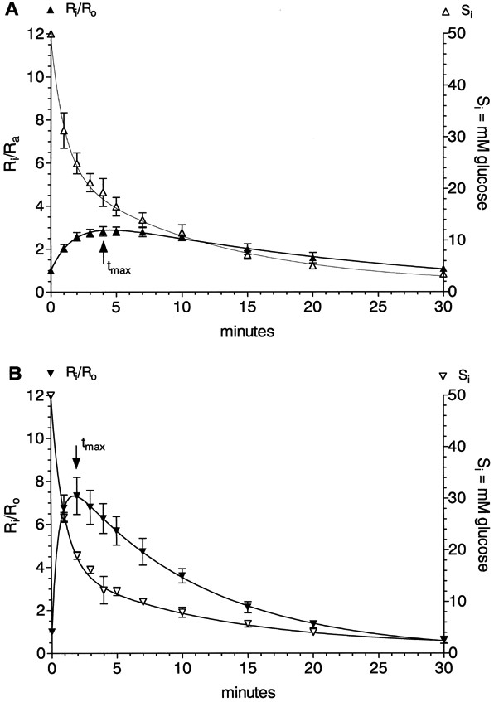
1 Glucose iso-countertransport (▴, ▾) and efflux (△, ▿) in plasma membrane vesicles prepared from wild-type ...
Notes:
1 Glucose iso-countertransport (▴, ▾) and efflux (△, ▿) in plasma membrane vesicles prepared from wild-type cells MC996A. The cells were grown to the ME growth phase on 2% glucose (A) and on 0.05% glucose (B) in the medium. Ri/Ro is the ratio of 14C-labelled glucose concentration inside to outside; Si is the inside concentration of unlabelled glucose. Mean value of six iso-countertransport and five efflux experiments±S. D. in (A) and four of each in (B).
Unless provided in the caption above, the following copyright applies to the content of this slide: © 2002 Federation of European Microbiological Societies. Published by Elsevier Science B.V. All rights reserved.

Slide 2
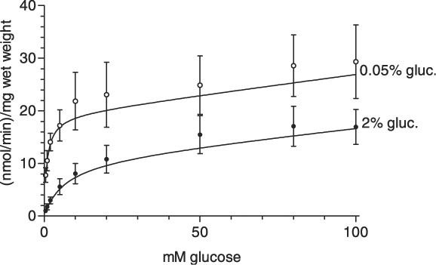
2 Initial glucose uptake (5 s) at 25°C in wild-type cells MC996A grown on 2% or 0.05% glucose to the ME growth ...
Notes:
2 Initial glucose uptake (5 s) at 25°C in wild-type cells MC996A grown on 2% or 0.05% glucose to the ME growth phase over a concentration range from 0.5 to 100 mM glucose. Mean of six experiments±S. D. in 2% glucose (2% gluc.) and mean of eight experiments±S. D. in 0.05% glucose (0.05% gluc.)-grown cells.
Unless provided in the caption above, the following copyright applies to the content of this slide: © 2002 Federation of European Microbiological Societies. Published by Elsevier Science B.V. All rights reserved.

Slide 3
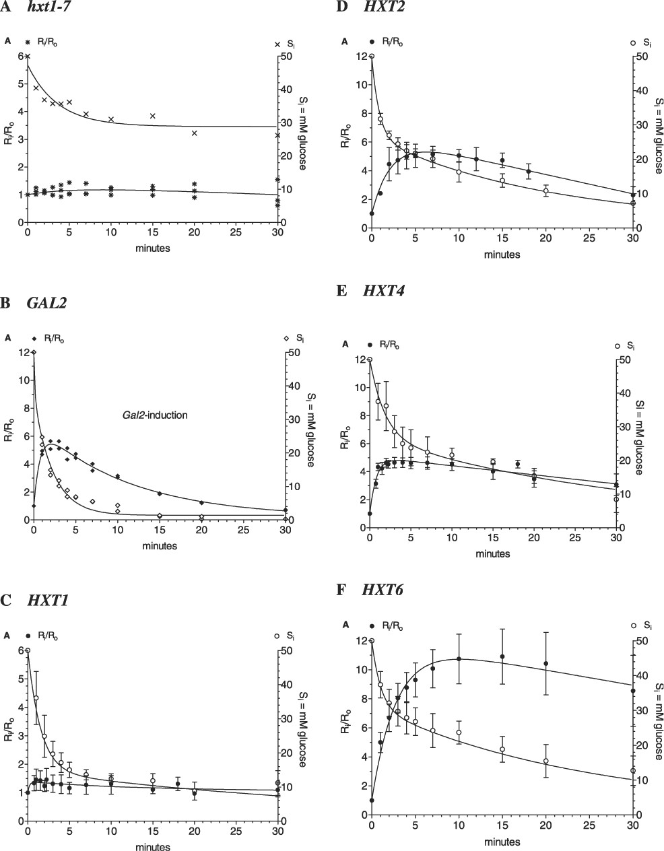
3 Glucose iso-countertransport and glucose efflux experiments in plasma membrane vesicles prepared from ...
Notes:
3 Glucose iso-countertransport and glucose efflux experiments in plasma membrane vesicles prepared from different hxt mutant strains. A: hxt1-7 null strain RE700A: the cells were grown to the ME growth phase on 2% maltose. Glucose iso-countertransport (*) (three single experiments). Glucose efflux (x) can exactly be fitted by an equation describing exponential decay with plateau formation (one of three similar experiments). B: hxt1-7 null strain after GAL2 induction: the cells were grown on 2% galactose to the ME growth phase. Glucose iso-countertransport (♦) and glucose efflux (♢) (two single experiments). C–F: The cells were grown to the ME growth phase on 2% glucose; glucose iso-countertransport (●) and glucose efflux (○). C: HXT1 strain (mean of six/seven experiments±S. D.), D: HXT2 strain (mean of four experiments±S. D.), E: HXT4 strain (mean of seven/nine experiments±S. D.), F: HXT6 strain (mean of five/four experiments±S. D.).
Unless provided in the caption above, the following copyright applies to the content of this slide: © 2002 Federation of European Microbiological Societies. Published by Elsevier Science B.V. All rights reserved.

Slide 4
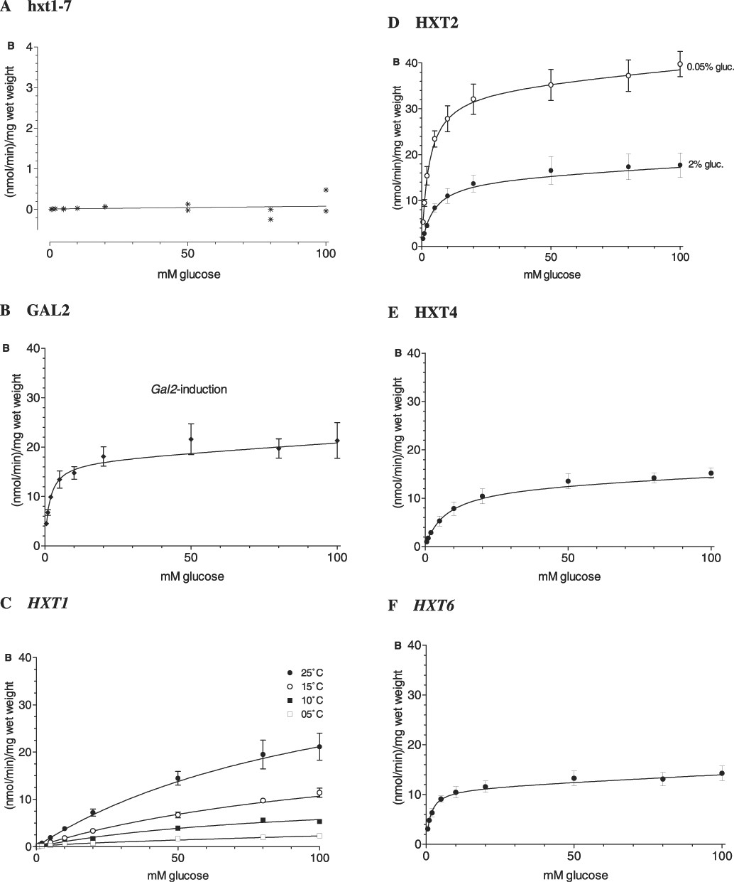
4 Initial glucose uptake at 25°C in different hxt mutant strains grown as described in Fig. 3. A: hxt1-7 null ...
Notes:
4 Initial glucose uptake at 25°C in different hxt mutant strains grown as described in Fig. 3. A: hxt1-7 null strain RE700A (2 experiments). B: hxt1-7 null strain after GAL2 induction (mean of four experiments±S. D.). C: HXT1 strain (initial glucose uptake at four temperatures: 25°C (mean of eight experiments±S. D.), 15°C (mean of four experiments±S. D.), 10°C (two experiments), 5°C (two experiments)), D: HXT2 strain grown to the ME growth phase on 0.05% (○) and 2% (●) glucose (mean of eight experiments each±S. D.), E: HXT4 strain (mean of 10 experiments±S. D.), F: HXT6 strain (mean of eight experiments±S. D.).
Unless provided in the caption above, the following copyright applies to the content of this slide: © 2002 Federation of European Microbiological Societies. Published by Elsevier Science B.V. All rights reserved.

Slide 5
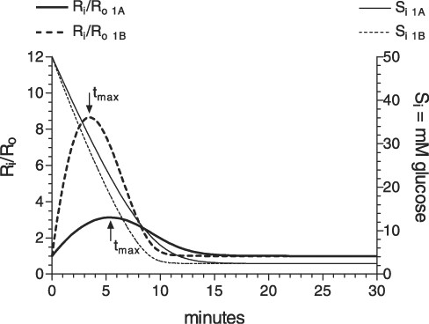
5 Simulation of iso-countertransport and efflux by FLUXSIM [14]. For simulation the apparent ...
Notes:
5 Simulation of iso-countertransport and efflux by FLUXSIM [14]. For simulation the apparent Km-values of 7.6 (A) and 1.6 mM (B) were taken from iso-countertransport results of experiments in plasma membrane vesicles in Fig. 1A,B and a 1.7-fold increase of Vm B in relation to Vm A from results in initial uptake in respective cells in Fig. 2.
Unless provided in the caption above, the following copyright applies to the content of this slide: © 2002 Federation of European Microbiological Societies. Published by Elsevier Science B.V. All rights reserved.

Slide 6
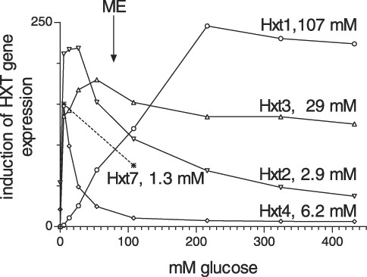
6 Induction of HXT gene expression with the respective glucose transporters and apparent K_{m}-values ...
Notes:
6 Induction of HXT gene expression with the respective glucose transporters and apparent Km-values (calculated from iso-countertransport) at the curves as a function of glucose concentration. Experimental points of fig. 1 of Özcan and Johnson [18] were digitised by GraphPAD (HXT1, HXT3, HXT2 and HXT4). The dotted line represents gene induction of HXT7 deduced from Fig. 1 of Reifenberger et al. [10]. ME ↓ represents the glucose concentration for HXT gene expression in wild-type cells grown at 2% glucose to the ME growth phase.
Unless provided in the caption above, the following copyright applies to the content of this slide: © 2002 Federation of European Microbiological Societies. Published by Elsevier Science B.V. All rights reserved.

