Slide 1
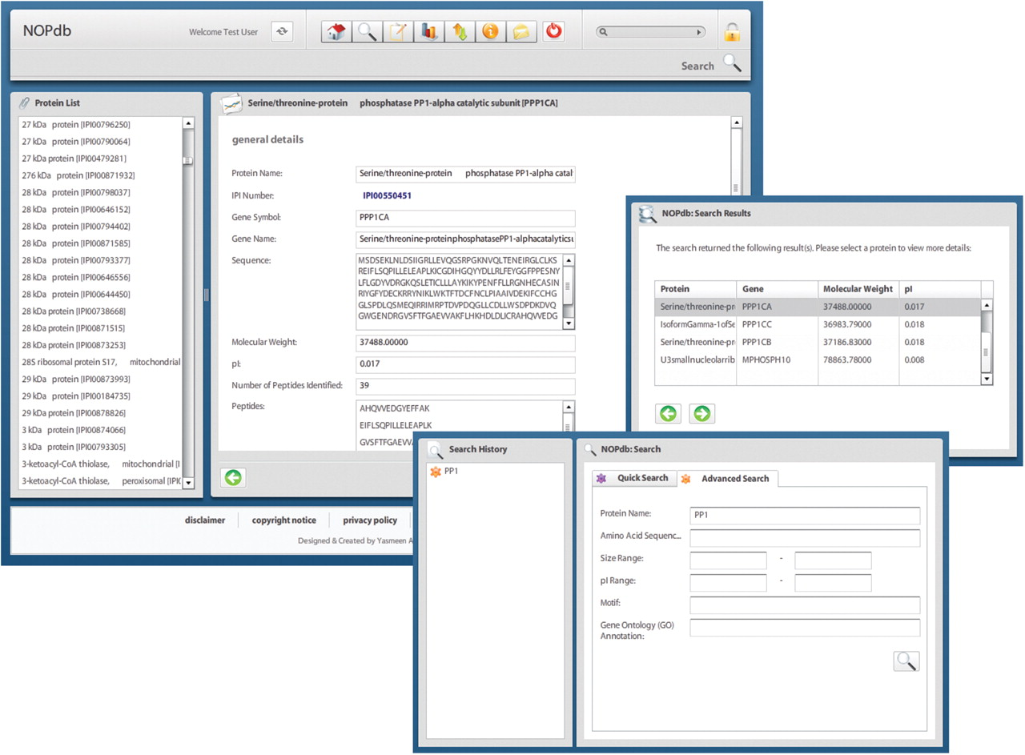
Figure 1. Snapshots of the NOPdb3.0 (http://www.lamondlab.com/NOPdb3.0/). For illustration, the database was searched ...
Notes:
Figure 1. Snapshots of the NOPdb3.0 (http://www.lamondlab.com/NOPdb3.0/). For illustration, the database was searched to identify a Protein Phosphatase 1 (PP1) isoform and here we show an overview page for this protein documenting its sequence, peptides identified, etc.
Unless provided in the caption above, the following copyright applies to the content of this slide: © 2008 The Author(s)This is an Open Access article distributed under the terms of the Creative Commons Attribution Non-Commercial License (http://creativecommons.org/licenses/by-nc/2.0/uk/) which permits unrestricted non-commercial use, distribution, and reproduction in any medium, provided the original work is properly cited.

Slide 2
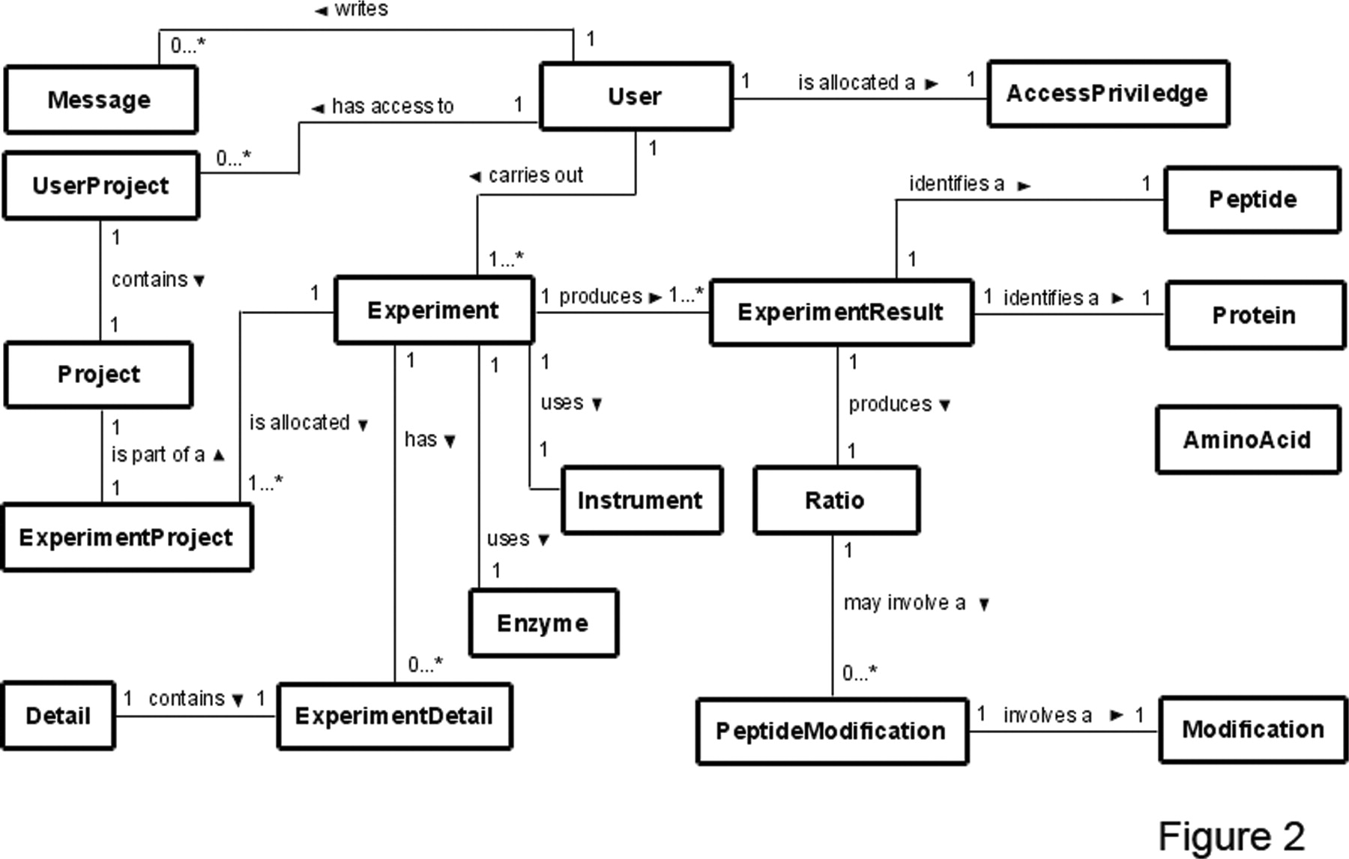
Figure 2. Entity Relationship (ER) diagram depicting the relationships between the tables present in the mySQL database ...
Notes:
Figure 2. Entity Relationship (ER) diagram depicting the relationships between the tables present in the mySQL database implemented for the NOPdb3.0 Content Management System.
Unless provided in the caption above, the following copyright applies to the content of this slide: © 2008 The Author(s)This is an Open Access article distributed under the terms of the Creative Commons Attribution Non-Commercial License (http://creativecommons.org/licenses/by-nc/2.0/uk/) which permits unrestricted non-commercial use, distribution, and reproduction in any medium, provided the original work is properly cited.

