Slide 1
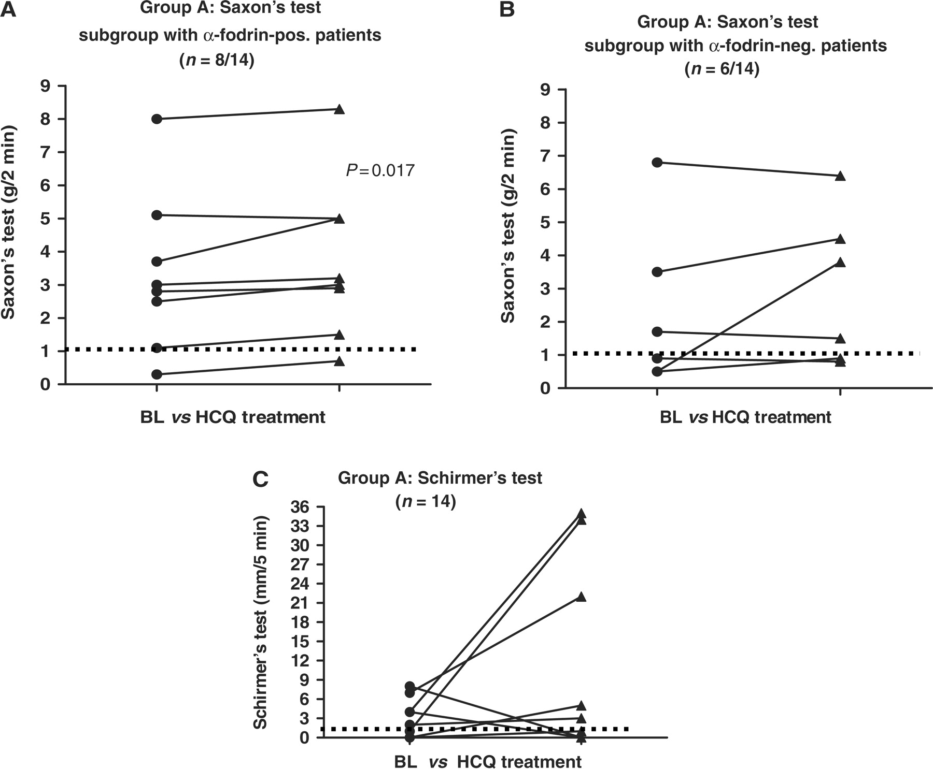
Fig. 1. Glandular function, i.e. Saxon's (A, B) and Schirmer's test (C) values are depicted at baseline and after ...
Notes:
Fig. 1. Glandular function, i.e. Saxon's (A, B) and Schirmer's test (C) values are depicted at baseline and after treatment with HCQ in patients with SS (Group A, n = 14). The Saxon's test values were subanalysed according to the patient's α-fodrin status. The α-fodrin antibody-positive subgroup (A, n = 8) revealed a significant increase in saliva production as measured by the Schirmer's test (P = 0.017). The dotted lines indicate the thresholds in regard to a residual glandular function, i.e. >1 g for the Saxon's and ⩾1 mm for the Schirmer's test, respectively.
Unless provided in the caption above, the following copyright applies to the content of this slide: © The Author 2009. Published by Oxford University Press on behalf of the British Society for Rheumatology. All rights reserved. For Permissions, please email: journals.permissions@oxfordjournals.org

Slide 2
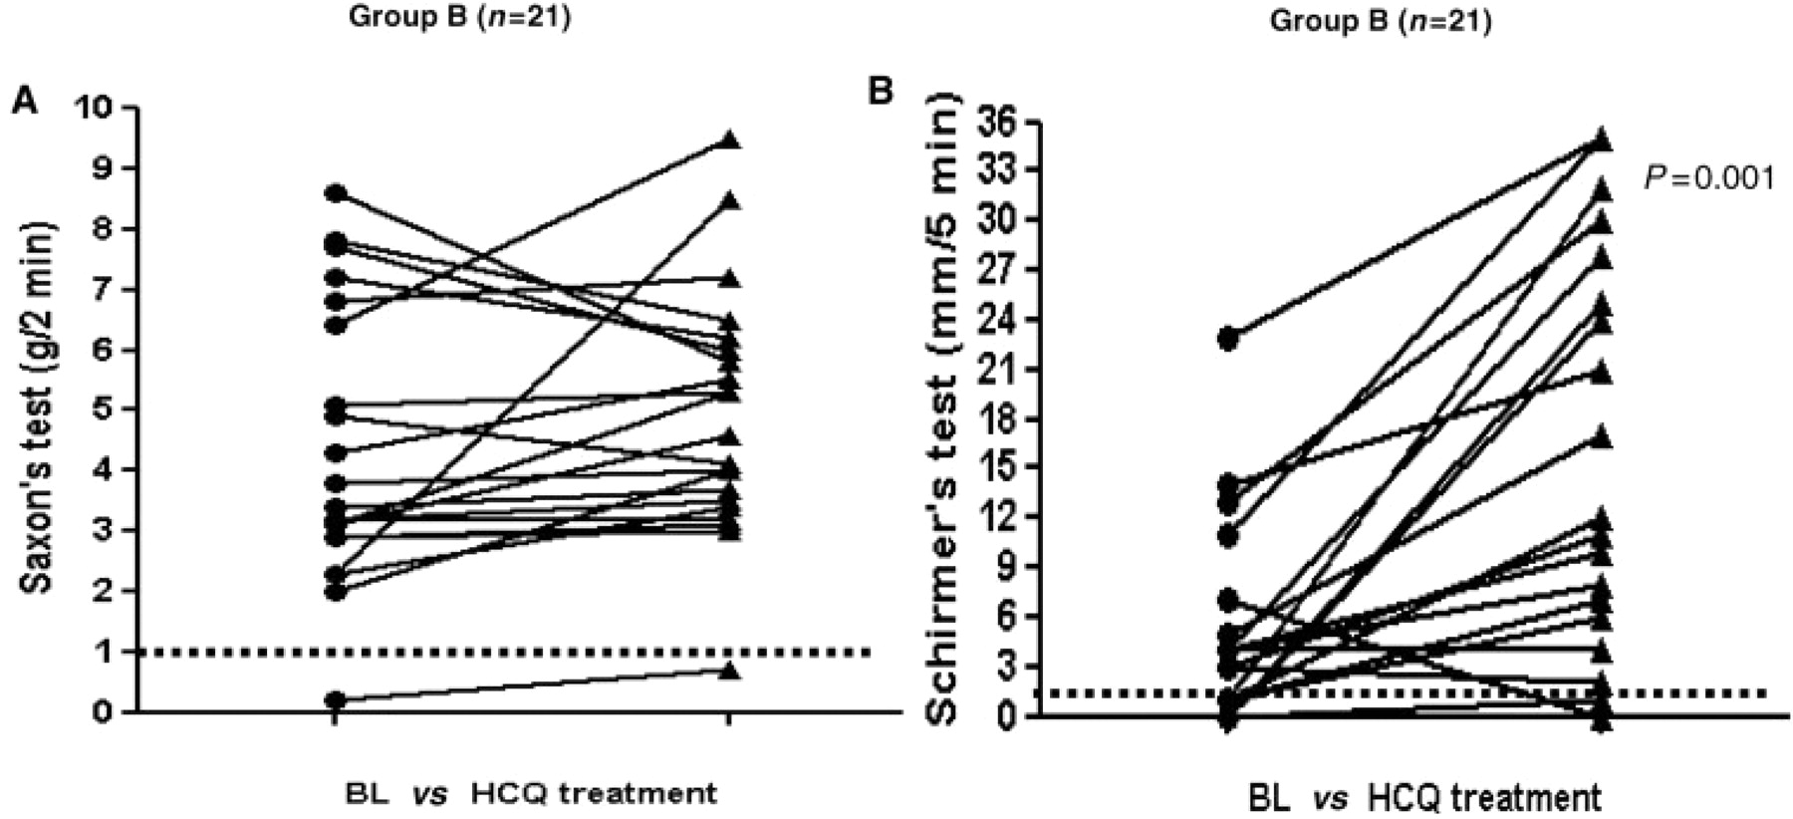
Fig. 2. Glandular function, i.e. Saxon's (A) and Schirmer's (B) test values are depicted at baseline and after ...
Notes:
Fig. 2. Glandular function, i.e. Saxon's (A) and Schirmer's (B) test values are depicted at baseline and after treatment with HCQ in α-fodrin antibody-positive patients with objective dryness (Group B, n = 21). There is a significant increase in tear flow (B). Again, the dotted lines indicate the threshold with regard to a residual glandular function, i.e. >1 g for the Saxon's and ≥1 mm for the Schirmer's test, respectively.
Unless provided in the caption above, the following copyright applies to the content of this slide: © The Author 2009. Published by Oxford University Press on behalf of the British Society for Rheumatology. All rights reserved. For Permissions, please email: journals.permissions@oxfordjournals.org

