Slide 1
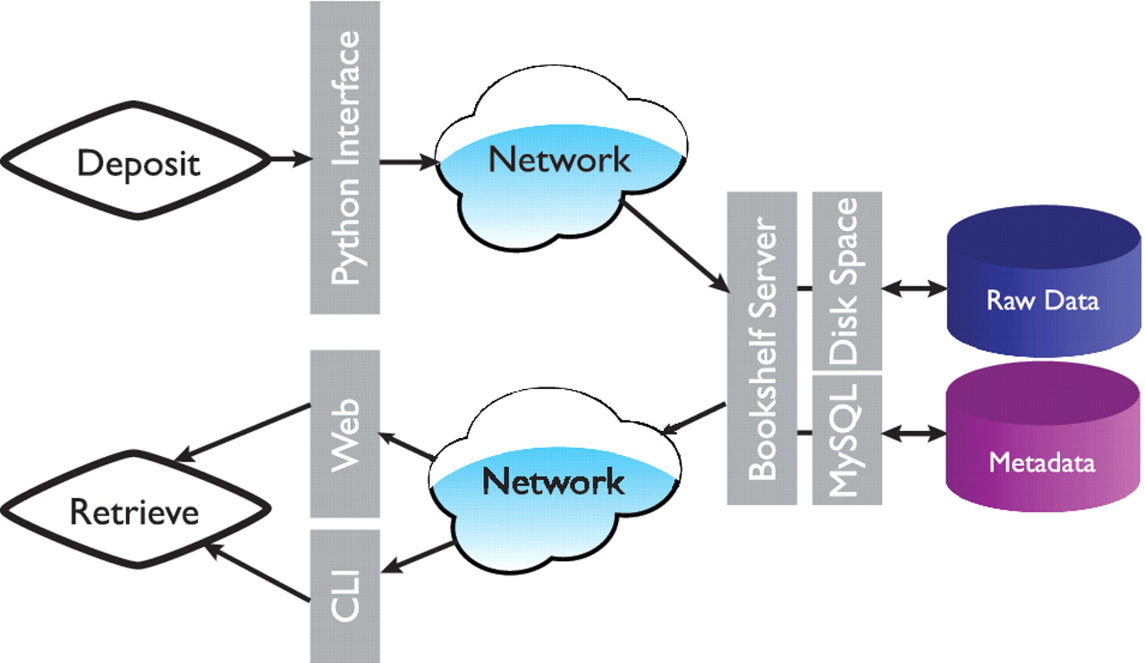
Figure 1. Overall architecture of the Bookshelf system. Command line interface is represented by CLI.
Notes:
Figure 1. Overall architecture of the Bookshelf system. Command line interface is represented by CLI.
Unless provided in the caption above, the following copyright applies to the content of this slide: © The Author(s) 2010. Published by Oxford University Press.This is Open Access article distributed under the terms of the Creative Commons Attribution Non-Commercial License (http://creativecommons.org/licenses/by-nc/2.5), which permits unrestricted non-commercial use, distribution, and reproduction in any medium, provided the original work is properly cited.

Slide 2
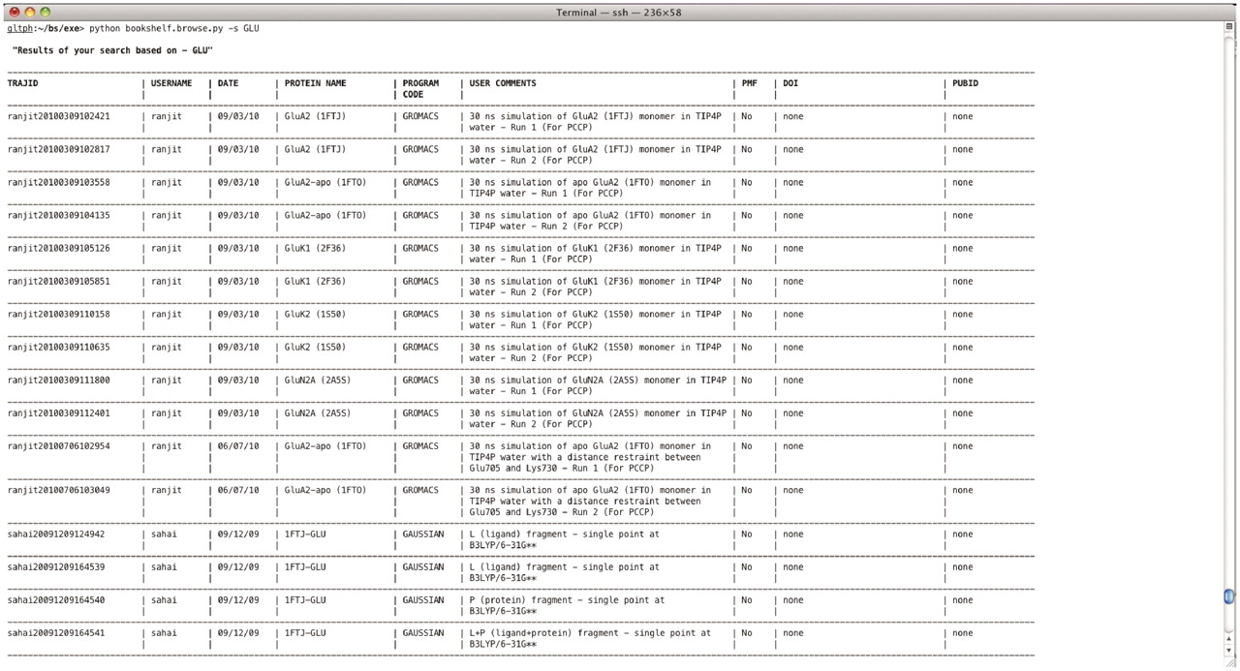
Figure 2. Output from a retrieval command ‘bookshelf.browse.py –s GLU’.
Notes:
Figure 2. Output from a retrieval command ‘bookshelf.browse.py –s GLU’.
Unless provided in the caption above, the following copyright applies to the content of this slide: © The Author(s) 2010. Published by Oxford University Press.This is Open Access article distributed under the terms of the Creative Commons Attribution Non-Commercial License (http://creativecommons.org/licenses/by-nc/2.5), which permits unrestricted non-commercial use, distribution, and reproduction in any medium, provided the original work is properly cited.

Slide 3
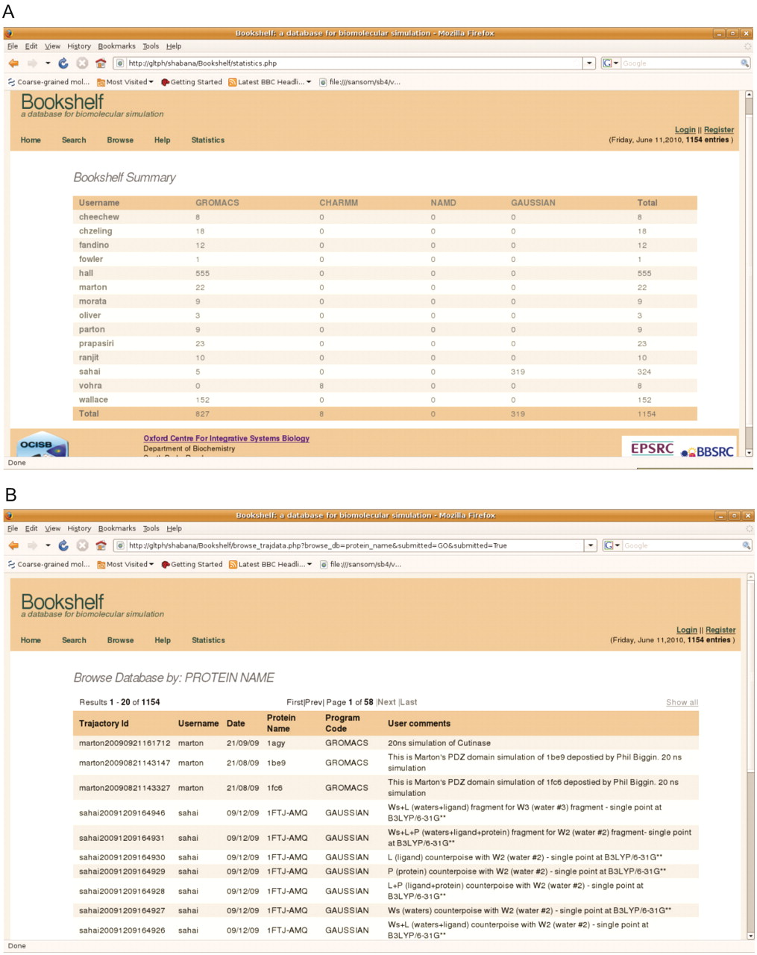
Figure 3. (A) Summary page describing depositions per user. (B) The web-interface displaying a metadata query by ...
Notes:
Figure 3. (A) Summary page describing depositions per user. (B) The web-interface displaying a metadata query by protein name.
Unless provided in the caption above, the following copyright applies to the content of this slide: © The Author(s) 2010. Published by Oxford University Press.This is Open Access article distributed under the terms of the Creative Commons Attribution Non-Commercial License (http://creativecommons.org/licenses/by-nc/2.5), which permits unrestricted non-commercial use, distribution, and reproduction in any medium, provided the original work is properly cited.

Slide 4
Figure 4. Example output from the installation at Southampton.
Notes:
Figure 4. Example output from the installation at Southampton.
Unless provided in the caption above, the following copyright applies to the content of this slide: © The Author(s) 2010. Published by Oxford University Press.This is Open Access article distributed under the terms of the Creative Commons Attribution Non-Commercial License (http://creativecommons.org/licenses/by-nc/2.5), which permits unrestricted non-commercial use, distribution, and reproduction in any medium, provided the original work is properly cited.

