Slide 1
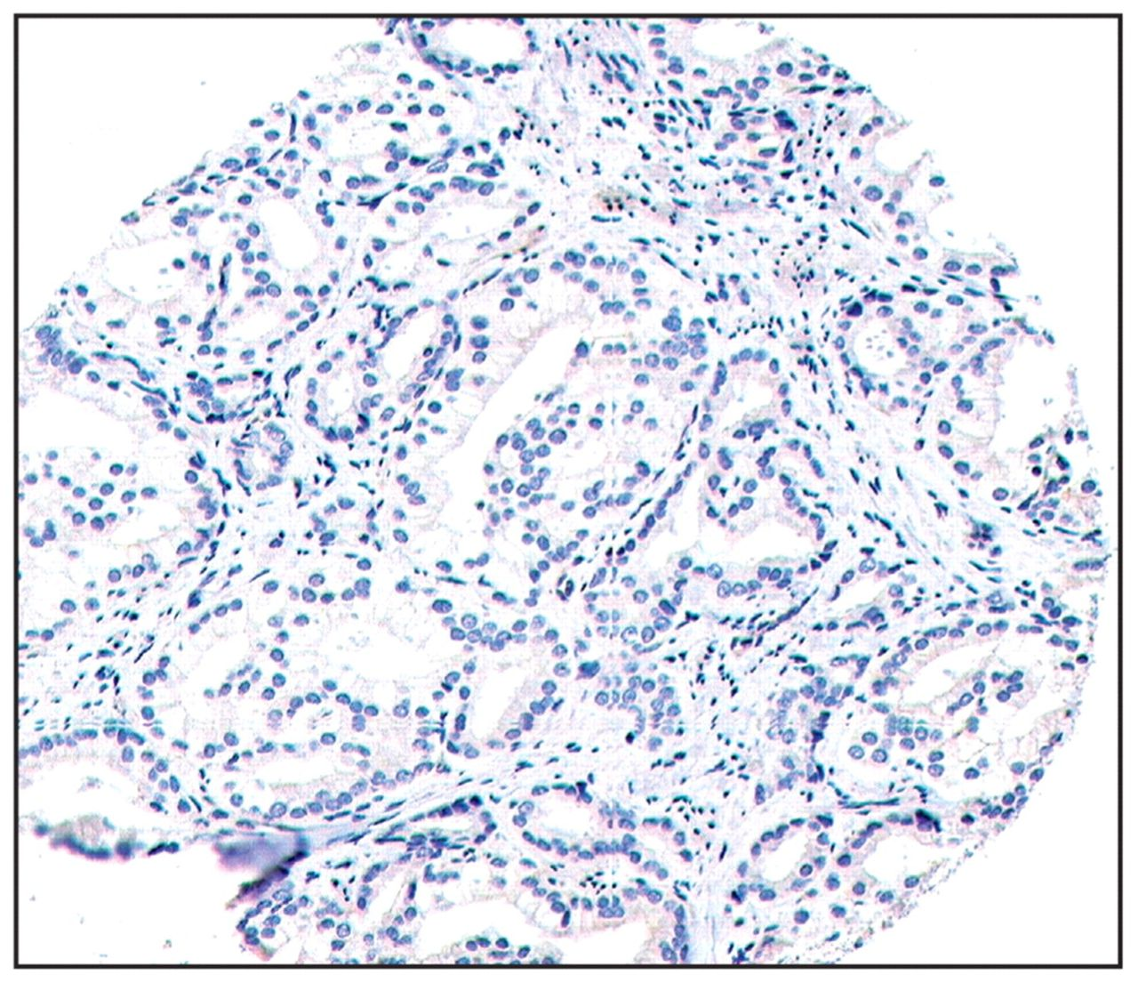
Image 1 Microarray core, study core 261A. Negative immunostain result (score 0) (Hey2/S0456, ×200).
Notes:
Image 1 Microarray core, study core 261A. Negative immunostain result (score 0) (Hey2/S0456, ×200).
Unless provided in the caption above, the following copyright applies to the content of this slide: © American Society for Clinical Pathology

Slide 2
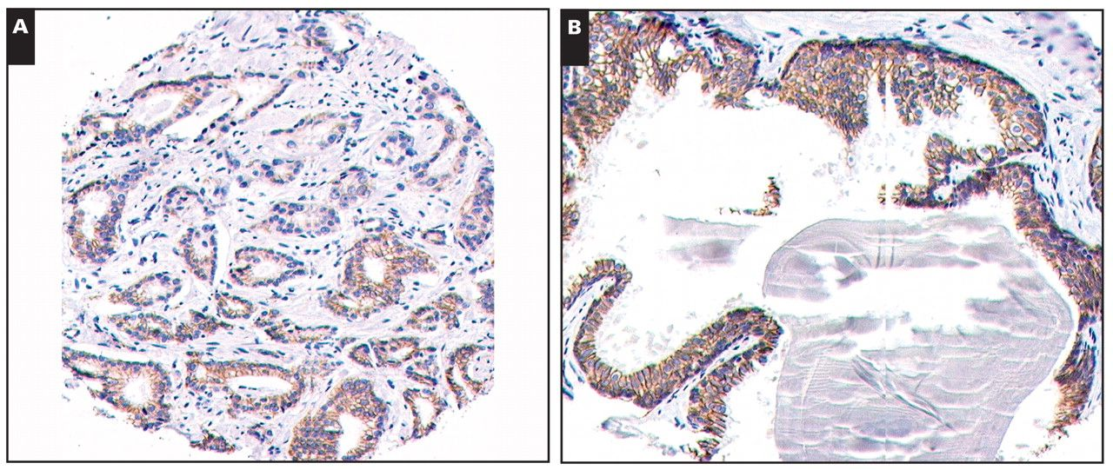
Image 2 Positive membrane immunostains. A, Score 2, core 268A (catenin/EP1247-1, ×200). B, Score 3, core 263B ...
Notes:
Image 2 Positive membrane immunostains. A, Score 2, core 268A (catenin/EP1247-1, ×200). B, Score 3, core 263B (catenin/EP1247-1, ×200).
Unless provided in the caption above, the following copyright applies to the content of this slide: © American Society for Clinical Pathology

Slide 3
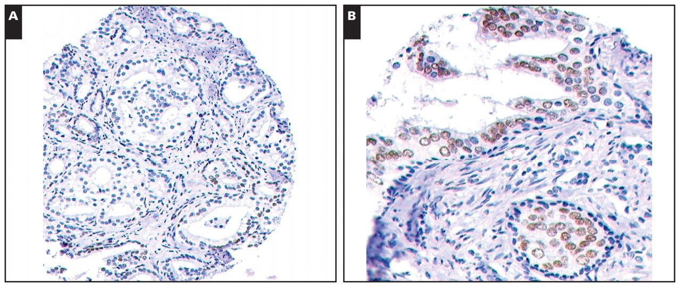
Image 3 Positive immunonuclear stains. A, Score 2, core 278A (EP1113-1/CAMP, ×200). B, Score 3, core 256B ...
Notes:
Image 3 Positive immunonuclear stains. A, Score 2, core 278A (EP1113-1/CAMP, ×200). B, Score 3, core 256B (EP1113-1/CAMP, ×400).
Unless provided in the caption above, the following copyright applies to the content of this slide: © American Society for Clinical Pathology

Slide 4
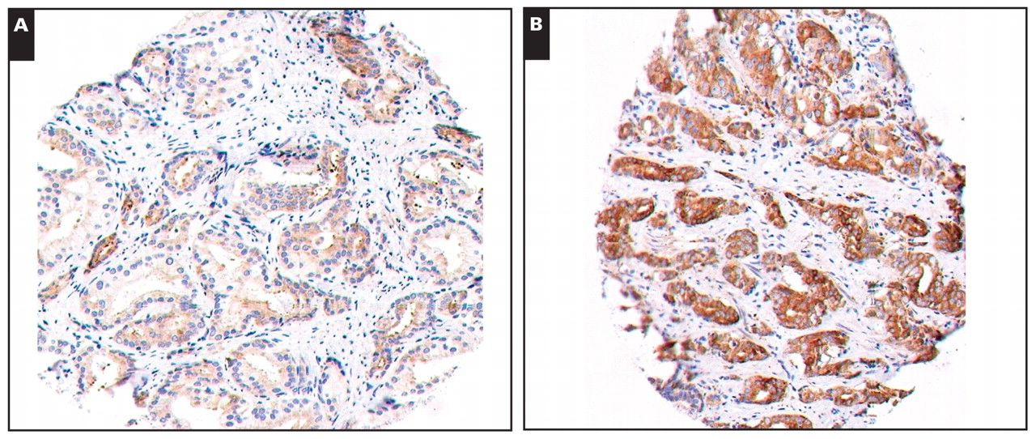
Image 4 Positive cytoplasmic immunostains. A, Score 2, core 271A (cytochrome p450-4z1/S0725M, ×200). B, Score 3, core ...
Notes:
Image 4 Positive cytoplasmic immunostains. A, Score 2, core 271A (cytochrome p450-4z1/S0725M, ×200). B, Score 3, core 276A (cytochrome p450-4z1/S0725M, ×200).
Unless provided in the caption above, the following copyright applies to the content of this slide: © American Society for Clinical Pathology

Slide 5
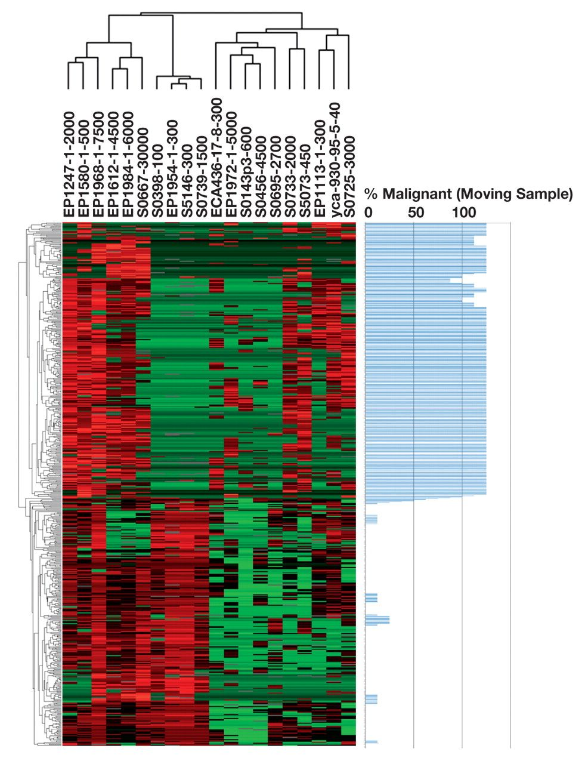
Figure 1 Marker/gene sequence cluster diagram for all tissue cores, benign and malignant, for all 304 cases studied. ...
Notes:
Figure 1 Marker/gene sequence cluster diagram for all tissue cores, benign and malignant, for all 304 cases studied. Gene sequences/molecular markers are represented along the x-axis (in the vertical rows). Individual tissue cores are represented along the y-axis (in the horizontal rows). Red indicates increased marker expression compared with other markers in the same case. Green indicates decreased marker expression compared with other markers in the same case. Black is the midpoint of expression. Gray indicates no tissue for the case. Cores with similar marker expression cluster together. Benign and malignant cores separate neatly, as demonstrated by the moving bar graph on the right. This adds confidence that the markers are reliable.
Unless provided in the caption above, the following copyright applies to the content of this slide: © American Society for Clinical Pathology

Slide 6
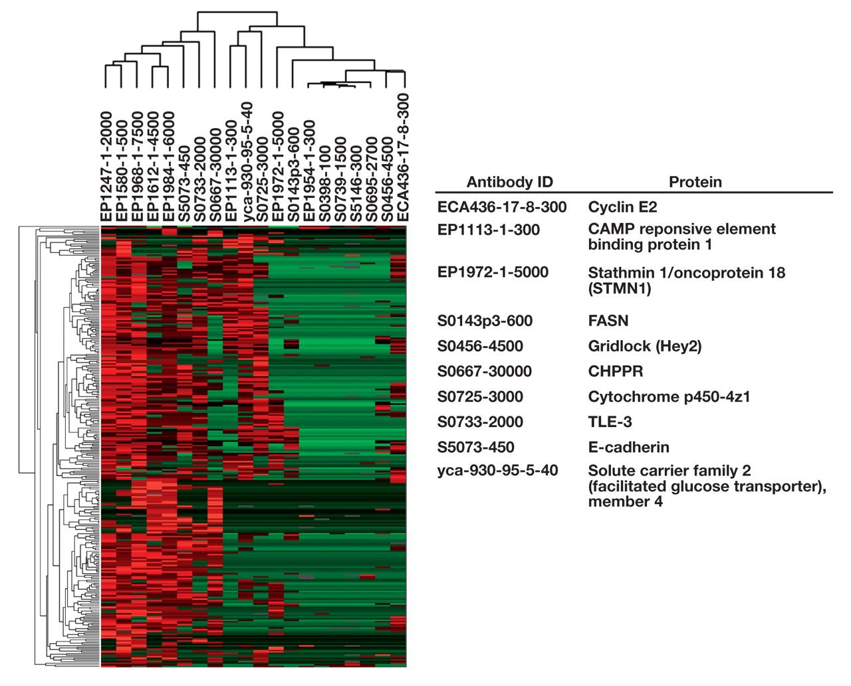
Figure 2 Marker/gene sequence cluster diagram for all malignant cores showing markers demonstrating the greatest ...
Notes:
Figure 2 Marker/gene sequence cluster diagram for all malignant cores showing markers demonstrating the greatest variability in the malignant tissue group.
Unless provided in the caption above, the following copyright applies to the content of this slide: © American Society for Clinical Pathology

Slide 7
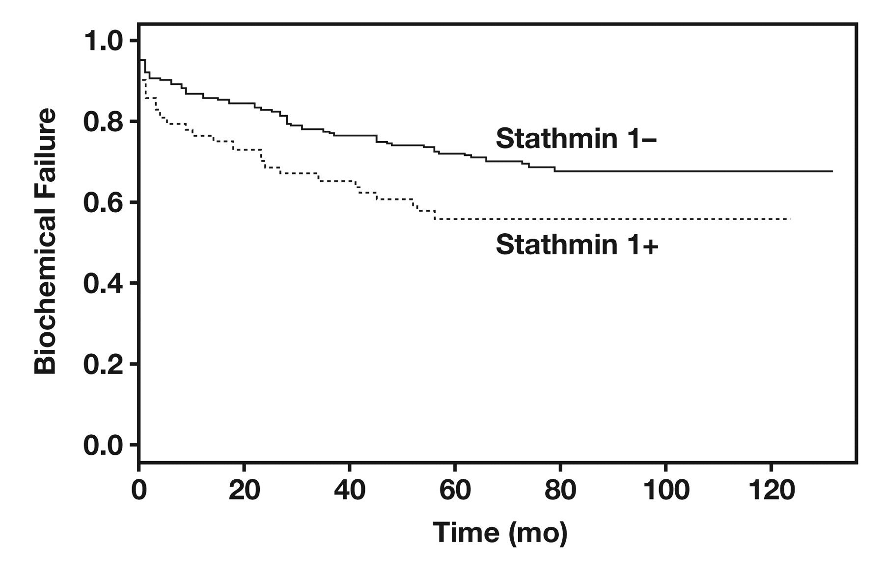
Figure 3 Kaplan-Meier estimate curve demonstrating biochemical failure–free probability for stathmin 1, a ...
Notes:
Figure 3 Kaplan-Meier estimate curve demonstrating biochemical failure–free probability for stathmin 1, a statistically significant prognostic marker.
Unless provided in the caption above, the following copyright applies to the content of this slide: © American Society for Clinical Pathology

Slide 8
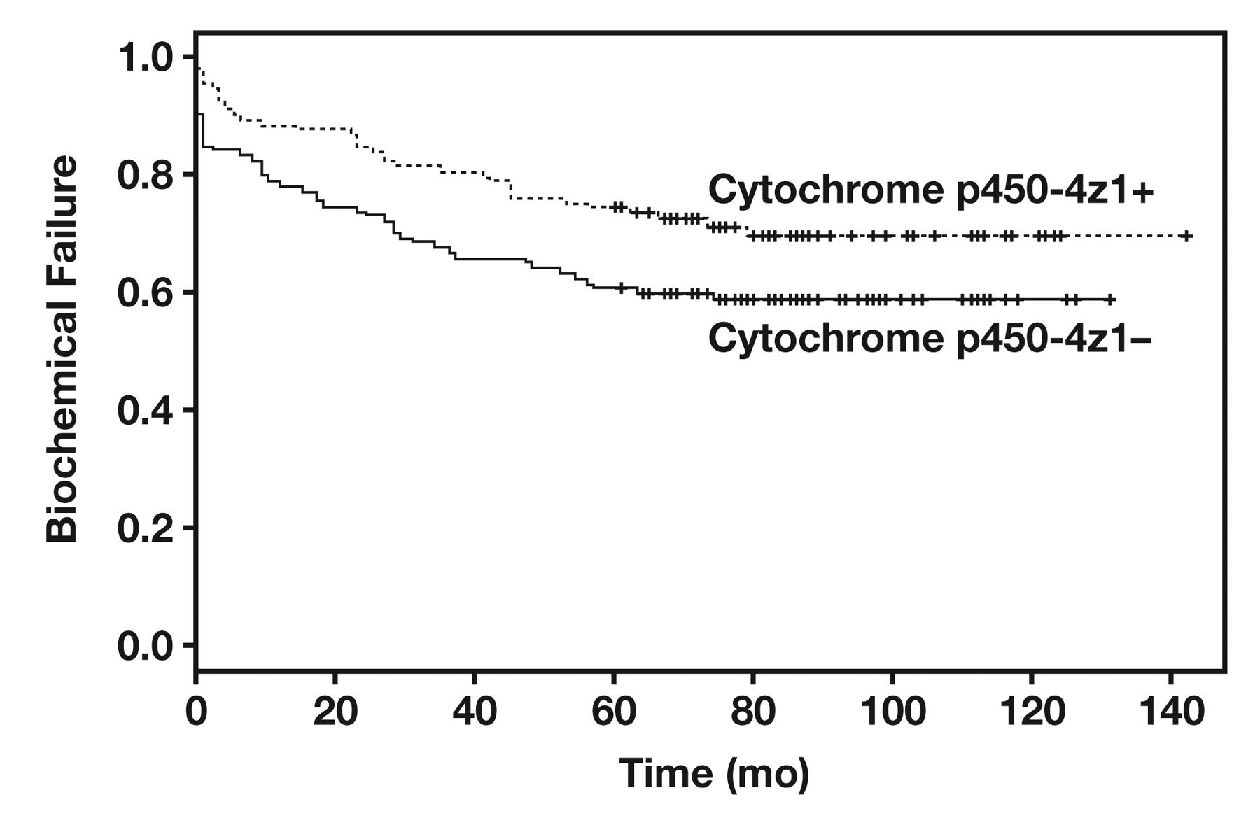
Figure 4 Kaplan-Meier estimate curve demonstrating biochemical failure–free probability for cytochrome p450-4z1, a ...
Notes:
Figure 4 Kaplan-Meier estimate curve demonstrating biochemical failure–free probability for cytochrome p450-4z1, a statistically significant prognostic marker.
Unless provided in the caption above, the following copyright applies to the content of this slide: © American Society for Clinical Pathology

Slide 9
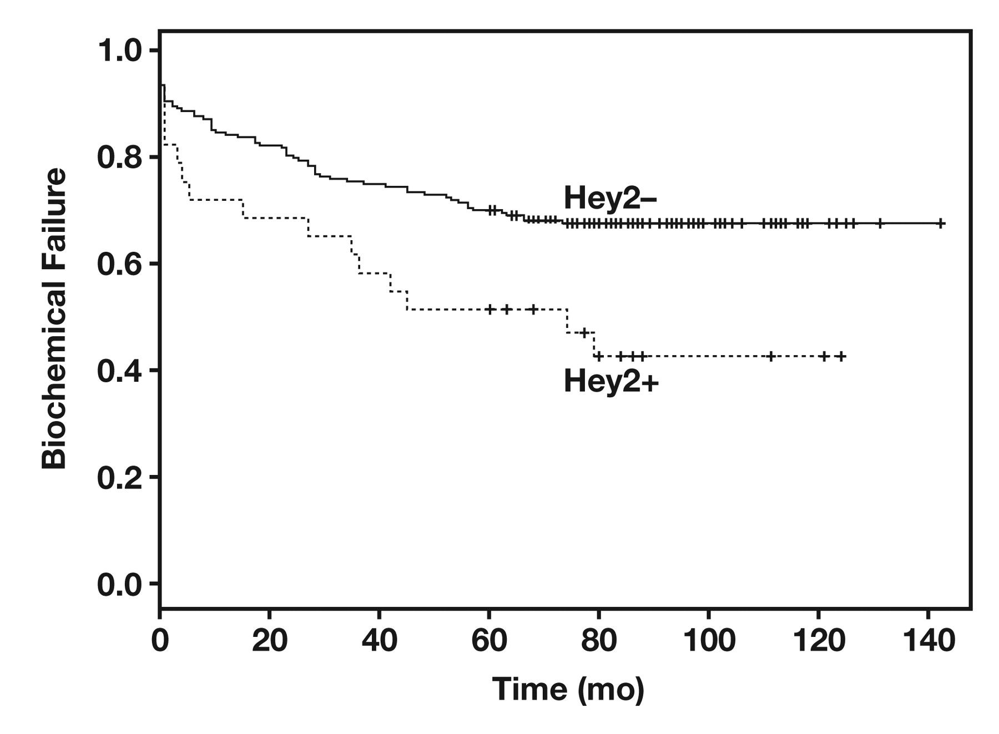
Figure 5 Kaplan-Meier estimate curve demonstrating biochemical failure–free probability for Hey2, a statistically ...
Notes:
Figure 5 Kaplan-Meier estimate curve demonstrating biochemical failure–free probability for Hey2, a statistically significant prognostic marker.
Unless provided in the caption above, the following copyright applies to the content of this slide: © American Society for Clinical Pathology

Slide 10
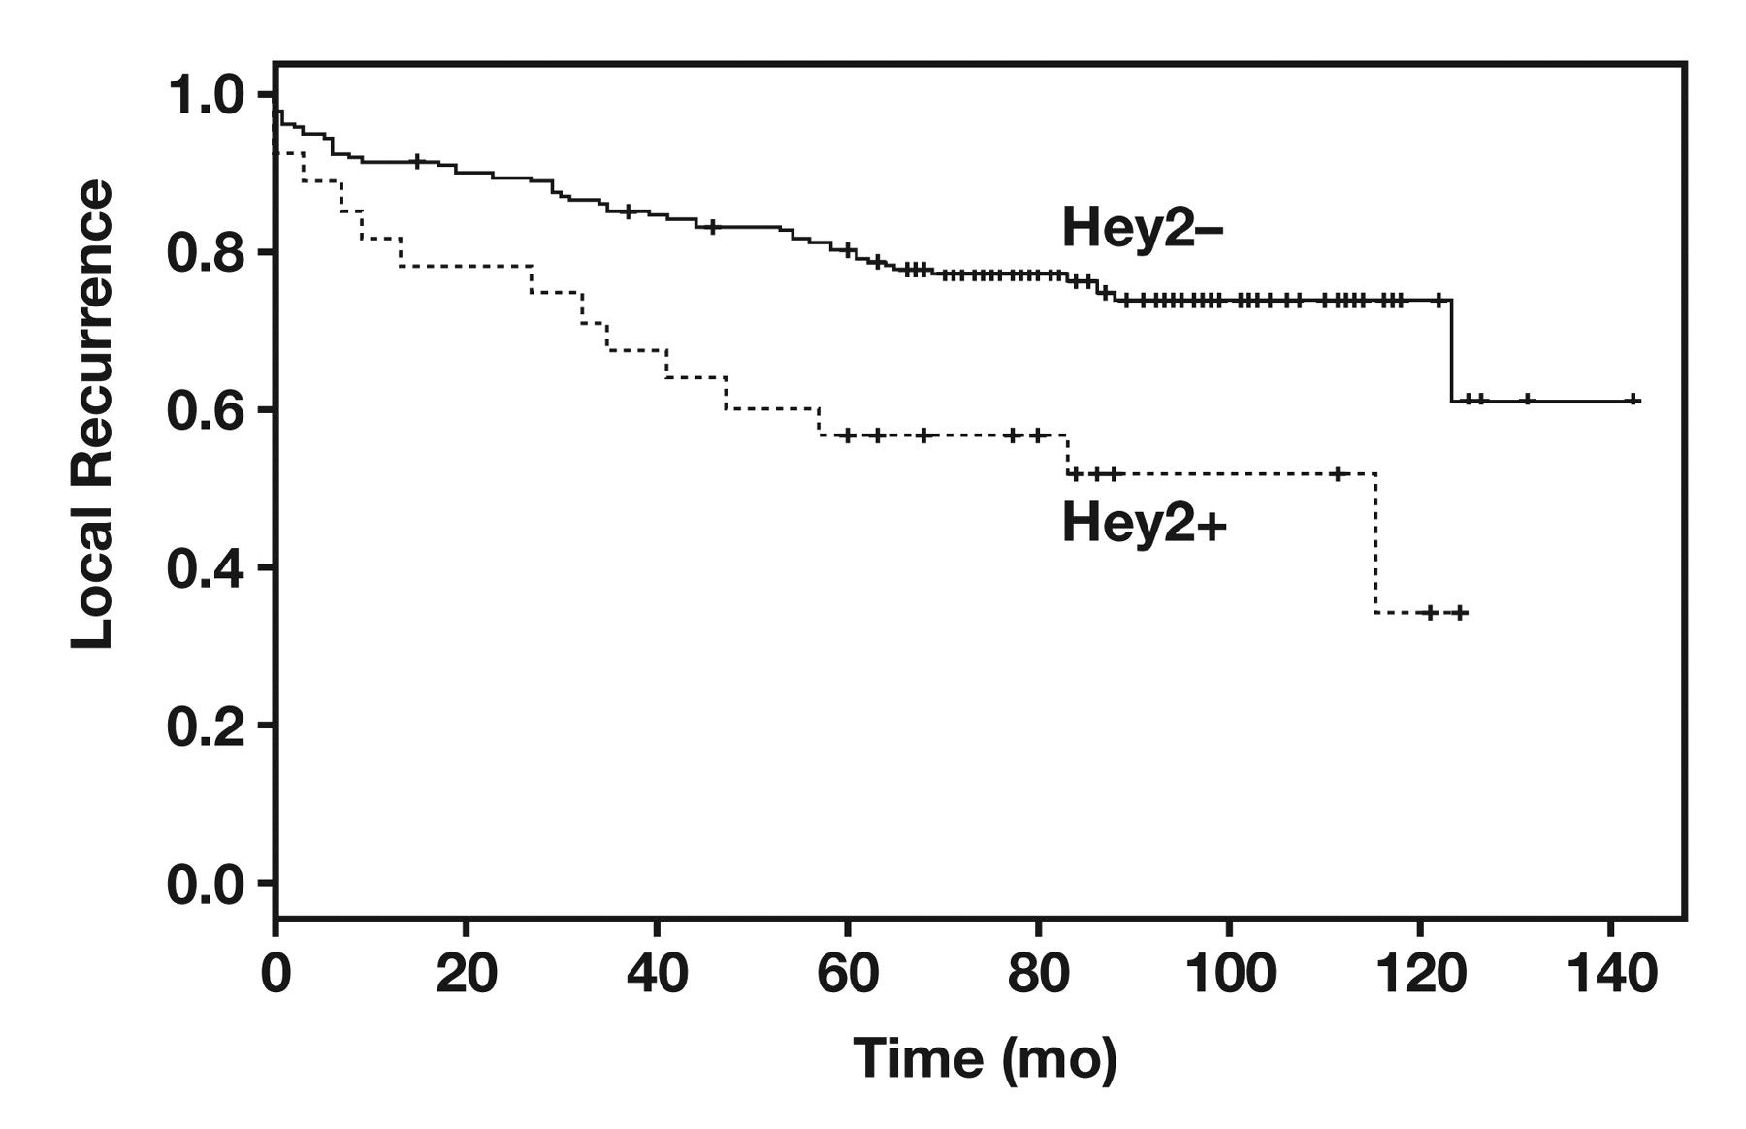
Figure 6 Kaplan-Meier estimate curve demonstrating local recurrence–free probability for Hey2, a statistically ...
Notes:
Figure 6 Kaplan-Meier estimate curve demonstrating local recurrence–free probability for Hey2, a statistically significant prognostic marker.
Unless provided in the caption above, the following copyright applies to the content of this slide: © American Society for Clinical Pathology

Slide 11
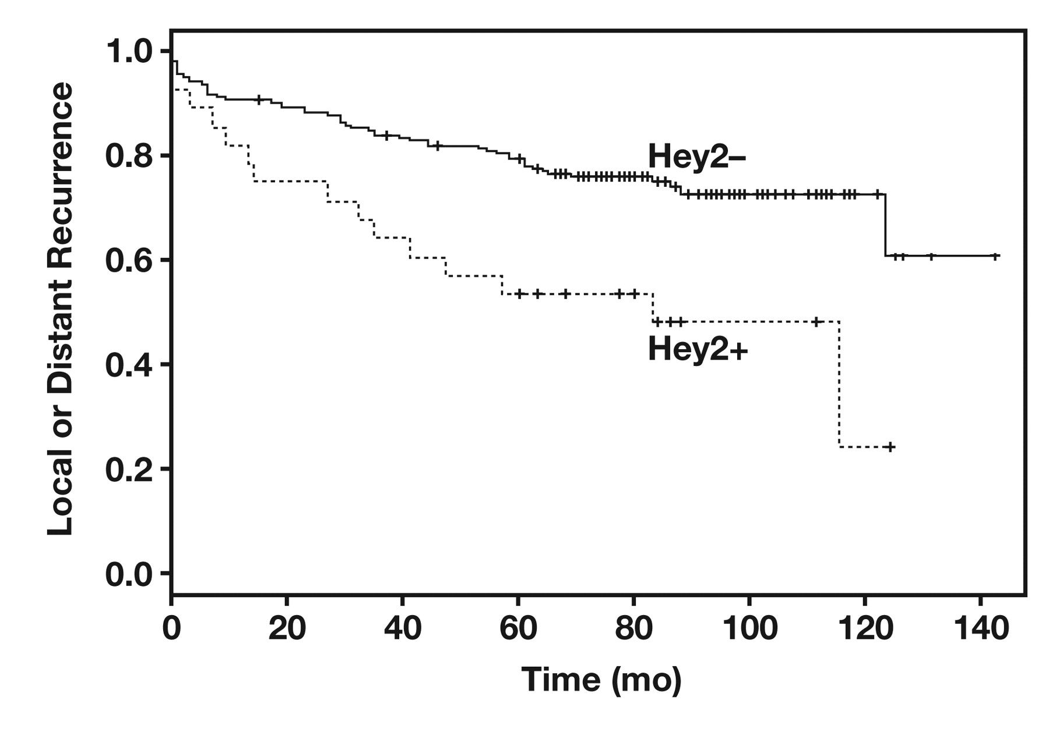
Figure 7 Kaplan-Meier estimate curve demonstrating local or distant recurrence–free probability for Hey2, a ...
Notes:
Figure 7 Kaplan-Meier estimate curve demonstrating local or distant recurrence–free probability for Hey2, a statistically significant prognostic marker.
Unless provided in the caption above, the following copyright applies to the content of this slide: © American Society for Clinical Pathology

Slide 12
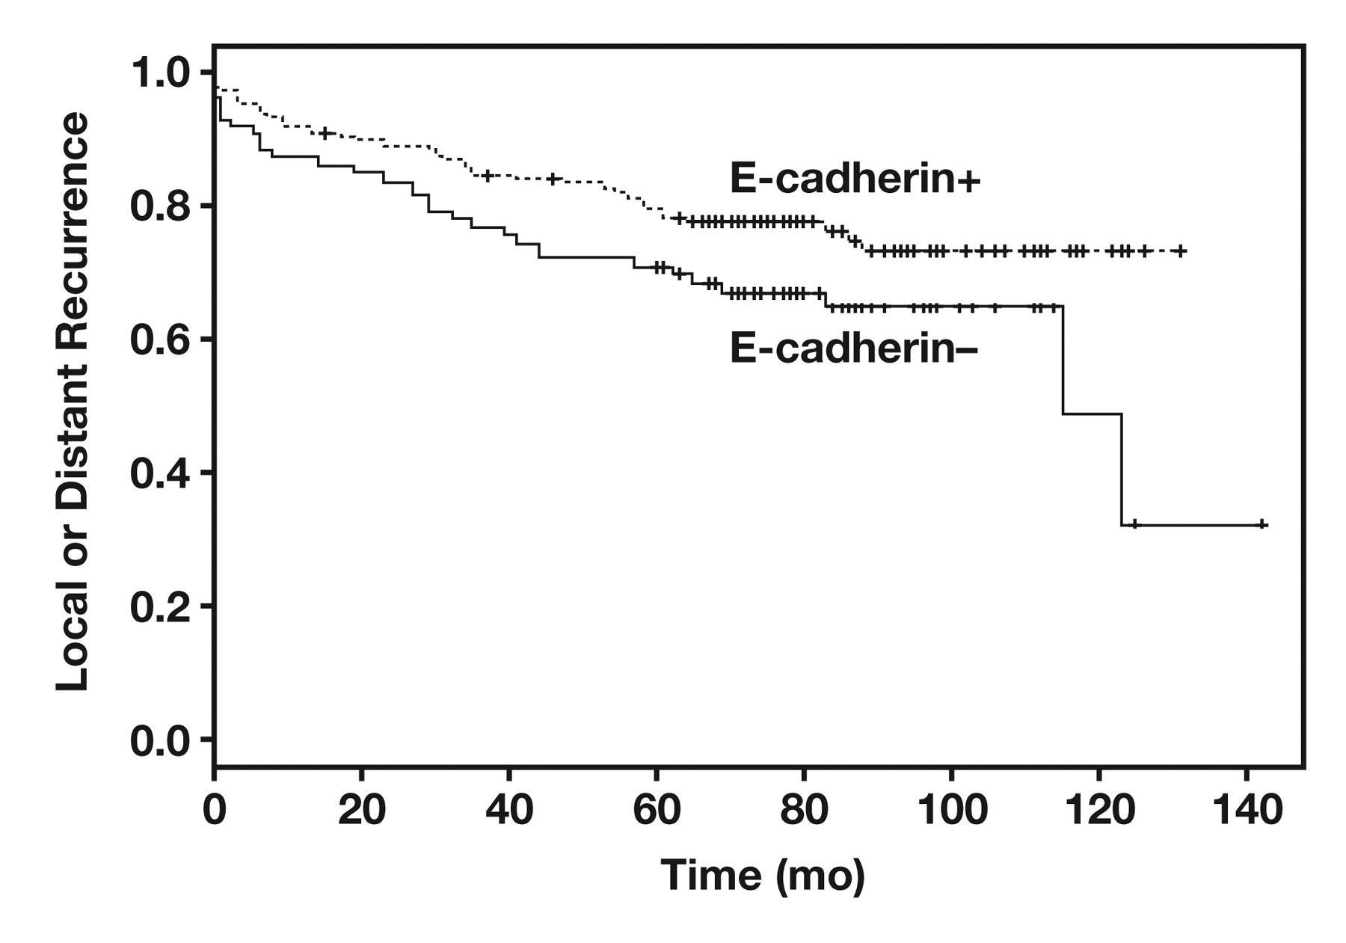
Figure 8 Kaplan-Meier estimate curve demonstrating local or distant recurrence–free probability for E-cadherin, a ...
Notes:
Figure 8 Kaplan-Meier estimate curve demonstrating local or distant recurrence–free probability for E-cadherin, a statistically significant prognostic marker.
Unless provided in the caption above, the following copyright applies to the content of this slide: © American Society for Clinical Pathology

Slide 13
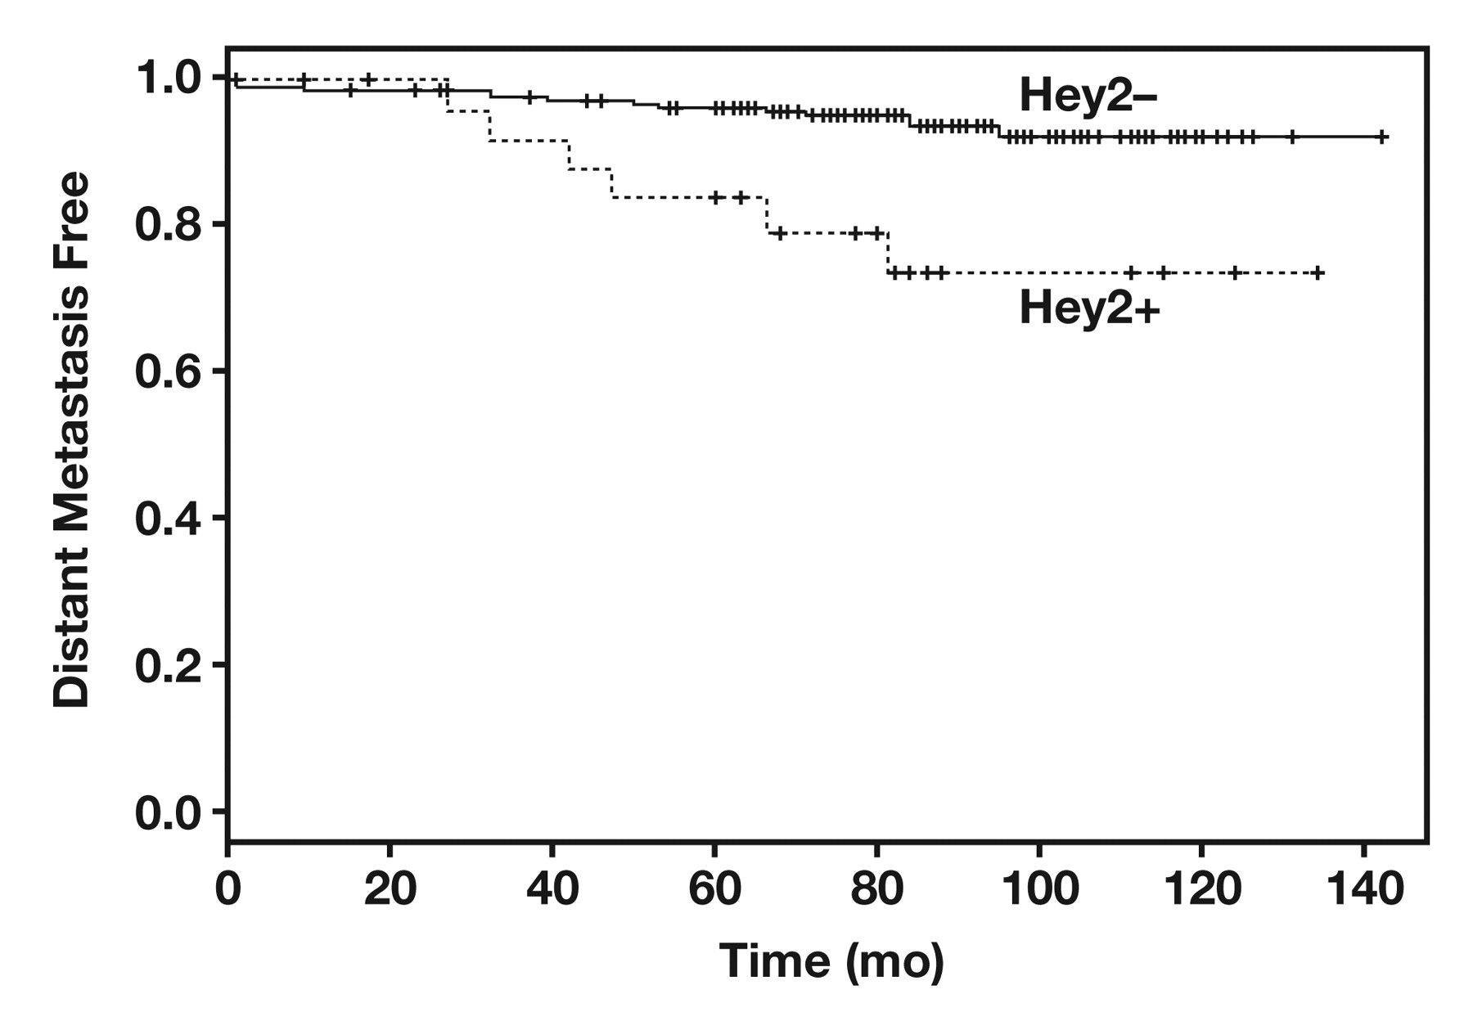
Figure 9 Kaplan-Meier estimate curve demonstrating distant metastasis–free probability for Hey2, a statistically ...
Notes:
Figure 9 Kaplan-Meier estimate curve demonstrating distant metastasis–free probability for Hey2, a statistically significant prognostic marker.
Unless provided in the caption above, the following copyright applies to the content of this slide: © American Society for Clinical Pathology

Slide 14
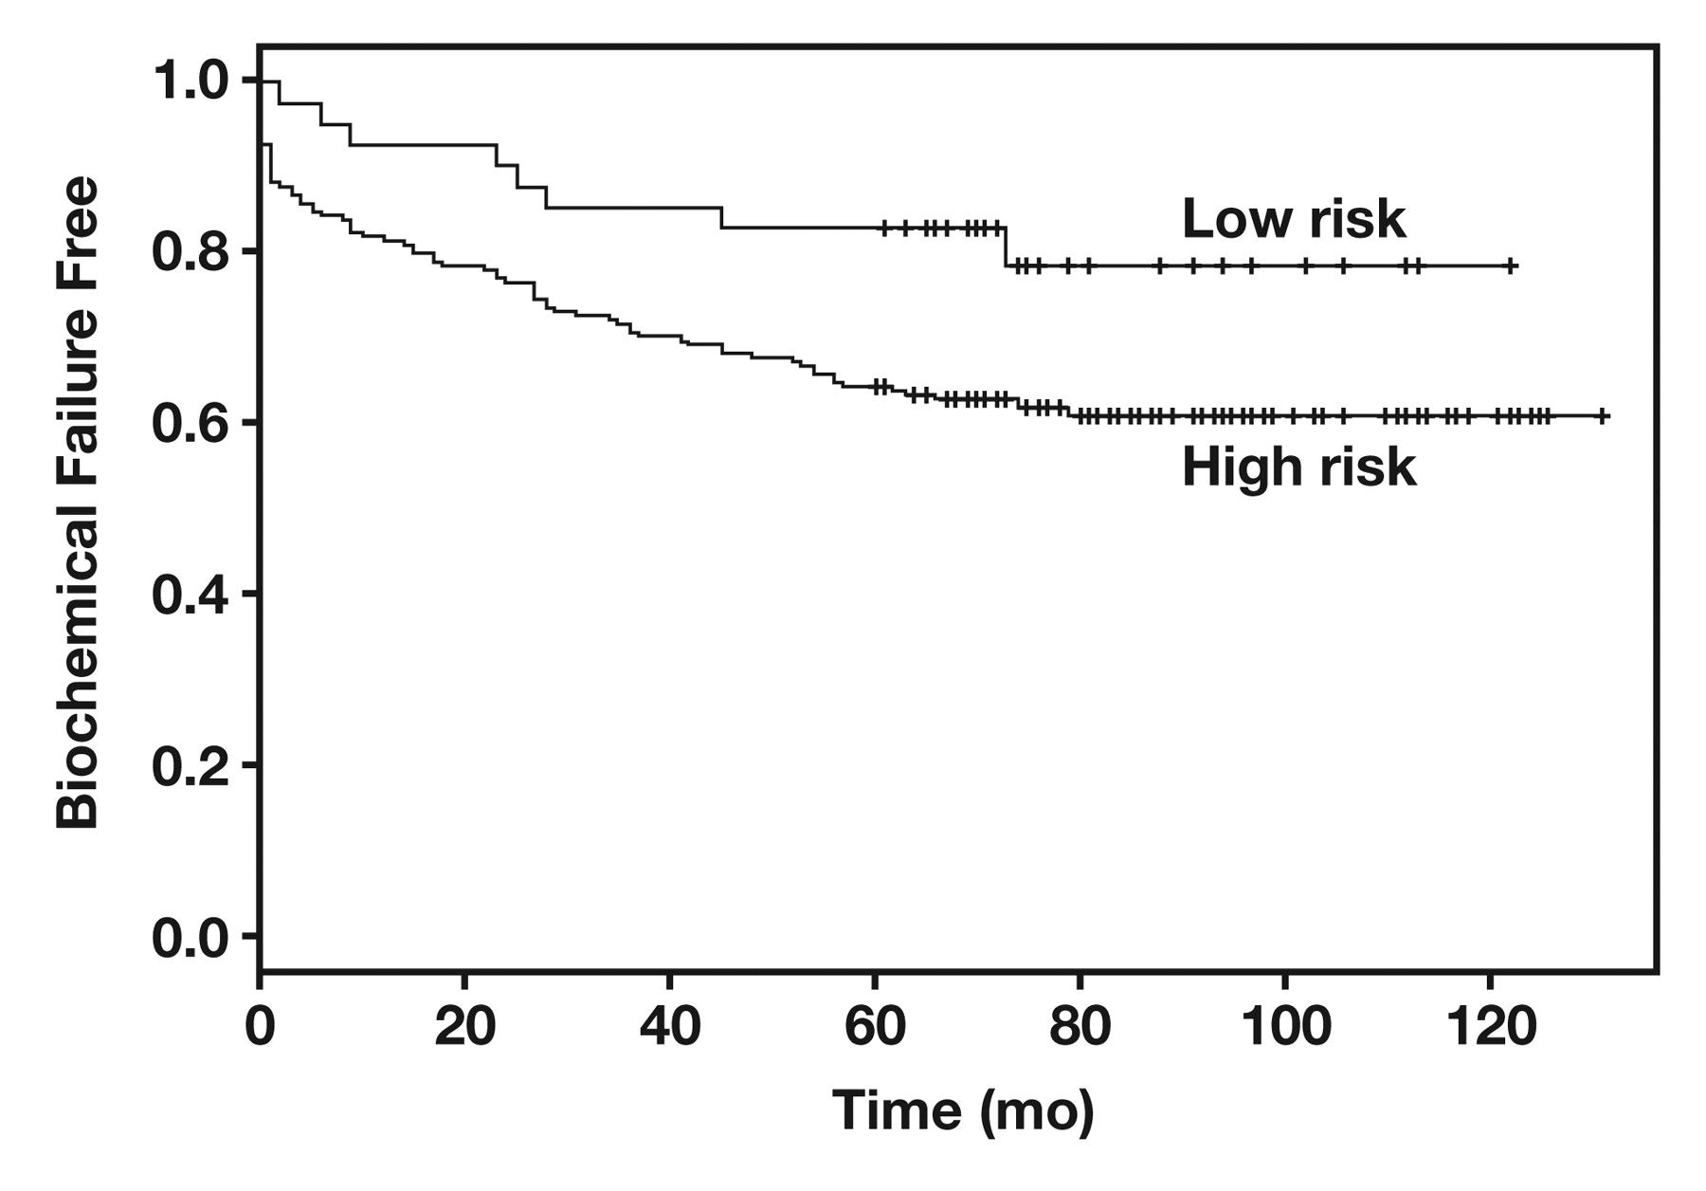
Figure 10 Kaplan-Meier estimate curve demonstrating biochemical failure–free probability for a 4-antibody model. The 4 ...
Notes:
Figure 10 Kaplan-Meier estimate curve demonstrating biochemical failure–free probability for a 4-antibody model. The 4 antibodies were stathmin 1, cytochrome p450-4z1, Hey2, and E-cadherin.
Unless provided in the caption above, the following copyright applies to the content of this slide: © American Society for Clinical Pathology

Slide 15
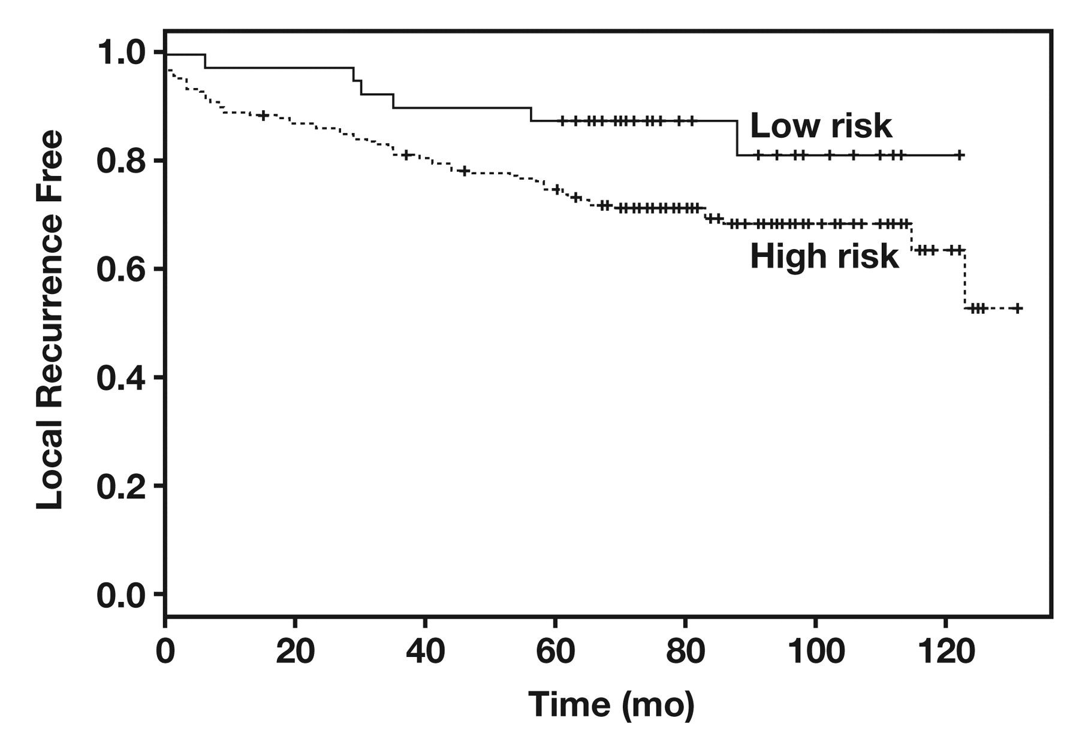
Figure 11 Kaplan-Meier estimate curve demonstrating local recurrence–free probability for a 4-antibody model. The 4 ...
Notes:
Figure 11 Kaplan-Meier estimate curve demonstrating local recurrence–free probability for a 4-antibody model. The 4 antibodies were stathmin 1, cytochrome p450-4z1, Hey2, and E-cadherin.
Unless provided in the caption above, the following copyright applies to the content of this slide: © American Society for Clinical Pathology

Slide 16
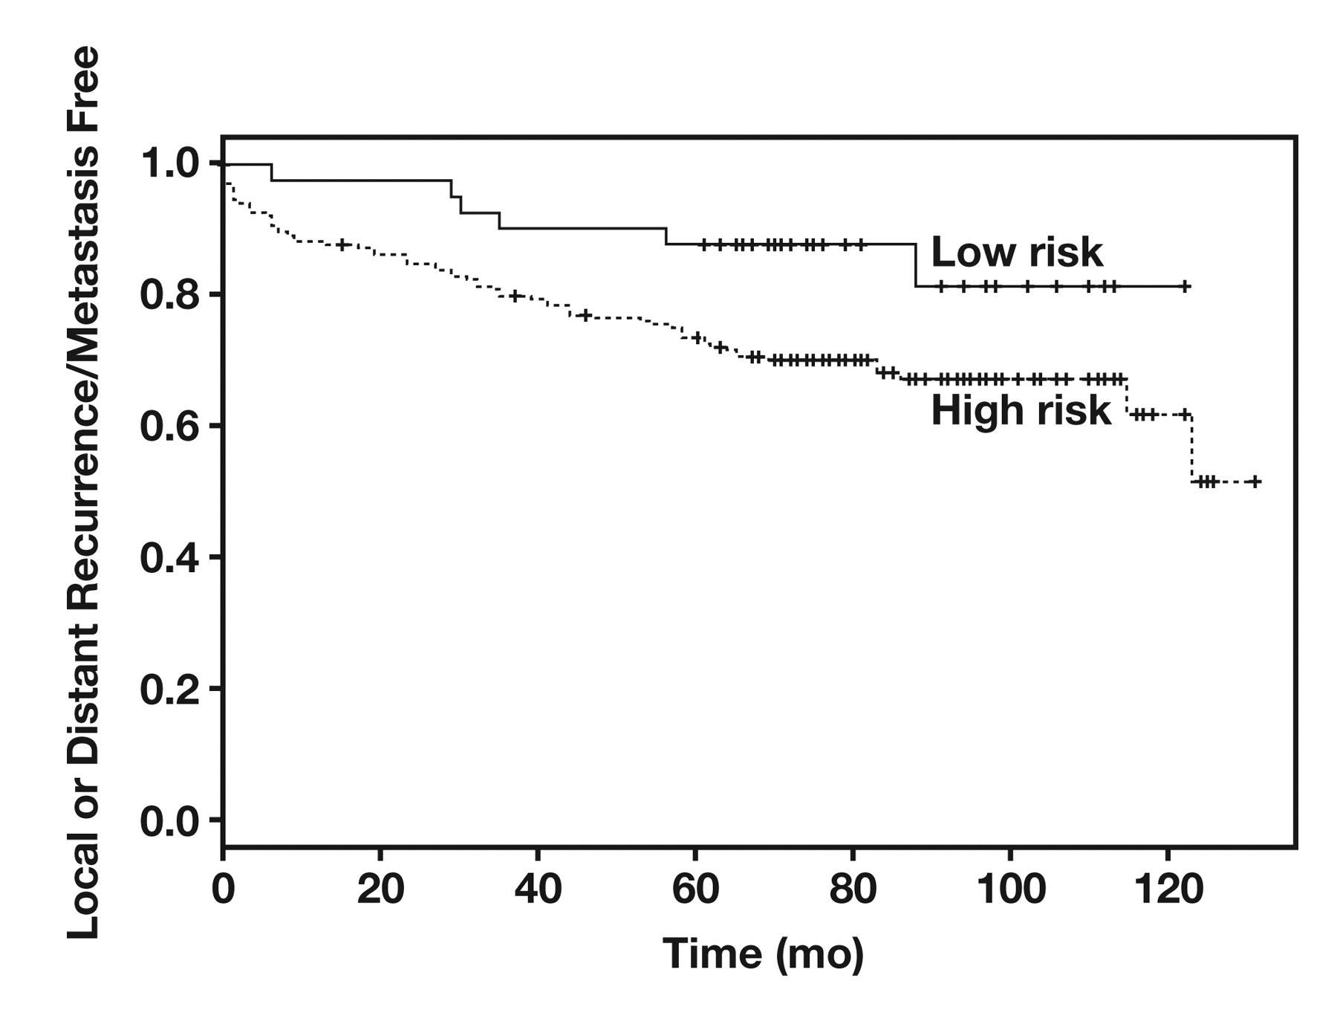
Figure 12 Kaplan-Meier estimate curve demonstrating local or distant recurrence/metastasis–free probability for a ...
Notes:
Figure 12 Kaplan-Meier estimate curve demonstrating local or distant recurrence/metastasis–free probability for a 4-antibody model. The 4 antibodies were stathmin 1, cytochrome p450-4z1, Hey2, and E-cadherin.
Unless provided in the caption above, the following copyright applies to the content of this slide: © American Society for Clinical Pathology

Slide 17
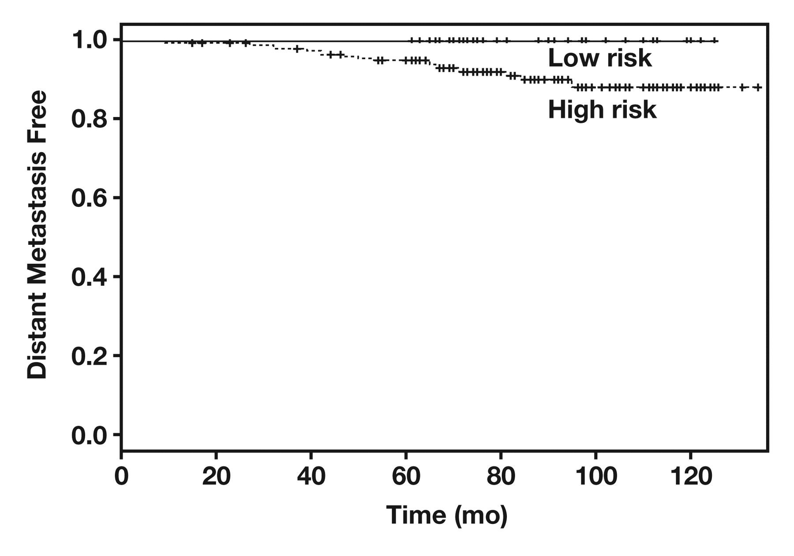
Figure 13 Kaplan-Meier estimate curve demonstrating distant metastasis–free probability for a 4-antibody model. The 4 ...
Notes:
Figure 13 Kaplan-Meier estimate curve demonstrating distant metastasis–free probability for a 4-antibody model. The 4 antibodies were stathmin 1, cytochrome p450-4z1, Hey2, and E-cadherin.
Unless provided in the caption above, the following copyright applies to the content of this slide: © American Society for Clinical Pathology

