Slide 1
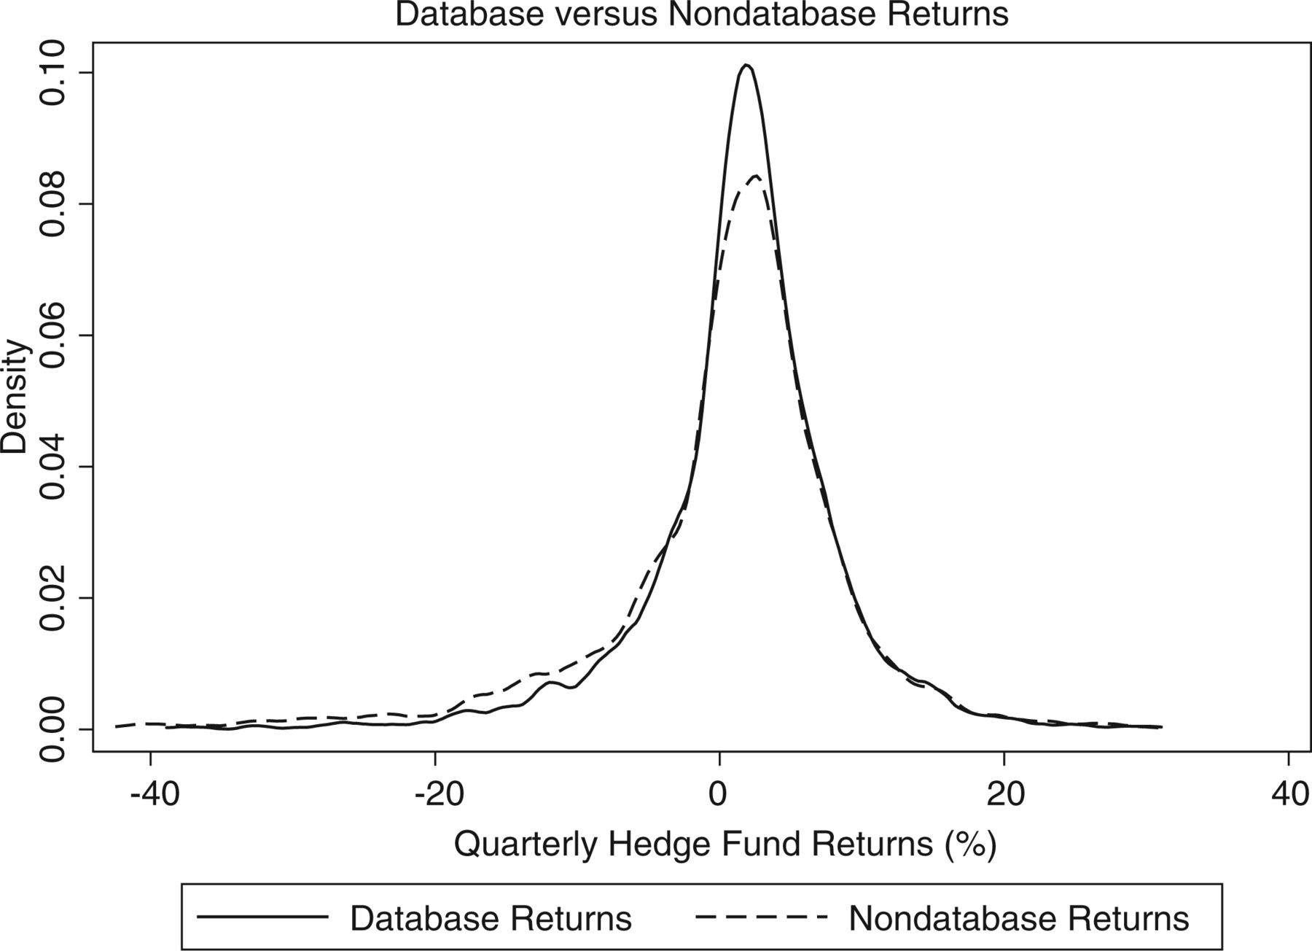
Figure 1 Kernel density estimations Figure 1 compares the distribution of returns found in the union of commercial ...
Notes:
Figure 1 Kernel density estimations Figure 1 compares the distribution of returns found in the union of commercial databases to those returns not reported to a database.
Unless provided in the caption above, the following copyright applies to the content of this slide: © The Author 2012. Published by Oxford University Press on behalf of The Society for Financial Studies. All rights reserved. For Permissions, please e-mail: journals.permissions@oup.com.

Slide 2
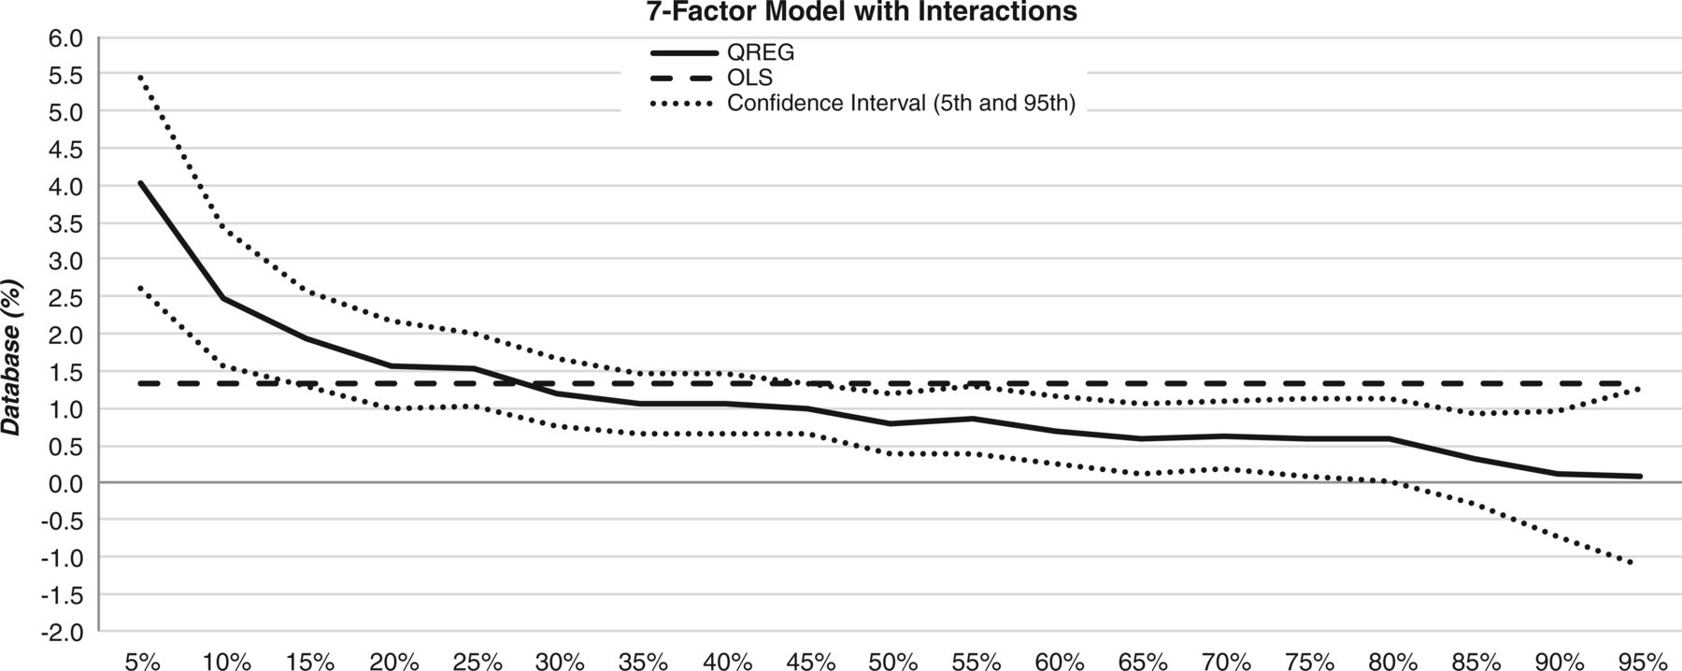
Figure 2 Estimates of database indicator by return quantile Figure 2 reports different estimates of the database ...
Notes:
Figure 2 Estimates of database indicator by return quantile Figure 2 reports different estimates of the database coefficient from a quantile regression using the Fung and Hsieh (2004) 7-factor model and interactions with the risk factors. The confidence interval (5% and 95%) for the coefficient is also shown. The coefficient estimate from the corresponding OLS regression is given for comparison purposes.
Unless provided in the caption above, the following copyright applies to the content of this slide: © The Author 2012. Published by Oxford University Press on behalf of The Society for Financial Studies. All rights reserved. For Permissions, please e-mail: journals.permissions@oup.com.

