Slide 1
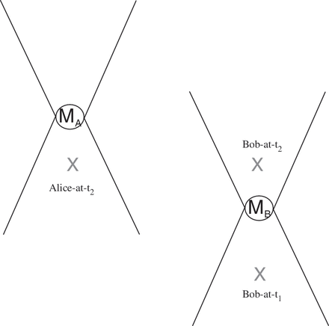
Figure 1. Space-time diagram for non-local correlations (times specified relative to Bob's frame).
Notes:
Figure 1. Space-time diagram for non-local correlations (times specified relative to Bob's frame).
Unless provided in the caption above, the following copyright applies to the content of this slide: © The Author 2012. Published by Oxford University Press on behalf of British Society for the Philosophy of Science. All rights reserved. For Permissions, please email: journals.permissions@oup.com

Slide 2
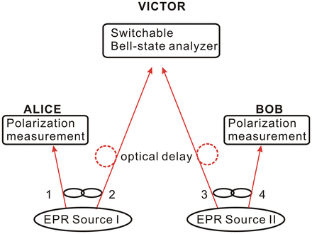
Figure 2. Entanglement swaping.
Notes:
Figure 2. Entanglement swaping.
Unless provided in the caption above, the following copyright applies to the content of this slide: © The Author 2012. Published by Oxford University Press on behalf of British Society for the Philosophy of Science. All rights reserved. For Permissions, please email: journals.permissions@oup.com

