Slide 1
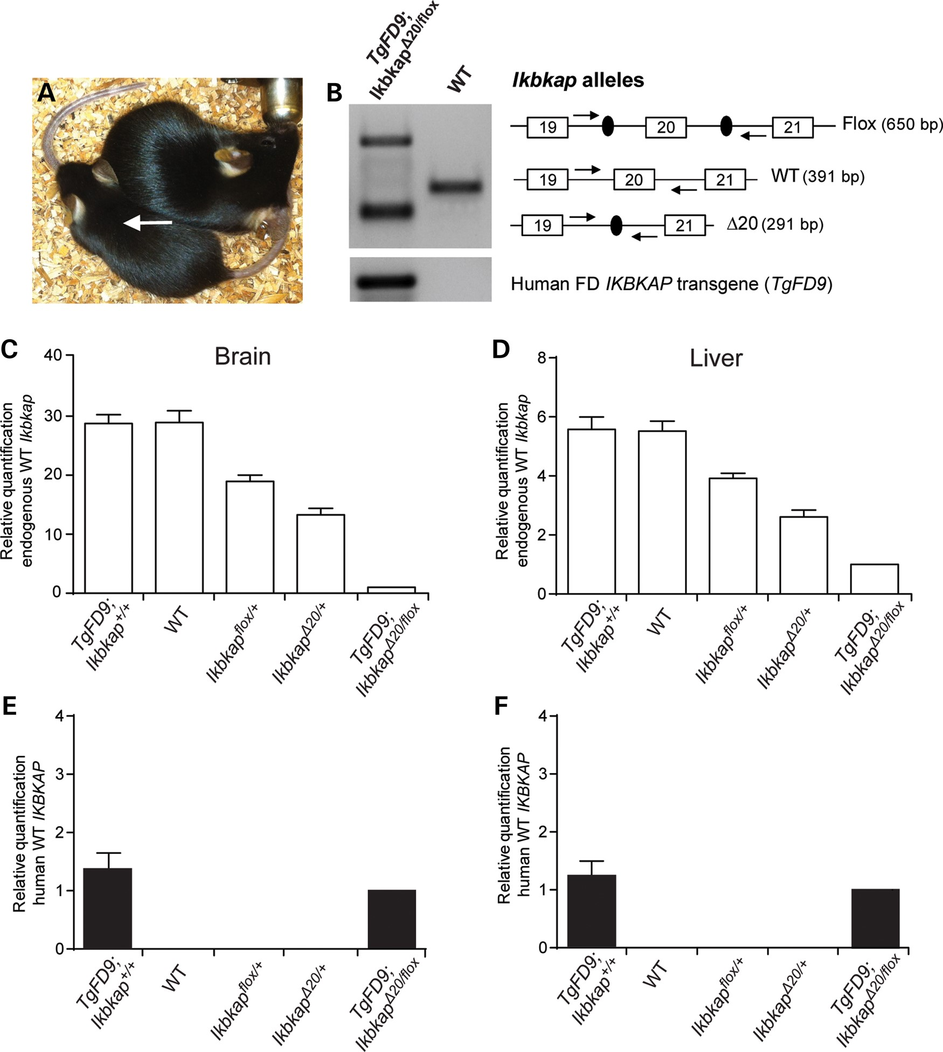
Figure 1. Generation of TgFD9; Ikbkap^{Δ20/flox} mouse model. (A) Seven-week-old TgFD9; ...
Notes:
Figure 1. Generation of TgFD9; IkbkapΔ20/flox mouse model. (A) Seven-week-old TgFD9; IkbkapΔ20/flox (arrow) and control littermate were photographed side by side. (B) Detection of Ikbkap alleles and human TgFD9 IKBKAP transgene in TgFD9; IkbkapΔ20/flox mouse by PCR on genomic DNA. All PCR products were sequenced to confirm identity. (C and D) qRTPCR of endogenous mouse WT Ikbkap transcripts in brain (C) and liver (D) of TgFD9; Ikbkap+/+ (n = 3), WT (n = 3), IkbkapΔ20/+ (n = 3), Ikbkapflox/+ (n = 3) relative to TgFD9; IkbkapΔ20/flox (n = 3) mice. TgFD9; IkbkapΔ20/flox mice expressed significantly low levels of endogenous WT Ikbkap compared with TgFD9; Ikbkap+/+, WT, IkbkapΔ20/+ and Ikbkapflox/+ mice, P < 0.0001. (E and F) Quantification of human WT IKBKAP transcripts in brain (E) and liver (F) of TgFD9; Ikbkap+/+ (n = 3), WT (n = 3), IkbkapΔ20/+ (n = 3), Ikbkapflox/+ (n = 3) relative to TgFD9; IkbkapΔ20/flox (n = 3) mice. The expression of the human IKBKAP is not significantly different between TgFD9; IkbkapΔ20/flox and TgFD9; Ikbkap+/+ mice. Data are expressed as mean ± SD.
Unless provided in the caption above, the following copyright applies to the content of this slide: © The Author 2016. Published by Oxford University Press. All rights reserved. For Permissions, please email: journals.permissions@oup.com

Slide 2
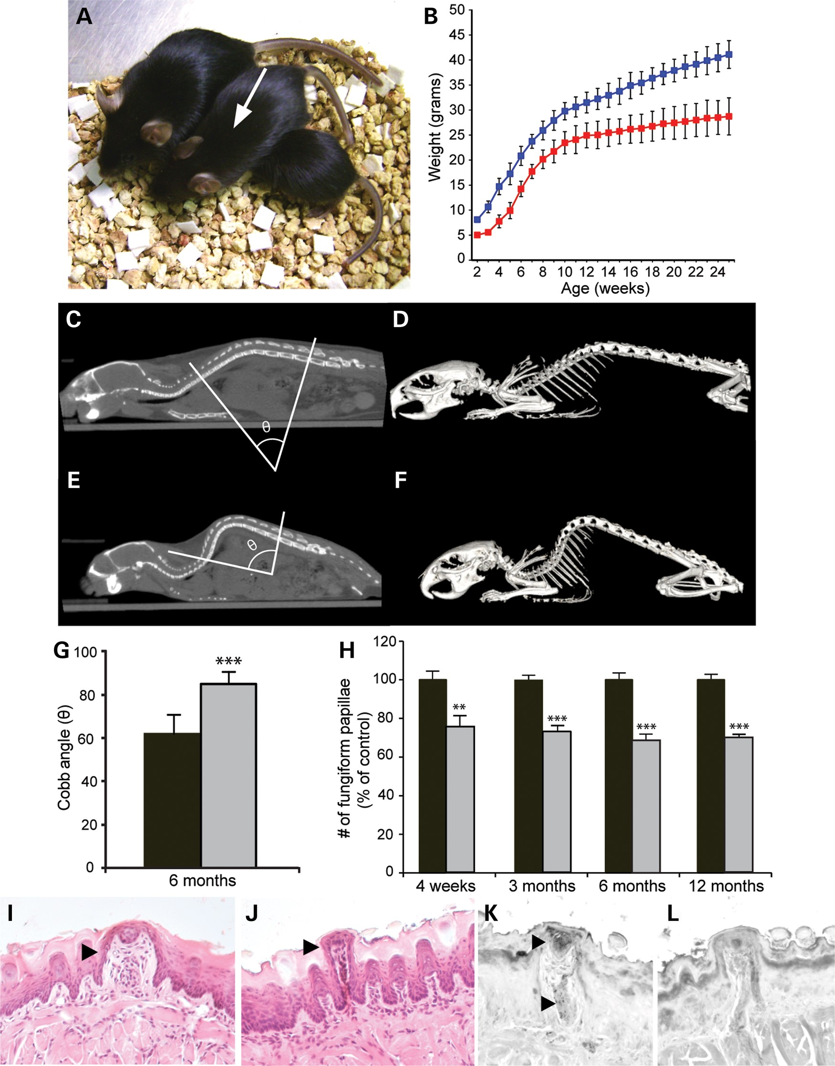
Figure 2. FD phenotypic features in TgFD9; Ikbkap^{Δ20/flox} mouse model. (A) Two-month-old control littermate ...
Notes:
Figure 2. FD phenotypic features in TgFD9; IkbkapΔ20/flox mouse model. (A) Two-month-old control littermate (left), TgFD9; IkbkapΔ20/flox (arrow) and IkbkapΔ20/flox (right) mice were photographed side by side. (B) Postnatal growth curves of TgFD9; IkbkapΔ20/flox (red, n = 6) and control (blue, n = 8) male mice. (C–G) Spinal deformity in TgFD9; IkbkapΔ20/flox mouse. Cobb angle measured in the coronal CT scan in control (C) and TgFD9; IkbkapΔ20/flox (E) mice. Representative three-dimensional CT images of the whole spine of 6-month-old control (D) and TgFD9; IkbkapΔ20/flox (F) mice. Bar chart showing the severity of the kyphosis in TgFD9; IkbkapΔ20/flox (grey, n = 6) and control (black, n = 6) 6-month-old mice (G). (H–L) Analysis of taste-bud papillae on the tongue from TgFD9; IkbkapΔ20/flox mouse. Counts of fungiform papillae using methylene blue staining in control (black, n = 6) and TgFD9; IkbkapΔ20/flox (grey, n = 6) tongues at 4 weeks, 3 months, 6 months and 12 months of age (H). Histological examination of tongue fungiform papillae. H&E staining of tongue coronal section in P23 control (I) and TgFD9; IkbkapΔ20/flox (J) littermates. Transverse paraffin sections of P23 control (K) and TgFD9; IkbkapΔ20/flox (L) tongues were immunostained with anti-CGRP antibody. Note the large number of CGRP-positive axons in WT fungiform papillae in contrast to their near absence in TgFD9; IkbkapΔ20/flox fungiform papillae. Data are expressed as mean ± SD. **P < 0.01, ***P < 0.001.
Unless provided in the caption above, the following copyright applies to the content of this slide: © The Author 2016. Published by Oxford University Press. All rights reserved. For Permissions, please email: journals.permissions@oup.com

Slide 3
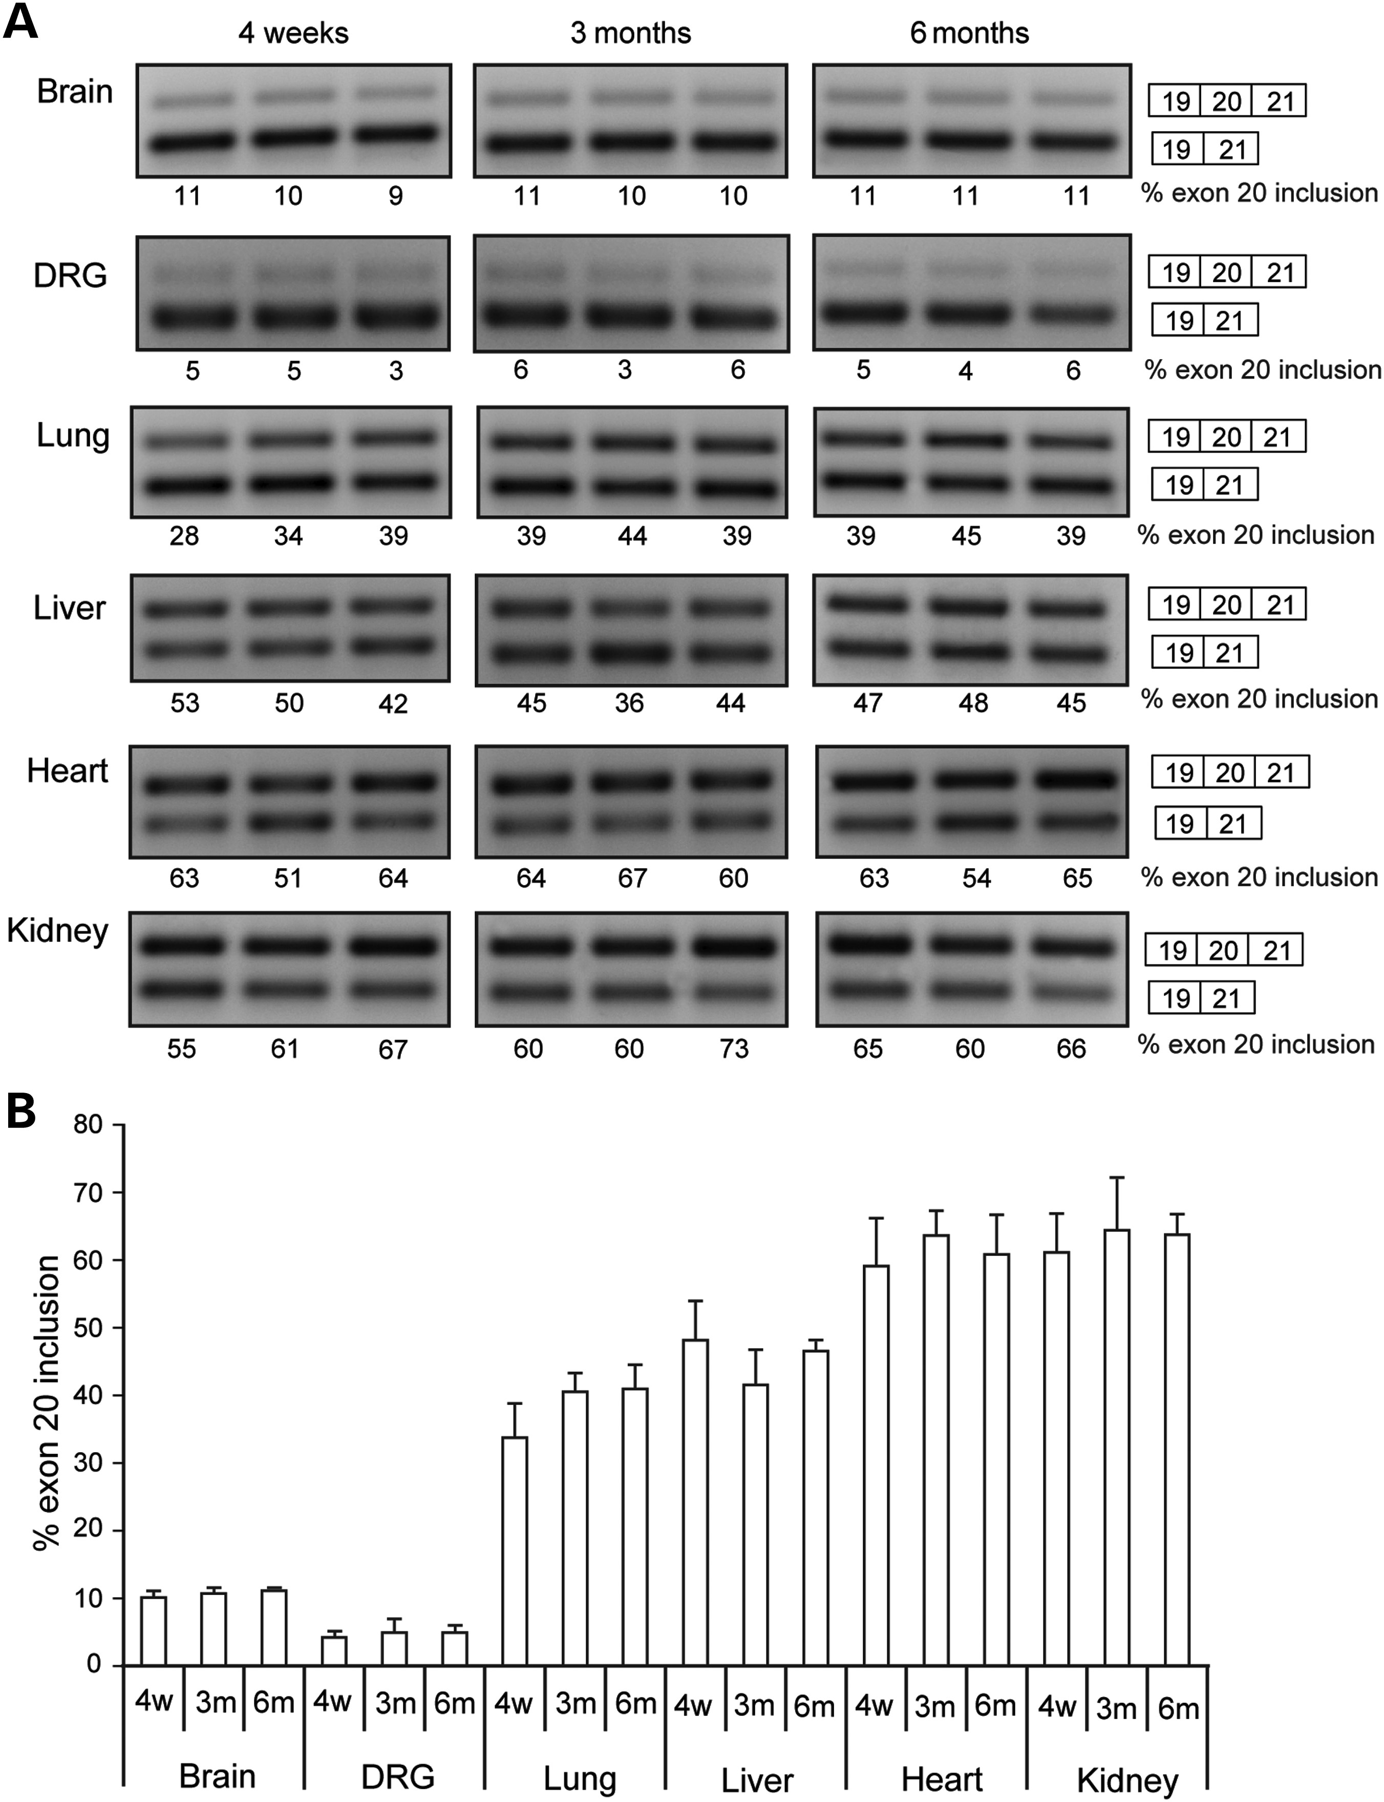
Figure 3. Tissue-specific mis-splicing in TgFD9; Ikbkap^{Δ20/flox} mouse model. (A) Splicing analysis of human ...
Notes:
Figure 3. Tissue-specific mis-splicing in TgFD9; IkbkapΔ20/flox mouse model. (A) Splicing analysis of human IKBKAP transcripts in brain, DRG, lung, liver, heart and kidney from 4-week-old, 3 and 6-month-old TgFD9; IkbkapΔ20/flox mice. (B) Quantification of the percent of exon 20 inclusion in brain, DRG, lung, liver, heart and kidney from TgFD9; IkbkapΔ20/flox mice. Data are expressed as mean ± SD.
Unless provided in the caption above, the following copyright applies to the content of this slide: © The Author 2016. Published by Oxford University Press. All rights reserved. For Permissions, please email: journals.permissions@oup.com

Slide 4
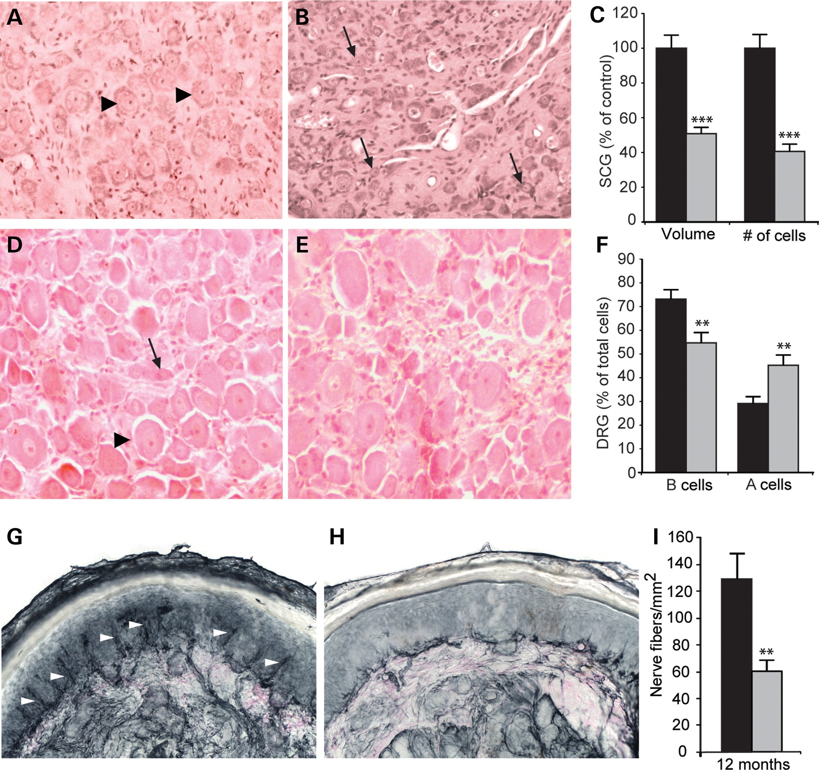
Figure 4. Sensory and sympathetic neuropathology in adult TgFD9; Ikbkap^{Δ20/flox} mice. (A–C) Sympathetic ...
Notes:
Figure 4. Sensory and sympathetic neuropathology in adult TgFD9; IkbkapΔ20/flox mice. (A–C) Sympathetic deficits in adult TgFD9; IkbkapΔ20/flox mice. Representative H&E-stained sections of SCG in control (A) and TgFD9; IkbkapΔ20/flox (B) mice at 18 months of age. Note that large neurons (arrowheads) are abundant in control (A) and that small neurons (arrows) are prevalent in TgFD9; IkbkapΔ20/flox SCG (B). (C) Volumes and total neuronal counts in SCGs from 18-month-old controls (black, n = 4) and TgFD9; IkbkapΔ20/flox (grey, n = 3) mice were calculated from serial paraffin sections spanning the whole ganglia and are expressed as percentage of controls. (D–F) Sensory deficits in adult TgFD9; IkbkapΔ20/flox mice. H&E staining of DRG in control (D) and TgFD9; IkbkapΔ20/flox (E) at 12 months of age. An arrowhead indicates a large light A cell, and an arrow points to a small B cell. (F) Percentage of large light (A cells) and small dark (B cells) neuronal cells over the total number of cells were scored and counted in defined areas encompassing 40–50 neurons in 12-month-old controls (black, n = 4) and TgFD9; IkbkapΔ20/flox (grey, n = 3) mice. (G and H) Evaluation of PGP9.5-positive ENF in 12-month-old TgFD9; IkbkapΔ20/flox and control plantar hindpaw skin. (I) Quantification of ENF density in 12-month-old control (black, n = 10) and TgFD9; IkbkapΔ20/flox (grey, n = 8) plantar hindpaws. Data are expressed as mean ± SD for volumes and neuronal counts. Data are expressed as mean ± SEM for ENF density. **P < 0.01, ***P < 0.001.
Unless provided in the caption above, the following copyright applies to the content of this slide: © The Author 2016. Published by Oxford University Press. All rights reserved. For Permissions, please email: journals.permissions@oup.com

Slide 5
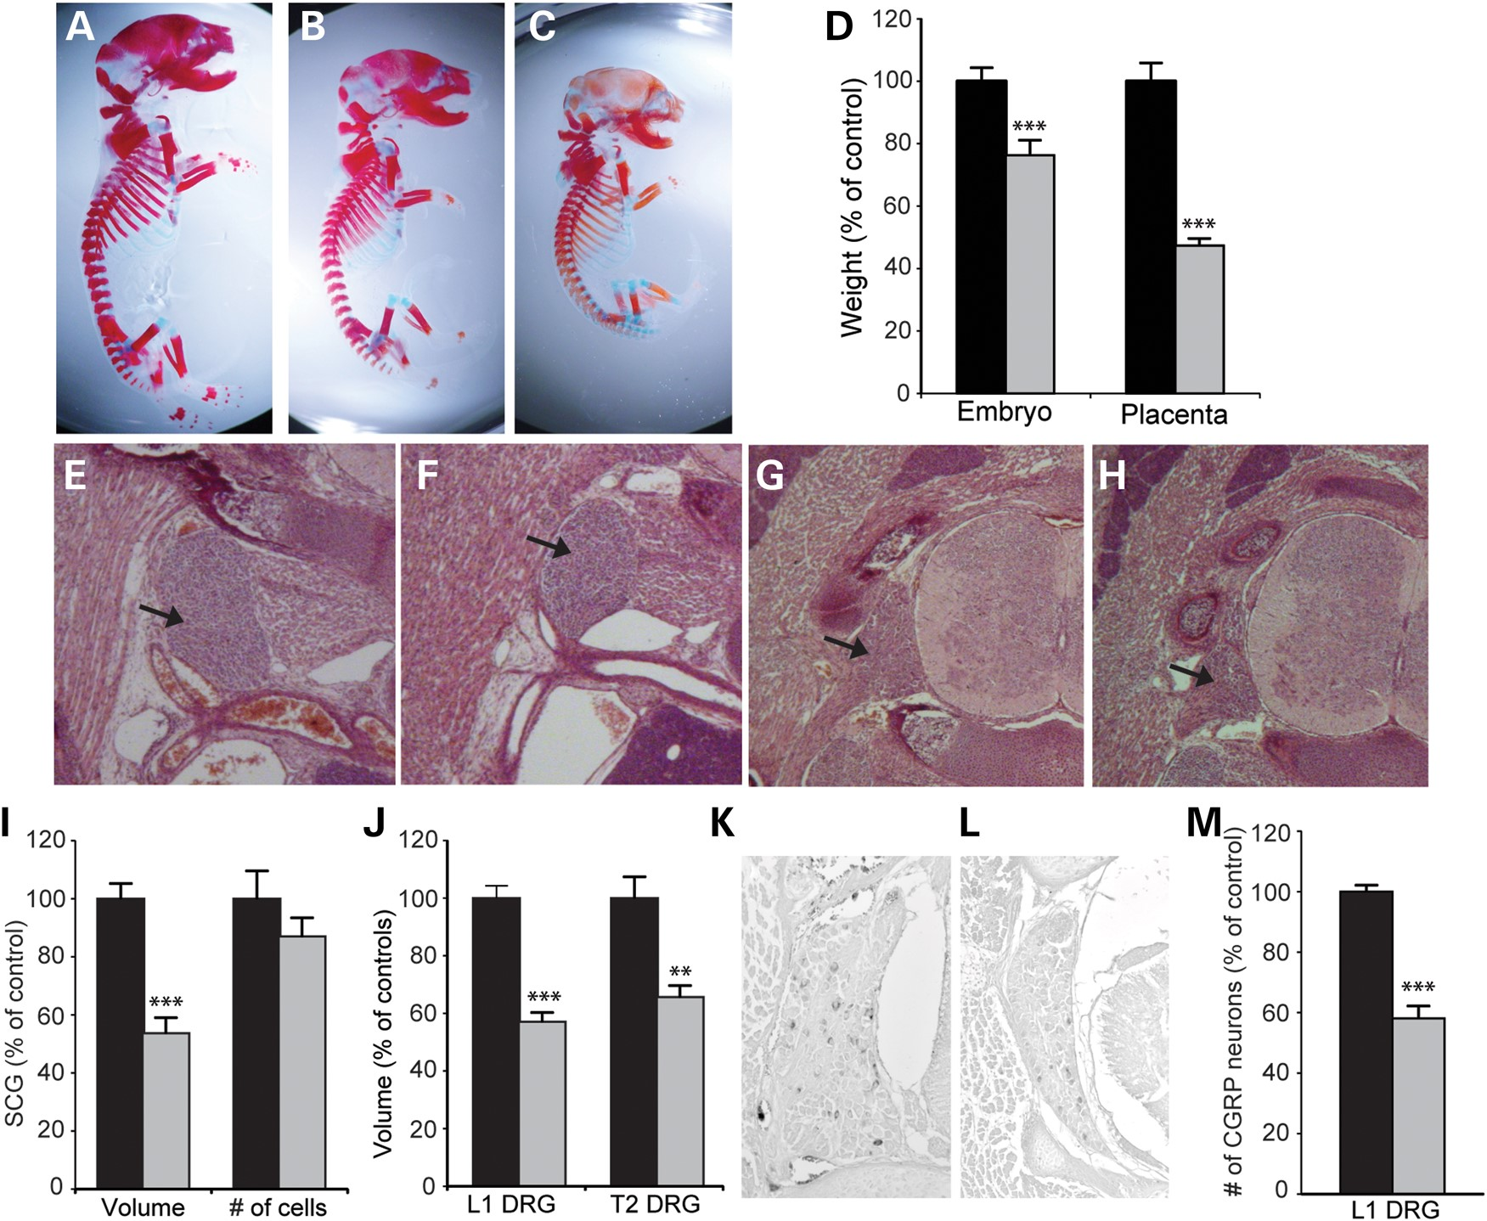
Figure 5. FD phenotypic features in TgFD9; Ikbkap^{Δ20/flox} embryos. (A–C) Control littermate (A), TgFD9; ...
Notes:
Figure 5. FD phenotypic features in TgFD9; IkbkapΔ20/flox embryos. (A–C) Control littermate (A), TgFD9; IkbkapΔ20/flox (B) and IkbkapΔ20/flox (C) E18.5 skeletal preparations photographed at the same magnification. (D) Weights of E18.5 controls (black, n = 5) and TgFD9; IkbkapΔ20/flox (grey, n = 3) embryos and placentas. (E and F) H&E-stained sections of SG of control (E) and TgFD9; IkbkapΔ20/flox (F) E18.5 embryos. (G and H) H&E-stained sections of DRG of control (G) and TgFD9; IkbkapΔ20/flox (H) E18.5 embryos. (I) Volumes and total neuronal counts in E18.5 SCG. (J) Volume of L1 and T2 DRG in controls (black, n = 5) and TgFD9; IkbkapΔ20/flox (grey, n = 3) embryos was normalized to body weight and are displayed as percentage of controls. (K–M) CGRP-positive neurons in E18.5 L1 DRG from control (K) and TgFD9; IkbkapΔ20/flox (L) embryos. Quantification of total CGRP neurons in control (black, n = 3), and (grey, n = 3) embryos (M). Data are presented as percentage of controls. For all graphs, data are expressed as mean ± SD. **P < 0.01, ***P < 0.001.
Unless provided in the caption above, the following copyright applies to the content of this slide: © The Author 2016. Published by Oxford University Press. All rights reserved. For Permissions, please email: journals.permissions@oup.com

