Slide 1
Figure 1. Microglia cells stained with Iba-1 marker and classified according to morphological aspects (Diz-Chaves et ...
Notes:
Figure 1. Microglia cells stained with Iba-1 marker and classified according to morphological aspects (Diz-Chaves et al. 2012). Highlighted, reactive phenotype (from Type III to V). Images at ×40 objective.
Unless provided in the caption above, the following copyright applies to the content of this slide: © The Author 2013. Published by Oxford University Press. All rights reserved. For Permissions, please e-mail: journals.permissions@oup.com

Slide 2
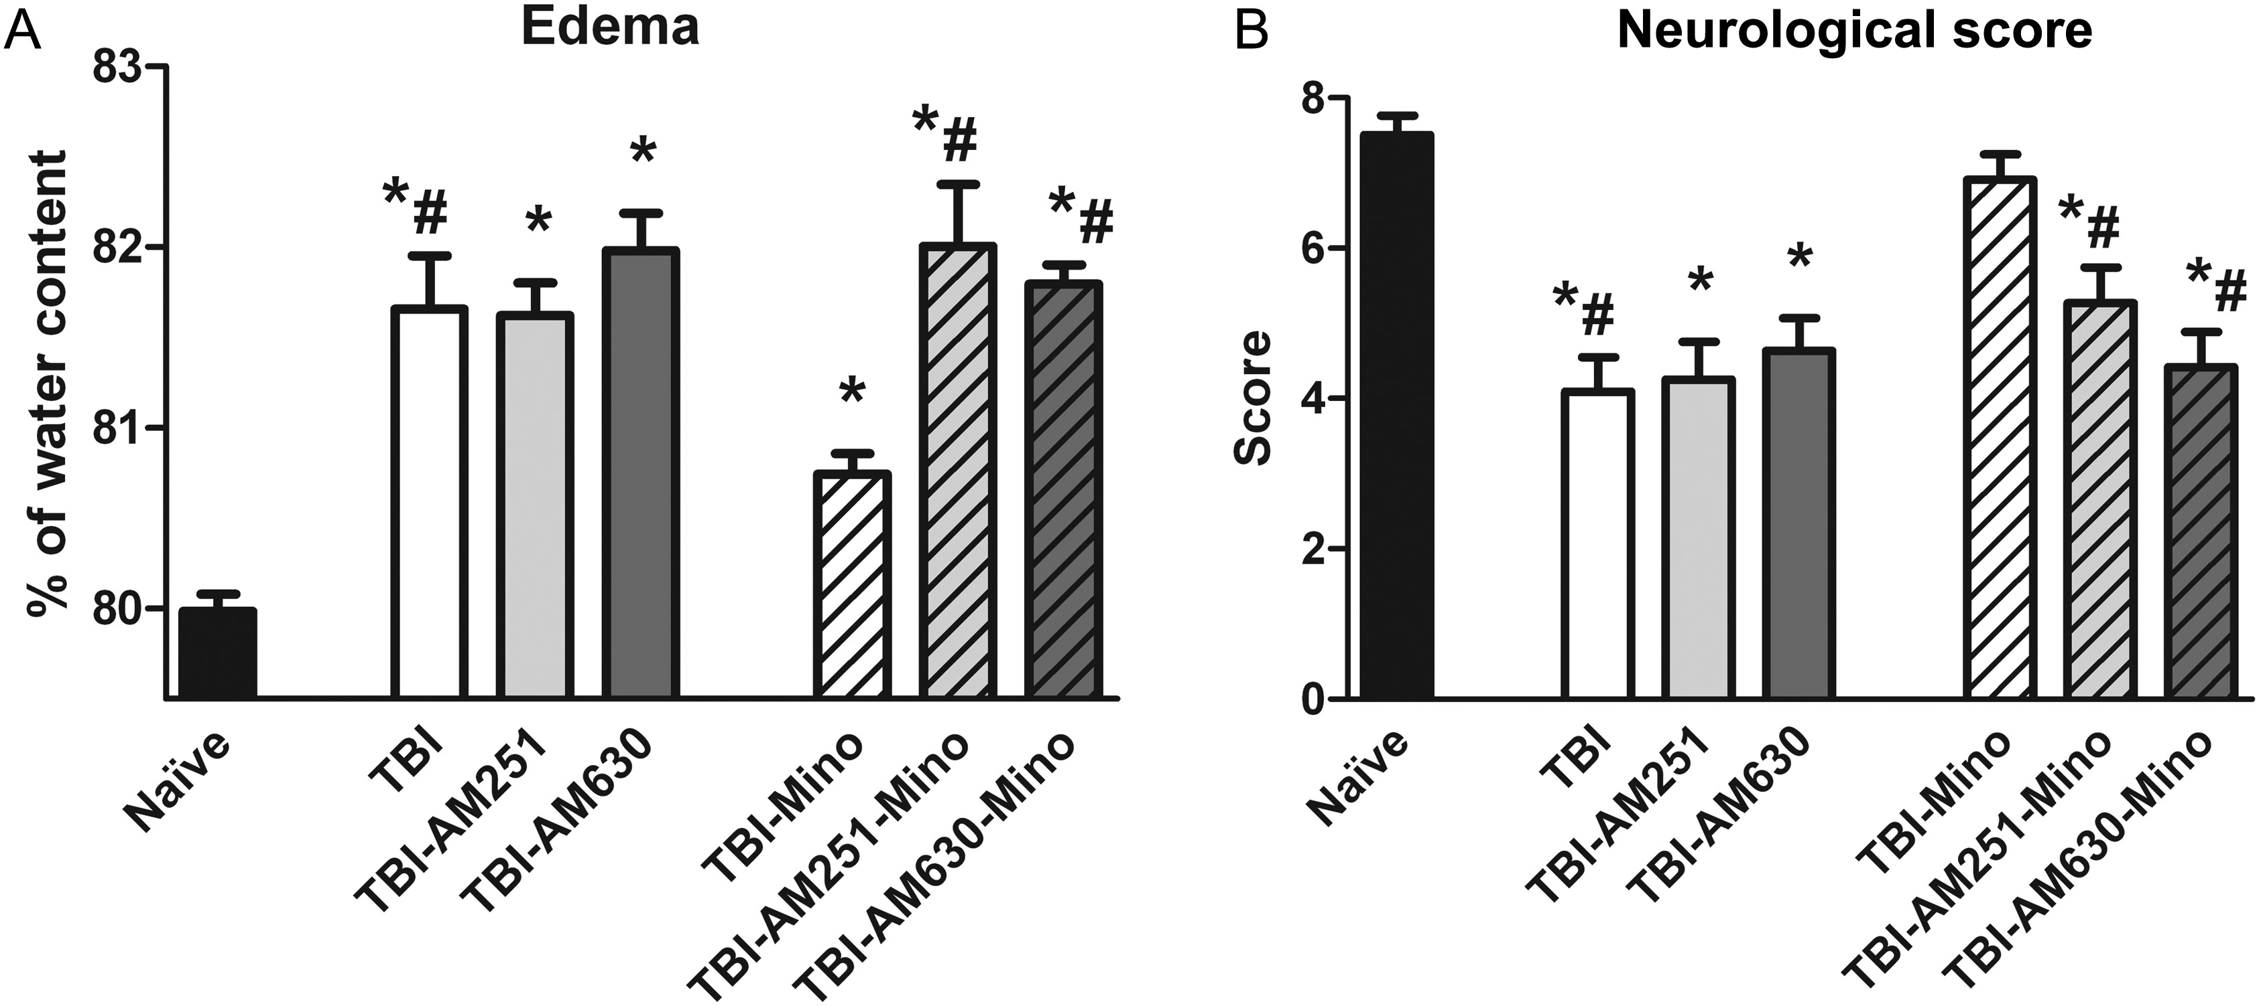
Figure 2. Effects of TBI, minocycline, and cannabinoid receptor antagonists on brain edema and neurological score, 24 h ...
Notes:
Figure 2. Effects of TBI, minocycline, and cannabinoid receptor antagonists on brain edema and neurological score, 24 h after lesion. Histograms represent the mean + SEM (n = 12) of the percentage of water (A) and of the neurological score (B). Naïve, noninjured animals; TBI, traumatic brain injury; AM251, CB1R antagonist; AM630, CB2R antagonist; Mino, minocycline. Significant differences, P < 0.05: * versus naïve; # versus TBI-Mino.
Unless provided in the caption above, the following copyright applies to the content of this slide: © The Author 2013. Published by Oxford University Press. All rights reserved. For Permissions, please e-mail: journals.permissions@oup.com

Slide 3
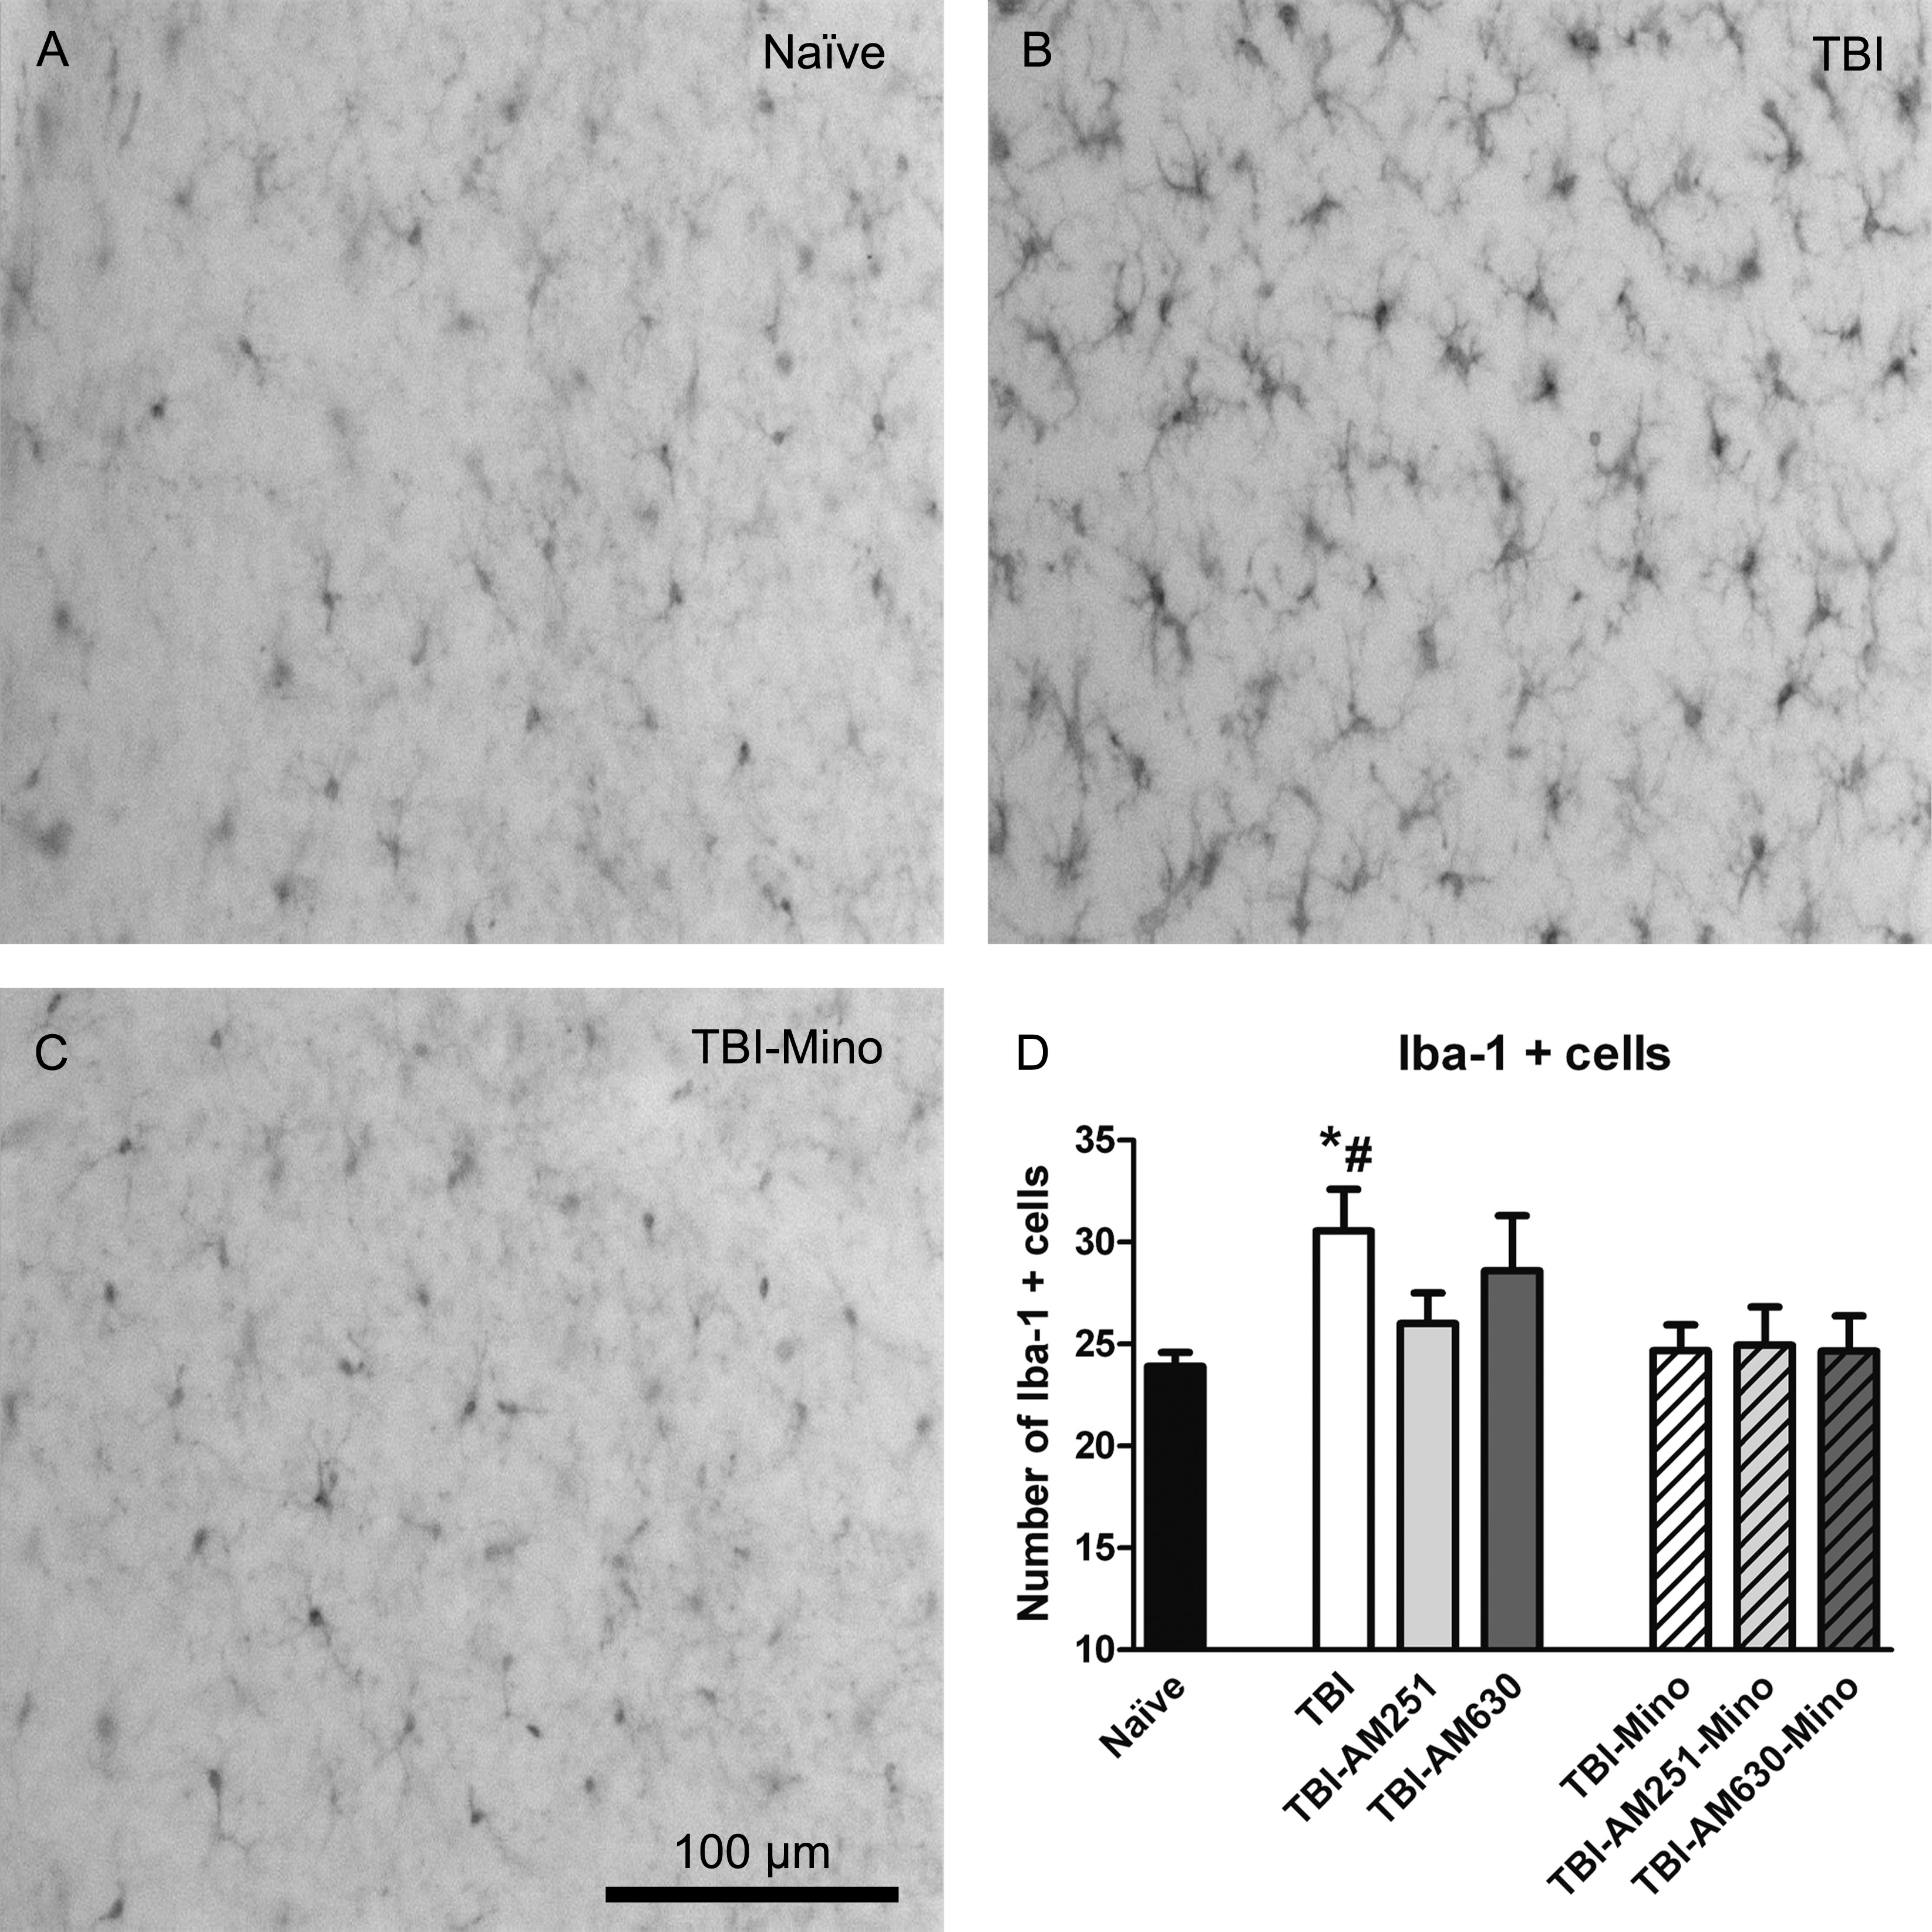
Figure 3. Effects of TBI, minocycline, and cannabinoid receptor antagonists on the number of microglial cells in the ...
Notes:
Figure 3. Effects of TBI, minocycline, and cannabinoid receptor antagonists on the number of microglial cells in the border of the lesion, 24 h after lesion. Representative examples of Iba-1-immunoreactive microglia cells in the injured brain area. (A) Naïve; (B) TBI; (C) TBI-Mino, (D) TBI-AM251-Mino; (E) TBI-AM630-Mino; and (F) histogram representing the mean + SEM (n = 8) of the percentage of microglial cells with the reactive phenotype. Naïve, noninjured animals; TBI, traumatic brain injury; AM251, CB1R antagonist; AM630, CB2R antagonist. Significant differences, P < 0.05: * versus naïve; # versus TBI-Mino.
Unless provided in the caption above, the following copyright applies to the content of this slide: © The Author 2013. Published by Oxford University Press. All rights reserved. For Permissions, please e-mail: journals.permissions@oup.com

Slide 4
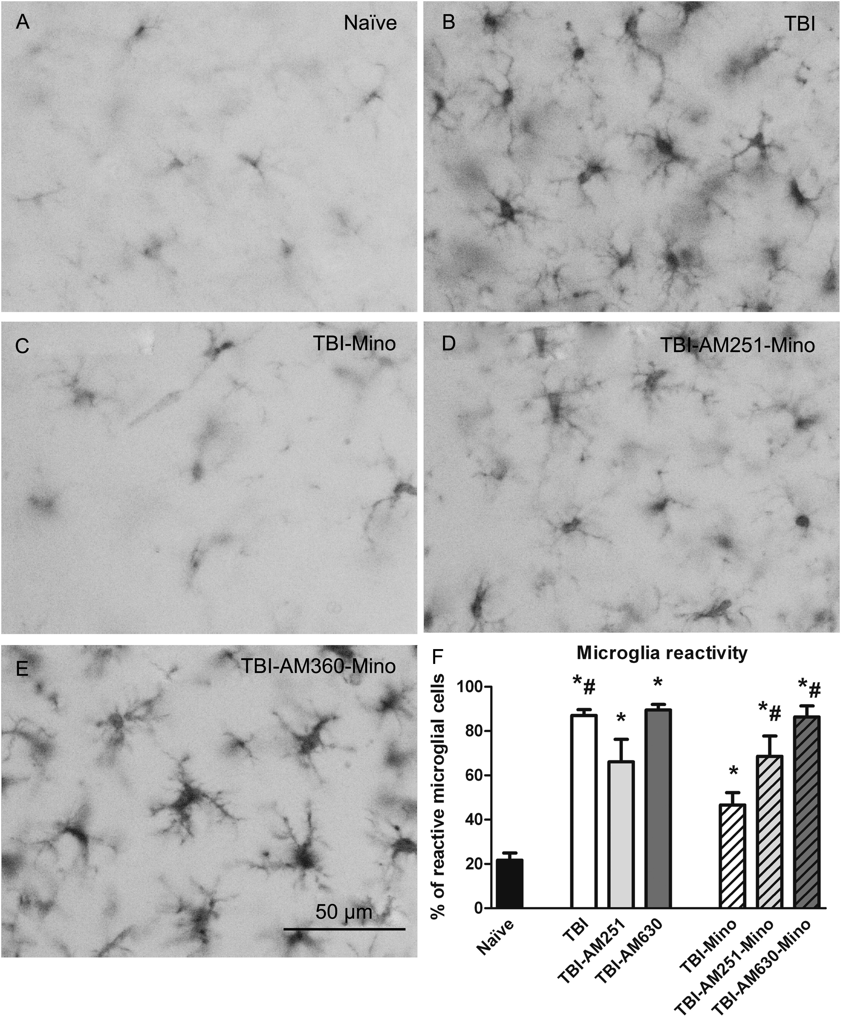
Figure 4. Effects of TBI, minocycline, and cannabinoid receptor antagonists on microglial reactivity in the border of ...
Notes:
Figure 4. Effects of TBI, minocycline, and cannabinoid receptor antagonists on microglial reactivity in the border of the lesion, 24 h after lesion. Representative examples of Iba-1-immunoreactive microglia cells. (A) Naïve; (B) TBI; (C) TBI-Mino, (D) TBI-AM251-Mino; (E) TBI-AM630-Mino; and (F) histogram representing the mean + SEM (n = 8) of the percentage of microglial cells with the reactive phenotype. Naïve, noninjured animals; TBI, traumatic brain injury; AM251, CB1R antagonist; AM630, CB2R antagonist; Mino, minocycline. Significant differences, P < 0.05: * versus naïve; # versus TBI-Mino.
Unless provided in the caption above, the following copyright applies to the content of this slide: © The Author 2013. Published by Oxford University Press. All rights reserved. For Permissions, please e-mail: journals.permissions@oup.com

Slide 5
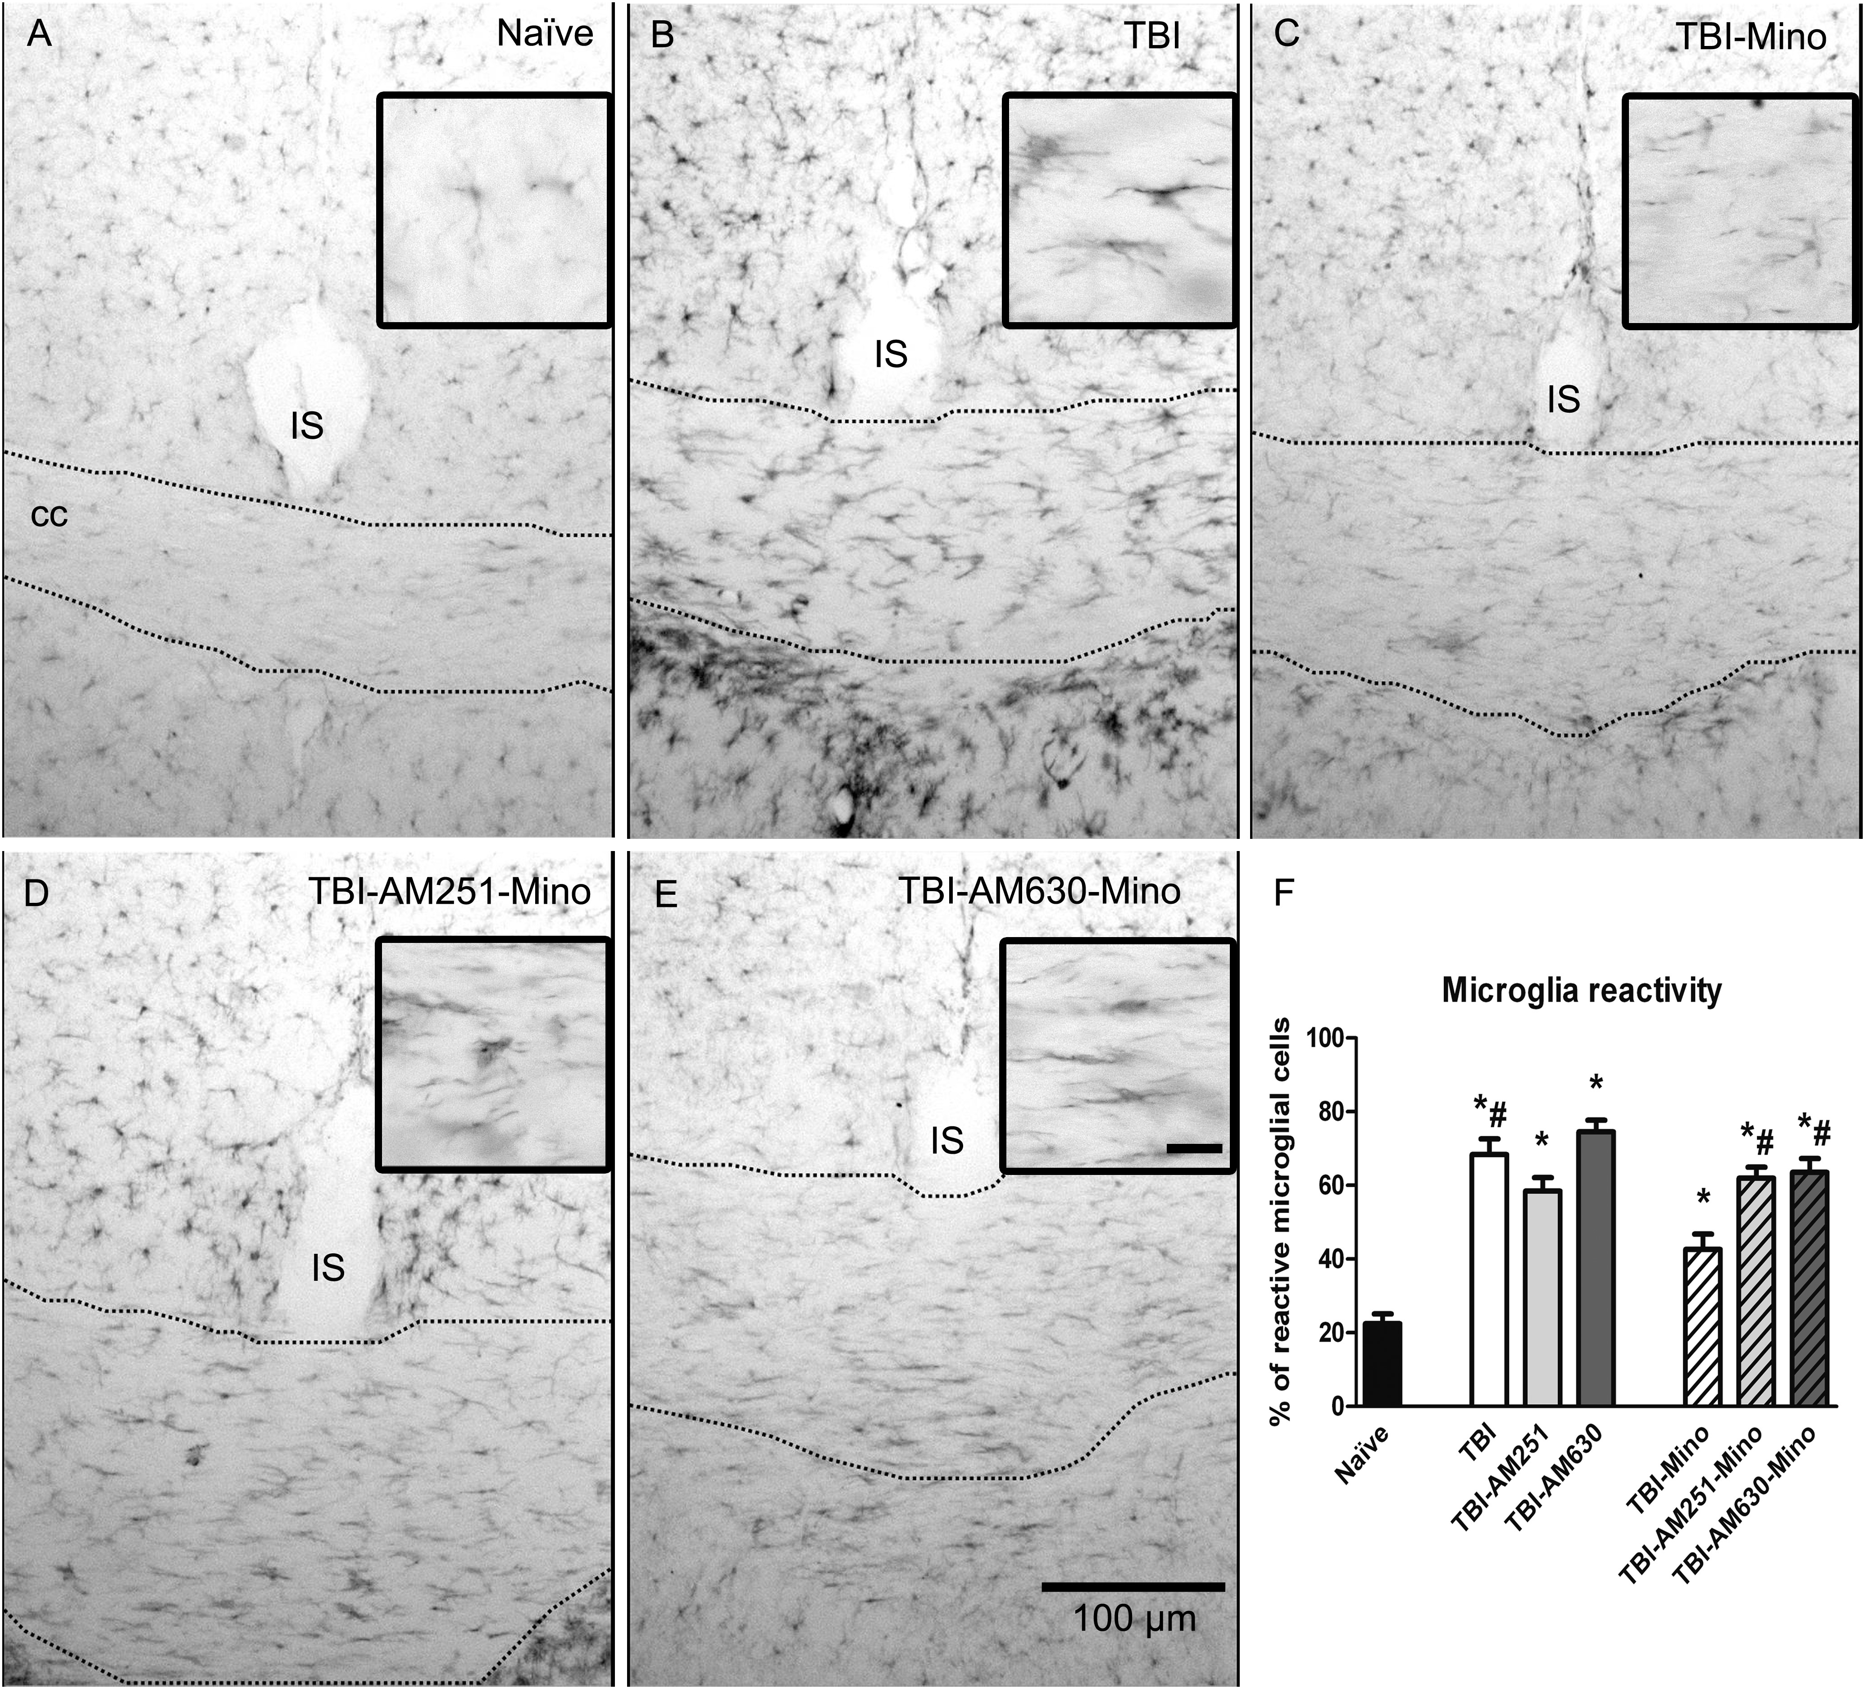
Figure 5. Effects of TBI, minocycline, and cannabinoid receptor antagonists on microglial reactivity in the corpus ...
Notes:
Figure 5. Effects of TBI, minocycline, and cannabinoid receptor antagonists on microglial reactivity in the corpus callosum, 24 h after lesion. Representative examples of Iba-1-immunoreactive microglia cells. (A) Naïve; (B) TBI; (C) TBI-Mino; (D) TBI-AM251-Mino; (E) TBI-AM630-Mino; and (F) histogram representing the mean + SEM (n = 4) of the percentage of microglial cells with the reactive phenotype. Naïve, noninjured animals; TBI, traumatic brain injury; AM251, CB1R antagonist; AM630, CB2R antagonist; Mino, minocycline; IS, interhemispheric space. Significant differences, P < 0.05: * versus naïve; # versus TBI-Mino.
Unless provided in the caption above, the following copyright applies to the content of this slide: © The Author 2013. Published by Oxford University Press. All rights reserved. For Permissions, please e-mail: journals.permissions@oup.com

Slide 6
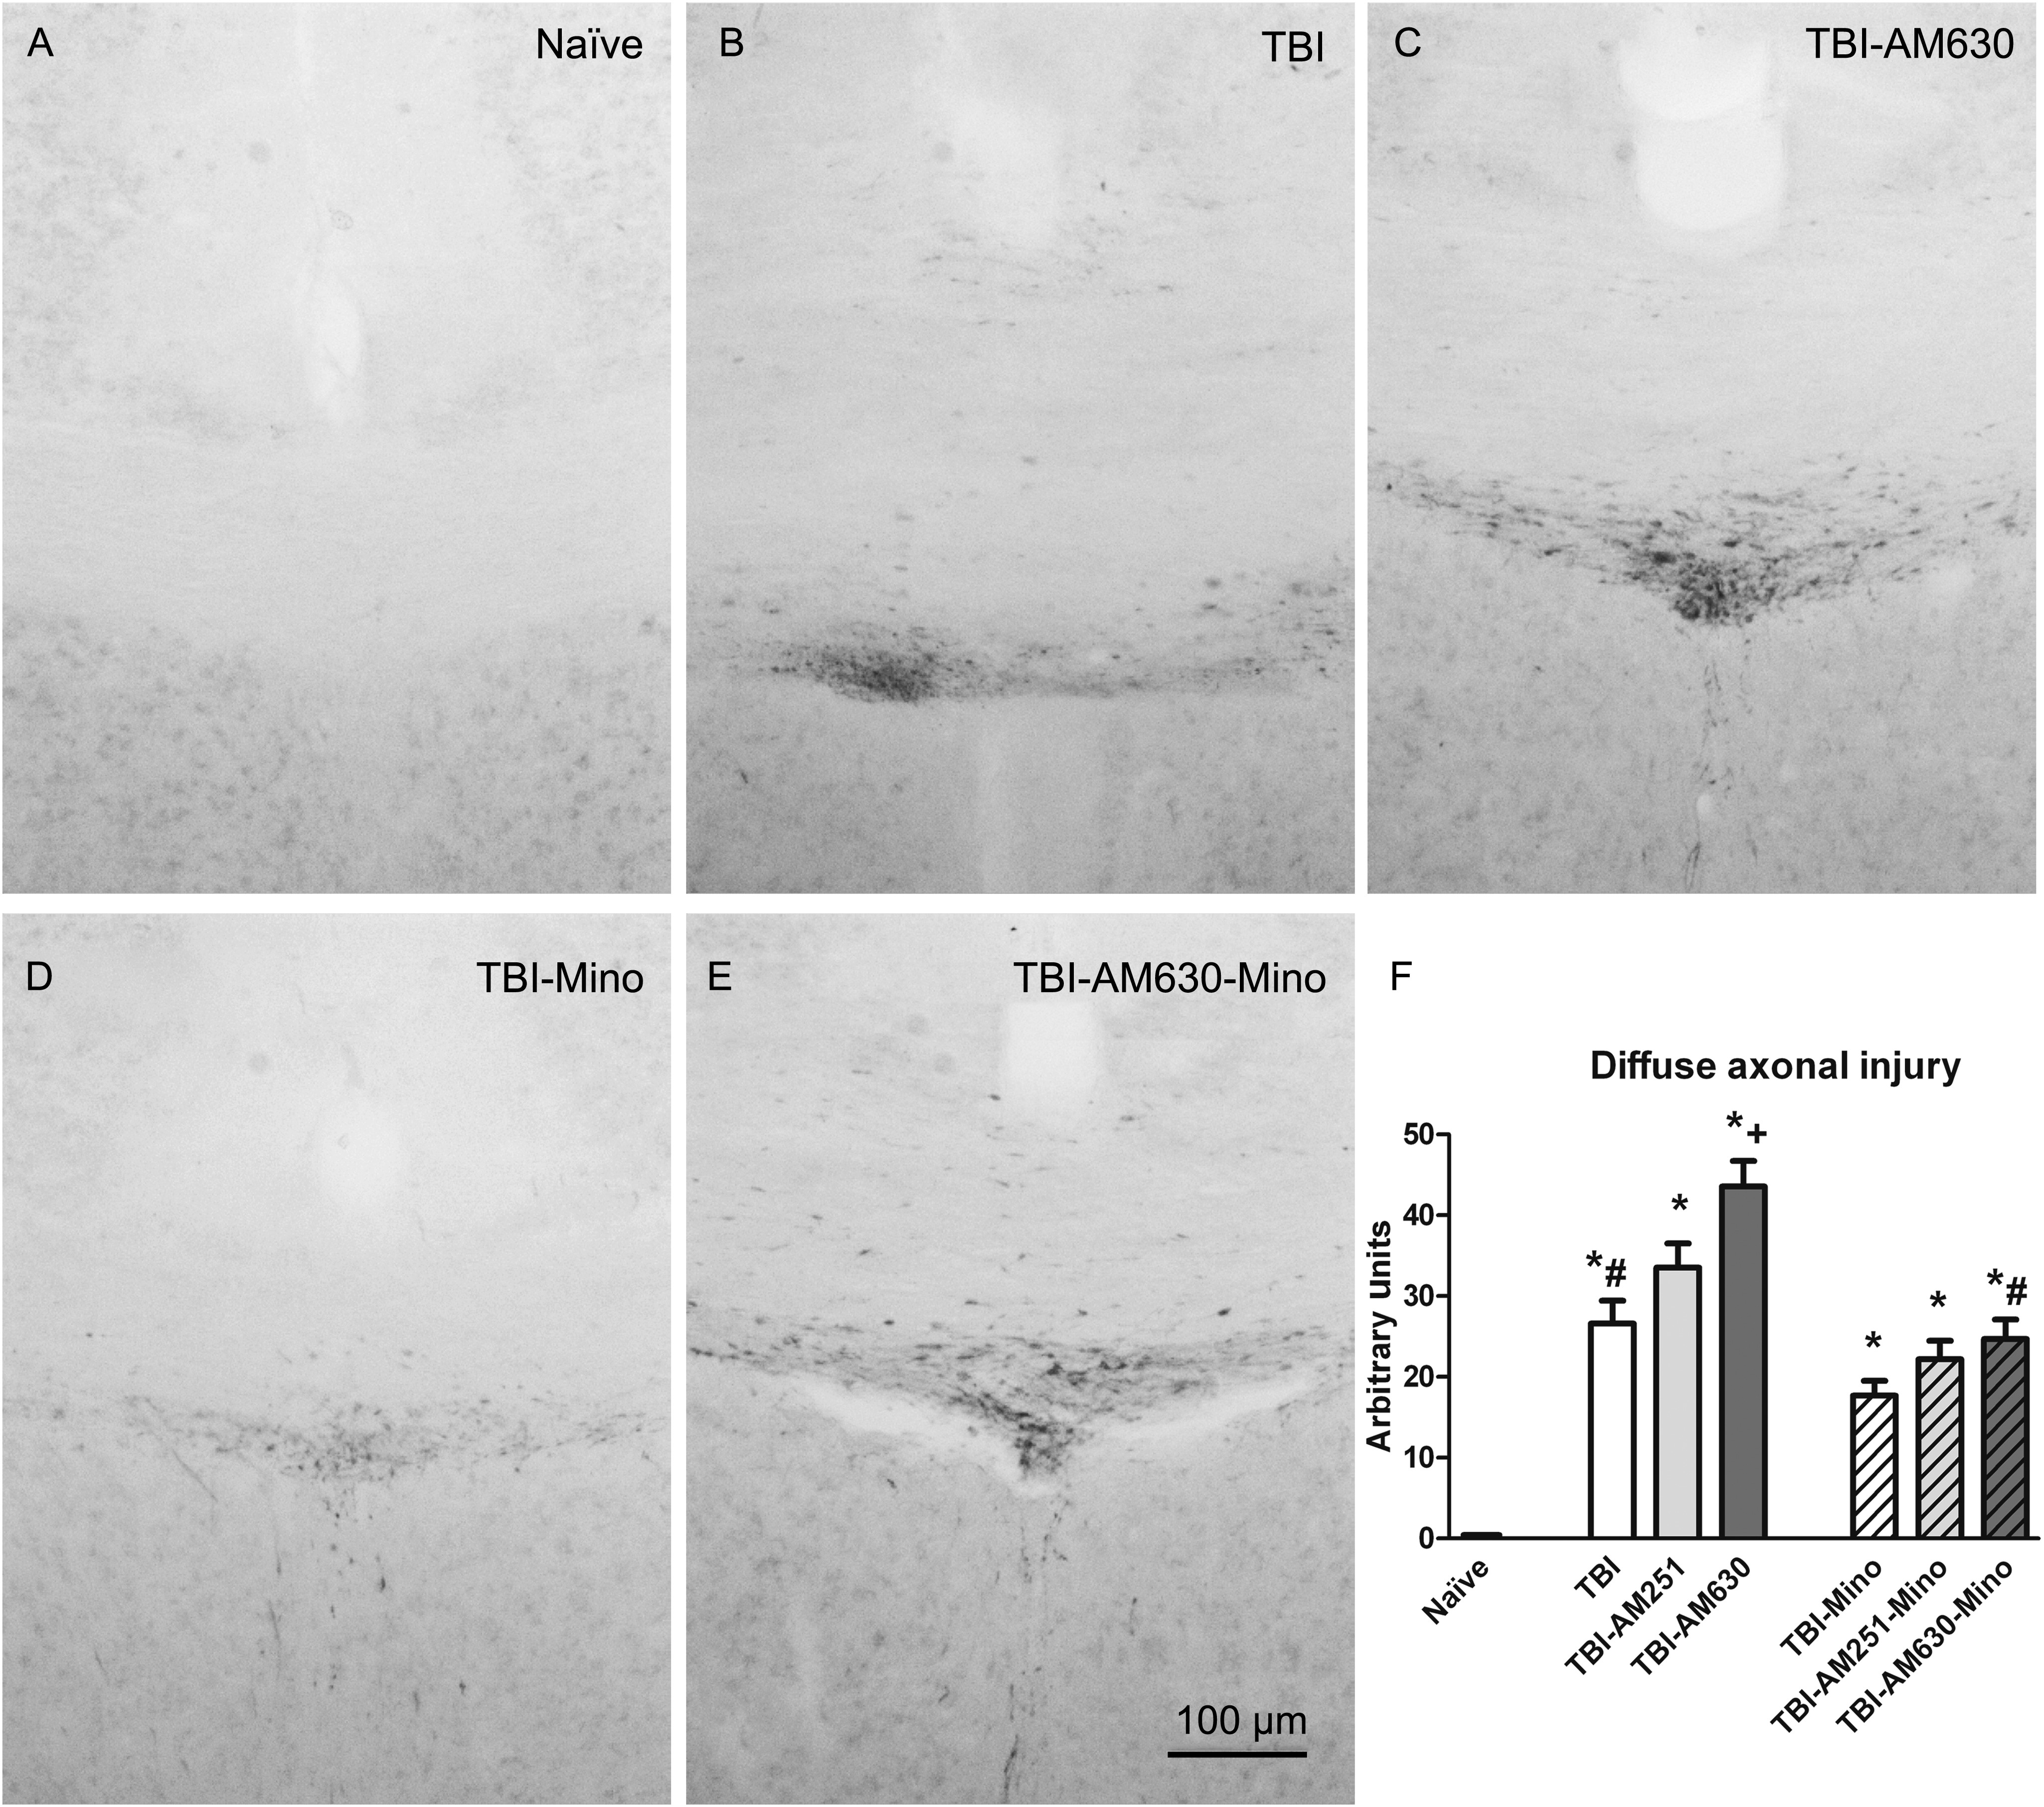
Figure 6. Effects of TBI, minocycline, and cannabinoid receptor antagonists on DAI, 24 h after lesion. Representative ...
Notes:
Figure 6. Effects of TBI, minocycline, and cannabinoid receptor antagonists on DAI, 24 h after lesion. Representative images of β-APP immunoreactivity in the corpus callosum. (A) Naïve; (B) TBI; (C) TBI-AM630; (D) TBI-Mino; (E) TBI-AM630-Mino; and (F) histograms represent the mean + SEM (n = 8) of the surface density of β-APP-immunolabeled axons. Naïve, noninjured animals; TBI, traumatic brain injury; AM251, CB1 receptor antagonist; AM630, CB2 receptor antagonist; Mino, minocycline. Significant differences, P < 0.05: * versus naïve; # versus TBI-Mino; + versus TBI.
Unless provided in the caption above, the following copyright applies to the content of this slide: © The Author 2013. Published by Oxford University Press. All rights reserved. For Permissions, please e-mail: journals.permissions@oup.com

