Slide 1
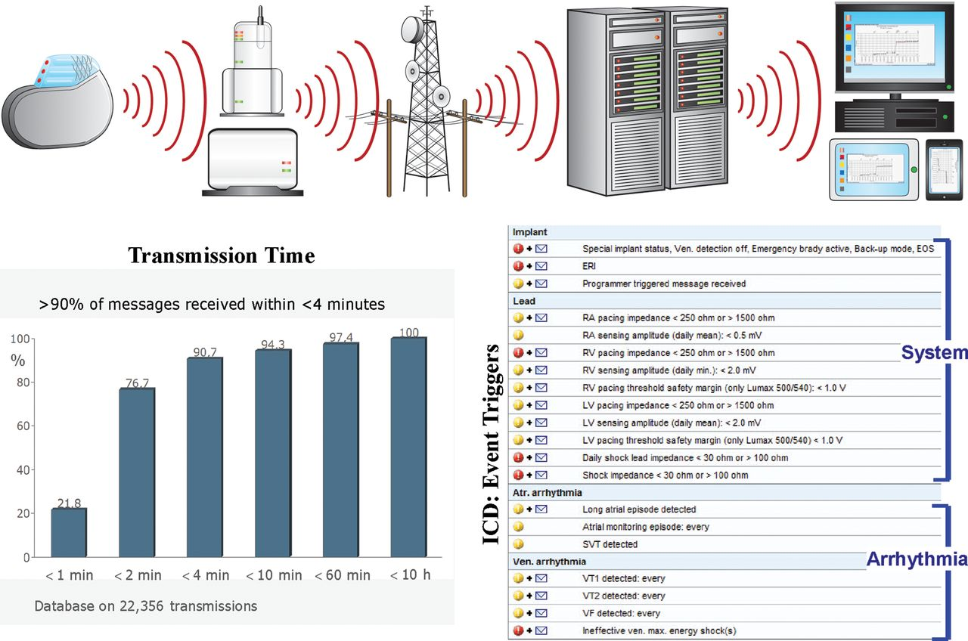
Figure 1 Home Monitoring technology. Top: transmission steps in this fully automatic system (modified with permission ...
Notes:
Figure 1 Home Monitoring technology. Top: transmission steps in this fully automatic system (modified with permission from ref.11). Both landline and portable GSM/landline patient modules are illustrated. Bottom Left >90% of transmissions were received in <5 min with 100% preservation of data integrity (compiled with permission from ref.10). Right event notification parameters may be individualized online.
Unless provided in the caption above, the following copyright applies to the content of this slide: © The Author 2012. Published by Oxford University Press on behalf of the European Society of CardiologyThis is an Open Access article distributed under the terms of the Creative Commons Attribution License (http://creativecommons.org/licenses/by-nc/3.0/), which permits non-commercial use, distribution, and reproduction in any medium, provided that the original authorship is properly and fully attributed; the Journal, Learned Society and Oxford University Press are attributed as the original place of publication with correct citation details given; if an article is subsequently reproduced or disseminated not in its entirety but only in part or as a derivative work this must be clearly indicated. For commercial re-use, please contact journals.permissions@oup.com

Slide 2
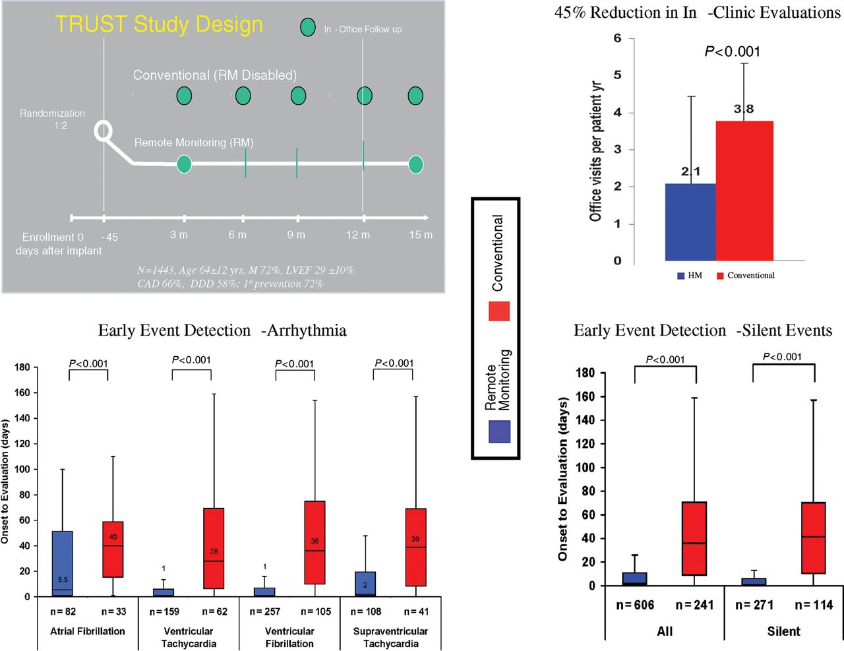
Figure 2 The TRUST trial. Top left: continuous remote monitoring compared with standard of care. Right: Home ...
Notes:
Figure 2 The TRUST trial. Top left: continuous remote monitoring compared with standard of care. Right: Home Monitoring reduced cardiac-resource utilization [scheduled and unscheduled clinic and hospital visits (including responses to Home Monitoring event notifications)] by 45% in 1 year. Bottom: time to physician evaluation of arrhythmias (left), and for silent events (right). Compiled with permission from ref.12
Unless provided in the caption above, the following copyright applies to the content of this slide: © The Author 2012. Published by Oxford University Press on behalf of the European Society of CardiologyThis is an Open Access article distributed under the terms of the Creative Commons Attribution License (http://creativecommons.org/licenses/by-nc/3.0/), which permits non-commercial use, distribution, and reproduction in any medium, provided that the original authorship is properly and fully attributed; the Journal, Learned Society and Oxford University Press are attributed as the original place of publication with correct citation details given; if an article is subsequently reproduced or disseminated not in its entirety but only in part or as a derivative work this must be clearly indicated. For commercial re-use, please contact journals.permissions@oup.com

Slide 3
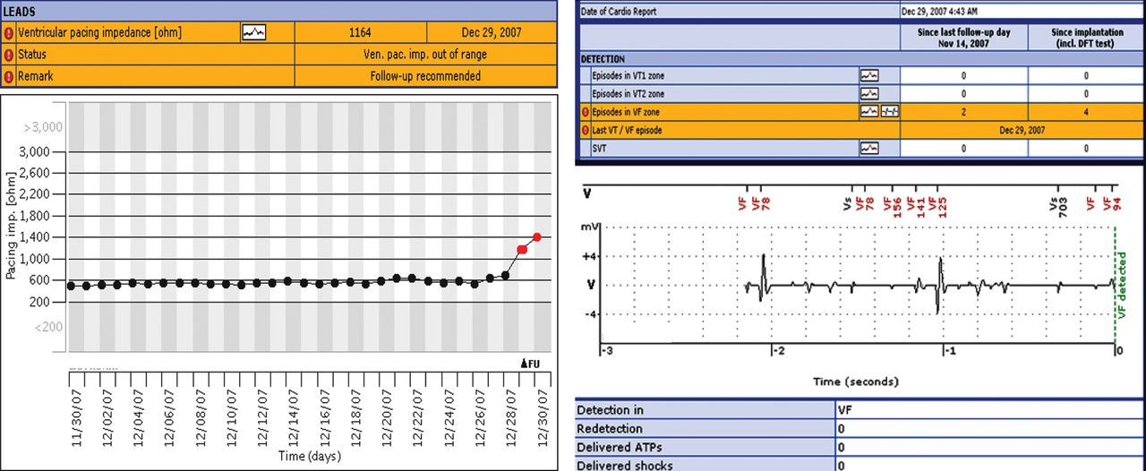
Figure 3 Home Monitoring generator coupled to a Fidelis (MDT 6949) lead. Two separate event notifications that were ...
Notes:
Figure 3 Home Monitoring generator coupled to a Fidelis (MDT 6949) lead. Two separate event notifications that were transmitted immediately on occurrence of lead fracture, occurring silently during sleep at 4:43 am, 6 weeks after last clinic follow-up in November 14. Left: lead impedance suddenly increased; right: ventricular fibrillation detection due to irregular sensed events. Electrogram definition in current generation has improved resolution (1/128 s) and includes post-detection sequences (e.g. Figure 2). The patient was reviewed within hours (FU) of the notifications. Compiled with permission from ref.29
Unless provided in the caption above, the following copyright applies to the content of this slide: © The Author 2012. Published by Oxford University Press on behalf of the European Society of CardiologyThis is an Open Access article distributed under the terms of the Creative Commons Attribution License (http://creativecommons.org/licenses/by-nc/3.0/), which permits non-commercial use, distribution, and reproduction in any medium, provided that the original authorship is properly and fully attributed; the Journal, Learned Society and Oxford University Press are attributed as the original place of publication with correct citation details given; if an article is subsequently reproduced or disseminated not in its entirety but only in part or as a derivative work this must be clearly indicated. For commercial re-use, please contact journals.permissions@oup.com

Slide 4
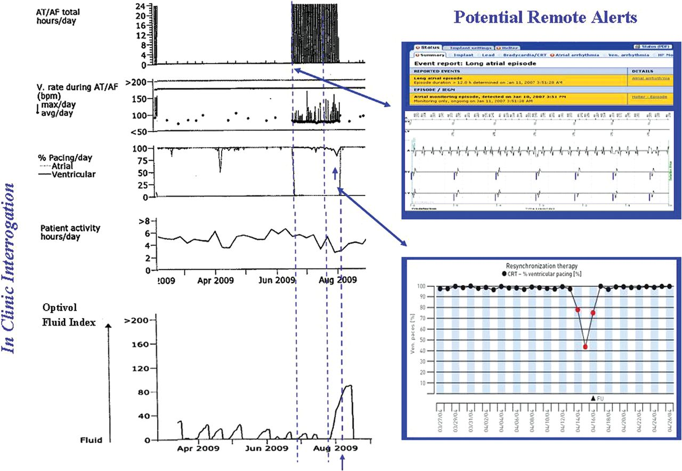
Figure 4 Interrogation of a CRT-D device in patient presenting with acute decompensated heart failure. Compiled with ...
Notes:
Figure 4 Interrogation of a CRT-D device in patient presenting with acute decompensated heart failure. Compiled with permission from ref.76
Unless provided in the caption above, the following copyright applies to the content of this slide: © The Author 2012. Published by Oxford University Press on behalf of the European Society of CardiologyThis is an Open Access article distributed under the terms of the Creative Commons Attribution License (http://creativecommons.org/licenses/by-nc/3.0/), which permits non-commercial use, distribution, and reproduction in any medium, provided that the original authorship is properly and fully attributed; the Journal, Learned Society and Oxford University Press are attributed as the original place of publication with correct citation details given; if an article is subsequently reproduced or disseminated not in its entirety but only in part or as a derivative work this must be clearly indicated. For commercial re-use, please contact journals.permissions@oup.com

Slide 5
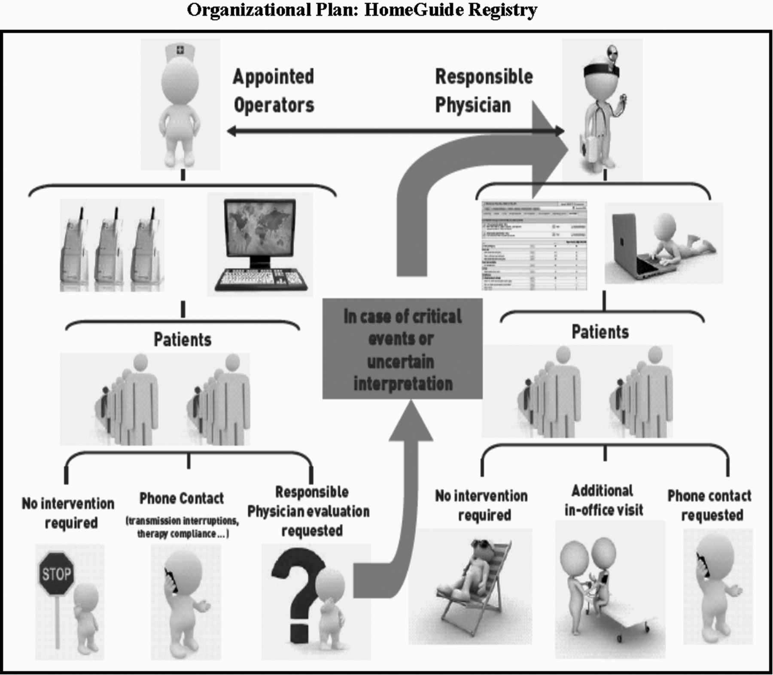
Figure 5 Home guide registry.⁵⁸
Notes:
Figure 5 Home guide registry.58
Unless provided in the caption above, the following copyright applies to the content of this slide: © The Author 2012. Published by Oxford University Press on behalf of the European Society of CardiologyThis is an Open Access article distributed under the terms of the Creative Commons Attribution License (http://creativecommons.org/licenses/by-nc/3.0/), which permits non-commercial use, distribution, and reproduction in any medium, provided that the original authorship is properly and fully attributed; the Journal, Learned Society and Oxford University Press are attributed as the original place of publication with correct citation details given; if an article is subsequently reproduced or disseminated not in its entirety but only in part or as a derivative work this must be clearly indicated. For commercial re-use, please contact journals.permissions@oup.com

