Slide 1
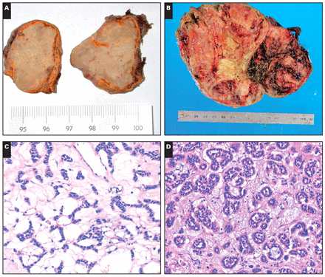
Image 1 A, Gross photograph of a myxoid adrenocortical adenoma. On the cut surface, the majority of the ...
Notes:
Image 1 A, Gross photograph of a myxoid adrenocortical adenoma. On the cut surface, the majority of the adrenocortical adenoma had yellow-grayish regions with gelatinous myxoid areas admixed with areas of firm and fibrous consistency. B, Gross photograph of a myxoid adrenocortical carcinoma. The section showed obvious areas of hemorrhage and necrosis. C, A myxoid adrenocortical adenoma showed anastomosing cords of tumor cells (H&E, ×200). D, Prominent pseudoglandular pattern in a background of myxoid stroma (H&E, ×200). E, In the myxoid matrix are floating clusters of cells (H&E, ×200). F, A microcystic pattern in the myxoid background (H&E, ×100). G, A myxoid adrenocortical carcinoma demonstrated sheets and solid patterns and obvious areas of hemorrhage (H&E, ×10). H, Under high magnification, the neoplastic cells showed abnormal mitosis (arrows) (H&E, ×400).
Unless provided in the caption above, the following copyright applies to the content of this slide: © American Society for Clinical Pathology

Slide 2
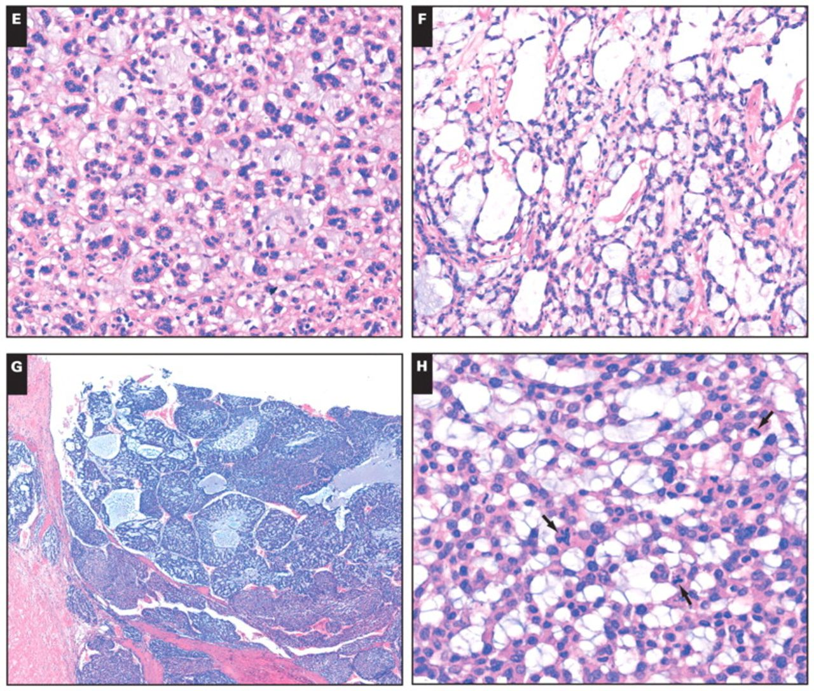
Image 1 A, Gross photograph of a myxoid adrenocortical adenoma. On the cut surface, the majority of the ...
Notes:
Image 1 A, Gross photograph of a myxoid adrenocortical adenoma. On the cut surface, the majority of the adrenocortical adenoma had yellow-grayish regions with gelatinous myxoid areas admixed with areas of firm and fibrous consistency. B, Gross photograph of a myxoid adrenocortical carcinoma. The section showed obvious areas of hemorrhage and necrosis. C, A myxoid adrenocortical adenoma showed anastomosing cords of tumor cells (H&E, ×200). D, Prominent pseudoglandular pattern in a background of myxoid stroma (H&E, ×200). E, In the myxoid matrix are floating clusters of cells (H&E, ×200). F, A microcystic pattern in the myxoid background (H&E, ×100). G, A myxoid adrenocortical carcinoma demonstrated sheets and solid patterns and obvious areas of hemorrhage (H&E, ×10). H, Under high magnification, the neoplastic cells showed abnormal mitosis (arrows) (H&E, ×400).
Unless provided in the caption above, the following copyright applies to the content of this slide: © American Society for Clinical Pathology

Slide 3
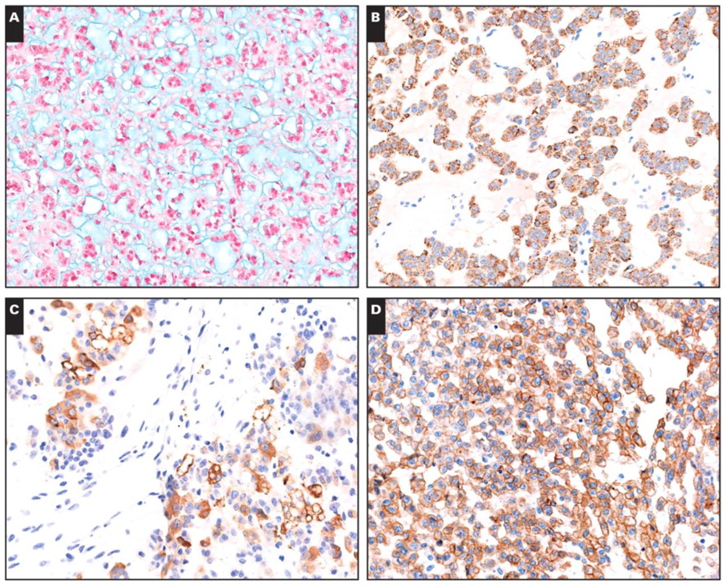
Image 2 A, Alcian blue staining showed extracellular acidic mucosubstances in the acellular myxoid areas in all cases ...
Notes:
Image 2 A, Alcian blue staining showed extracellular acidic mucosubstances in the acellular myxoid areas in all cases (×200). B, Immunohistochemical positivity for Melan-A staining in a myxoid adrenocortical adenoma. The myxoid areas between the cortical cells are negative (×200). C, A myxoid adrenocortical carcinoma was positive for α-inhibin (×200). D, Immunohistochemical positivity for epidermal growth factor receptor in the tumor cells of a myxoid adrenocortical carcinoma (×200).
Unless provided in the caption above, the following copyright applies to the content of this slide: © American Society for Clinical Pathology

Slide 4
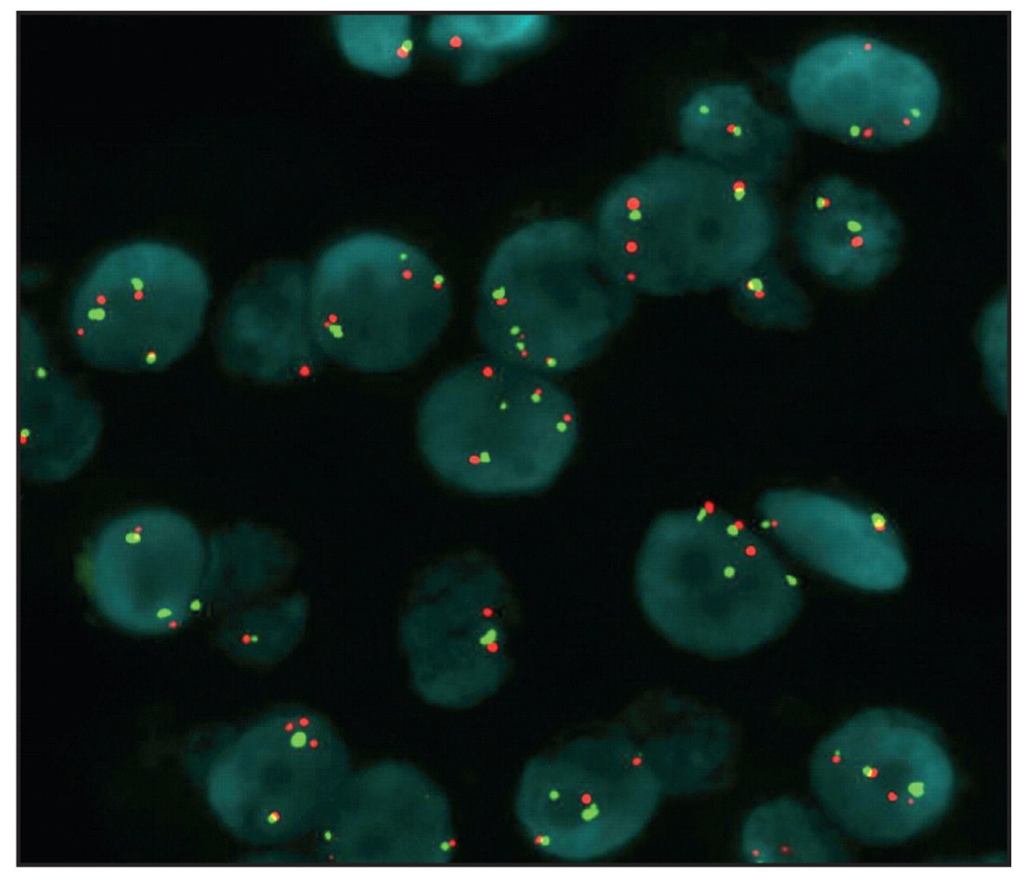
Image 4 The myxoid adenoma cells show high polysomy of epidermal growth factor receptor (EGFR) by fluorescence in ...
Notes:
Image 4 The myxoid adenoma cells show high polysomy of epidermal growth factor receptor (EGFR) by fluorescence in situ hybridization. Green signals represent the chromosome 7 centromere; red signals, the EGFR gene.
Unless provided in the caption above, the following copyright applies to the content of this slide: © American Society for Clinical Pathology

Slide 5
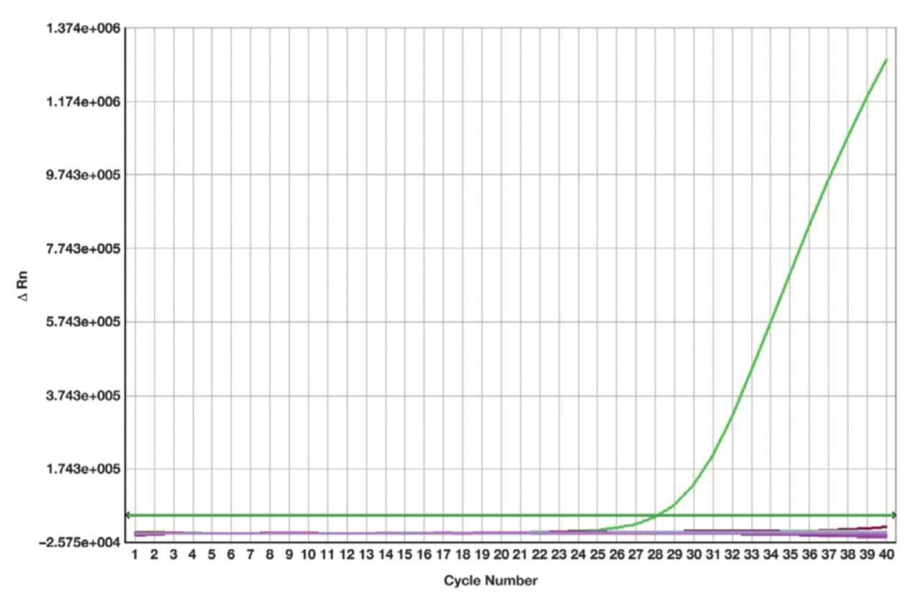
Image 3 (Case 5) No mutation was found in a myxoid adrenocortical neoplasm. One ascending curve represented a ...
Notes:
Image 3 (Case 5) No mutation was found in a myxoid adrenocortical neoplasm. One ascending curve represented a wild-type of epidermal growth factor receptor detected by Scorpion Amplified Refractory Mutation System.
Unless provided in the caption above, the following copyright applies to the content of this slide: © American Society for Clinical Pathology

