Slide 1
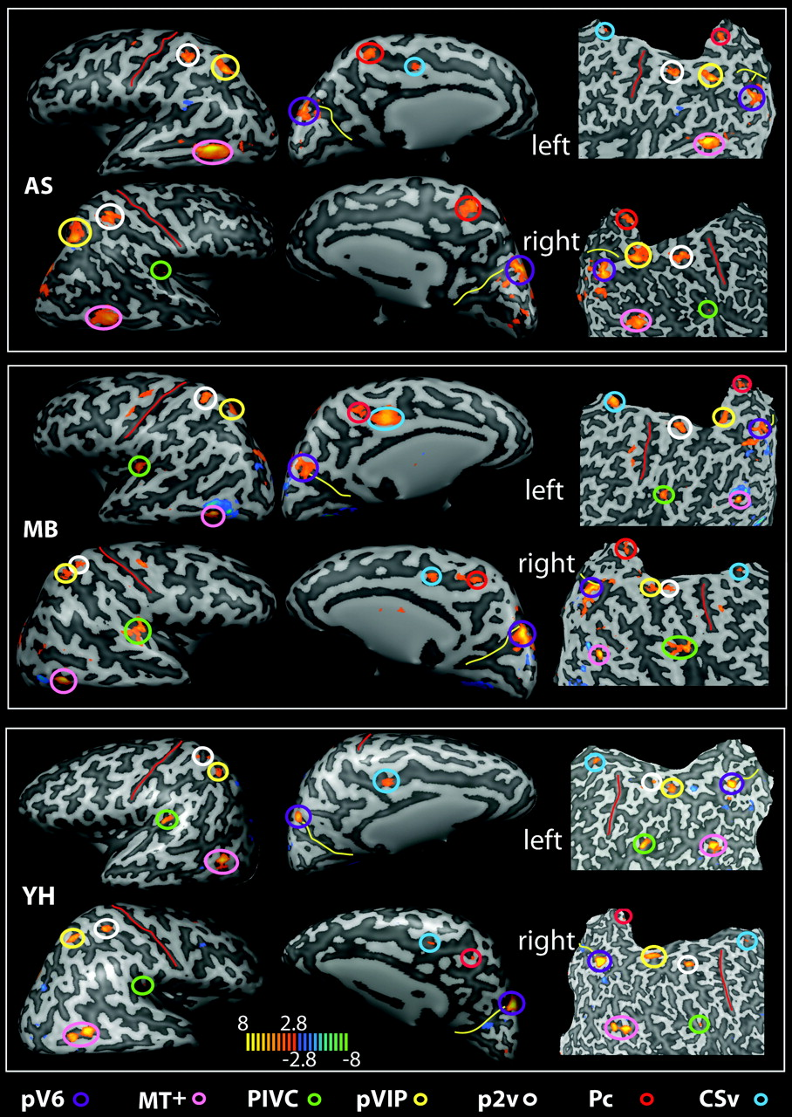
Figure 1. Brain areas selectively responsive to the egomotion-compatible (EC) stimulus. For 3 participants (AS, MB, and ...
Notes:
Figure 1. Brain areas selectively responsive to the egomotion-compatible (EC) stimulus. For 3 participants (AS, MB, and YH), the map of regions showing a significantly greater response to one flow stimulus than to an array of flow stimuli is overlaid onto inflated (left and central panels in each case) and flattened (right panels) representations of the left and right hemispheres. T values are color coded (see color bar). Various active regions are highlighted by colored circles (see color key; all activations shown thresholded at P < 0.005 uncorrected). The red line marks the central sulcus and the yellow line the POS. Pc, precuneus.
Unless provided in the caption above, the following copyright applies to the content of this slide: © The Authors 2009. Published by Oxford University Press.This is an Open Access article distributed under the terms of the Creative Commons Attribution Non-Commercial License (http://creativecommons.org/licenses/by-nc/2.5), which permits unrestricted non-commercial use, distribution, and reproduction in any medium, provided the original work is properly cited.

Slide 2
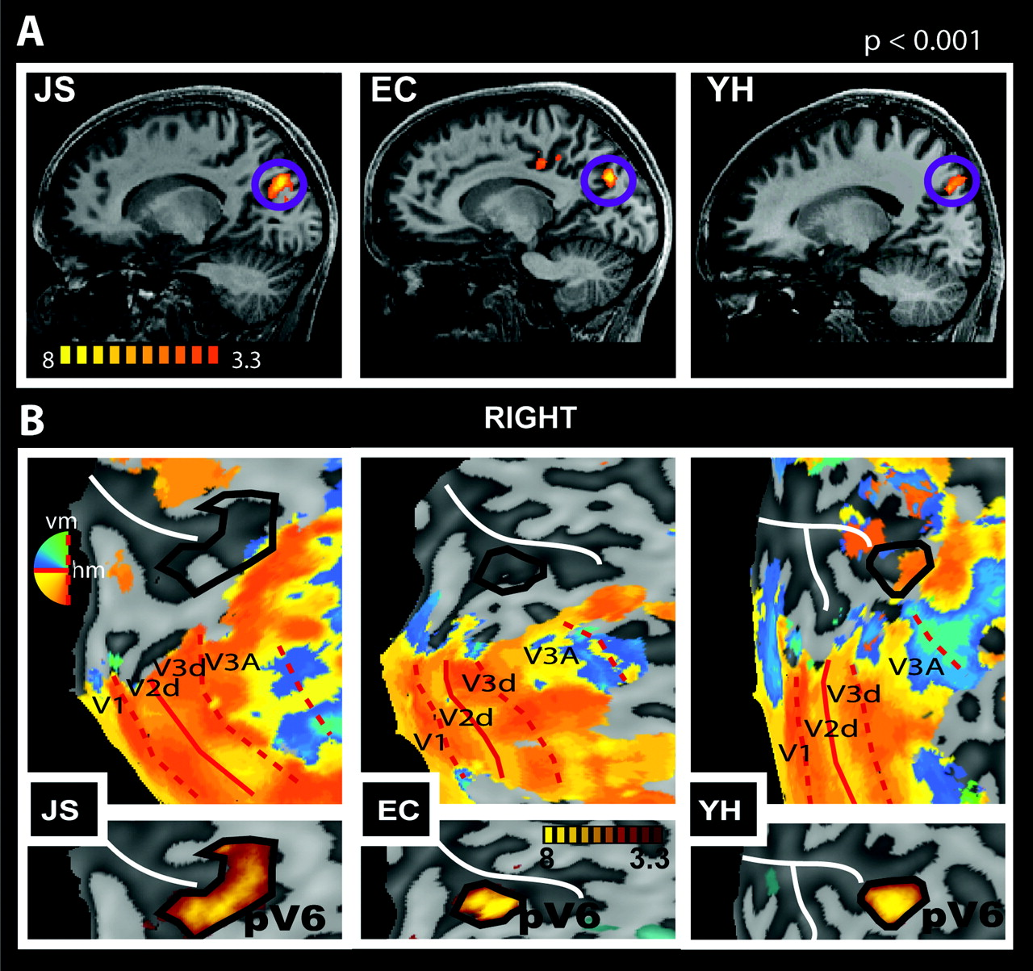
Figure 2. Differential response to EC stimuli in the POS. (A) Sagittal slices of the right hemisphere of 3 participants ...
Notes:
Figure 2. Differential response to EC stimuli in the POS. (A) Sagittal slices of the right hemisphere of 3 participants (JS, EC, and YH) showing the localization of a region selectively responsive to EC stimulation in the fundus of the POS. T values are color coded (see color bar). (B) Retinotopic maps (upper panels) and regions selectively responsive to EC (lower panels), overlaid onto flattened representations of the right occipital lobes of the same 3 participants. Retinotopic maps were obtained with narrow-field (24°) stimulation and show the demarcation of dorsal visual areas V1–V3A. The location of the POS region defined by sensitivity to EC stimuli, taken from the lower panel, is also shown (solid black line) on each retinotopic map. Red thin lines show the borders between visual areas (dashed: vertical meridian [vm]; continuous: horizontal meridian [hm]). Representations of different parts of the visual field are color coded (see color wheel; all activations thresholded at P < 0.01). The white line marks the POS.
Unless provided in the caption above, the following copyright applies to the content of this slide: © The Authors 2009. Published by Oxford University Press.This is an Open Access article distributed under the terms of the Creative Commons Attribution Non-Commercial License (http://creativecommons.org/licenses/by-nc/2.5), which permits unrestricted non-commercial use, distribution, and reproduction in any medium, provided the original work is properly cited.

Slide 3
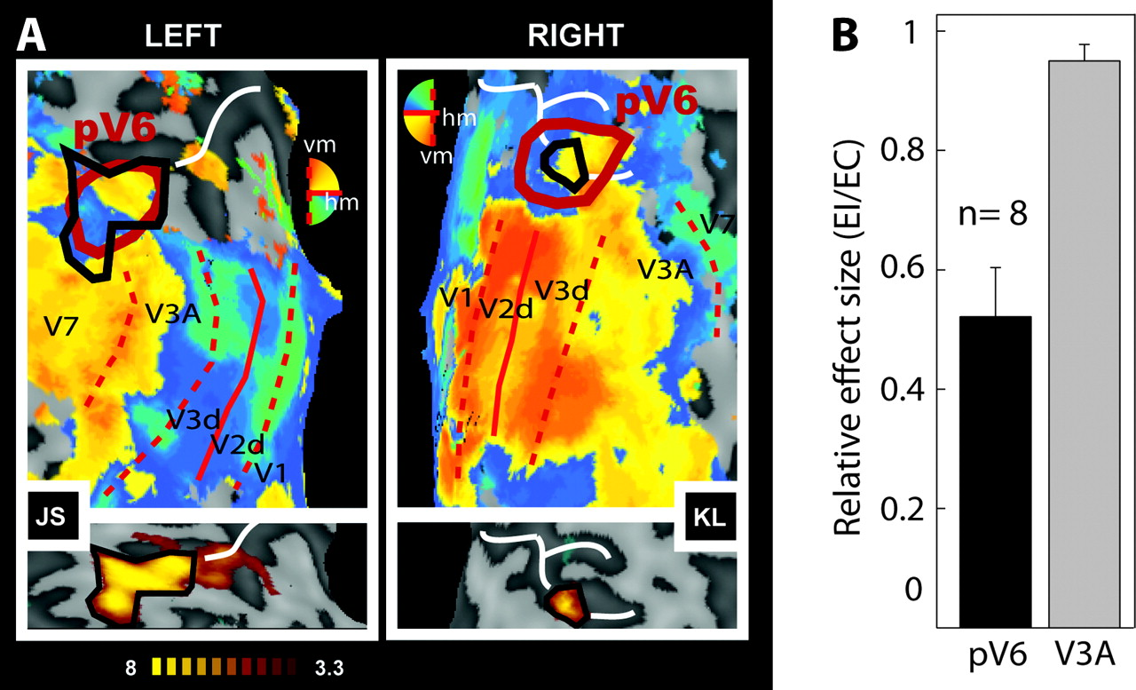
Figure 3. Sensitivity of putative human V6 to EC visual stimulation. (A) Retinotopic maps (upper panels) and regions ...
Notes:
Figure 3. Sensitivity of putative human V6 to EC visual stimulation. (A) Retinotopic maps (upper panels) and regions selectively responsive to EC (lower panels) overlaid onto flattened representations of the occipital lobes of 2 participants (JS and KL). Retinotopic maps were obtained with wide-field (70°) stimulation and show dorsal visual areas and the demarcation of human pV6 based on retinotopic criteria (thick red line). pV6 has a full hemifield representation with the upper quadrant represented nearer to V2 and the lower quadrant nearer to V3A (note that the color key is vertically reversed for the 2 hemispheres, in BrainVoyager convention). pV6 as defined by sensitivity to EC stimuli, from the lower panel, is also shown (solid black line) on each retinotopic map. Thin red lines show the borders between visual areas (dashed: vertical meridian [vm]; continuous: horizontal meridian [hm]). Representations of different parts of the visual field are color coded (see color wheel [note that colors have opposite dorsal–ventral meanings in the 2 hemispheres]; all activations thresholded at P < 0.01). The white line marks the POS. (B) Relative response magnitudes, in terms of the average coefficient of beta values (EI/EC), in areas V3A and pV6 (n = 8 hemispheres). Bars represent the mean coefficients across participants ± standard error of the mean.
Unless provided in the caption above, the following copyright applies to the content of this slide: © The Authors 2009. Published by Oxford University Press.This is an Open Access article distributed under the terms of the Creative Commons Attribution Non-Commercial License (http://creativecommons.org/licenses/by-nc/2.5), which permits unrestricted non-commercial use, distribution, and reproduction in any medium, provided the original work is properly cited.

Slide 4
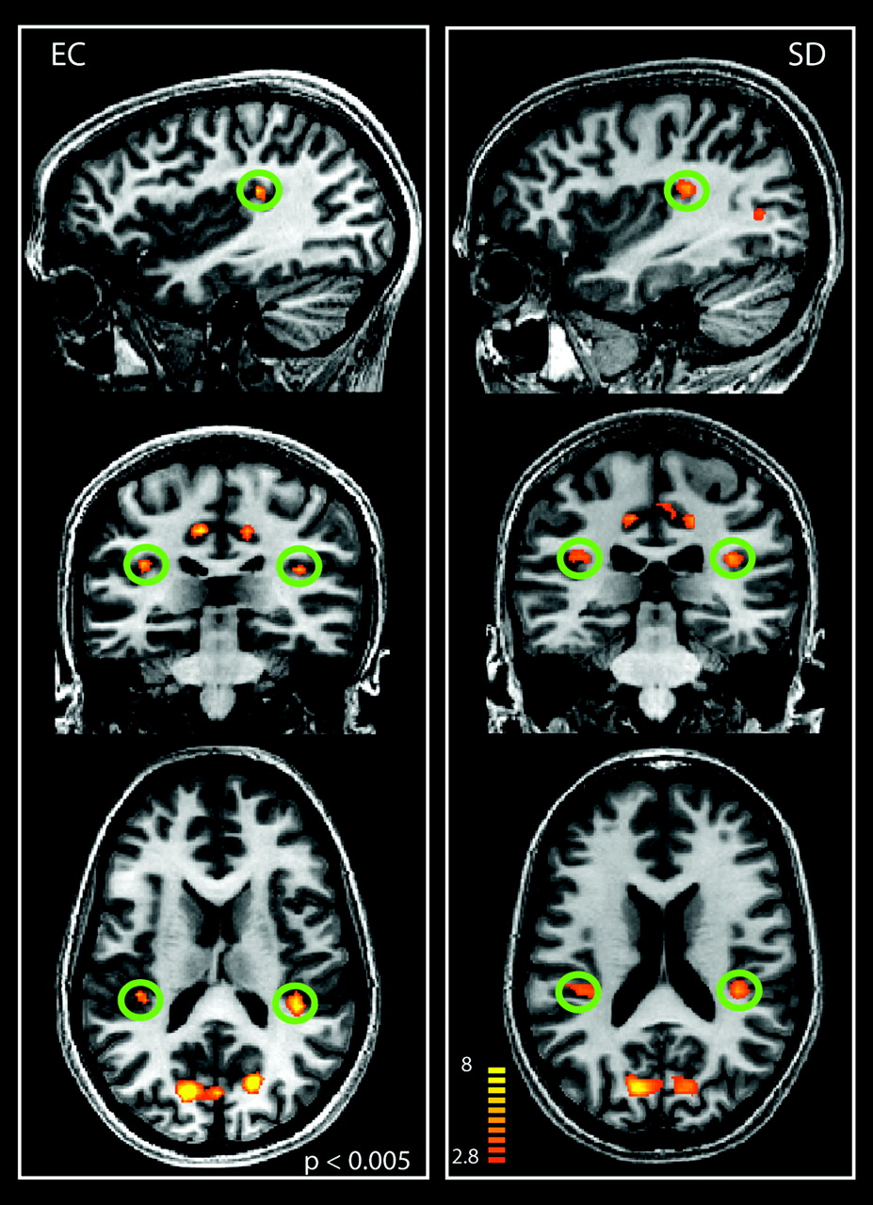
Figure 4. Activation of human PIVC with EC visual stimulation. The figure shows the regions selectively responsive to ...
Notes:
Figure 4. Activation of human PIVC with EC visual stimulation. The figure shows the regions selectively responsive to EC stimuli in sagittal, coronal, and axial slices of the brains of 2 individuals. The green circles indicate the localization of the PIVC. T values are color coded (see color bar).
Unless provided in the caption above, the following copyright applies to the content of this slide: © The Authors 2009. Published by Oxford University Press.This is an Open Access article distributed under the terms of the Creative Commons Attribution Non-Commercial License (http://creativecommons.org/licenses/by-nc/2.5), which permits unrestricted non-commercial use, distribution, and reproduction in any medium, provided the original work is properly cited.

Slide 5
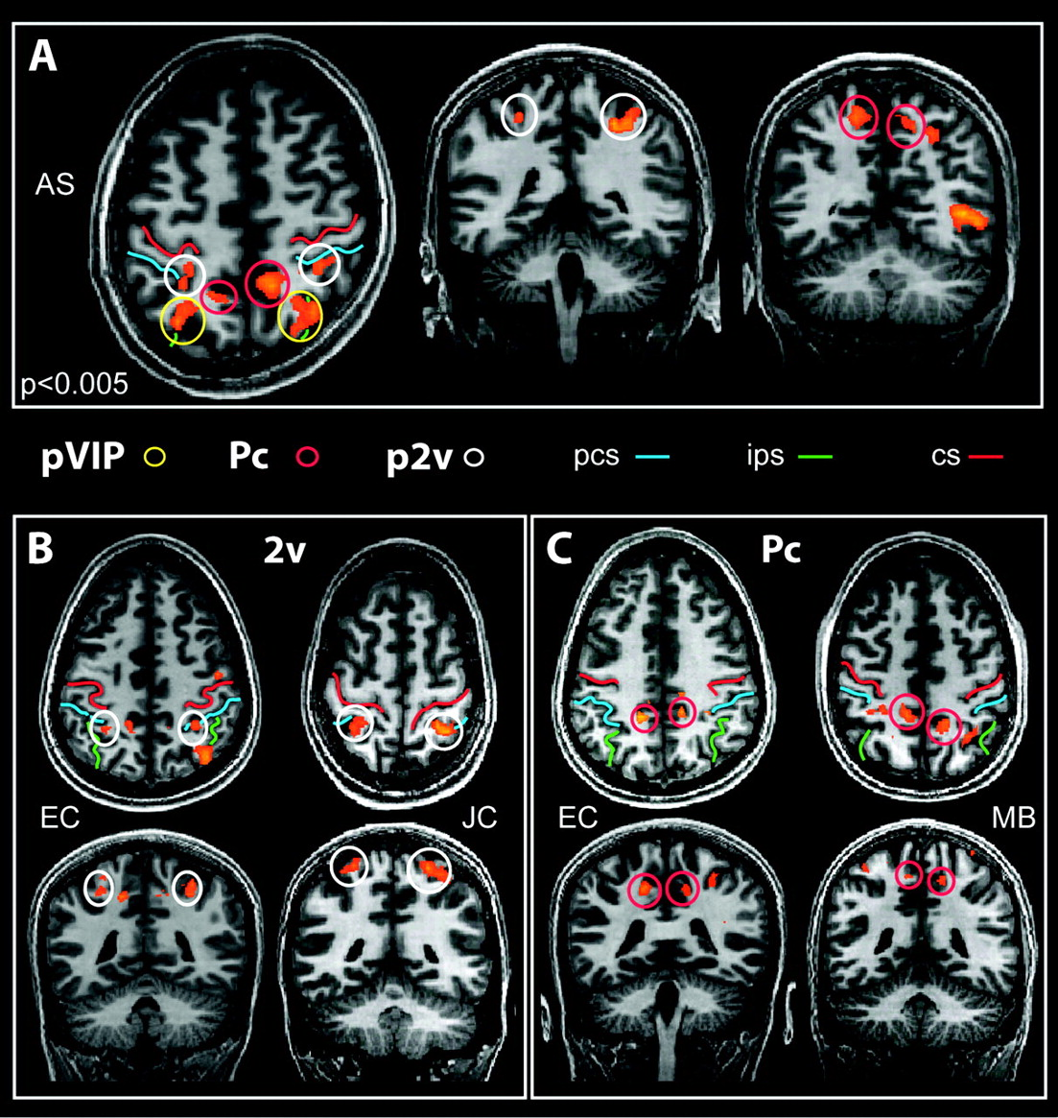
Figure 5. Parietal regions activated by EC stimuli. (A) Slices from the brain of a representative participant, showing ...
Notes:
Figure 5. Parietal regions activated by EC stimuli. (A) Slices from the brain of a representative participant, showing the location of all 3 parietal regions (p2v, pVIP, and Pc) in the same axial slice (left) and in coronal view. (B, C) Location of areas p2v (B) and Pc (C) in slices from 2 other participants. The 3 regions are identified with colored circles as in other figures. Three sulci are marked by colored lines: central sulcus (cs), intraparietal sulcus (ips), and postcentral sulcus (pcs). T values are color coded as in Figure 3.
Unless provided in the caption above, the following copyright applies to the content of this slide: © The Authors 2009. Published by Oxford University Press.This is an Open Access article distributed under the terms of the Creative Commons Attribution Non-Commercial License (http://creativecommons.org/licenses/by-nc/2.5), which permits unrestricted non-commercial use, distribution, and reproduction in any medium, provided the original work is properly cited.

Slide 6
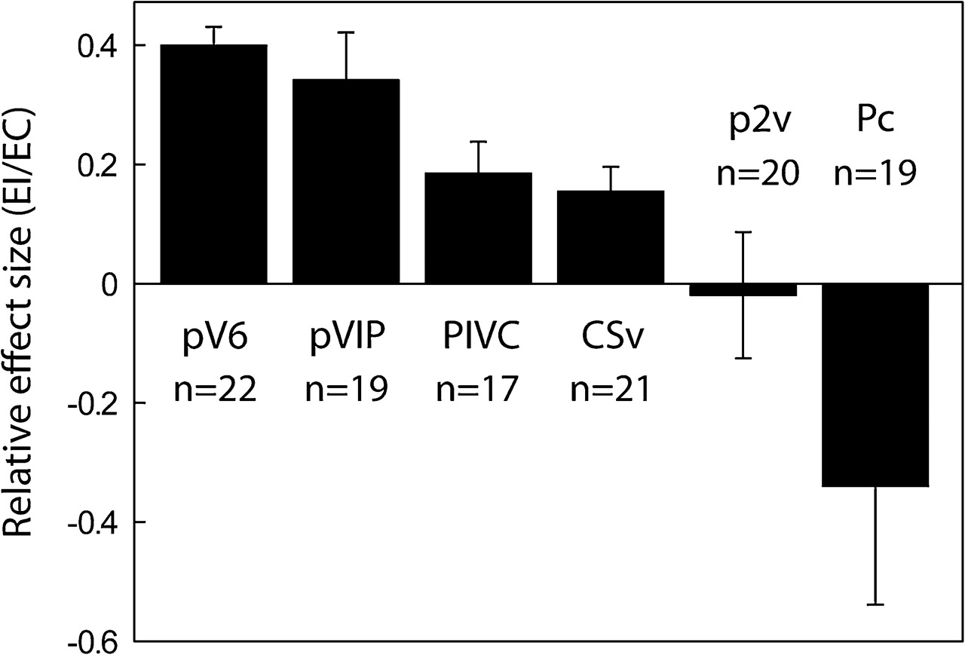
Figure 6. Average coefficient of beta values (EI/EC) in areas pV6, pVIP, PIVC, CSv, p2v, and Pc. Beta values were ...
Notes:
Figure 6. Average coefficient of beta values (EI/EC) in areas pV6, pVIP, PIVC, CSv, p2v, and Pc. Beta values were extracted from functionally defined ROIs (see Materials and Methods and Results). Bars represent the mean coefficients ± SEM across runs and participants (n indicates number of hemispheres).
Unless provided in the caption above, the following copyright applies to the content of this slide: © The Authors 2009. Published by Oxford University Press.This is an Open Access article distributed under the terms of the Creative Commons Attribution Non-Commercial License (http://creativecommons.org/licenses/by-nc/2.5), which permits unrestricted non-commercial use, distribution, and reproduction in any medium, provided the original work is properly cited.

