Slide 1
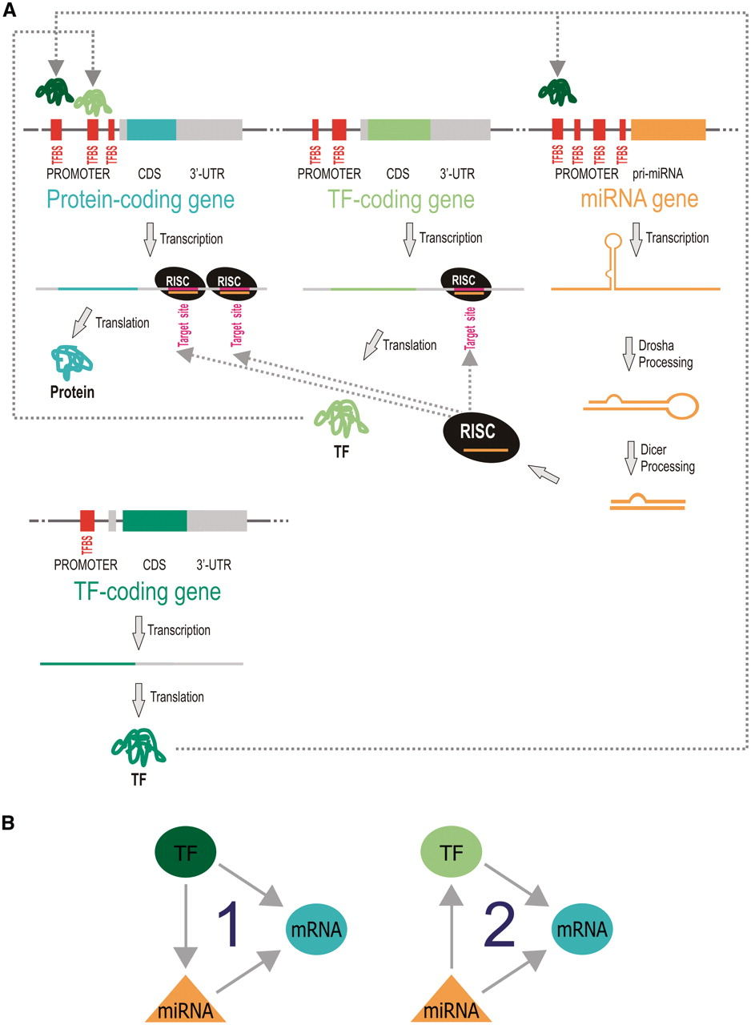
Figure 1. Interplay of miRNAs and TFs in gene/transcripts expression regulation involves mixed regulatory circuits. ...
Notes:
Figure 1. Interplay of miRNAs and TFs in gene/transcripts expression regulation involves mixed regulatory circuits. Panels A and B represent the molecular biology and the simplified schematization of interconnected pathways of transcriptional and post-transcriptional regulation, respectively: (1) a TF (dark green) interacts both with a protein-coding gene and a miRNA promoter, regulating their transcription, whereas the regulated miRNA targets the protein-coding mRNA exerting post-transcriptional regulation; (2) a miRNA regulates post-transcriptionally both a gene encoding a TF (light green) and a protein-coding gene, that is transcriptional target of the same TF.
Unless provided in the caption above, the following copyright applies to the content of this slide: © The Author(s) 2012. Published by Oxford University Press.This is an Open Access article distributed under the terms of the Creative Commons Attribution Non-Commercial License (http://creativecommons.org/licenses/by-nc/3.0), which permits unrestricted non-commercial use, distribution, and reproduction in any medium, provided the original work is properly cited.

Slide 2
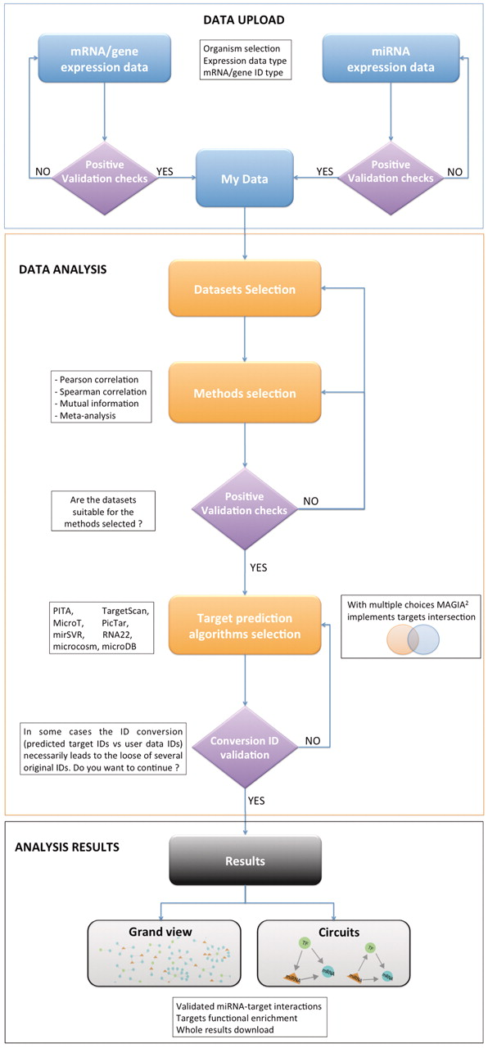
Figure 2. MAGIA² flow chart illustrating the different steps implemented with the back- and front-end in ...
Notes:
Figure 2. MAGIA2 flow chart illustrating the different steps implemented with the back- and front-end in Upload, Analysis and Results sections of MAGIA2.
Unless provided in the caption above, the following copyright applies to the content of this slide: © The Author(s) 2012. Published by Oxford University Press.This is an Open Access article distributed under the terms of the Creative Commons Attribution Non-Commercial License (http://creativecommons.org/licenses/by-nc/3.0), which permits unrestricted non-commercial use, distribution, and reproduction in any medium, provided the original work is properly cited.

Slide 3
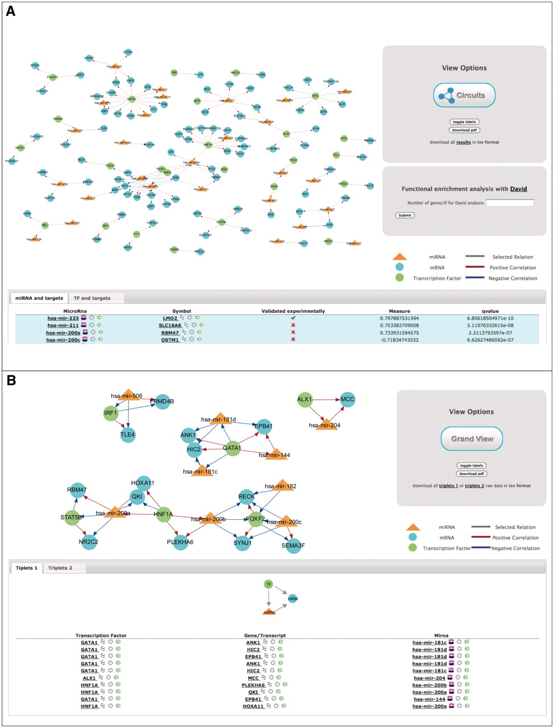
Figure 3. MAGIA² results using NCI-60 matched gene and miRNA expression data. (A) Regulatory network ...
Notes:
Figure 3. MAGIA2 results using NCI-60 matched gene and miRNA expression data. (A) Regulatory network reconstructed using the best miRNA-target and TF-target interactions. (B) Top 20 mixed regulatory circuits.
Unless provided in the caption above, the following copyright applies to the content of this slide: © The Author(s) 2012. Published by Oxford University Press.This is an Open Access article distributed under the terms of the Creative Commons Attribution Non-Commercial License (http://creativecommons.org/licenses/by-nc/3.0), which permits unrestricted non-commercial use, distribution, and reproduction in any medium, provided the original work is properly cited.

