Slide 1
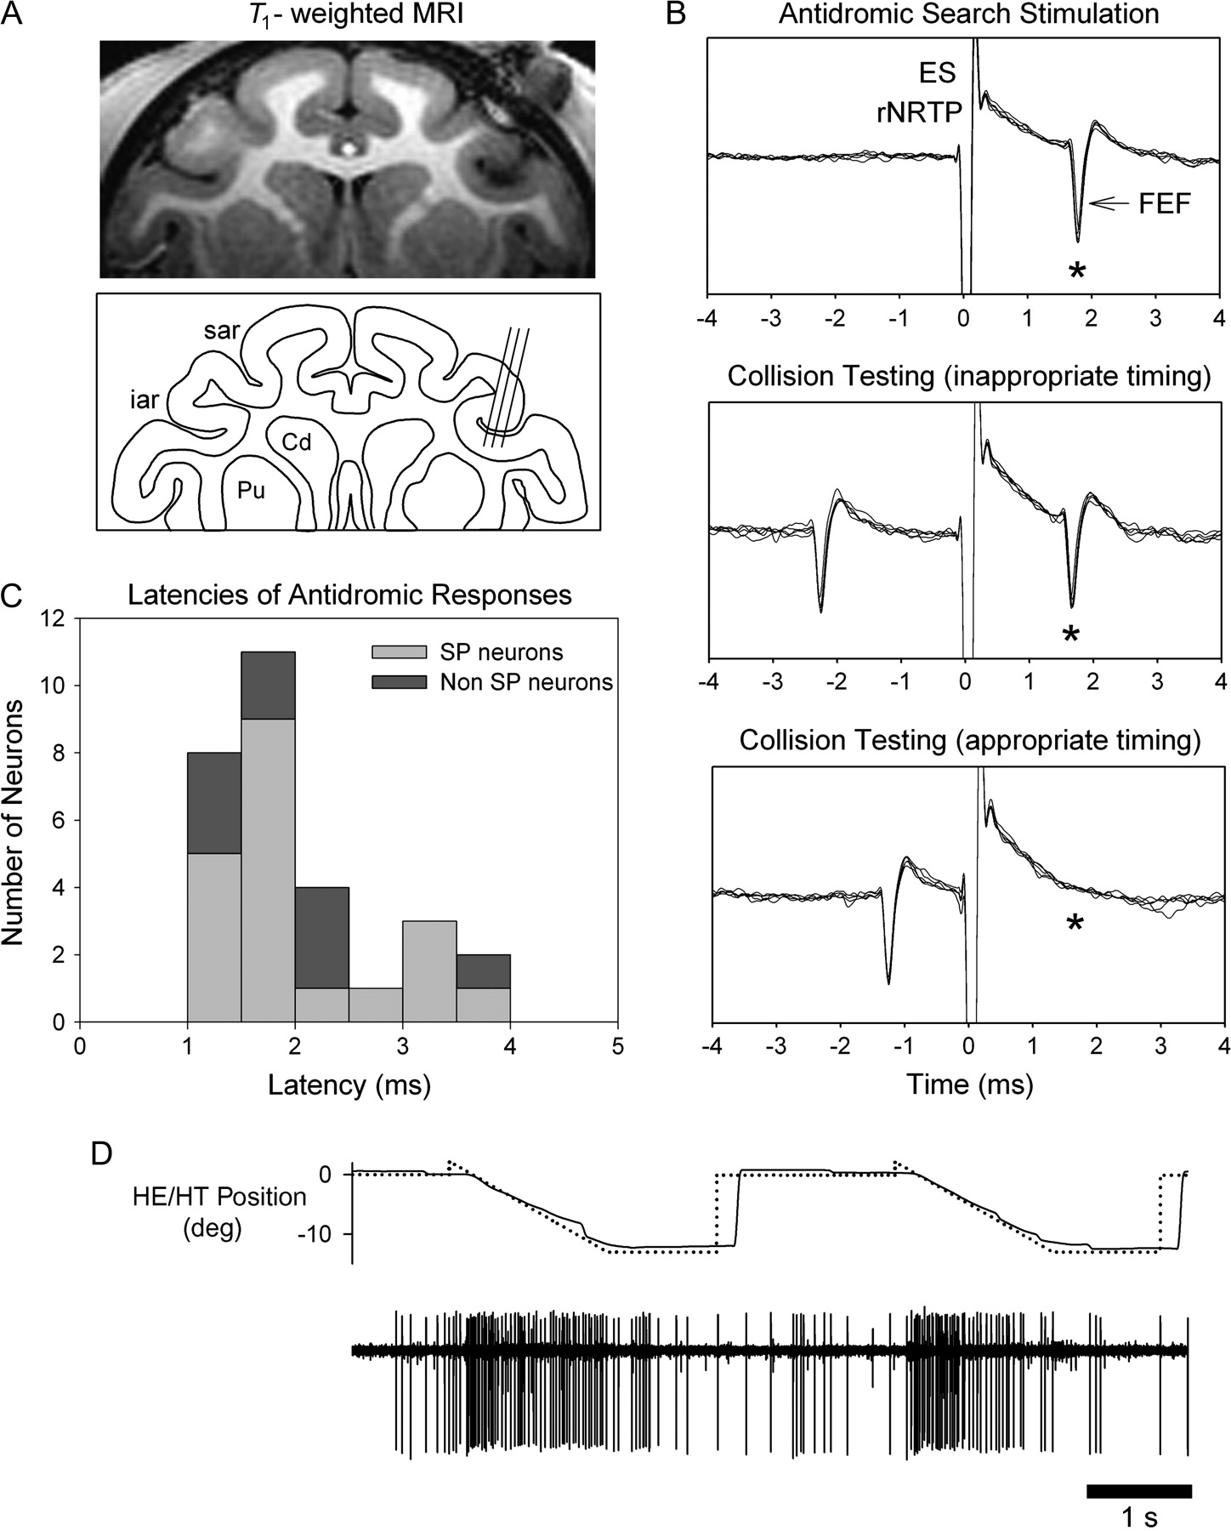
Figure 1. Location of FEF and examples of unit testing during SP. (A) Recoding sites of SP neurons in right FEF ...
Notes:
Figure 1. Location of FEF and examples of unit testing during SP. (A) Recoding sites of SP neurons in right FEF verified by structural magnetic resonance imaging (MRI) (T1-weighted, fast spin echo; Siemens, 3-T magnet). Line drawing indicating representative recording tracks run on a 15° angle tilted lateral with respect to pure vertical. Penetrations and unit depths reconstructed by MRI and measurements taken from microdrive readings during recording SP neurons in FEF. (B) SP-related FEF neuron antidromically activated (*) following biphasic single-pulse electrical stimulation (50 μA, 200-μs duration) of the rNRTP at the depth of SP neurons. Top panel: 5 successive antidromic trials in “search mode” aligned on the electrical stimulation artifact. Middle panel: antidromic spikes (*) continue to be elicited when inappropriate timing was used between a naturally occurring FEF spike and the stimulus pulse. Bottom panel: when appropriate timing is used between the naturally occurring spike and the stimulus pulse collision occurs (i.e., no evoked FEF at expected time (*). (C) Histogram of latencies between onset of electrical stimulation pulse in rNRTP and evoked FEF spikes. Median latency between stimulation in the rNRTP and evoked FEF spikes was 1.69 ms. Mean action potential duration of antidromically activated FEF neurons was 331 μs (standard deviation = 103 μs). (D) Representative well-isolated FEF neuron during 2 successive step-ramp trials.
Unless provided in the caption above, the following copyright applies to the content of this slide: © 2008 The AuthorsThis is an Open Access article distributed under the terms of the Creative Commons Attribution Non-Commercial License (http://creativecommons.org/licenses/by-nc/2.0/uk/) which permits unrestricted non-commercial use, distribution, and reproduction in any medium, provided the original work is properly cited.

Slide 2
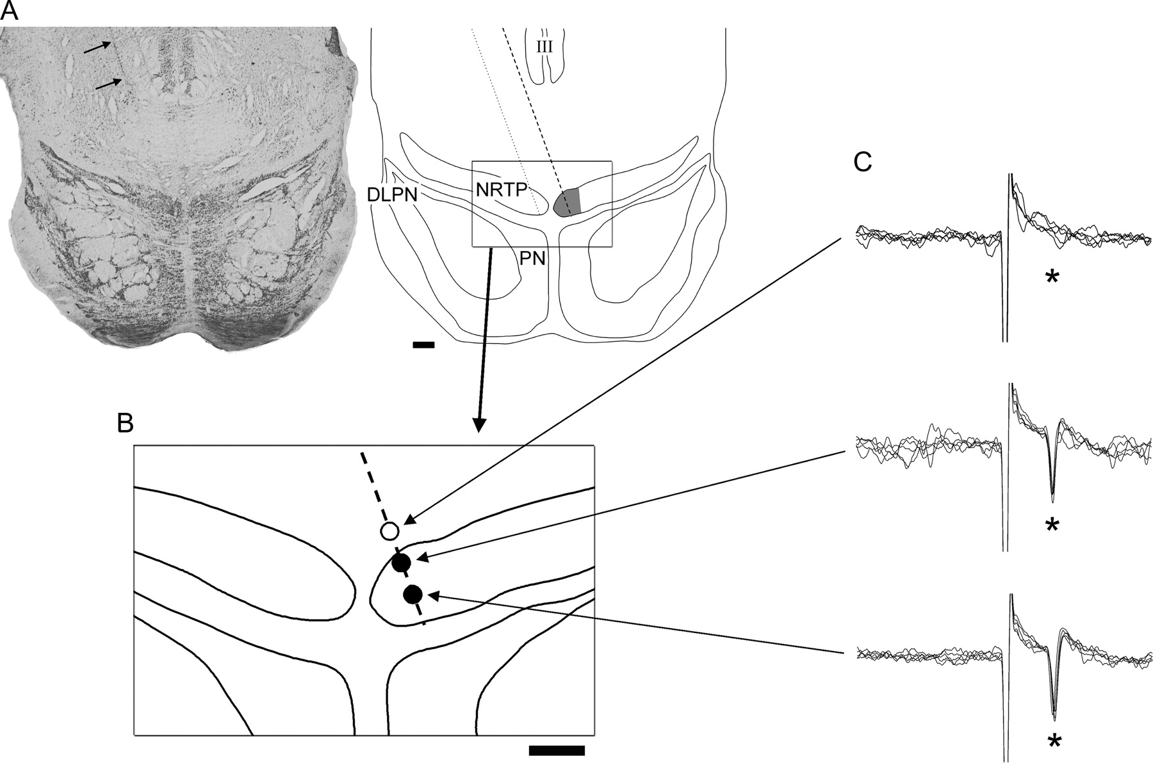
Figure 2. Location of the rNRTP and depth profile of effective stimulation sites for FEF antidromic activation. (A) ...
Notes:
Figure 2. Location of the rNRTP and depth profile of effective stimulation sites for FEF antidromic activation. (A) Nissl-stained section and line drawing showing anatomical location of rNRTP region, where SP neurons were recorded. Electrode tracks (e.g., arrows) are visible traveling to the rNRTP region on a 20° angle from a chamber placed on the left side of the head. Borders of rNRTP indicated by the dashed outlined area. Inset drawing shows higher magnification view of the rNRTP region (B). Successful antidromic testing sites indicated by filled circles inside the rNRTP. Depths were taken from microdrive readings. (C) Representative FEF neuron antidromically activated (asterisk) following stimulation (50 μA) at 2 successful sites in the rNRTP. Stimulation delivered immediately above (500 μm) the rNRTP failed to activate FEF neurons (C, top). Five successive trials are overlaid for each stimulation site. Scale bar = 1 mm. III, OMN; PN, pontine nucleus.
Unless provided in the caption above, the following copyright applies to the content of this slide: © 2008 The AuthorsThis is an Open Access article distributed under the terms of the Creative Commons Attribution Non-Commercial License (http://creativecommons.org/licenses/by-nc/2.0/uk/) which permits unrestricted non-commercial use, distribution, and reproduction in any medium, provided the original work is properly cited.

Slide 3
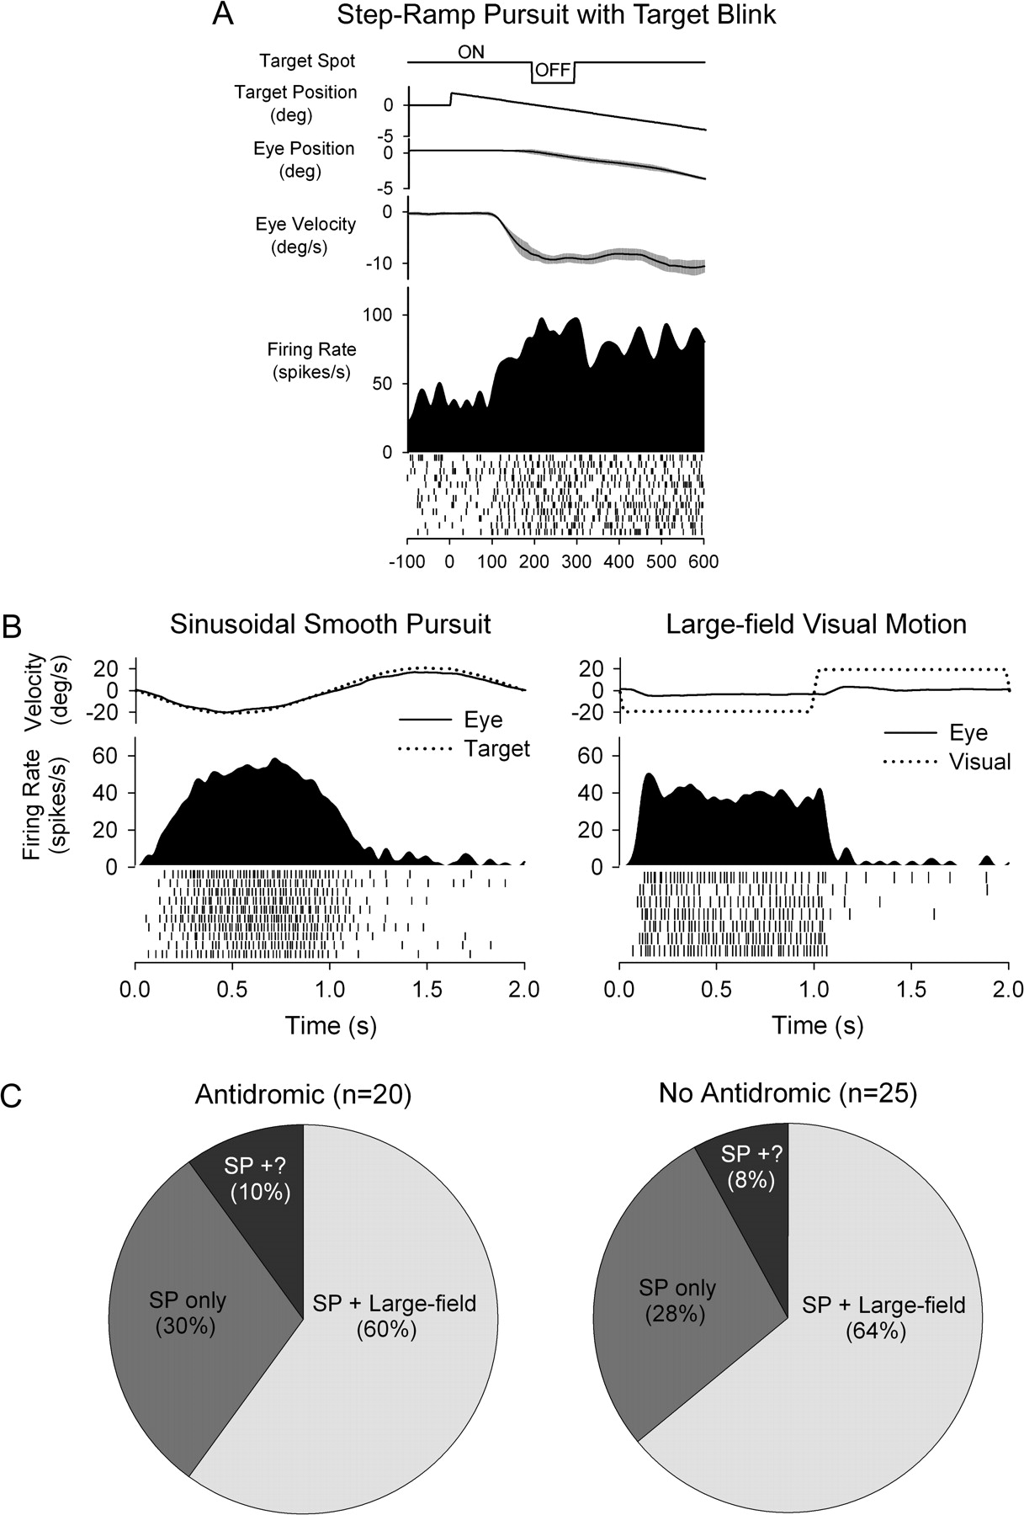
Figure 3. SP and visual sensitivity of FEF neurons. (A) Example of FEF neuron tested during step-ramp pursuit with ...
Notes:
Figure 3. SP and visual sensitivity of FEF neurons. (A) Example of FEF neuron tested during step-ramp pursuit with target blink. Response continues during the blink, indicating extraretinal sensitivity. (B) Representative neuronal response of FEF neuron during sinusoidal SP tracking at 0.5 Hz ± 10° and visual stimulation with a large-field, constant speed random dot pattern (0.5 Hz ± 10°). This SP-related neuron also showed a visual response at short latency (∼65 ms) following the start of leftward visual motion. (C) Proportional distributions of large-field visual and SP responses in activated and nonactivated FEF neurons. Isolation was lost on some SP neurons before visual testing during fixation (SP+?).
Unless provided in the caption above, the following copyright applies to the content of this slide: © 2008 The AuthorsThis is an Open Access article distributed under the terms of the Creative Commons Attribution Non-Commercial License (http://creativecommons.org/licenses/by-nc/2.0/uk/) which permits unrestricted non-commercial use, distribution, and reproduction in any medium, provided the original work is properly cited.

Slide 4
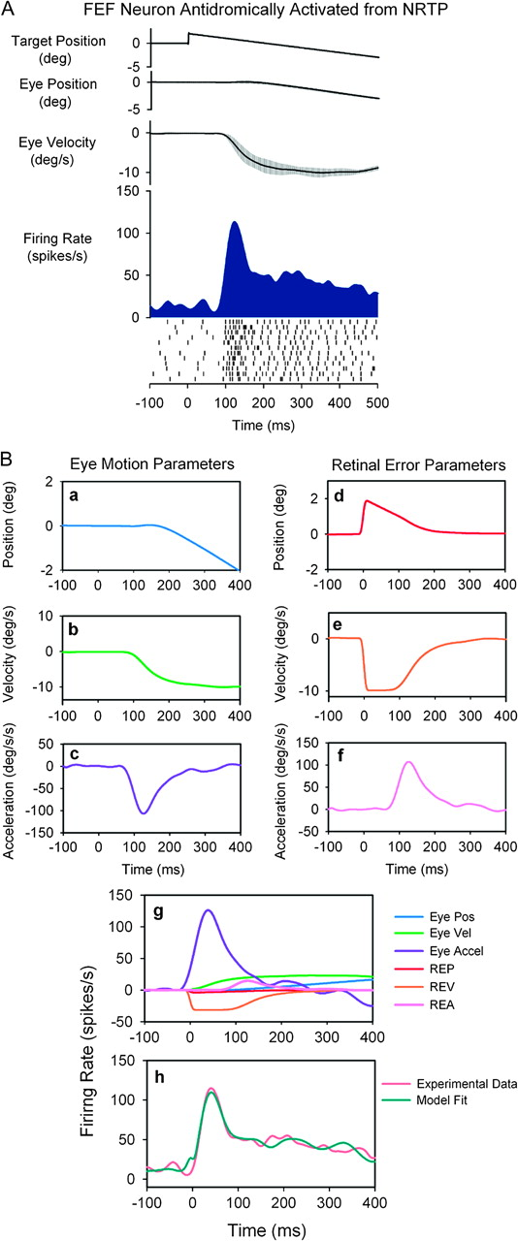
Figure 4. Step-ramp SP response of a representative FEF neuron that was antidromically activated from rNRTP. (A) ...
Notes:
Figure 4. Step-ramp SP response of a representative FEF neuron that was antidromically activated from rNRTP. (A) Averaged data from step-ramp trials (10°/s). Traces show horizontal target and eye position, eye velocity, and neuronal activity (spike density and rasters). (B) Curve-fitting procedure used to identify model parameters. Individual panels (a–f) show the dynamic values of the components that make up the model. (g) The relative contributions of the components of the model toward the unit response. (h) The observed spike density function and the best fit obtained using the model below. The equation for the corresponding fit: FR(t)=10.07−5.65E(t−5)−2.31E˙(t−5)−1.18E¨(t−5)−2.14R(t+82)+3.18R˙(t+82)+0.14R¨(t+82). The neuron was most sensitive to eye acceleration.
Unless provided in the caption above, the following copyright applies to the content of this slide: © 2008 The AuthorsThis is an Open Access article distributed under the terms of the Creative Commons Attribution Non-Commercial License (http://creativecommons.org/licenses/by-nc/2.0/uk/) which permits unrestricted non-commercial use, distribution, and reproduction in any medium, provided the original work is properly cited.

Slide 5
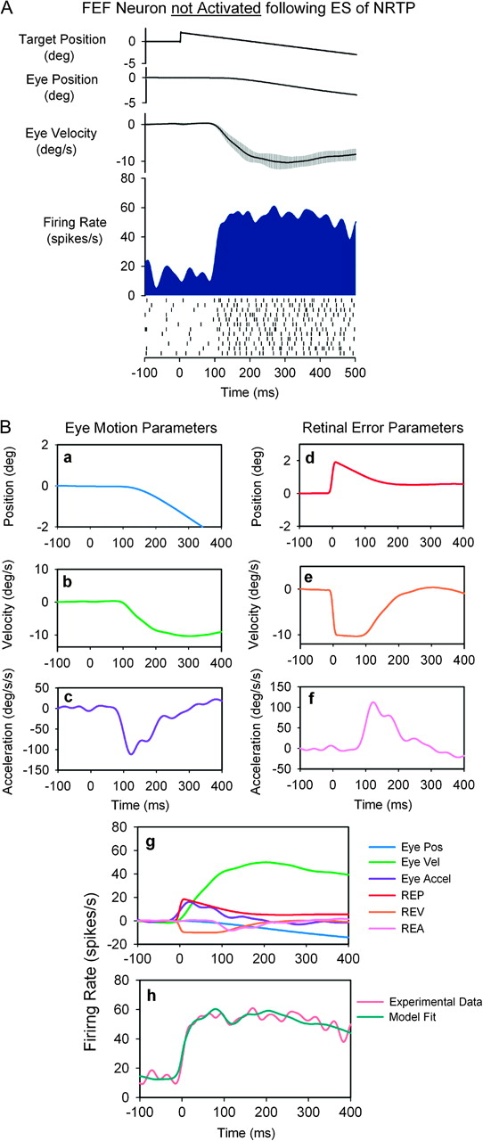
Figure 5. SP response of a representative FEF neuron not activated following electrical stimulation of rNRTP. See ...
Notes:
Figure 5. SP response of a representative FEF neuron not activated following electrical stimulation of rNRTP. See Figure 4 for description of panels. The equation for the best fit in (h): FR(t)=14.26+5.19E(t−2)−4.26E˙(t−2)+0.02E¨(t−2)+21.26R(t+98)+1.15R˙(t+98)−0.05R¨(t+98). The neuron was most sensitive to eye speed.
Unless provided in the caption above, the following copyright applies to the content of this slide: © 2008 The AuthorsThis is an Open Access article distributed under the terms of the Creative Commons Attribution Non-Commercial License (http://creativecommons.org/licenses/by-nc/2.0/uk/) which permits unrestricted non-commercial use, distribution, and reproduction in any medium, provided the original work is properly cited.

Slide 6
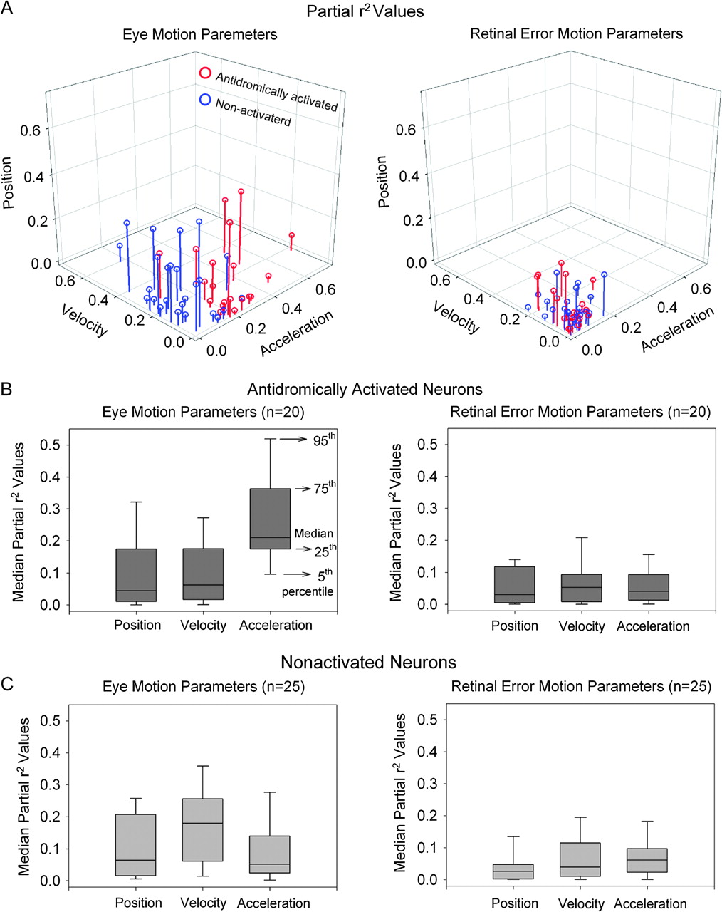
Figure 6. Comparison of partial r² values between eye (A, left panel) and retinal error (A, right panel) ...
Notes:
Figure 6. Comparison of partial r2 values between eye (A, left panel) and retinal error (A, right panel) position, velocity, and acceleration parameters for each FEF neuron antidromically activated (red symbols) or not activated (blue symbols) following electrical stimulation of rNRTP. (B) Median partial r2 values of eye motion (left panel) and retinal error motion parameters (right panel) for neurons antidromically activated from rNRTP. Eye acceleration parameters show larger partial r2 values than eye position and velocity parameters, indicating the relative importance of eye acceleration. Retinal error motion parameters show relatively smaller contributions than eye motion parameters. (C) Median partial r2 values of eye motion (left panel) and retinal error motion parameters (right panel) in neurons not activated following electrical stimulation of rNRTP. Eye velocity parameter shows larger partial r2 values than eye position and acceleration parameters, indicating the relative importance of eye velocity.
Unless provided in the caption above, the following copyright applies to the content of this slide: © 2008 The AuthorsThis is an Open Access article distributed under the terms of the Creative Commons Attribution Non-Commercial License (http://creativecommons.org/licenses/by-nc/2.0/uk/) which permits unrestricted non-commercial use, distribution, and reproduction in any medium, provided the original work is properly cited.

Slide 7
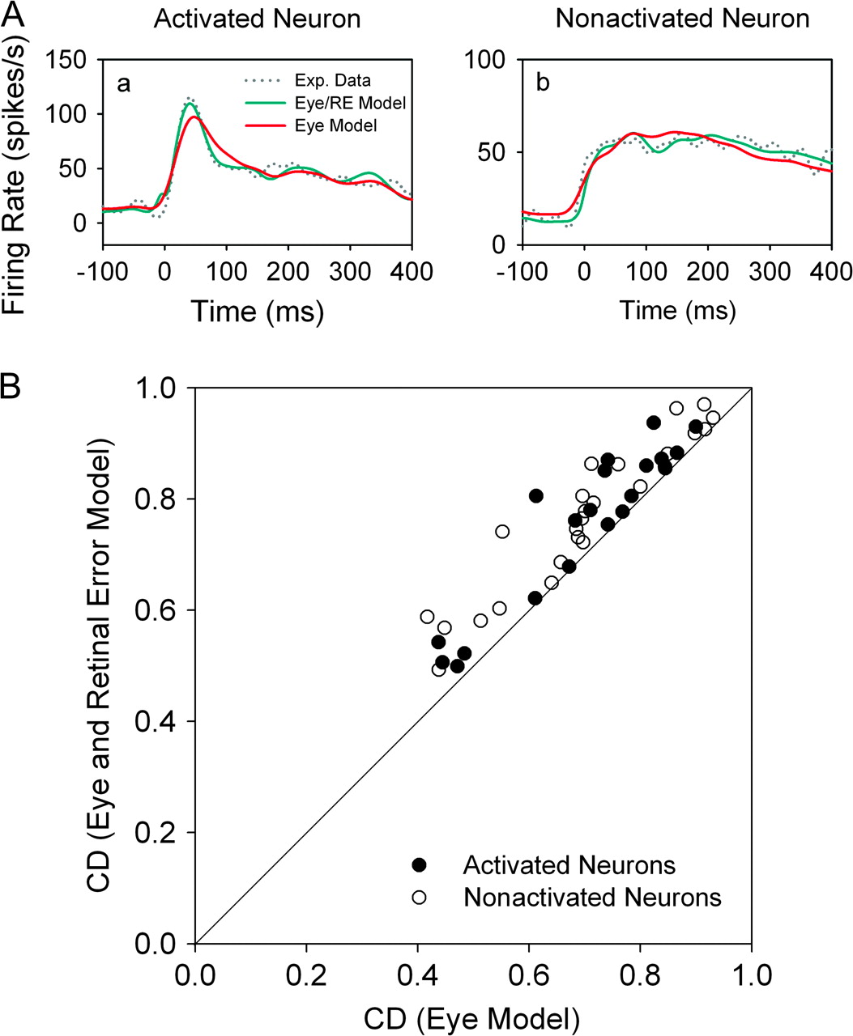
Figure 7. Comparison of CDs obtained using 6-component (eye and retinal error motion) model versus CDs obtained using ...
Notes:
Figure 7. Comparison of CDs obtained using 6-component (eye and retinal error motion) model versus CDs obtained using 3-component (eye motion) models. (A) The observed spike density function (dotted lines) and the best fit obtained using 6-component (green traces) or 3-component (red traces) models in representative antidromically activated (a) and nonactivated (b) neurons. (B) Pairwise comparisons of CDs taken from 6-component and 3-component models of antidromically activated (filled circles) and nonactivated (open circles) neuronal responses.
Unless provided in the caption above, the following copyright applies to the content of this slide: © 2008 The AuthorsThis is an Open Access article distributed under the terms of the Creative Commons Attribution Non-Commercial License (http://creativecommons.org/licenses/by-nc/2.0/uk/) which permits unrestricted non-commercial use, distribution, and reproduction in any medium, provided the original work is properly cited.

Slide 8
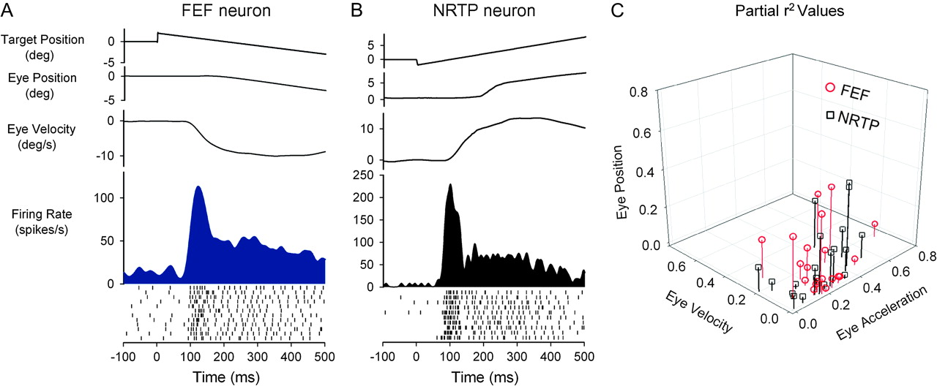
Figure 8. Comparison of neuronal response dynamics for representative FEF (conventions as in Figure 3) and rNRTP (Ono ...
Notes:
Figure 8. Comparison of neuronal response dynamics for representative FEF (conventions as in Figure 3) and rNRTP (Ono et al. 2005) SP neurons during step-ramp tracking. Response of antidromically activated FEF SP neuron (A) and rNRTP SP neuron (B). Both neurons show a strong transient responses during SP initiation. (C) Partial r2values for SP neurons in the rNRTP (Ono et al. 2005) and in FEF (antidromically activated from rNRTP). Both populations show considerable overlap with a trend toward most sensitivity to eye acceleration.
Unless provided in the caption above, the following copyright applies to the content of this slide: © 2008 The AuthorsThis is an Open Access article distributed under the terms of the Creative Commons Attribution Non-Commercial License (http://creativecommons.org/licenses/by-nc/2.0/uk/) which permits unrestricted non-commercial use, distribution, and reproduction in any medium, provided the original work is properly cited.

