Slide 1
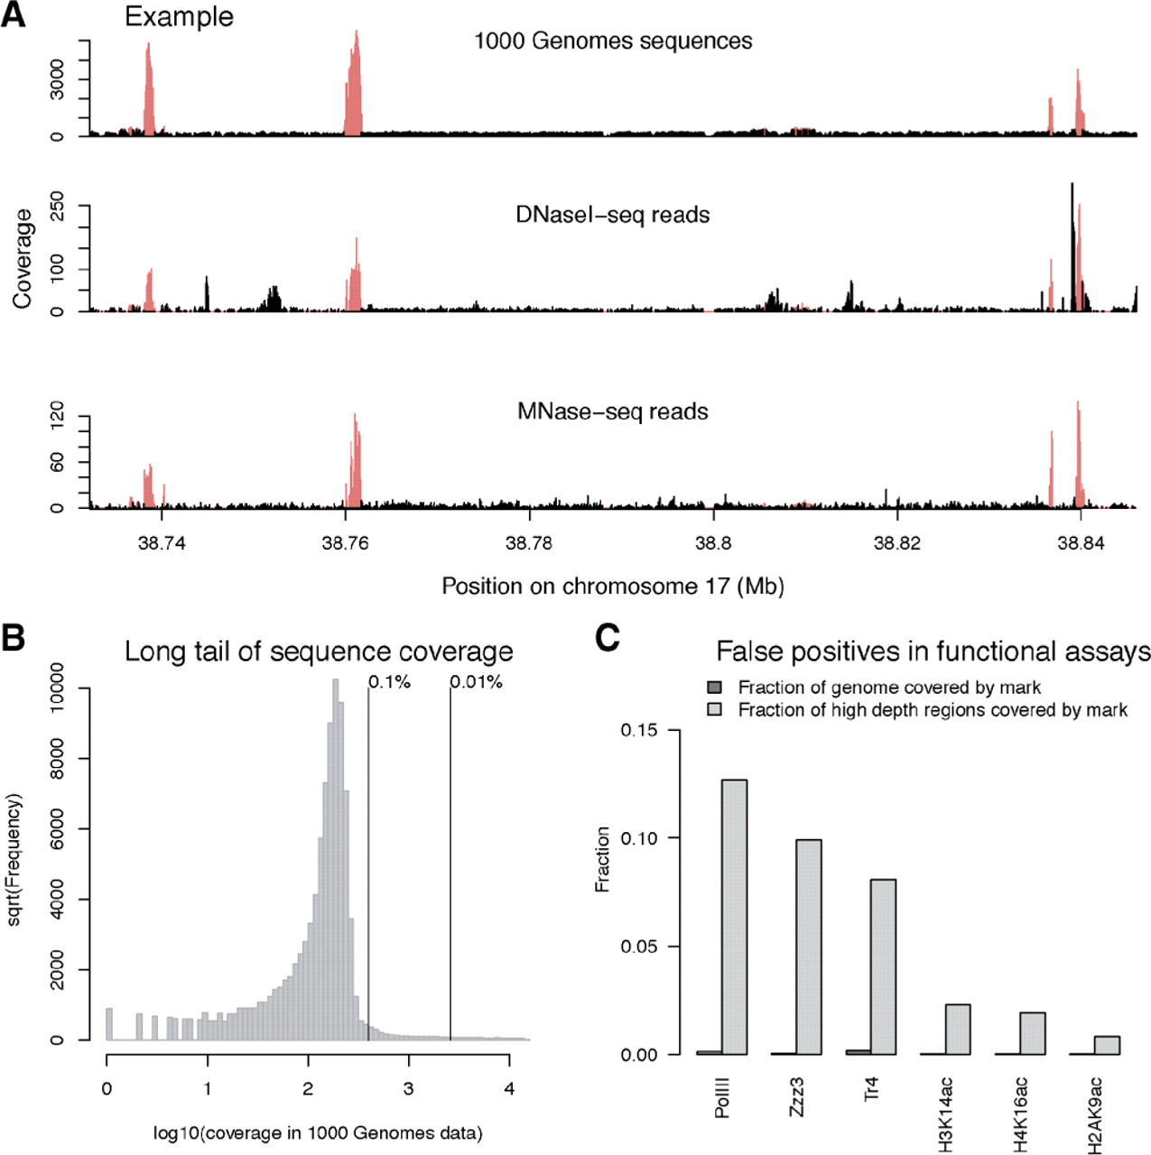
Fig. 1. Sequences absent from the reference genome cause spurious peaks of sequencing reads. (A) An example of such a ...
Notes:
Fig. 1. Sequences absent from the reference genome cause spurious peaks of sequencing reads. (A) An example of such a region. In each panel, we plot the density of uniquely mapped sequencing reads from three sources: the Illumina data from low coverage sequencing of Yoruba individuals from the 1000 Genomes Project (summed across all individuals), a study of DNaseI hypersensitivity (Pique-Regi et al., 2011) and a study of MNase sensitivity (Schones et al., 2008). In the first of these, copy number is expected to be approximately constant. In red are regions that we call as high depth regions at a threshold of 0.1%. (B) A long tail of very high read depth for sequences present once in the human reference. Using the coverage from the 1000 Genomes Project data, we plot the histogram of the coverage at each base (using 500 Mb of sequence). Marked are the positions corresponding to the top 0.1 and 0.01% of the distribution. (C) Collapsed repeats cause false peaks of sequencing reads in functional assays. For each experiment, we plot the fraction of the genome covered occupied by the mark, as well as the fraction of the HDRs covered by the mark. For the ChIP-seq on transcription factors, we used the binding sites called by the ENCODE Project (ENCODE Project Consortium, 2007) using PeakSeq (Rozowsky et al., 2009). For the ChIP-seq on histone modifications (Wang et al., 2008), we split the genome into windows of 200 bases and called the most extreme 0.1% of windows as bound. Shown are selected experiments; for all experiments see Supplementary Figures S2 and S3.
Unless provided in the caption above, the following copyright applies to the content of this slide: © The Author(s) 2011. Published by Oxford University Press.This is an Open Access article distributed under the terms of the Creative Commons Attribution Non-Commercial License (http://creativecommons.org/licenses/by-nc/2.5), which permits unrestricted non-commercial use, distribution, and reproduction in any medium, provided the original work is properly cited.

