Slide 1
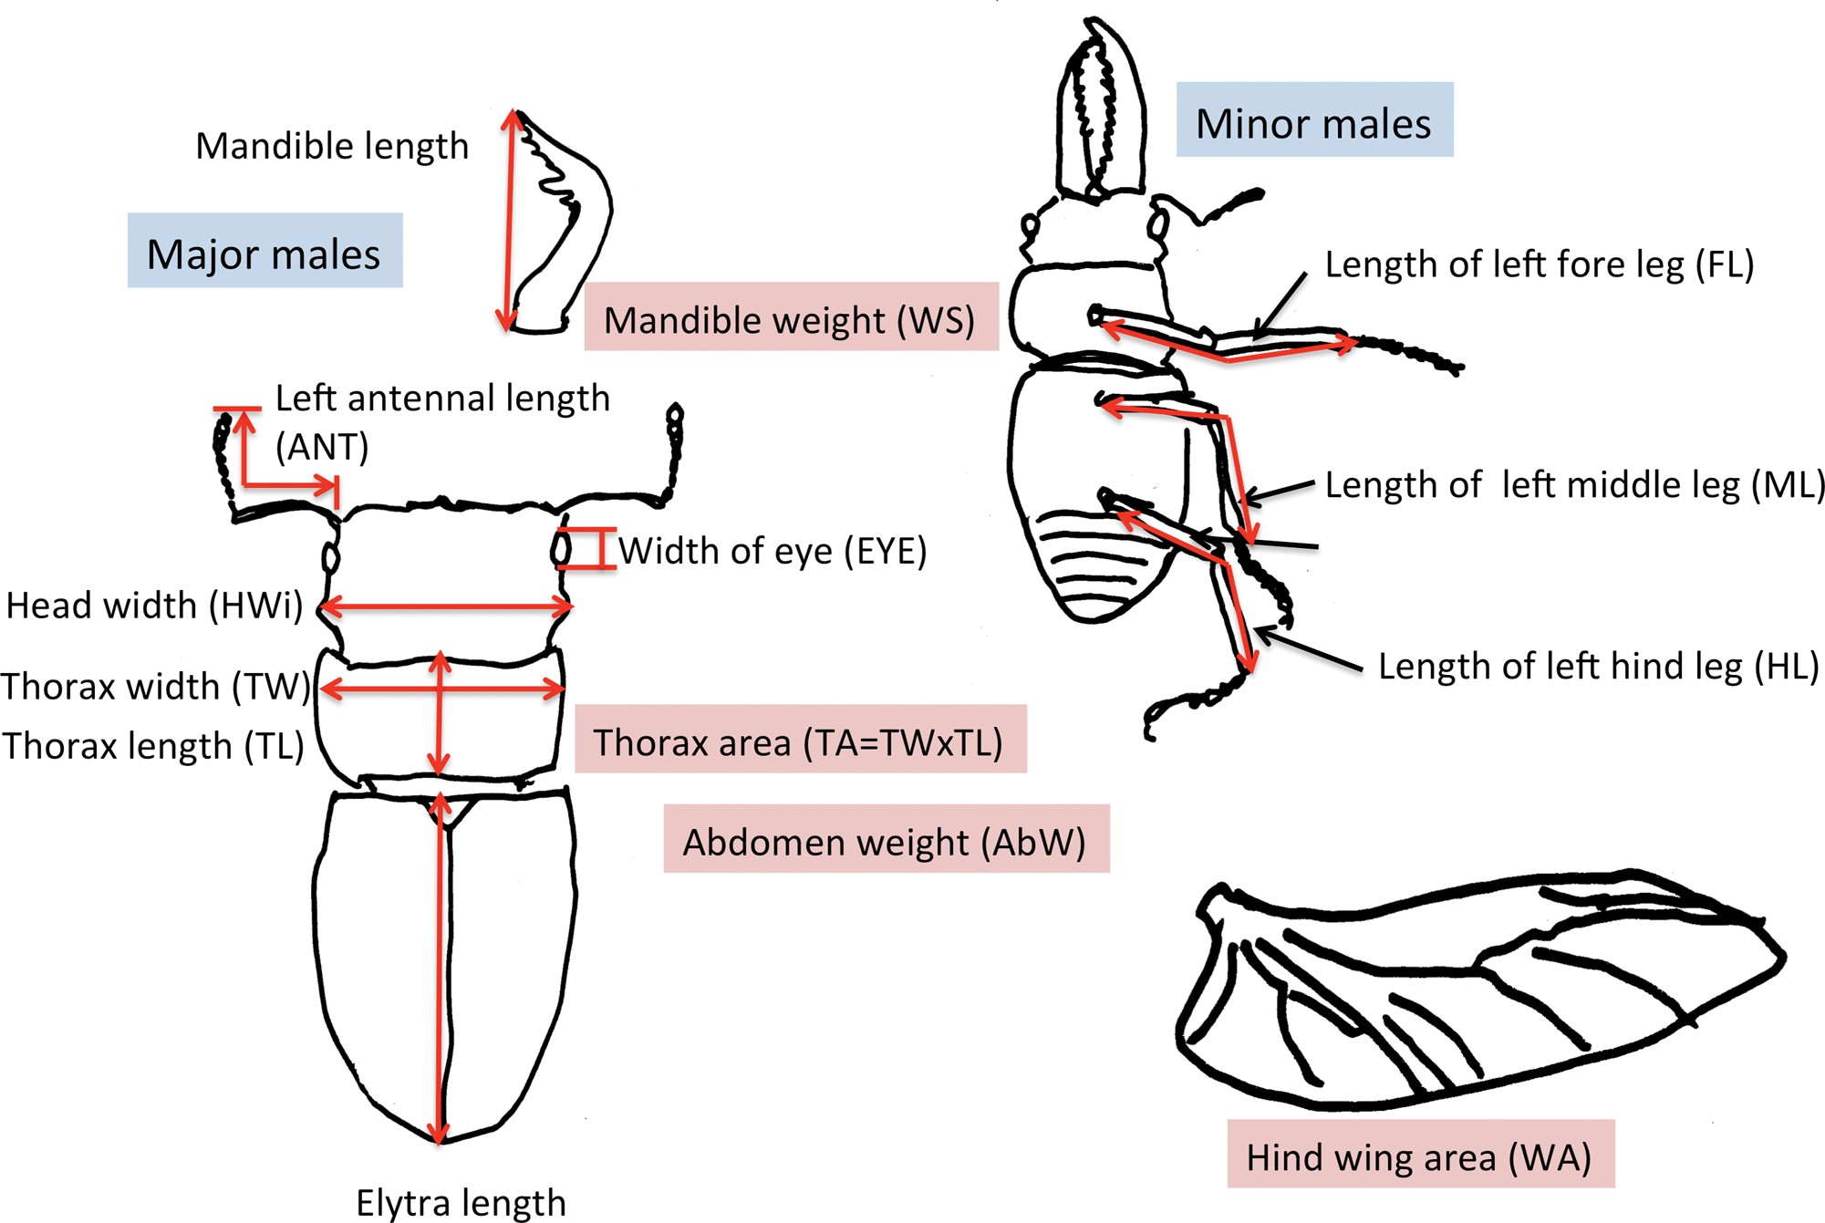
Fig. 1. Measured traits for each of the 50 major and minor P. inclinatus males. Pink frames around traits indicate ...
Notes:
Fig. 1. Measured traits for each of the 50 major and minor P. inclinatus males. Pink frames around traits indicate the dry weight or the area of those traits.
Unless provided in the caption above, the following copyright applies to the content of this slide: © The Authors 2017. Published by Oxford University Press on behalf of Entomological Society of America. All rights reserved. For Permissions, please email: journals.permissions@oup.com

