Slide 1
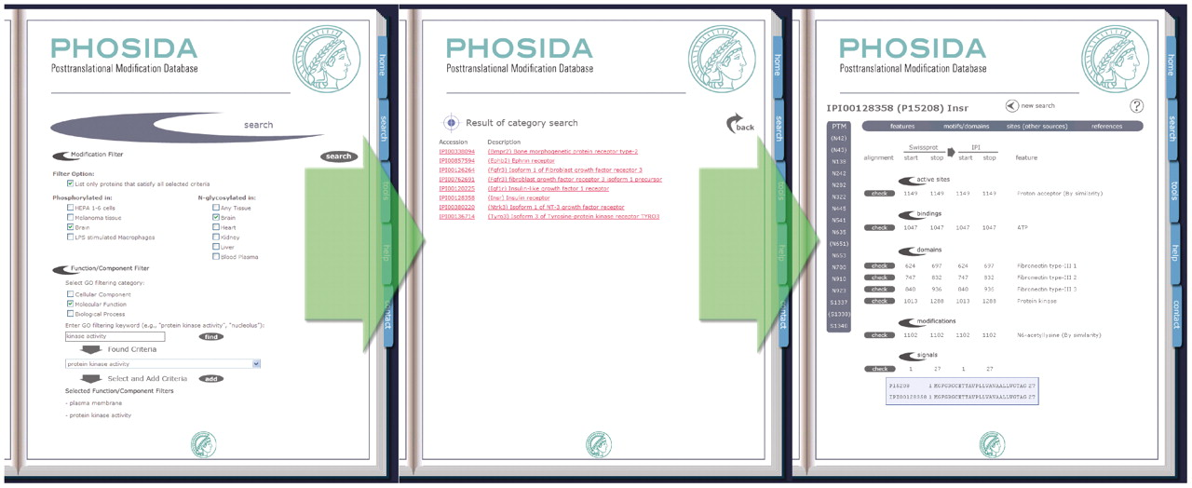
Figure 1. The new browsing function allows the searching for posttranslationally modified proteins that were identified ...
Notes:
Figure 1. The new browsing function allows the searching for posttranslationally modified proteins that were identified in a particular experiment or cell type. Furthermore, the gene ontology filter enables users to search for modified proteins with specific cellular localization and molecular function (left panel). Selecting one of the resulting protein entries (middle panel) yields the protein annotation web page (right panel). In addition to general protein information, identified posttranslational modification sites are listed. Clicking on one of the site buttons results in the provision of site-specific information. In the illustrated example, searching for protein kinases that are both phosphorylated and N-glycosylated in the mouse brain and localized in the plasma membrane yields a list of proteins that match the specified search criteria. One of these proteins is the insulin receptor.
Unless provided in the caption above, the following copyright applies to the content of this slide: © The Author(s) 2010. Published by Oxford University Press.This is an Open Access article distributed under the terms of the Creative Commons Attribution Non-Commercial License (http://creativecommons.org/licenses/by-nc/2.5), which permits unrestricted non-commercial use, distribution, and reproduction in any medium, provided the original work is properly cited.

Slide 2
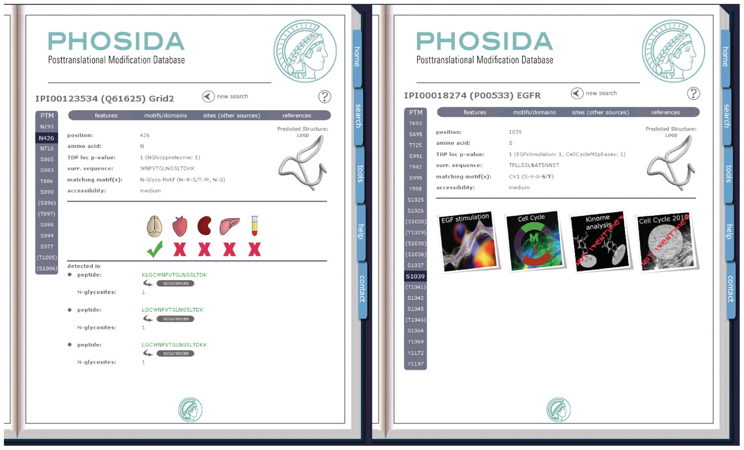
Figure 2. On the site level PHOSIDA provides the surrounding sequence, matching motifs, the predicted secondary ...
Notes:
Figure 2. On the site level PHOSIDA provides the surrounding sequence, matching motifs, the predicted secondary structure, the predicted accessibility, the corresponding identified peptides and the identification state in certain cell types (left panel: N-glycosylated asparagine on position 426 of the mouse glutamate receptor 2 subunit) or experiments (right panel: serine on position 1039 of the human EGF receptor).
Unless provided in the caption above, the following copyright applies to the content of this slide: © The Author(s) 2010. Published by Oxford University Press.This is an Open Access article distributed under the terms of the Creative Commons Attribution Non-Commercial License (http://creativecommons.org/licenses/by-nc/2.5), which permits unrestricted non-commercial use, distribution, and reproduction in any medium, provided the original work is properly cited.

Slide 3
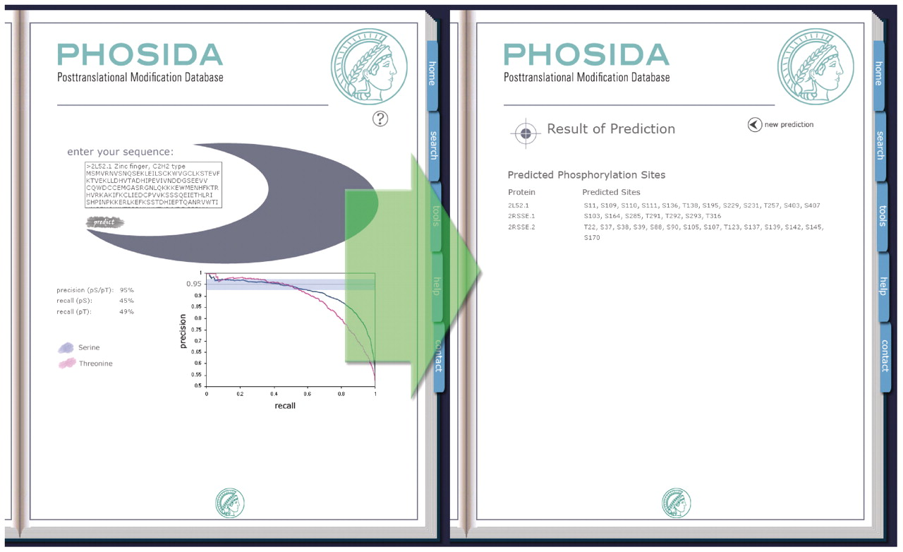
Figure 3. Species-specific phosphorylation or acetylation site predictors allow the in silico identification of ...
Notes:
Figure 3. Species-specific phosphorylation or acetylation site predictors allow the in silico identification of proteins based on the primary sequence. Users can insert the sequence of a single protein or the sequences of multiple proteins in FASTA format (left panel). Using specified precision recall values, the predicted posttranslational modification sites are listed (right panel).
Unless provided in the caption above, the following copyright applies to the content of this slide: © The Author(s) 2010. Published by Oxford University Press.This is an Open Access article distributed under the terms of the Creative Commons Attribution Non-Commercial License (http://creativecommons.org/licenses/by-nc/2.5), which permits unrestricted non-commercial use, distribution, and reproduction in any medium, provided the original work is properly cited.

Slide 4
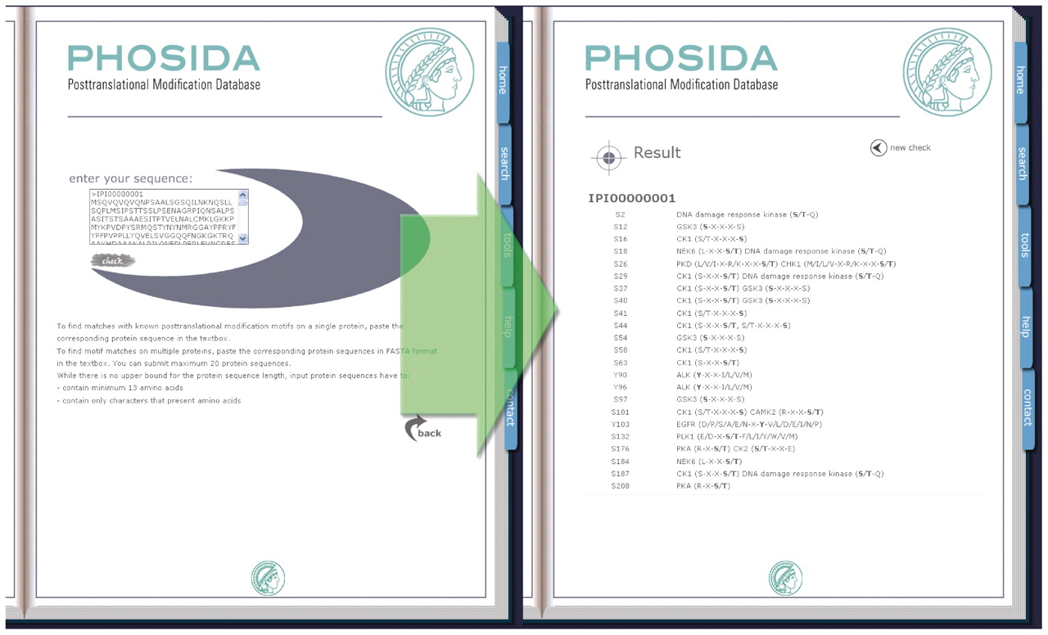
Figure 4. The Motif Matcher searches for sequence matches with annotated motifs including kinase recognition patterns. ...
Notes:
Figure 4. The Motif Matcher searches for sequence matches with annotated motifs including kinase recognition patterns. Users can insert a single sequence or multiple sequences (left panel) to find motif matches (right panel).
Unless provided in the caption above, the following copyright applies to the content of this slide: © The Author(s) 2010. Published by Oxford University Press.This is an Open Access article distributed under the terms of the Creative Commons Attribution Non-Commercial License (http://creativecommons.org/licenses/by-nc/2.5), which permits unrestricted non-commercial use, distribution, and reproduction in any medium, provided the original work is properly cited.

Slide 5
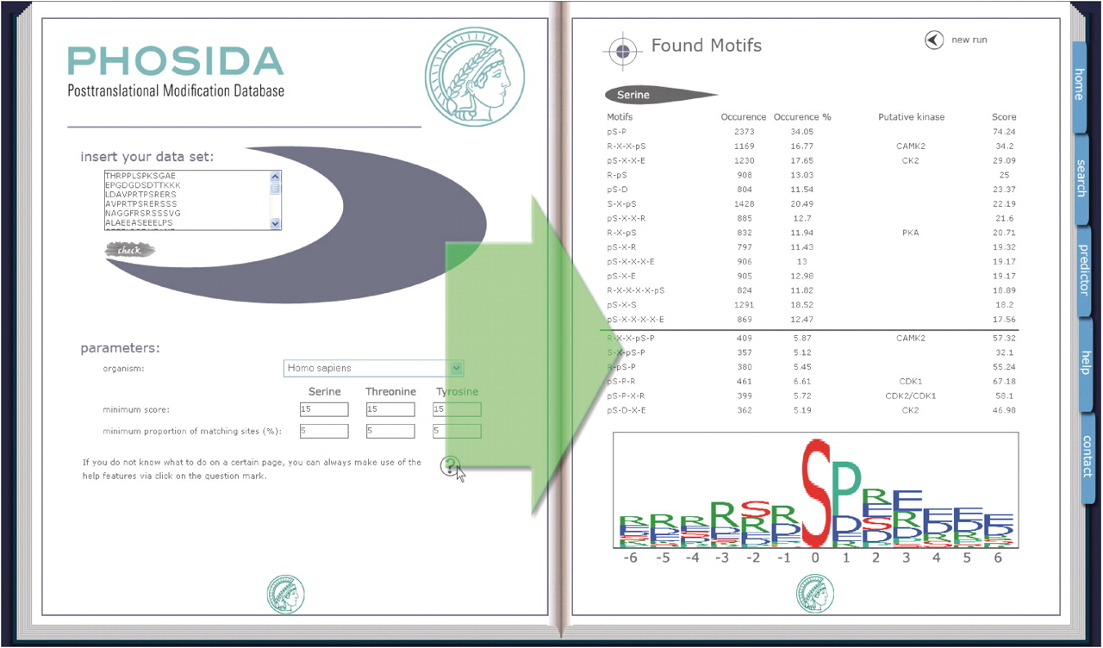
Figure 5. The Motif Finder identifies significantly overrepresented consensus sequences in given large-scale phospho ...
Notes:
Figure 5. The Motif Finder identifies significantly overrepresented consensus sequences in given large-scale phospho data sets. It compares the position specific amino acid frequencies in the input set (left panel) with the ones of the background set. Based on bootstrap statistics the motif finder extracts de novo sequence motifs and matches them with annotated kinase motifs (right panel).
Unless provided in the caption above, the following copyright applies to the content of this slide: © The Author(s) 2010. Published by Oxford University Press.This is an Open Access article distributed under the terms of the Creative Commons Attribution Non-Commercial License (http://creativecommons.org/licenses/by-nc/2.5), which permits unrestricted non-commercial use, distribution, and reproduction in any medium, provided the original work is properly cited.

