Slide 1
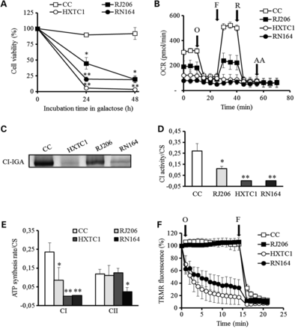
Figure 1. MtDNA mutations differently affect CI function and cellular bioenergetic competence. (A) Cell viability in ...
Notes:
Figure 1. MtDNA mutations differently affect CI function and cellular bioenergetic competence. (A) Cell viability in glucose-free medium containing galactose. Data are mean ± SD of viable cells expressed as percent of cells considering time = 0 as 100% (n = 4; *P < 0.05; **P < 0.001). (B) Cellular OCR profile. Measurements of OCR were performed upon injection of 1 µm oligomycin (O), 0.1 µm FCCP (F), 1 µm rotenone (R) and 1 µm antimycin A (AA) in high glucose medium. Data (mean ± SE) are expressed as picomoles of O2 per minute per 3 × 104cells (n = 3). (C) CI-IGA assay in isolated mitochondria. One representative BN-PAGE gel of three is shown. (D) Spectrophotometric determination of CI activity (NADH:DB:DCIP oxidoreductase), after subtraction of 1 μm rotenone-insensitive activity and normalization on citrate synthase activity (CS) and protein content. Data are mean ± SD (n = 3; *P < 0.05; **P < 0.001). (E) Rate of mitochondrial ATP synthesis in digitonin-permeabilized cells driven by pyruvate/malate (CI) and SA plus rotenone (CII). Data normalized for CS activity and protein content are mean ± SD (n = 4; *P < 0.05; **P < 0.001). (F) Mitochondrial membrane potential evaluation in cybrid clones grown in high glucose medium. Arrows indicate the addition of 6 µm oligomycin (O) and 4 µm FCCP (F). Data are mean ± SE (n = 4). Fluorescence readings following the addition of oligomycin and preceding that of FCCP revealed a statistically significant difference (P < 0.05) for all time points between HXTC1 and RN164 cells vs RJ206 and CC clones.
Unless provided in the caption above, the following copyright applies to the content of this slide: © The Author 2013. Published by Oxford University Press. All rights reserved. For Permissions, please email: journals.permissions@oup.com

Slide 2
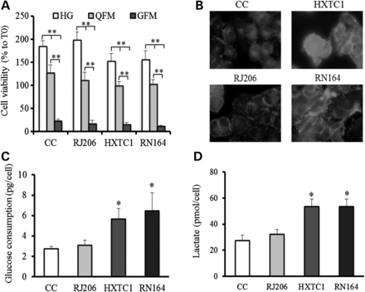
Figure 2. Severe CI dysfunction modifies cellular glucose metabolism. (A) Cell lines were incubated for 24 h in ...
Notes:
Figure 2. Severe CI dysfunction modifies cellular glucose metabolism. (A) Cell lines were incubated for 24 h in different media. HG, high glucose medium containing 25 mm glucose plus L-glutamine; QFM, high glucose without L-glutamine; GFM, glucose-free medium supplemented with L-glutamine. Cell viability was determined using the SRB assay. Data are mean ± SD (n = 4, **P < 0.001). (B) Glucose uptake was determined by using 30 µm of 6-NBDG, a fluorescent non-hydrolyzable glucose analog. Cells were visualized with a digital imaging system, using an inverted epifluorescence microscope (magnification ×63/1.4 oil objective) at 488 nm. (C) Glucose consumption determined in cells incubated in the presence of high glucose (25 mm) medium for 24 h. Data (mean ± SE) are expressed as picograms of consumed glucose normalized on cell number (n = 3; *P < 0.05). (D) L-lactate production of cells incubated in the presence of high glucose for 24 h. Data (mean ± SE) are expressed as picomoles of L-lactate normalized on cell number (n = 3; *P < 0.05).
Unless provided in the caption above, the following copyright applies to the content of this slide: © The Author 2013. Published by Oxford University Press. All rights reserved. For Permissions, please email: journals.permissions@oup.com

Slide 3
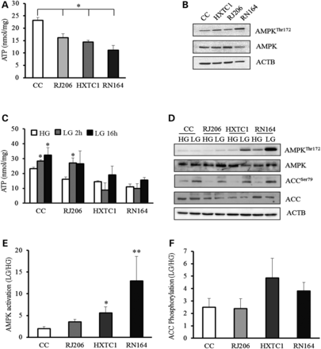
Figure 3. Severe CI deficit leads to the activation of AMP-dependent kinase. (A) Total ATP levels determined in the ...
Notes:
Figure 3. Severe CI deficit leads to the activation of AMP-dependent kinase. (A) Total ATP levels determined in the presence of high glucose (25 mm). Data are mean ± SD (n = 3; *P < 0.05). (B) Western blot analysis of total and phosphorylated (Thr172) AMPK levels in the presence of 25 mm glucose. ACTB was used as a loading control. Blots are representative of three different experiments. (C) ATP levels determined in the presence of 25 mm (T0) or 5 mm glucose (LG) for 2 h and 16 h. Data are mean ± SD (n = 3; *P < 0.05). (D) Western blot analysis of total and phosphorylated (Thr172) AMPK and total and phosphorylated (Ser79) ACC levels in the presence of 25 mm glucose (HG) or after incubation with 5 mm glucose (LG) for 16 h. ACTB was used as a loading control. Blots are representative of three different experiments. (E) Densitometric evaluation of AMPK activation in clones. Data are the ratio (mean ± SE, n = 5; *P < 0.05) of AMPK activation in low glucose (LG, 5 mm) referred to high glucose (HG, 25 mm). AMPK activation has been evaluated as the ratio of phosphorylated AMPK Thr172 and total AMPK band intensity, each normalized on the corresponding ACTB band intensity. (F) Densitometric evaluation of ACC phosphorylation. Data are the ratio (mean ± SE, n = 5; *P < 0.05) of ACC phosphorylation in low glucose (LG, 5 mm) referred to high glucose (HG, 25 mm), each normalized on the corresponding ACTB band intensity.
Unless provided in the caption above, the following copyright applies to the content of this slide: © The Author 2013. Published by Oxford University Press. All rights reserved. For Permissions, please email: journals.permissions@oup.com

Slide 4
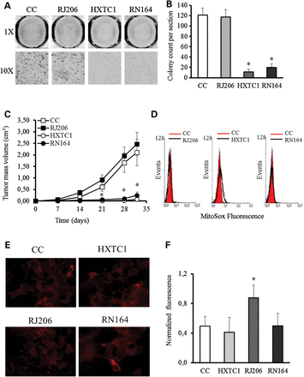
Figure 4. Severe mitochondrial defects hamper tumor growth in a ROS-independent manner. (A) Representative images (n = ...
Notes:
Figure 4. Severe mitochondrial defects hamper tumor growth in a ROS-independent manner. (A) Representative images (n = 3) of anchorage-independent colony growth in soft agar. Magnifications ×1 and ×10. (B) Colony count on soft agar plates after 14 days; data are mean ± SD (n = 3, *P < 0.05). (C) Tumor growth induced upon injection of controls and mutant cell lines in nude mice. Data are mean ± SE (n = 3, 15 animals inoculated in each experiment; *P < 0.05). (D) Mitochondrial superoxide anion production determined by flow cytometry using MitoSOX™ fluorescent dye. Values from representative experiments are shown. (E) Mitochondrial superoxide anion production determined by epifluorescence microscopy using MitoSOX™ fluorescent dye. Cells were visualized with a digital imaging system, using an inverted epifluorescence microscope (magnification ×63/1.4 oil objective) at 580 nm. Images are representative of three different experiments. Ten images were acquired for each experiment. (F) Hydrogen peroxide levels were measured using H2DCFDA, as described in Materials and methods. Data are mean ± SE (n = 3; *P < 0.05).
Unless provided in the caption above, the following copyright applies to the content of this slide: © The Author 2013. Published by Oxford University Press. All rights reserved. For Permissions, please email: journals.permissions@oup.com

Slide 5
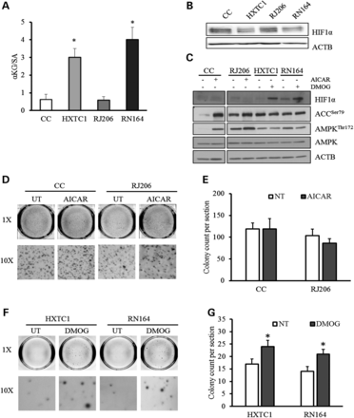
Figure 5. HIF1α destabilization is responsible for blocking tumor growth in cells carrying severe CI defect. (A) The ...
Notes:
Figure 5. HIF1α destabilization is responsible for blocking tumor growth in cells carrying severe CI defect. (A) The ratio of αKG and SA levels was calculated by measuring each metabolite in three different experiments (*P < 0.05). (B) Western blot analysis of HIF1α in nuclear fractions. ACTB was used as a loading control. One representative experiment of three is shown. (C) Western blot analysis of HIF1α, total and phosphorylated AMPK in cell lysates after treatment with 600 µm AICAR or 1 µm DMOG for 24 h. ACTB was used as a loading control. One representative experiment of three is shown. (D–F) Representative images (n = 3) of anchorage-independent colony growth in soft agar of CC and RJ206 in the absence or presence of 600 µm AICAR and of HXTC1 and RN164 in the absence or presence of 1 µm DMOG. Magnifications ×1 and ×10. (E–G) Colony count on soft agar plates after 20 days; data are mean ± SD (n = 3, *P < 0.05).
Unless provided in the caption above, the following copyright applies to the content of this slide: © The Author 2013. Published by Oxford University Press. All rights reserved. For Permissions, please email: journals.permissions@oup.com

Slide 6
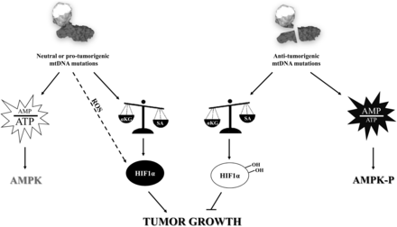
Figure 6. Mitochondrial bioenergetic defects drive hypoxic adaptation and regulate tumor progression. MtDNA mutations ...
Notes:
Figure 6. Mitochondrial bioenergetic defects drive hypoxic adaptation and regulate tumor progression. MtDNA mutations may be classified as (i) neutral or pro-tumorigenic or (ii) anti-tumorigenic, depending on their effect on the consequent bioenergetic defect. In cancer cells harbouring neutral or pro-tumorigenic mutations, a mild functional defect of CI occurs and the mitochondrial energetic impairment is not sufficient to modify the physiological αKG/SA ratio, leading to HIF1α stabilization and, lastly, to tumor growth. Chronic oxidative stress (ROS) may also contribute to HIF1α transcriptional regulation. Conversely, when an mtDNA mutation affects the structural stabilization of CI or completely abolishes its function, the energetic impairment is particularly dramatic and induces an alteration in the αKG/SA ratio, which ultimately causes chronic HIF1α destabilization and block of tumor progression. In this case, the energetic defect alters the AMP/ATP ratio triggering the activation of AMPK. AMPK and HIF1α active forms are indicated in black, and their inactive forms in light grey.
Unless provided in the caption above, the following copyright applies to the content of this slide: © The Author 2013. Published by Oxford University Press. All rights reserved. For Permissions, please email: journals.permissions@oup.com

