Slide 1
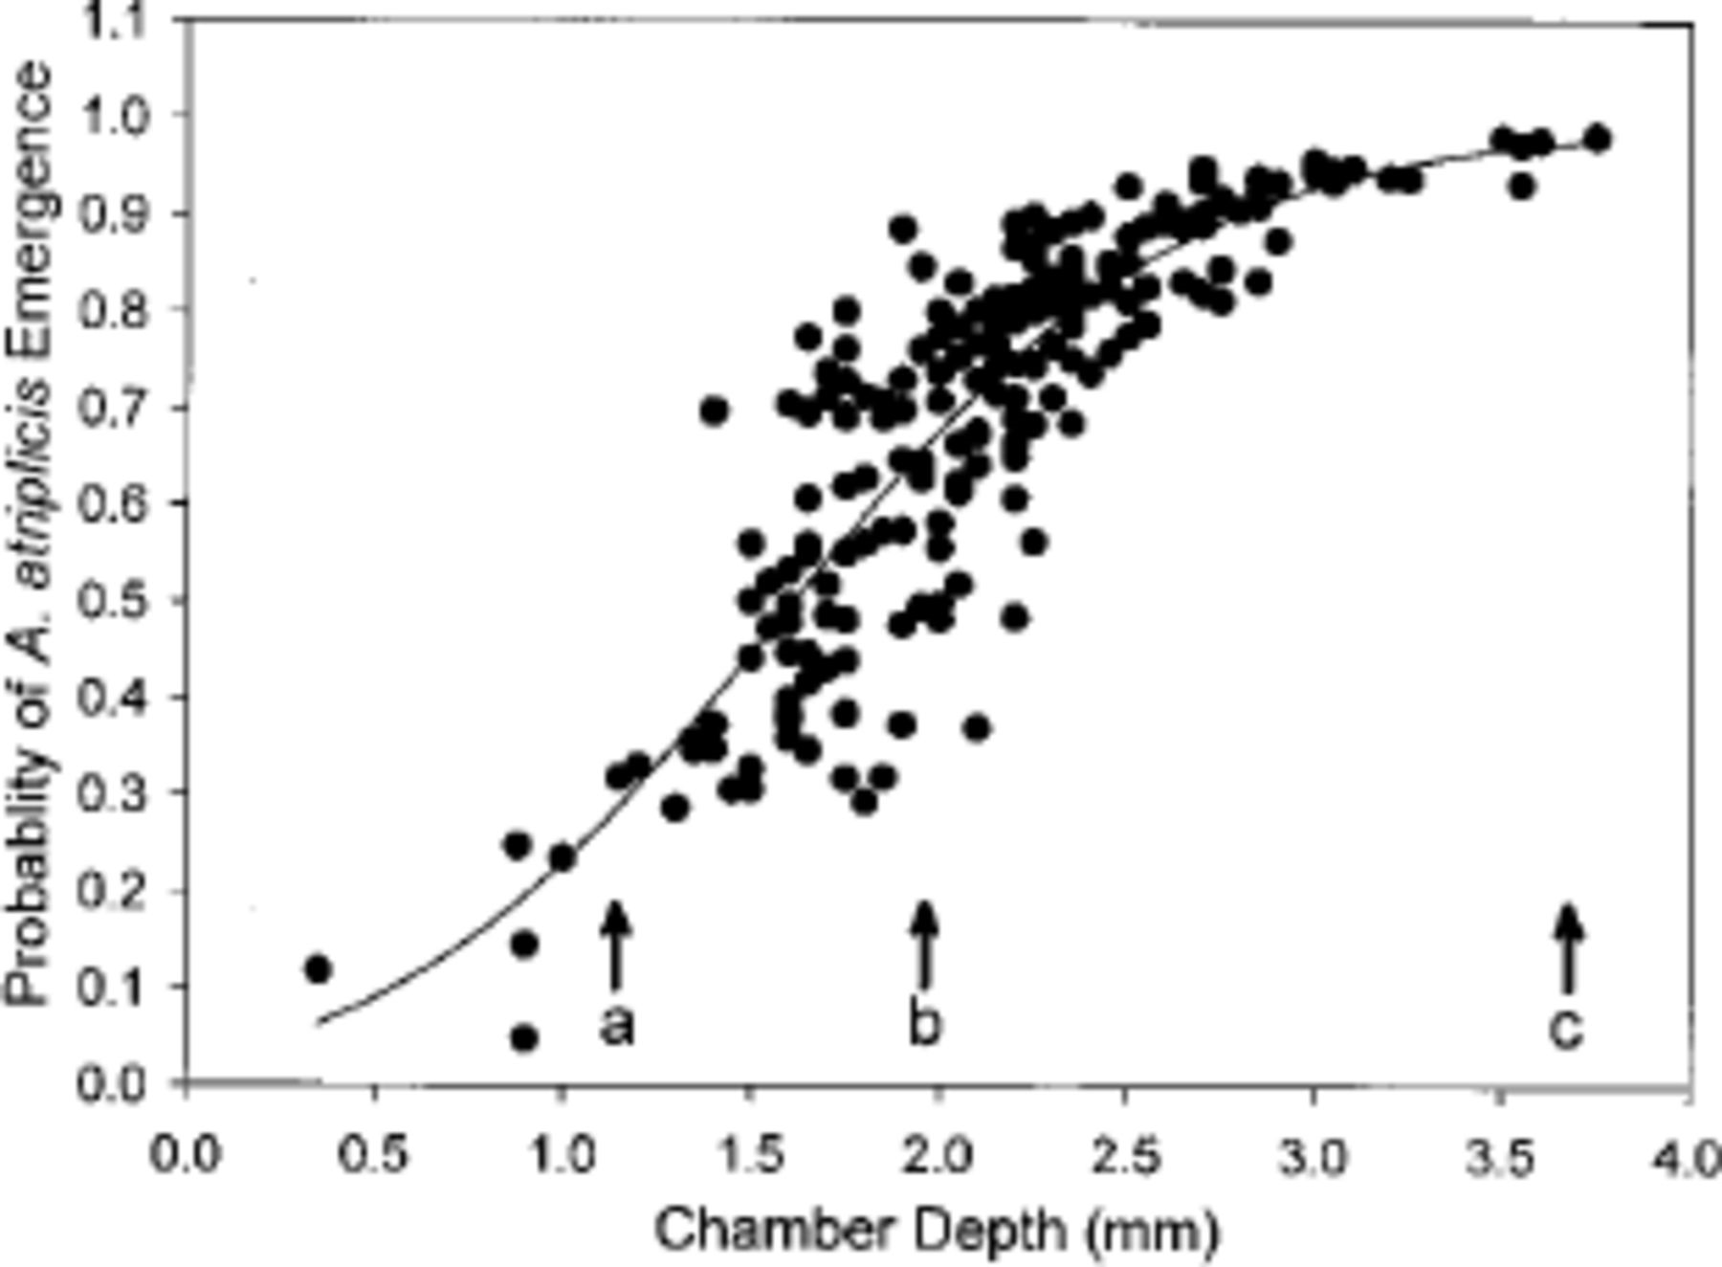
Fig. 1. Probability that an A. atriplicis will survive until emergence from its gall as a function of larval chamber ...
Notes:
Fig. 1. Probability that an A. atriplicis will survive until emergence from its gall as a function of larval chamber depth. Arrows indicate the maximum gall depth that the ovipositor could reach for three of the major parasitoids: (a) R. tegularis, (b) T. cecidobroter, and (c) T. umbilicates.
Unless provided in the caption above, the following copyright applies to the content of this slide: © 2004 Entomological Society of AmericaThis is an Open Access article distributed under the terms of the Creative Commons Attribution Non-Commercial License (http://creativecommons.org/licenses/by-nc/3.0/), which permits non-commercial reuse, distribution, and reproduction in any medium, provided the original work is properly cited. For commercial re-use, please contact journals.permissions@oup.com

Slide 2
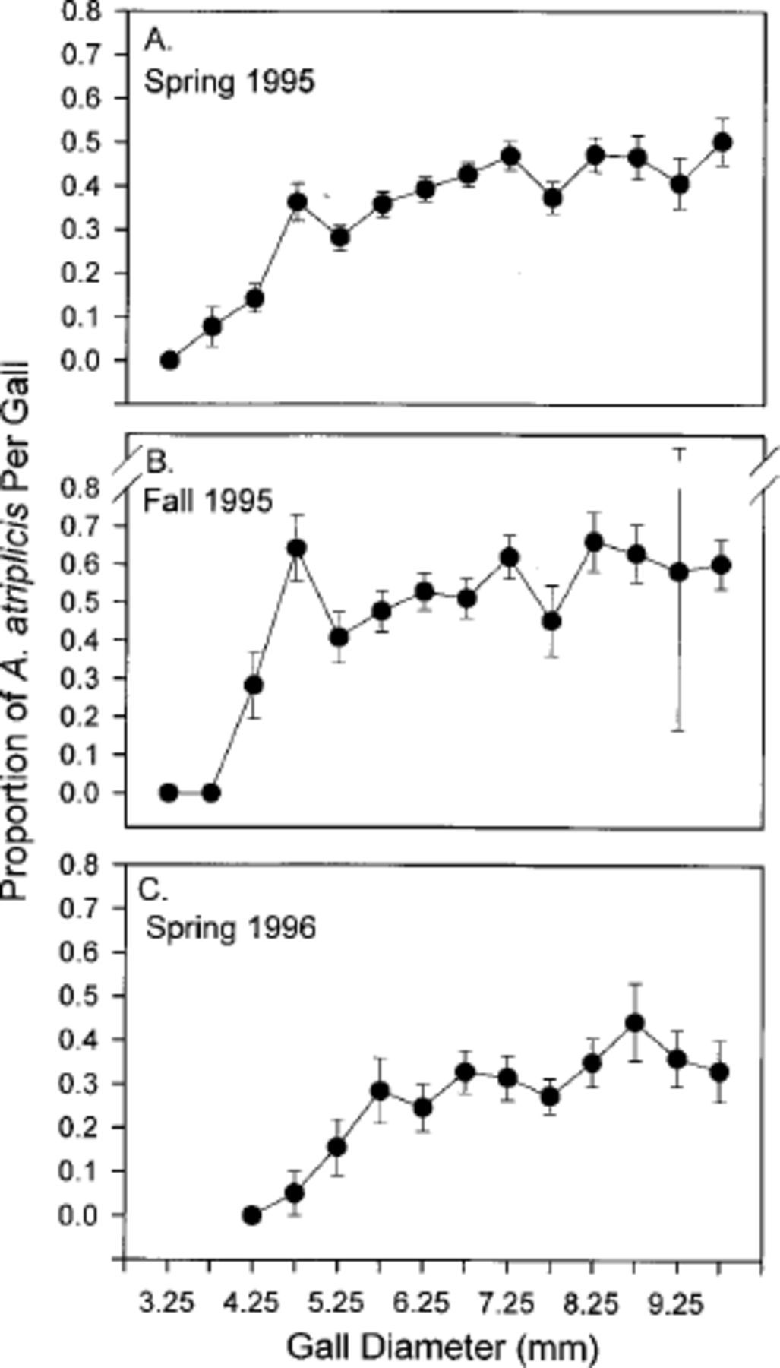
Fig. 2. Mean proportion per gall survivorship (±1 SE) of A. atriplicis until adult emergence for the indicated gall ...
Notes:
Fig. 2. Mean proportion per gall survivorship (±1 SE) of A. atriplicis until adult emergence for the indicated gall diameter classes for three seasons. The means include data from all three all sites.
Unless provided in the caption above, the following copyright applies to the content of this slide: © 2004 Entomological Society of AmericaThis is an Open Access article distributed under the terms of the Creative Commons Attribution Non-Commercial License (http://creativecommons.org/licenses/by-nc/3.0/), which permits non-commercial reuse, distribution, and reproduction in any medium, provided the original work is properly cited. For commercial re-use, please contact journals.permissions@oup.com

Slide 3
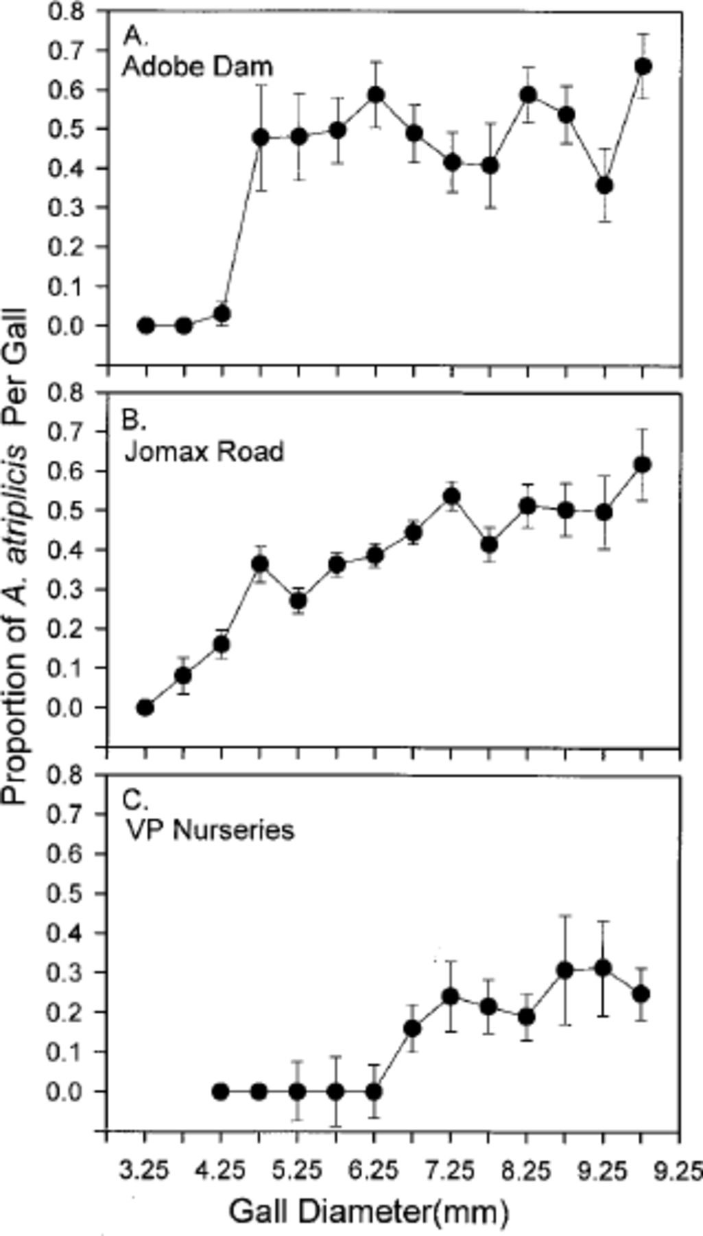
Fig. 3. Mean proportion per gall survivorship (±1 SE) of A. atriplicis until adult emergence for the indicated gall ...
Notes:
Fig. 3. Mean proportion per gall survivorship (±1 SE) of A. atriplicis until adult emergence for the indicated gall diameter classes for three seasons. The means includes data from all three seasons.
Unless provided in the caption above, the following copyright applies to the content of this slide: © 2004 Entomological Society of AmericaThis is an Open Access article distributed under the terms of the Creative Commons Attribution Non-Commercial License (http://creativecommons.org/licenses/by-nc/3.0/), which permits non-commercial reuse, distribution, and reproduction in any medium, provided the original work is properly cited. For commercial re-use, please contact journals.permissions@oup.com

Slide 4
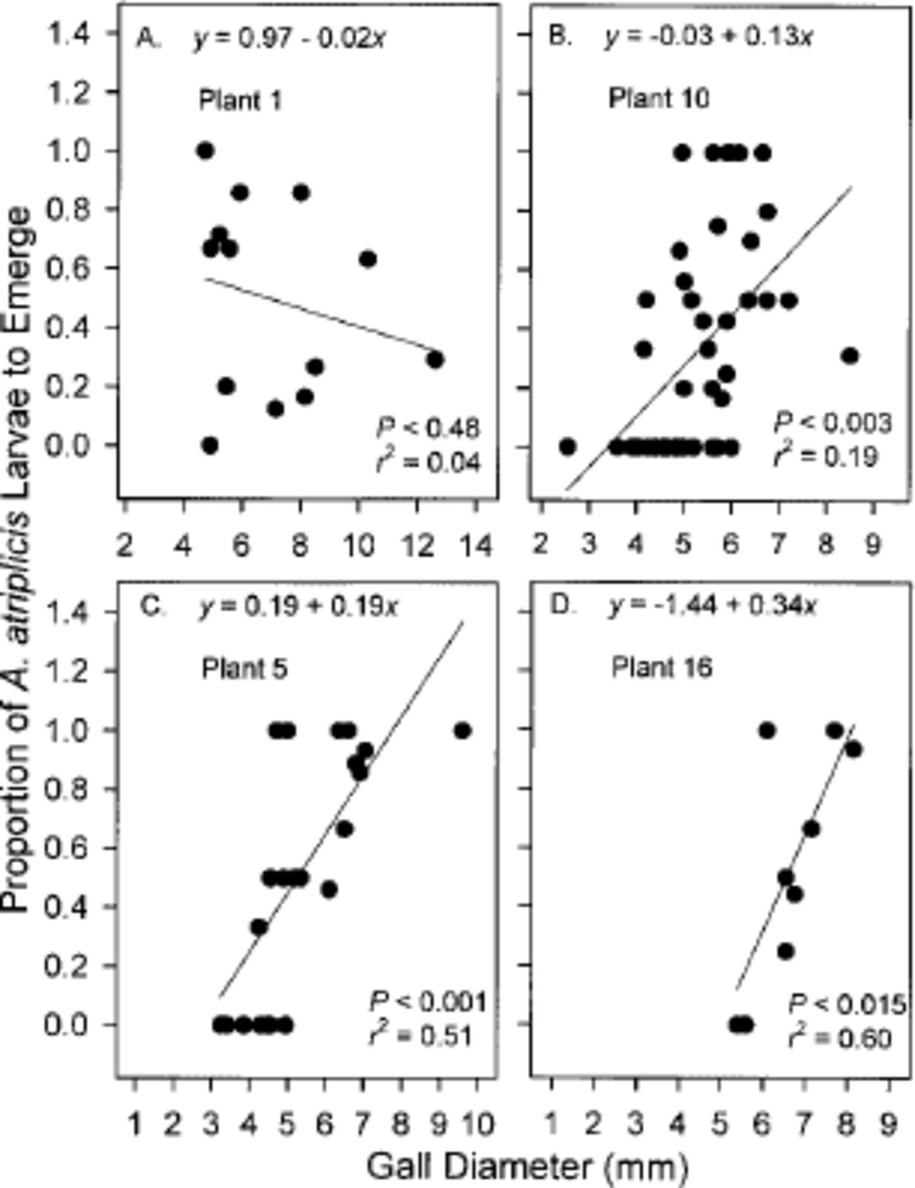
Fig. 4. Relationship of larval survival to gall size for four plants growing on the Jomax Road site in spring 1995. ...
Notes:
Fig. 4. Relationship of larval survival to gall size for four plants growing on the Jomax Road site in spring 1995. Individual plants differed in the relationship between gall diameter and larval survival, and a range of relationships are shown from a nonsignificant relationship (A) to highly significant relationships with a range of slopes (B–D).
Unless provided in the caption above, the following copyright applies to the content of this slide: © 2004 Entomological Society of AmericaThis is an Open Access article distributed under the terms of the Creative Commons Attribution Non-Commercial License (http://creativecommons.org/licenses/by-nc/3.0/), which permits non-commercial reuse, distribution, and reproduction in any medium, provided the original work is properly cited. For commercial re-use, please contact journals.permissions@oup.com

Slide 5
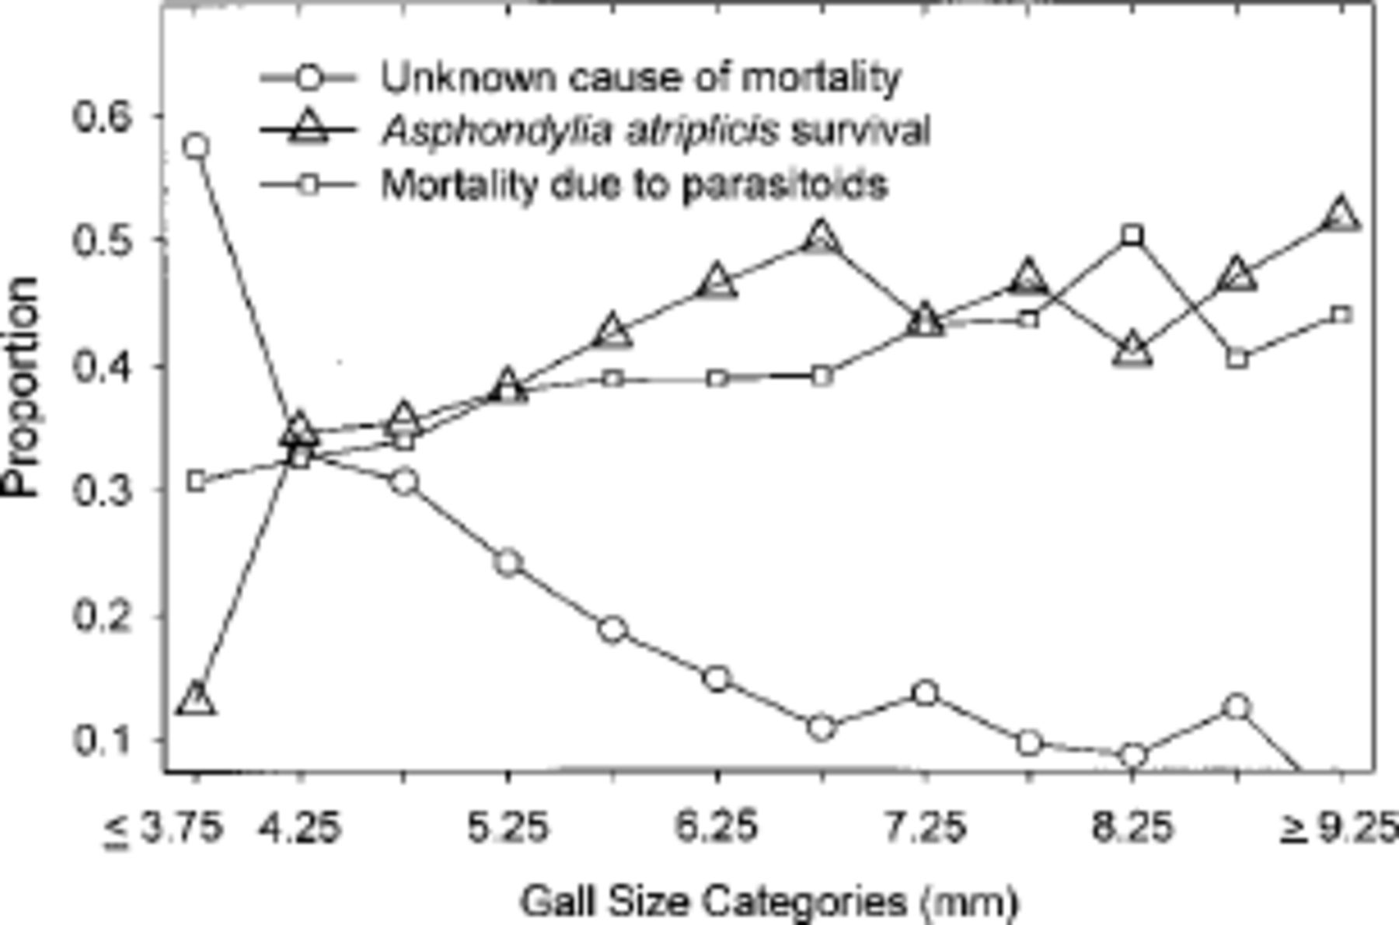
Fig. 5. Mean proportion per gall survivorship of A. atri-plicis larvae, and mortality due to unknown factors and ...
Notes:
Fig. 5. Mean proportion per gall survivorship of A. atri-plicis larvae, and mortality due to unknown factors and parasitism for the indicated gall diameter classes for three sites over all seasons.
Unless provided in the caption above, the following copyright applies to the content of this slide: © 2004 Entomological Society of AmericaThis is an Open Access article distributed under the terms of the Creative Commons Attribution Non-Commercial License (http://creativecommons.org/licenses/by-nc/3.0/), which permits non-commercial reuse, distribution, and reproduction in any medium, provided the original work is properly cited. For commercial re-use, please contact journals.permissions@oup.com

