Slide 1
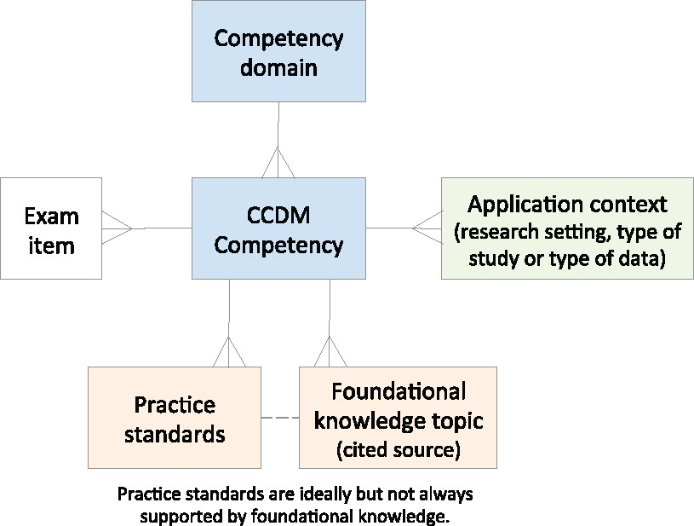
Figure 1. Relationships between competencies, foundational knowledge, practice standards, and application context.
Notes:
Figure 1. Relationships between competencies, foundational knowledge, practice standards, and application context.
Unless provided in the caption above, the following copyright applies to the content of this slide: © The Author 2017. Published by Oxford University Press on behalf of the American Medical Informatics Association. All rights reserved. For Permissions, please email: journals.permissions@oup.com

Slide 2
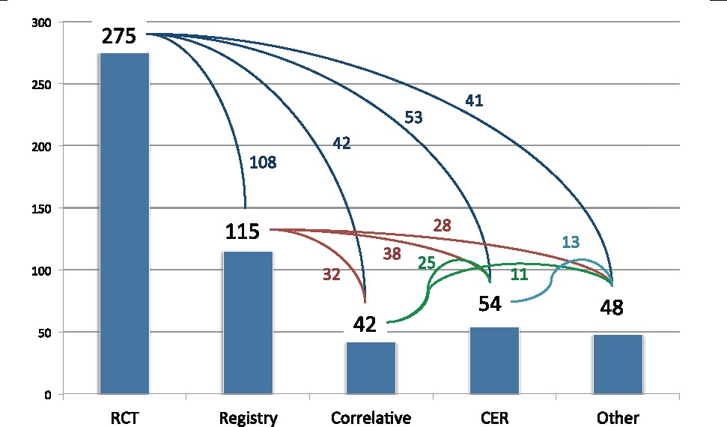
Figure 2. Types of studies for which respondents manage data.
Notes:
Figure 2. Types of studies for which respondents manage data.
Unless provided in the caption above, the following copyright applies to the content of this slide: © The Author 2017. Published by Oxford University Press on behalf of the American Medical Informatics Association. All rights reserved. For Permissions, please email: journals.permissions@oup.com

Slide 3
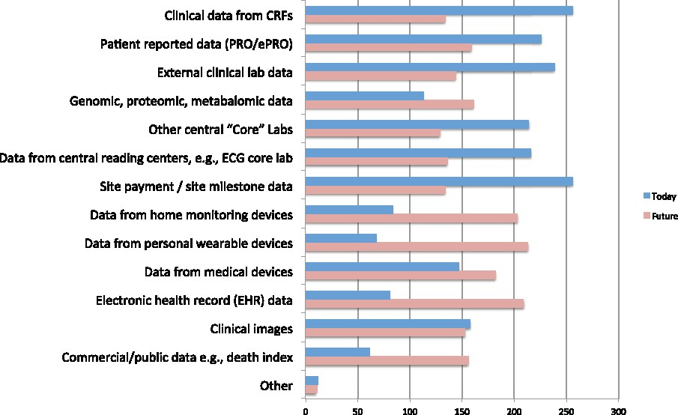
Figure 3. Types of data managed by respondents.
Notes:
Figure 3. Types of data managed by respondents.
Unless provided in the caption above, the following copyright applies to the content of this slide: © The Author 2017. Published by Oxford University Press on behalf of the American Medical Informatics Association. All rights reserved. For Permissions, please email: journals.permissions@oup.com

Slide 4
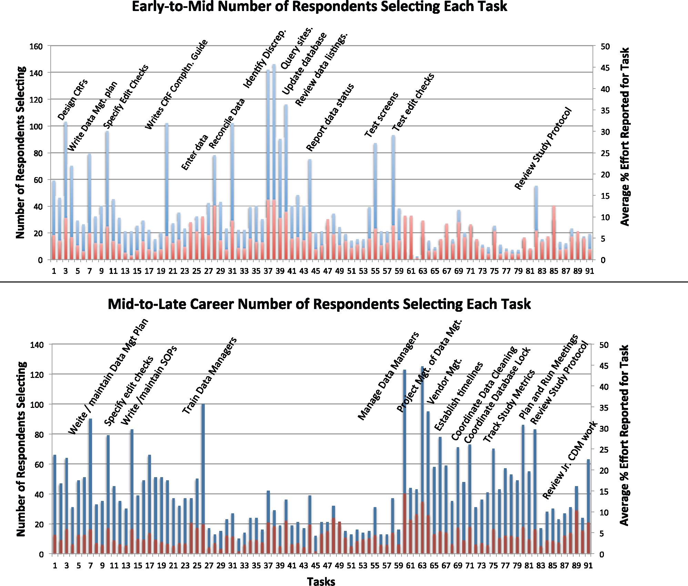
Figure 4. Job tasks indicated by respondents.
Notes:
Figure 4. Job tasks indicated by respondents.
Unless provided in the caption above, the following copyright applies to the content of this slide: © The Author 2017. Published by Oxford University Press on behalf of the American Medical Informatics Association. All rights reserved. For Permissions, please email: journals.permissions@oup.com

