Slide 1
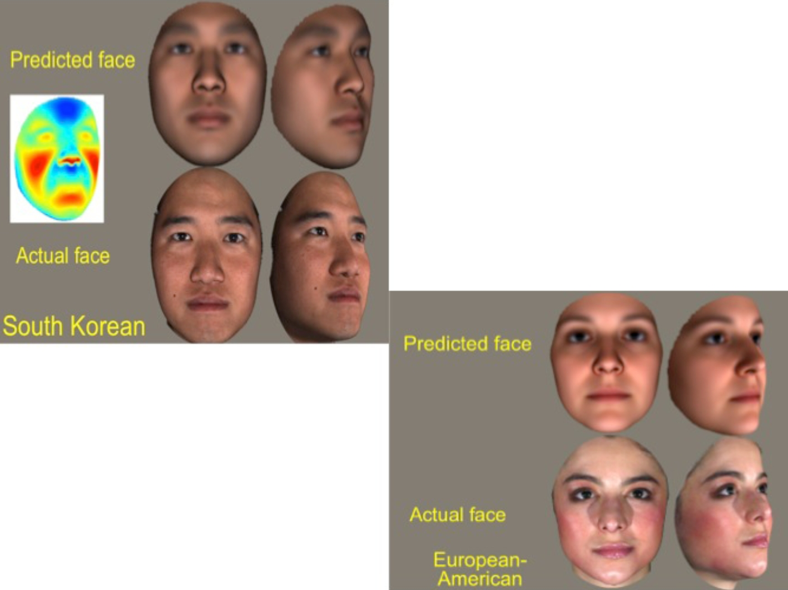
Figure 1. Comparison of computer rendered facial images predicted from genomic data to subject's actual photograph. ...
Notes:
Figure 1. Comparison of computer rendered facial images predicted from genomic data to subject's actual photograph. Methodology described in Claes et al., Modeling 3D Facial Shape from DNA, 10 PLoS Genet (2014). Image provided by and used with the permission of Dr. Mark Shriver, Pennsylvania State University Department of Anthropology
Unless provided in the caption above, the following copyright applies to the content of this slide: © The Author 2017. Published by Oxford University Press on behalf of Duke University School of Law, Harvard Law School, Oxford University Press, and Stanford Law School.This is an Open Access article distributed under the terms of the Creative Commons Attribution-NonCommercial-NoDerivs licence (http://creativecommons.org/licenses/by-nc-nd/4.0/), which permits non-commercial reproduction and distribution of the work, in any medium, provided the original work is not altered or transformed in any way, and that the work is properly cited. For commercial re-use, please contact journals.permissions@oup.com

