Slide 1
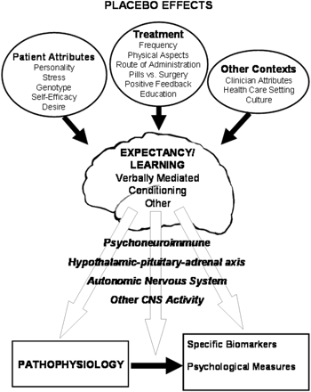
Fig. 1 Theoretical model of issues impacting development of expectancy and how brain outputs may produce a placebo ...
Notes:
Fig. 1 Theoretical model of issues impacting development of expectancy and how brain outputs may produce a placebo effect.
Unless provided in the caption above, the following copyright applies to the content of this slide: © The Author (2008). Published by Oxford University Press on behalf of the Guarantors of Brain. All rights reserved. For Permissions, please email: journals.permissions@oxfordjournals.org

