Slide 1
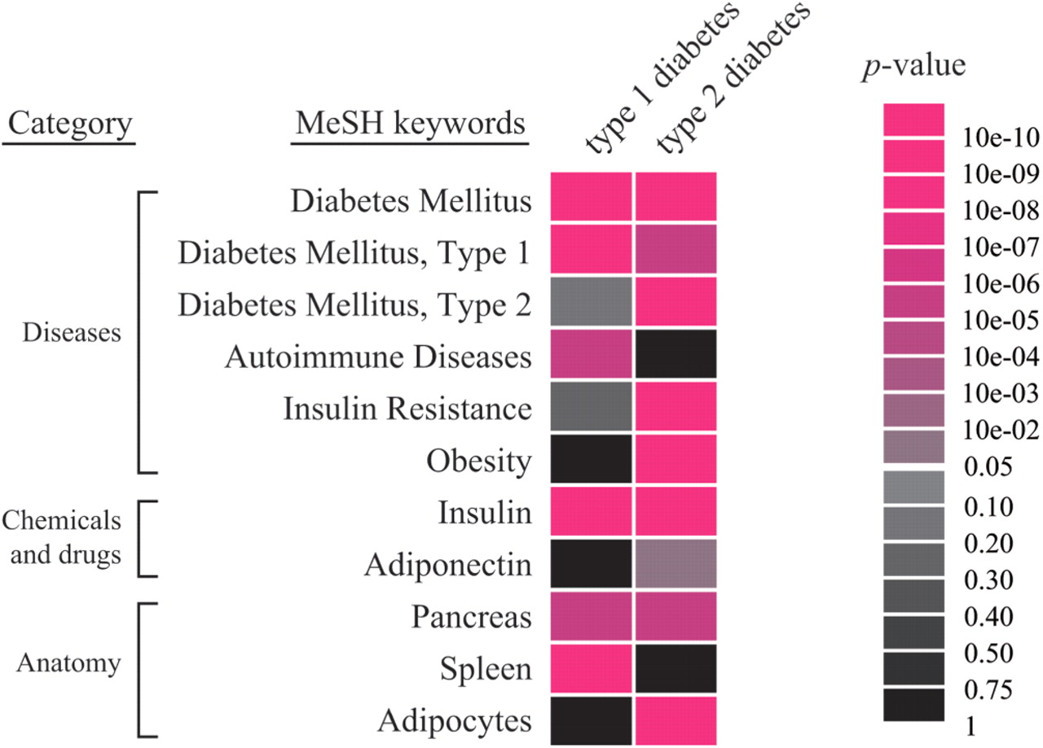
Figure 1. Differences and similarities between feature profiles of types 1 and 2 diabetes. Typical features and scores ...
Notes:
Figure 1. Differences and similarities between feature profiles of types 1 and 2 diabetes. Typical features and scores of types 1 and 2 diabetes are shown. The background colors of each association reflect the P-value. Type 1 diabetes is an autoimmune disorder, whereas type 2 diabetes is a metabolic disorder. These profiles clarify the differences between the features of these diseases.
Unless provided in the caption above, the following copyright applies to the content of this slide: © 2009 The Author(s)This is an Open Access article distributed under the terms of the Creative Commons Attribution Non-Commercial License (http://creativecommons.org/licenses/by-nc/2.0/uk/) which permits unrestricted non-commercial use, distribution, and reproduction in any medium, provided the original work is properly cited.

