Slide 1
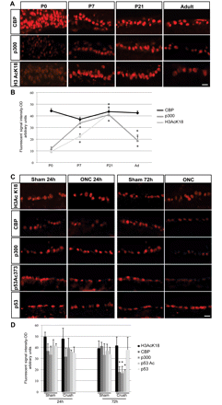
Figure 1 Maturation and optic nerve crush are associated with a decrease of histone acetyltransferase p300 in the ...
Notes:
Figure 1 Maturation and optic nerve crush are associated with a decrease of histone acetyltransferase p300 in the retinal ganglion cell layer. (A) Representative pictures of the retinal ganglion cell layer at different time points during retinal ganglion cell maturation (P0, P7, P21 and adult) immunostained against CBP, p300 and H3AcK18. Scale bar = 20 µm. (B) The level of protein expression was quantified by analysis of fluorescence intensity and represented on the graph. The graphs show an increase of H3AcK18 and p300 between P0 and P21 and a decrease in adult, whereas CBP expression was not altered. P300 and H3 AcK18 level show a similar expression pattern during retinal ganglion cell maturation (n = 3). Asterisks = unpaired two-tailed t-test, *P-value < 0.01; n = 3. Each average value per time point was measured against the average value of all time points together. Error bars represent SD. (C) Immunohistochemistry of retinae shows immunostaining of retinal ganglion cell layer against H3 AcK18, CBP, p300, p53 Ac373 and p53, 24 h and 72 h after optic nerve crush (ONC) compared with sham. No change is observed for H3K18 acetylation at either 24 h or at 72 h after optic nerve crush compared with sham, whereas a decrease of p300 and CBP expression is shown along with a decrease of p53 Ac373, while p53 basal level was stable. Scale bar = 20 µm. (D) The graph represents quantification of the protein level obtained by measurement of the fluorescence signal. Asterisks = unpaired two-tailed t-test, *P-value < 0.01; n = 3. Error bars represent SD. OD = optical density.
Unless provided in the caption above, the following copyright applies to the content of this slide: © The Author (2011). Published by Oxford University Press on behalf of the Guarantors of Brain. All rights reserved. For Permissions, please email: journals.permissions@oup.com

Slide 2
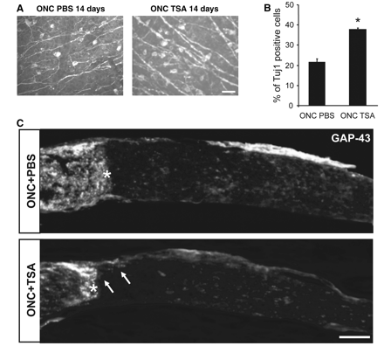
Figure 2 Histone deacetylases inhibition induces survival of retinal ganglion cells but not a significant enhancement ...
Notes:
Figure 2 Histone deacetylases inhibition induces survival of retinal ganglion cells but not a significant enhancement of axonal regeneration. (A) Representative pictures of whole mount retina immunostained against β-III tubulin showing an increase of retinal ganglion cell survival 14 days after optic nerve crush (ONC) and injection of trichostatin A (TSA) 10 ng/ml, compared with optic nerve crush with phosphate-buffered saline (PBS). Scale bar = 50 µm. (B) The bar graph shows quantification of retinal ganglion cells β-III tubulin (Tuj1)-positive cells after optic nerve crush with phosphate-buffered saline or trichostatin A injection compared with sham. Asterisk = unpaired two-tailed t-test, *P-value < 0.05; n = 3. Error bars represent SD. (C) Optic nerve longitudinal sections were immunostained against GAP-43 14 days after optic nerve crush with phosphate-buffered saline or trichostatin A 10 ng/ml. Representative pictures show sporadic short axons past the lesion site after trichostatin A stimulation. Scale bar = 100 µm.
Unless provided in the caption above, the following copyright applies to the content of this slide: © The Author (2011). Published by Oxford University Press on behalf of the Guarantors of Brain. All rights reserved. For Permissions, please email: journals.permissions@oup.com

Slide 3
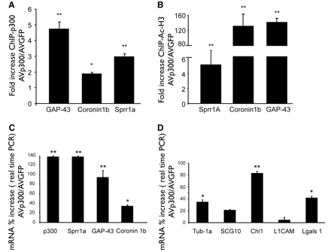
Figure 7 Infection of AVp300 enhances promoter occupancy of p300 and histone acetylation on specific proregenerative ...
Notes:
Figure 7 Infection of AVp300 enhances promoter occupancy of p300 and histone acetylation on specific proregenerative genes along with an increase of their gene expression level. (A) Chromatin immunoprecipitation (ChIP) assay from dissected retina shows increased occupancy of the GAP-43, coronin 1 b and Sprr1a promoters by p300 following 24 h of optic nerve crush plus AVp300 injection versus AVGFP. Fold change was calculated as a ratio of promoter occupancy between AVp300 treated versus AVGFP in three independent animals in triplicate samples. Asterisks = unpaired two-tailed t-test, *P-value < 0.05, **P-value < 0.01. Error bars represent SD. (B) Bar graph shows an increase of histone H3 acetylation on Sprr1a, coronin 1 b and GAP-43 promoter 24 h after optic nerve crush with AVp300 compared with AVGFP infection. Fold change was calculated as a ratio of promoter occupancy between AVp300 treated versus AVGFP in three independent animals in triplicate samples. Asterisks = unpaired two-tailed t-test, *P-value < 0.05, **P-value < 0.01. Error bars represent SD. (C and D) Bar graphs show real-time reverse transcriptase polymerase chain reaction (PCR) messenger RNA (mRNA) expression data for p300 and a number of regeneration-associated genes including Sprr1a, GAP-43 and coronin 1 b (C) or for α-tubulin1a, SCG10, Chl1, L1CAM and Lgals1 (D). Optic nerve crush with AVp300 induces an increase of several of these genes compared with optic nerve crush with AVGFP in three independent animals. Asterisks = unpaired two-tailed t-test, *P-value < 0.05, **P-value < 0.01. Error bars represent SD.
Unless provided in the caption above, the following copyright applies to the content of this slide: © The Author (2011). Published by Oxford University Press on behalf of the Guarantors of Brain. All rights reserved. For Permissions, please email: journals.permissions@oup.com

Slide 4
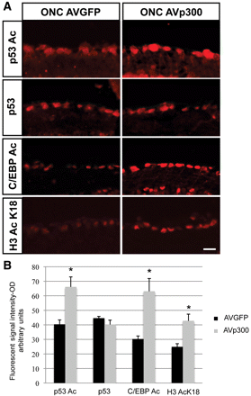
Figure 6 p300 overexpression leads to increased acetylation of p53, C/EBP and H3 K18. (A) Immunohistochemistry of ...
Notes:
Figure 6 p300 overexpression leads to increased acetylation of p53, C/EBP and H3 K18. (A) Immunohistochemistry of retinae against p53 Ac373, p53, C/EBP Ac215/216 and H3AcK18 shows expression in the retinal ganglion cell layer 24 h after optic nerve crush (ONC) and AVGFP or AVp300 infection. Shown is an increase of H3AcK18, p53 and C/EBP acetylation. The basal level of p53 is unchanged. Scale bar = 20 µm. (B) The bar graphs represent assessment of fluorescence signal in retinal ganglion cells for the different antigens. Asterisk = unpaired two-tailed t-test, *P-value < 0.01; n = 3. Error bars represent SD. OD = optical density.
Unless provided in the caption above, the following copyright applies to the content of this slide: © The Author (2011). Published by Oxford University Press on behalf of the Guarantors of Brain. All rights reserved. For Permissions, please email: journals.permissions@oup.com

Slide 5
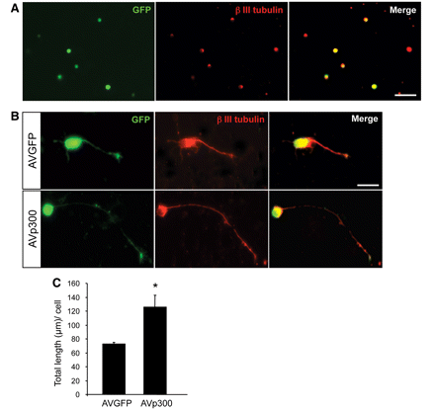
Figure 5 Overexpression of p300 induces neurite outgrowth in cultured cells. (A) Retinal cells were cultured on ...
Notes:
Figure 5 Overexpression of p300 induces neurite outgrowth in cultured cells. (A) Retinal cells were cultured on poly-d-lysine for 24 h and infected with AVGFP or AVp300 at MOI 100. Immunostaining against β-III tubulin for retinal ganglion cells shows a colocalization with infected green fluorescence protein (GFP)-positive cells. Scale bar = 20 µm. (B) Representative pictures of dissociated retinal primary culture immunostained against β III-tubulin show enhanced neurite outgrowth in p300-infected GFP-positive cells compared with control virus infection. Scale bar = 20 µm. (C) Quantification of neurite length shows an increase in neurite outgrowth 72 h after infection of AVp300 compared with AVGFP-infected cells. Asterisk = unpaired two-tailed t-test, *P-value < 0.01; n = 3. Error bars represent SD. MOI = multiplicity of infection.
Unless provided in the caption above, the following copyright applies to the content of this slide: © The Author (2011). Published by Oxford University Press on behalf of the Guarantors of Brain. All rights reserved. For Permissions, please email: journals.permissions@oup.com

Slide 6
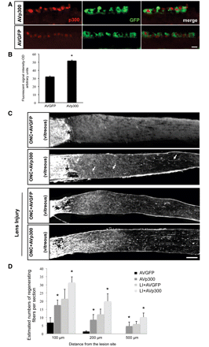
Figure 4 p300 over-expression by adenovirus infection induces axonal regeneration of the optic nerve. (A) ...
Notes:
Figure 4 p300 over-expression by adenovirus infection induces axonal regeneration of the optic nerve. (A) Representative pictures of retinal ganglion cell layer after immunostaining in the retina against p300 shows expression of p300 in green fluorescence protein (GFP)-positive cells 24 h after optic nerve crush (ONC) and AVp300 or AVGFP infection. An increase of p300 expression in the retinal ganglion cell layer is shown following AVp300-GFP versus AVGFP infection. Scale bar = 20 µm. (B) Bar graph represents quantification of p300 protein levels analysed by measurement of the fluorescence signal. Asterisks = unpaired two-tailed t-test, *P-value < 0.01; n = 3. Error bars represent SD. (C) Representative pictures of longitudinal optic nerve sections immunostained against GAP-43 14 days after optic nerve crush and infected with AVGFP or AVp300-GFP (alone or in combination with lens injury) show axonal regeneration in AVp300-infected rats, which is enhanced by lens injury. Scale bar = 100 µm. (D) Adenoviral overexpression of p300 alone or in combination with lens injury induces a significant increase in the number of axons past the lesion site compared with AVGFP-infected nerves alone or in combination with lens injury as shown in the bar graph (n = 4 per condition). Asterisks = unpaired two-tailed t-test, *P-value < 0.05. Error bars represent SD. (E) Representative pictures of whole flat retina immunostained against β-III tubulin (Tuj1) 14 days after optic nerve crush with AVGFP or AVp300 infection. Scale bar = 50 µm. (F) Bar graphs show quantification of retinal ganglion β-III tubulin-positive cells on whole flat retina (n = 3) that reveals no difference in retinal ganglion cell survival (as compared with sham) 14 days after optic nerve crush with AVGFP or AVp300. OD = optical density.
Unless provided in the caption above, the following copyright applies to the content of this slide: © The Author (2011). Published by Oxford University Press on behalf of the Guarantors of Brain. All rights reserved. For Permissions, please email: journals.permissions@oup.com

Slide 7
Figure 4 p300 over-expression by adenovirus infection induces axonal regeneration of the optic nerve. (A) ...
Notes:
Figure 4 p300 over-expression by adenovirus infection induces axonal regeneration of the optic nerve. (A) Representative pictures of retinal ganglion cell layer after immunostaining in the retina against p300 shows expression of p300 in green fluorescence protein (GFP)-positive cells 24 h after optic nerve crush (ONC) and AVp300 or AVGFP infection. An increase of p300 expression in the retinal ganglion cell layer is shown following AVp300-GFP versus AVGFP infection. Scale bar = 20 µm. (B) Bar graph represents quantification of p300 protein levels analysed by measurement of the fluorescence signal. Asterisks = unpaired two-tailed t-test, *P-value < 0.01; n = 3. Error bars represent SD. (C) Representative pictures of longitudinal optic nerve sections immunostained against GAP-43 14 days after optic nerve crush and infected with AVGFP or AVp300-GFP (alone or in combination with lens injury) show axonal regeneration in AVp300-infected rats, which is enhanced by lens injury. Scale bar = 100 µm. (D) Adenoviral overexpression of p300 alone or in combination with lens injury induces a significant increase in the number of axons past the lesion site compared with AVGFP-infected nerves alone or in combination with lens injury as shown in the bar graph (n = 4 per condition). Asterisks = unpaired two-tailed t-test, *P-value < 0.05. Error bars represent SD. (E) Representative pictures of whole flat retina immunostained against β-III tubulin (Tuj1) 14 days after optic nerve crush with AVGFP or AVp300 infection. Scale bar = 50 µm. (F) Bar graphs show quantification of retinal ganglion β-III tubulin-positive cells on whole flat retina (n = 3) that reveals no difference in retinal ganglion cell survival (as compared with sham) 14 days after optic nerve crush with AVGFP or AVp300. OD = optical density.
Unless provided in the caption above, the following copyright applies to the content of this slide: © The Author (2011). Published by Oxford University Press on behalf of the Guarantors of Brain. All rights reserved. For Permissions, please email: journals.permissions@oup.com

Slide 8
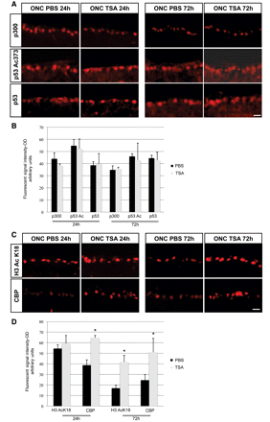
Figure 3 Histone deacetylases inhibition does not modify p300 expression or p53-dependent acetylation. (A) Retinae ...
Notes:
Figure 3 Histone deacetylases inhibition does not modify p300 expression or p53-dependent acetylation. (A) Retinae were immunostained against p300, p53Ac373 and p53 24 h and 72 h after optic nerve crush (ONC) with or without trichostatin A (TSA; 10 ng/ml). Shown are representative pictures of retinal ganglion cells showing no change for p300, p53 or p53Ac373 expression at 24 h or at 72 h after trichostatin A, compared with phosphate-buffered saline (PBS)-injected animals. Scale bar = 20 µm. (B) The bar graphs show quantification of p300, p53Ac373 and p53 protein level analysed by measurement of the fluorescence signal. (C) Immunostaining against H3AcK18 and CBP on retinal ganglion cells 24 h and 72 h after optic nerve crush with phosphate-buffered saline or trichostatin A represented in the pictures show a significant increase of H3AcK18 and CBP 72 h after trichostatin A injection compared with phosphate-buffered saline. Scale bar = 20 µm. (D) Quantification of expression levels of H3AcK18 and CBP are represented in the bar graphs. Asterisks = unpaired two-tailed t-test, *P-value < 0.05. Error bars represent SD.
Unless provided in the caption above, the following copyright applies to the content of this slide: © The Author (2011). Published by Oxford University Press on behalf of the Guarantors of Brain. All rights reserved. For Permissions, please email: journals.permissions@oup.com

