Slide 1
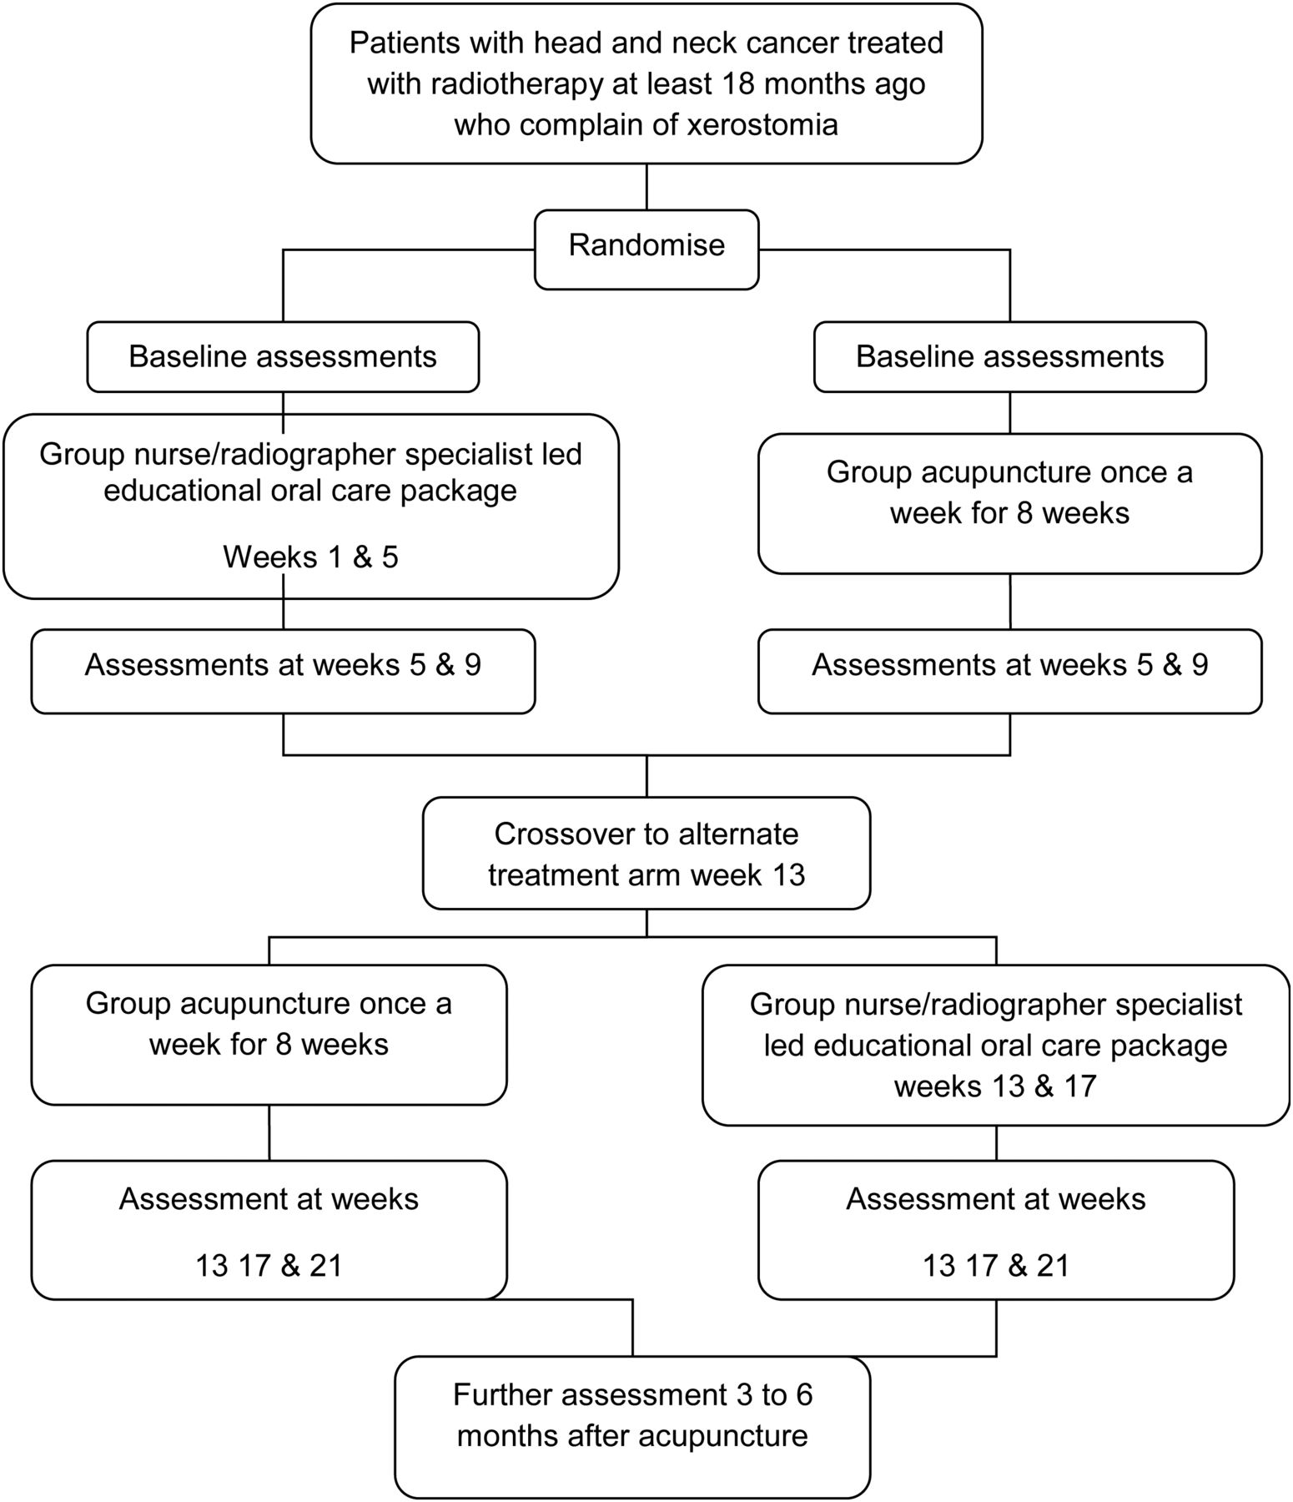
Figure 1. Trial schema.
Notes:
Figure 1. Trial schema.
Unless provided in the caption above, the following copyright applies to the content of this slide: © The Author 2012. Published by Oxford University Press on behalf of the European Society for Medical Oncology. All rights reserved. For permissions, please email: journals.permissions@oup.com.

Slide 2
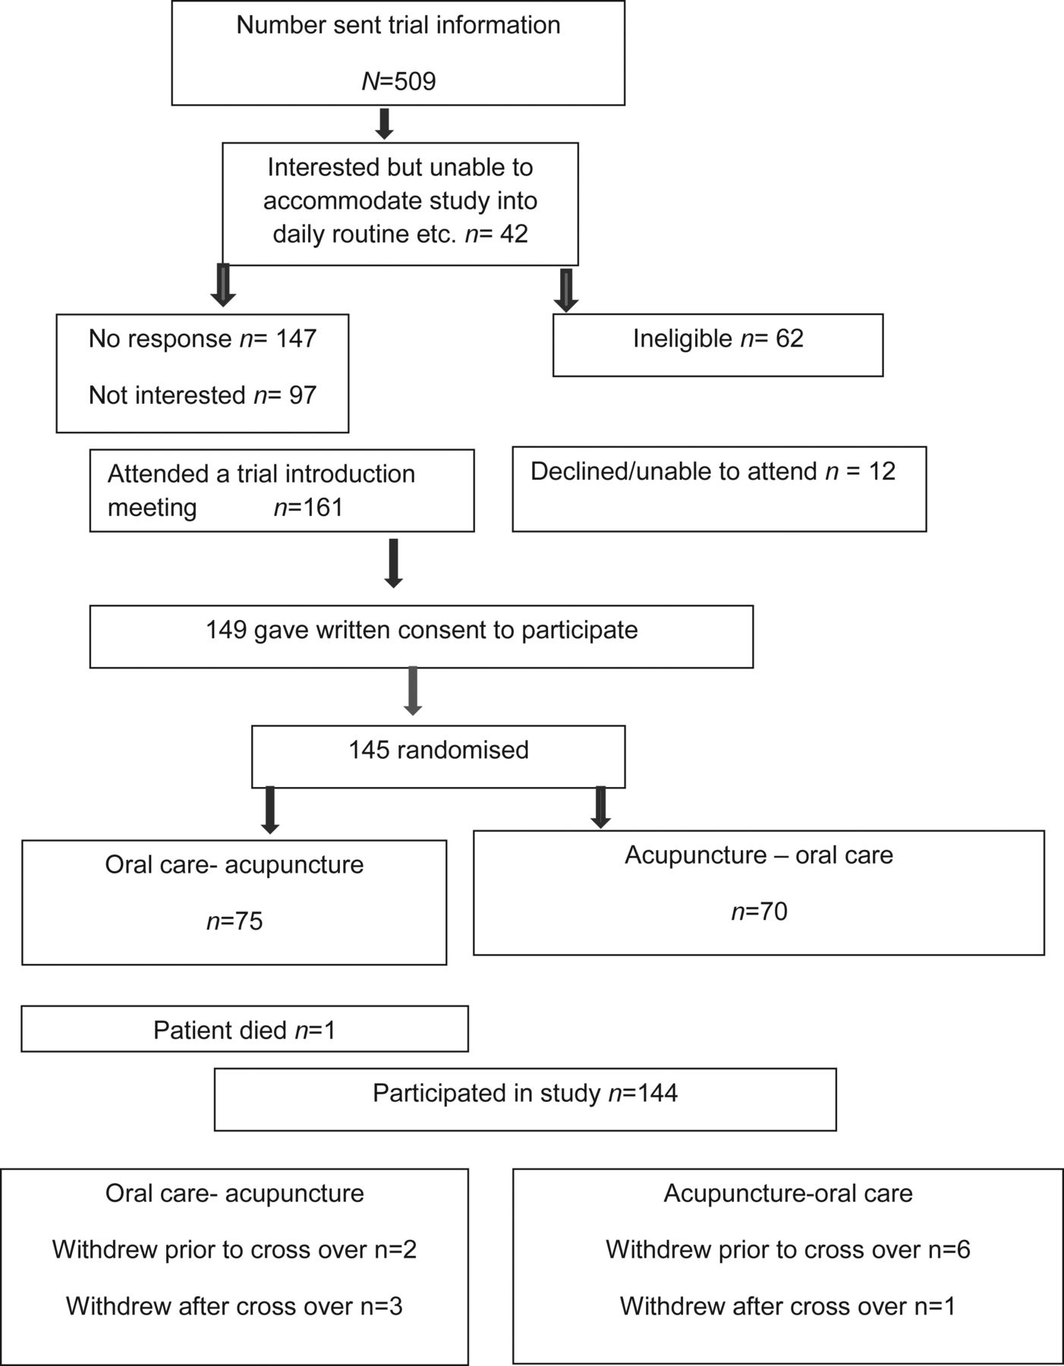
Figure 2. Recruitment consort diagram.
Notes:
Figure 2. Recruitment consort diagram.
Unless provided in the caption above, the following copyright applies to the content of this slide: © The Author 2012. Published by Oxford University Press on behalf of the European Society for Medical Oncology. All rights reserved. For permissions, please email: journals.permissions@oup.com.

