Slide 1
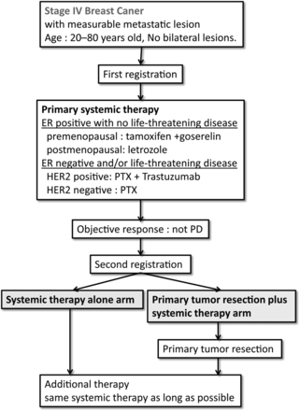
Figure 1. Study Schema. A randomized controlled trial comparing primary tumour resection plus systemic therapy with ...
Notes:
Figure 1. Study Schema. A randomized controlled trial comparing primary tumour resection plus systemic therapy with systemic therapy alone in metastatic breast cancer (PRIM-BC): Japan Clinical Oncology Group Study JCOG1017. ER, estrogen receptor; HER2, human epidermal growth factor receptor type-2; PTX, paclitaxel; PD, progressive disease.
Unless provided in the caption above, the following copyright applies to the content of this slide: © The Author 2012. Published by Oxford University Press. All rights reserved. For Permissions, please email: journals.permissions@oup.com

