Slide 1
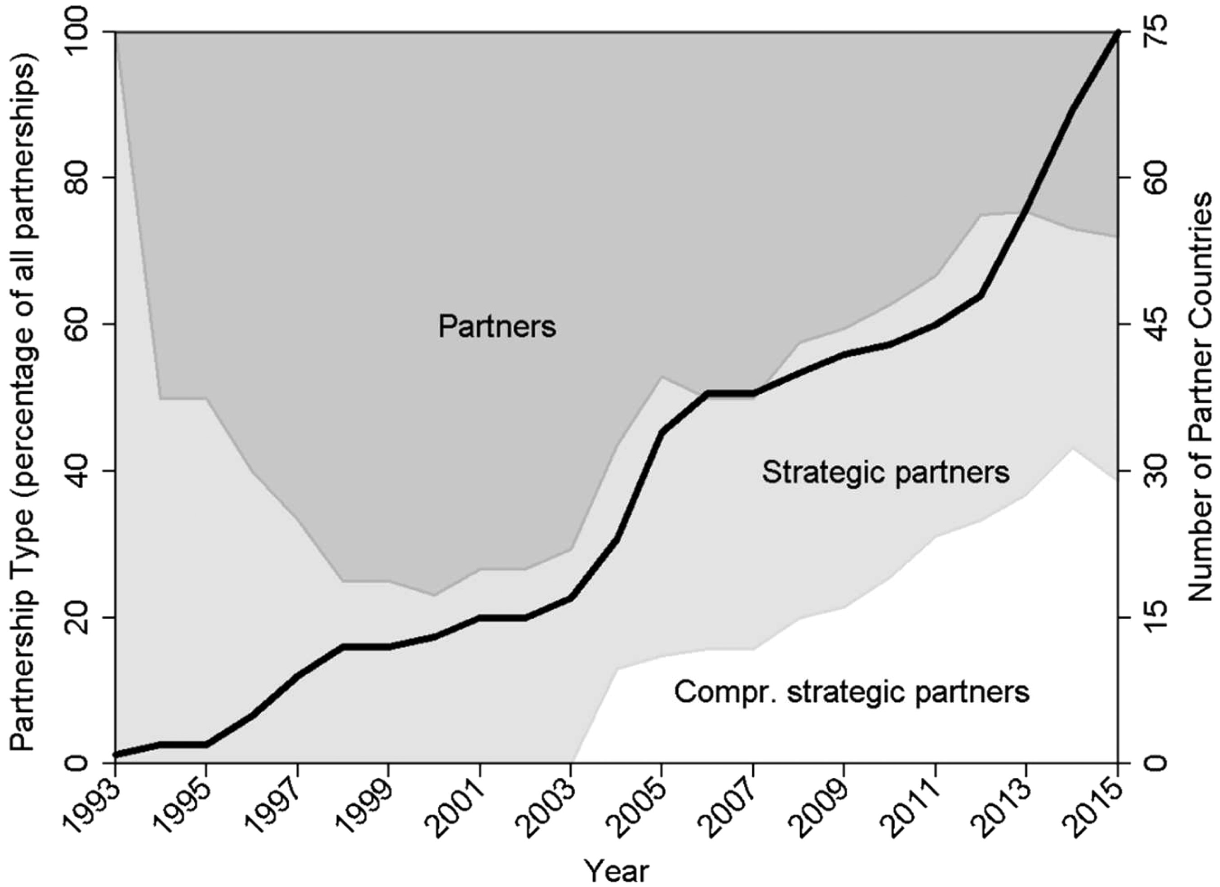
Fig. 1 China’s Partner Countries by Type of Partnership (1993–2015).
Notes:
Fig. 1 China’s Partner Countries by Type of Partnership (1993–2015).
Unless provided in the caption above, the following copyright applies to the content of this slide: © The Author 2017. Published by Oxford University Press on behalf of The Institute of International Relations, Tsinghua University. All rights reserved. For permissions, please e-mail: journals.permissions@oup.com.

Slide 2
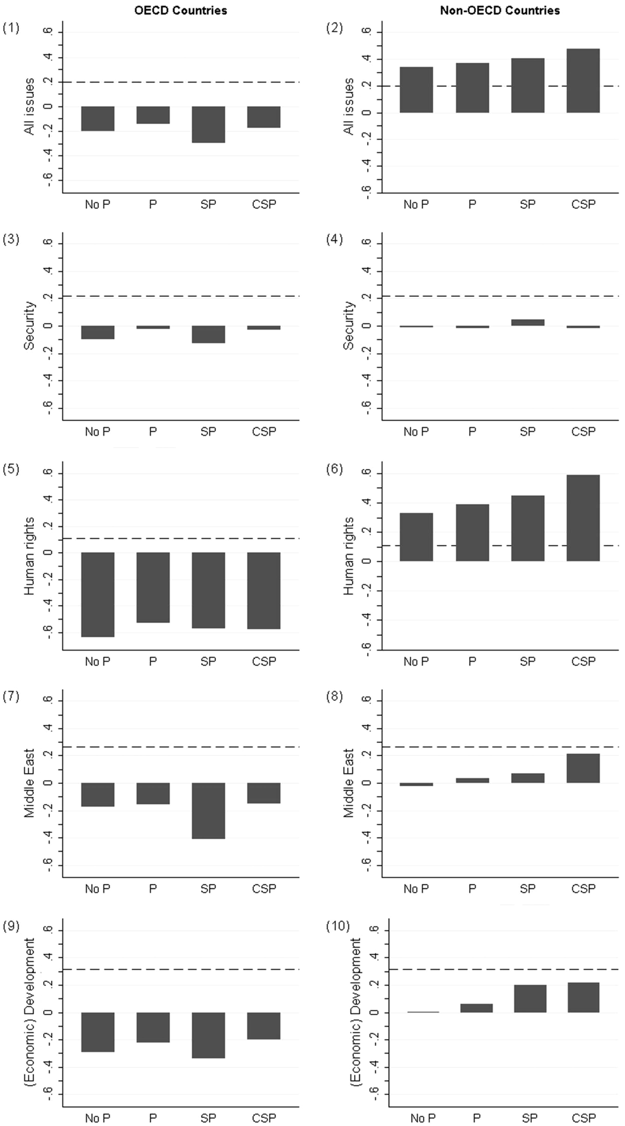
Fig. 4 Partnerships’ Impact on UNGA Voting Similarity. Notes: Voting similarity is based on UNGA roll-call votes. ...
Notes:
Fig. 4 Partnerships’ Impact on UNGA Voting Similarity. Notes: Voting similarity is based on UNGA roll-call votes. The index ranges from −1 (least similar interests) to + 1 (most similar interests). Policy issues are coded based on Voeten (2013), and by the author in the case of human rights issues. For data sources and the calculation of the similarity index see Häge (2011) and Strüver (2016). The partner countries are classified in four categories: No P = years with no partnership agreement; P = partnership years; SP = strategic partnership years; CSP = comprehensive strategic partnership years. The dashed horizontal line shows the global mean of respective measurements for all countries in the dataset.
Unless provided in the caption above, the following copyright applies to the content of this slide: © The Author 2017. Published by Oxford University Press on behalf of The Institute of International Relations, Tsinghua University. All rights reserved. For permissions, please e-mail: journals.permissions@oup.com.

Slide 3
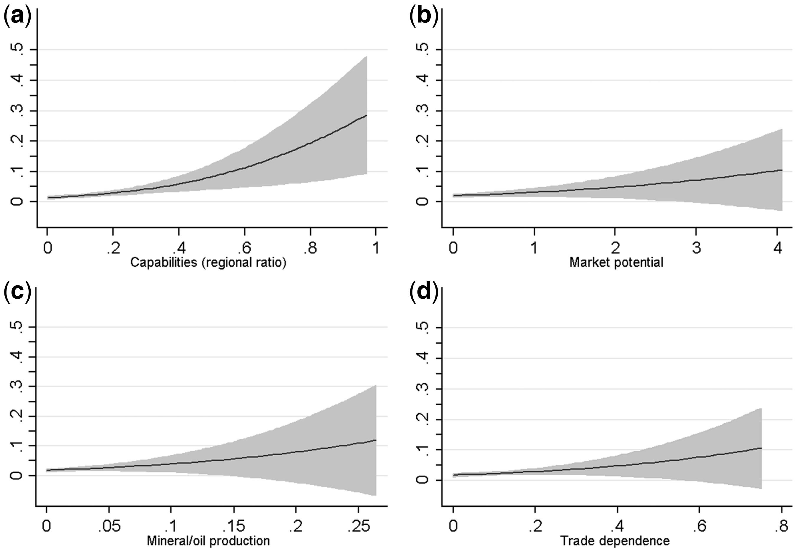
Fig. 2 Marginal Effects of the Main Independent Variables on Partner Choice.
Notes:
Fig. 2 Marginal Effects of the Main Independent Variables on Partner Choice.
Unless provided in the caption above, the following copyright applies to the content of this slide: © The Author 2017. Published by Oxford University Press on behalf of The Institute of International Relations, Tsinghua University. All rights reserved. For permissions, please e-mail: journals.permissions@oup.com.

Slide 4
Fig. 3 Marginal Effects of Ideological Affinities on Partner Choice.
Notes:
Fig. 3 Marginal Effects of Ideological Affinities on Partner Choice.
Unless provided in the caption above, the following copyright applies to the content of this slide: © The Author 2017. Published by Oxford University Press on behalf of The Institute of International Relations, Tsinghua University. All rights reserved. For permissions, please e-mail: journals.permissions@oup.com.

Slide 5
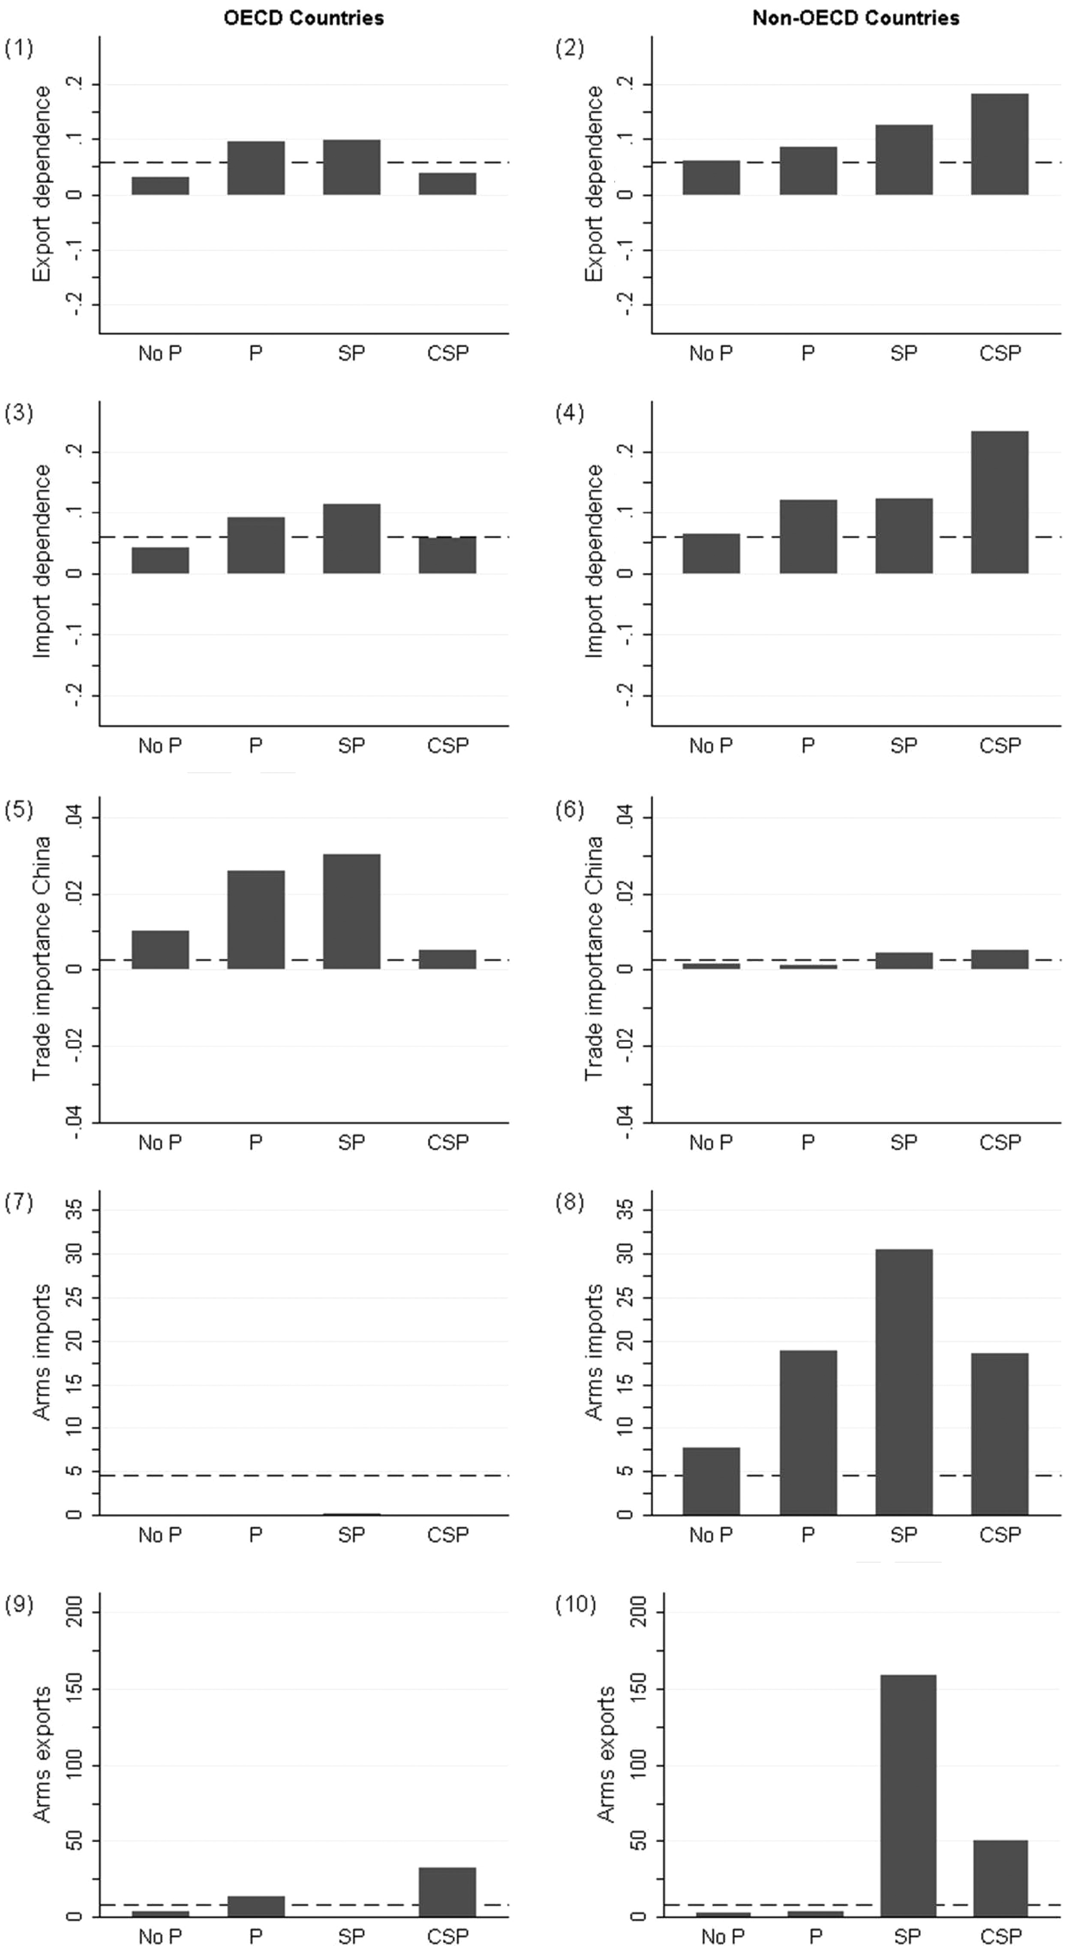
Fig. 5 Partnerships’ Impact on Merchandise and Arms Trade. Notes: Trade dependence measures the ratio of a country’s ...
Notes:
Fig. 5 Partnerships’ Impact on Merchandise and Arms Trade. Notes: Trade dependence measures the ratio of a country’s merchandise trade with China to total trade. Trade importance, in contrast, measures the relative importance of a country to China’s overall trade. Data sources are provided in the data section of this article. Partner countries are classified in four categories: No P = years with no partnership agreement; P = partnership years; SP = strategic partnership years; CSP = comprehensive strategic partnership years. The dashed horizontal line shows the global mean of the respective measurement for all countries in the dataset.
Unless provided in the caption above, the following copyright applies to the content of this slide: © The Author 2017. Published by Oxford University Press on behalf of The Institute of International Relations, Tsinghua University. All rights reserved. For permissions, please e-mail: journals.permissions@oup.com.

