Slide 1
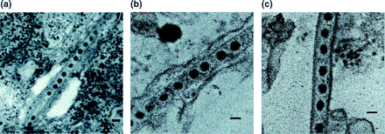
Fig. 1. Pns10 tubules in cultured leafhopper cells. (a) Tubule in cytoplasm. Black dots are RDV particles. (b) Tubule ...
Notes:
Fig. 1. Pns10 tubules in cultured leafhopper cells. (a) Tubule in cytoplasm. Black dots are RDV particles. (b) Tubule surrounded by plasma membrane. (c) Tubule without plasma membrane. These snapshots were taken of the same specimen. Bars in a, b, and c: 50 nm.
Unless provided in the caption above, the following copyright applies to the content of this slide: © Oxford University Press 2007

Slide 2
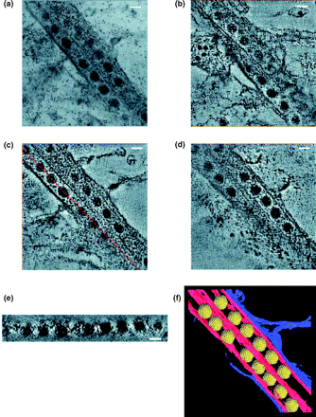
Fig. 2. Nontilted image of the region used for tomography. (a) Small black dots are colloidal gold as described in ...
Notes:
Fig. 2. Nontilted image of the region used for tomography. (a) Small black dots are colloidal gold as described in Methods. Three sections through the 3D map reconstructed from the dual-tilt series (b, c, d). The 3D map was cut parallel to the nontilted sample at z = 42 nm (b), 69 nm (c), and 81 nm (d). The thickness of the 3D map along the z-axis is 130 nm. (e) is cut parallel to the long axis of the left Pns10 tubule as a broken red line at (c) showing the position of the slice. Docking of the RDV model (yellow) made from the PDB data into the segmented model generated by tomographic reconstruction (f). Red and blue region represents Pns10 tubule and plasma membrane, respectively. Bars in a, b, c, and d: 50 nm.
Unless provided in the caption above, the following copyright applies to the content of this slide: © Oxford University Press 2007

Slide 3
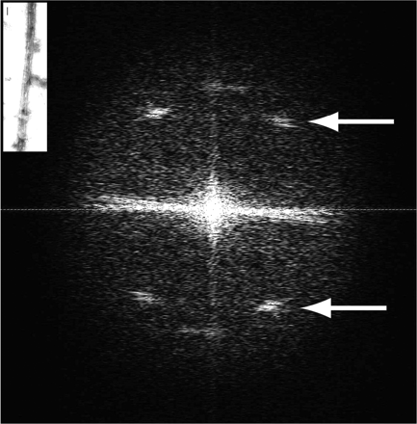
Fig. 3. Reconstructed Pns10 tubule in vitro (inset) was Fourier-transformed. Strong white layer lines, as indicated ...
Notes:
Fig. 3. Reconstructed Pns10 tubule in vitro (inset) was Fourier-transformed. Strong white layer lines, as indicated by arrows, are located at the X shape, representing helical symmetry, even though the tubule was flattened during the staining process. Bar in inset: 100 nm.
Unless provided in the caption above, the following copyright applies to the content of this slide: © Oxford University Press 2007

