Slide 1
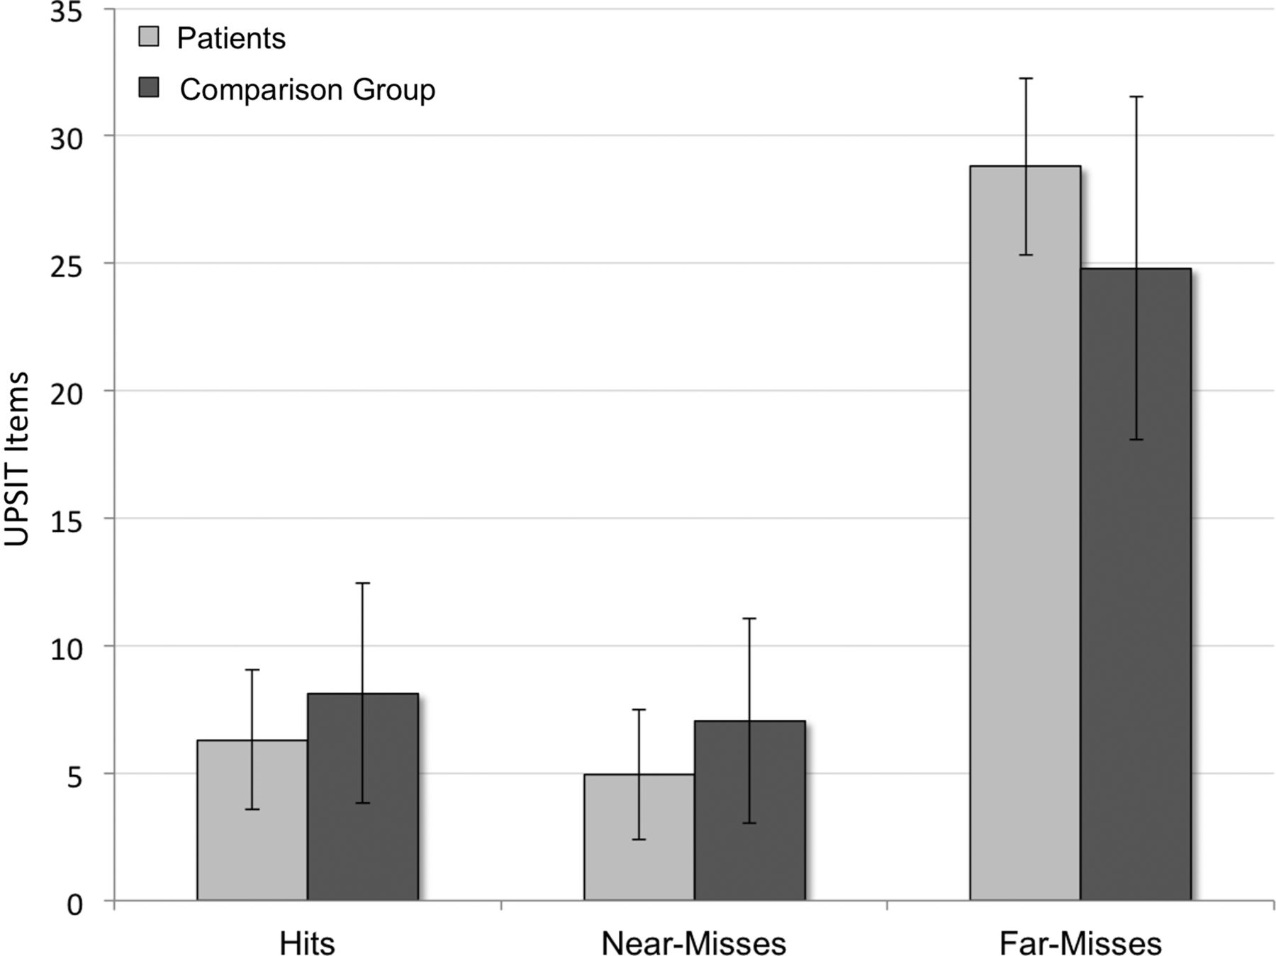
Fig. 1. Means and 95% confidence intervals for accuracy on the free-response UPSIT by group.
Notes:
Fig. 1. Means and 95% confidence intervals for accuracy on the free-response UPSIT by group.
Unless provided in the caption above, the following copyright applies to the content of this slide: © The Author 2013. Published by Oxford University Press. All rights reserved. For permissions, please e-mail: journals.permissions@oup.com

