Slide 1
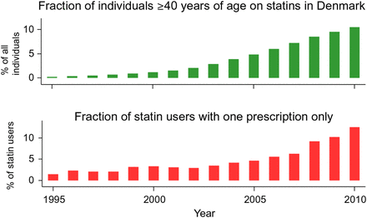
Figure 1 Trends in statin use (upper panel) and statin non-adherence/discontinuation (lower panel) in adults ≥40 ...
Notes:
Figure 1 Trends in statin use (upper panel) and statin non-adherence/discontinuation (lower panel) in adults ≥40 years, in Denmark over the period 1995–2010. Statin use from 1 January 1995 to 31 December 2010 was classified according to the Anatomical Therapeutic Classification of Drugs code C10AA, as registered in the national Danish Registry of Medicinal Products Statistics, recording information on all prescribed drugs dispensed at all Danish pharmacies from 1995 onwards (for details see references26,27). The percentage of the Danish population aged ≥40 years on statins increased from <1% in 1995 to 11% in 2010. Correspondingly, non-adherence or discontinuation (defined as the percentage of patients starting statins who only redeemed one prescription) increased from 2% in 1995 to 13% in 2010. Figure designed by Dr Sune F. Nielsen and Prof Børge G. Nordestgaard.
Unless provided in the caption above, the following copyright applies to the content of this slide: © The Author 2015. Published by Oxford University Press on behalf of the European Society of Cardiology.This is an Open Access article distributed under the terms of the Creative Commons Attribution Non-Commercial License (http://creativecommons.org/licenses/by-nc/4.0/), which permits non-commercial re-use, distribution, and reproduction in any medium, provided the original work is properly cited. For commercial re-use, please contact journals.permissions@oup.com

Slide 2
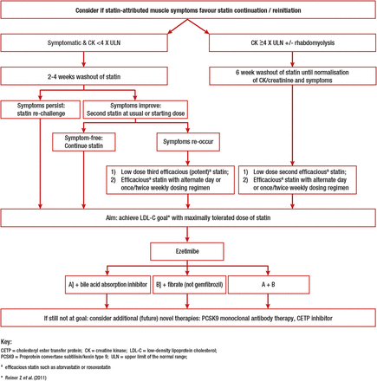
Figure 2 Therapeutic flow-chart for management of patients with statin-associated muscle symptoms.
Notes:
Figure 2 Therapeutic flow-chart for management of patients with statin-associated muscle symptoms.
Unless provided in the caption above, the following copyright applies to the content of this slide: © The Author 2015. Published by Oxford University Press on behalf of the European Society of Cardiology.This is an Open Access article distributed under the terms of the Creative Commons Attribution Non-Commercial License (http://creativecommons.org/licenses/by-nc/4.0/), which permits non-commercial re-use, distribution, and reproduction in any medium, provided the original work is properly cited. For commercial re-use, please contact journals.permissions@oup.com

Slide 3
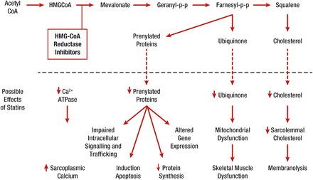
Figure 3 Effects potentially involved in statin-related muscle injury/symptoms (Reproduced with permission from ...
Notes:
Figure 3 Effects potentially involved in statin-related muscle injury/symptoms (Reproduced with permission from Needham and Mastaglia 2014).79 A number of statin-mediated effects have been proposed including reduced levels of non-cholesterol end-products of the mevalonate pathway; reduced sarcolemmal and/or sarcoplasmic reticular cholesterol; increased myocellular fat and/or sterols; inhibition of production of prenylated proteins or guanosine triphosphate (GTP)ases; alterations in muscle protein catabolism; decreased myocellular creatine; changes in calcium homeostasis; immune-mediated effects of statins and effects on mitochondrial function—see Figure 4 and Box 4. Ca2+ATPase, calcium ATPase; HMG CoA, 3-hydroxy-3-methyl-glutaryl-CoA; PP, pyrophosphate.
Unless provided in the caption above, the following copyright applies to the content of this slide: © The Author 2015. Published by Oxford University Press on behalf of the European Society of Cardiology.This is an Open Access article distributed under the terms of the Creative Commons Attribution Non-Commercial License (http://creativecommons.org/licenses/by-nc/4.0/), which permits non-commercial re-use, distribution, and reproduction in any medium, provided the original work is properly cited. For commercial re-use, please contact journals.permissions@oup.com

Slide 4
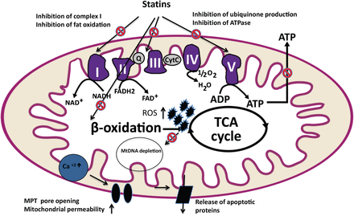
Figure 4 Possible targets of statins in the mitochondrion with deleterious effects on muscle function. The interaction ...
Notes:
Figure 4 Possible targets of statins in the mitochondrion with deleterious effects on muscle function. The interaction of statins with muscle mitochondria can involve (i) reduced production of prenylated proteins including the mitochondrial electron transport chain (ETC) protein, ubiquinone (coenzyme Q10), (ii) subnormal levels of farnesyl pyrophosphate and geranylgeranyl pyrophosphate leading to impaired cell growth and autophagy, (iii) low membrane cholesterol content affecting membrane fluidity and ion channels, and (iv) the triggered calcium release from the sarcoplasmic reticulum via ryanodine receptors, resulting in impaired calcium signalling.92–94 Statin-induced depletion of myocellular ubiquinone, an essential coenzyme which participates in electron transport during oxidative phosphorylation,95 may attenuate electron transfer between complexes I, III, and II of ETC. ADP, adenosine diphosphate; ATP, adenosine triphosphate; Cyt C, cytochrome C; FAD, flavin adenine dinucleotide; FADH2, flavin adenine dinucleotide reduced; MPT, mitochondrial permeability transition; MtDNA, mitochondrial DNA; NAD, nicotinamide adenine dinucleotide; NADH, nicotinamide adenine dinucleotide; ROS, reactive oxidative species; TCA cycle, tricarboxylic acid cycle.
Unless provided in the caption above, the following copyright applies to the content of this slide: © The Author 2015. Published by Oxford University Press on behalf of the European Society of Cardiology.This is an Open Access article distributed under the terms of the Creative Commons Attribution Non-Commercial License (http://creativecommons.org/licenses/by-nc/4.0/), which permits non-commercial re-use, distribution, and reproduction in any medium, provided the original work is properly cited. For commercial re-use, please contact journals.permissions@oup.com

